Slide 1
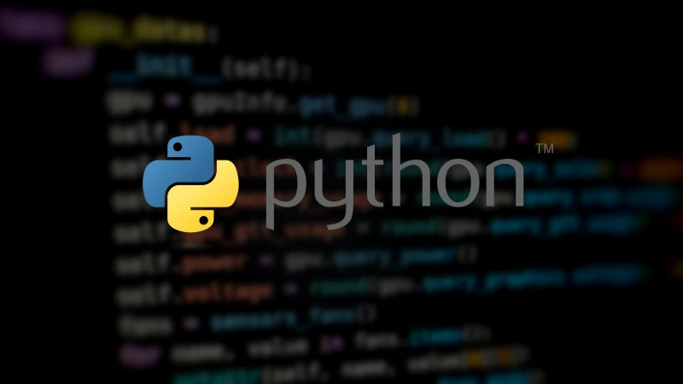
WELCOME TO
KT

Slide 2
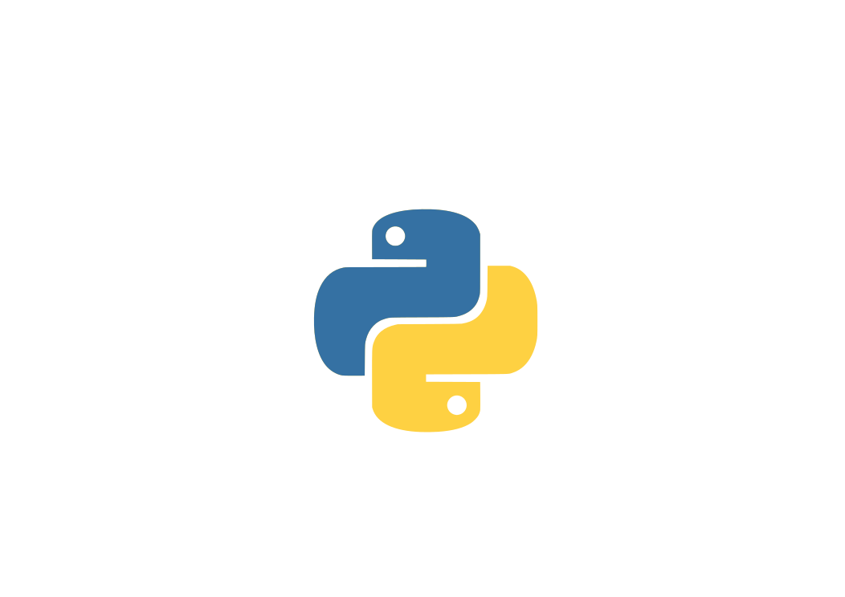
Topics:
What is Python?
What can we do with Python?
Key Features of Python?
What are the applications built using Python?
Is Python OOPS or not?
Hello World program

Slide 3
Python used for:
Web Development
Data Science and Analysis
Machine Learning and AI
DevOps and Cloud

Slide 4
Key Features
Easy to Learn
Open Source
Cross platform compatability
Error friendly

Slide 5
Is Python OOPS?
Principles:
-Encapsulation
-Inheritance
-Polymorphism
-Abstraction

Slide 6


