Slide 1
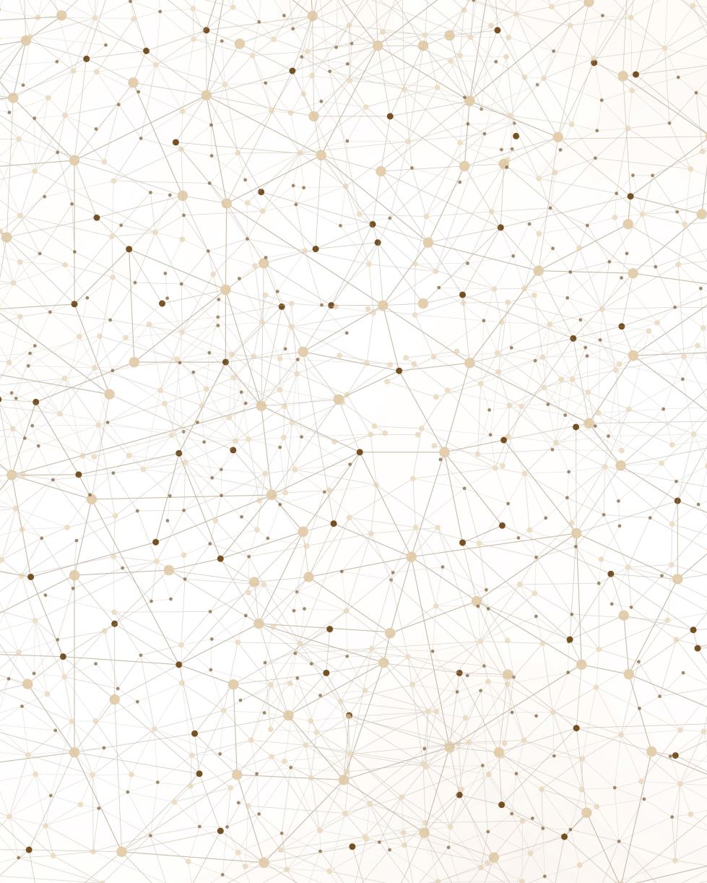
AI SONG GENERATION CAPSTONE PROJECT
INFO 6105 Data Science Engineering and Methods – Anusha Gali (002898649)
Notes:
Hello and Welcome to my capstone project presentation for INFO6105. Today, I’m excited to take you on a journey where cutting-edge data science meets innovative music production to create an innovative auditory experience. This project has culminated in the creation of an album of six distinct songs, each crafted with the help of advanced AI technologies.

Slide 2
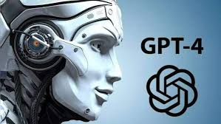

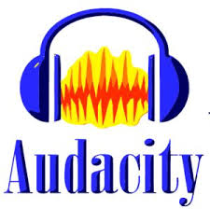
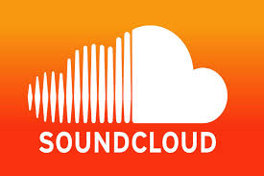
Tools Used:
For generating lyrical content
For composing fitting musical accompaniments
For editing and production of each track
For publishing tracks
Notes:
In this project, I’ve harnessed the power of AI through three primary tools: ChatGPT for generating lyrical content, Suno for composing fitting musical accompaniments, Audacity for the detailed editing and production of each track and Soundcloud to publish our tracks. These technologies together have allowed us to bridge the gap between artificial intelligence and human musical expression.

Slide 3
Chat gpt:
ChatGPT uses machine learning techniques to generate text based on enormous amounts of data it was trained on, which includes books, articles, and websites across a wide array of subjects.
ChatGPT works through a process called natural language processing, or NLP. When given a prompt—like a song theme or a specific emotion—the model predicts and generates words one at a time, crafting sentences that follow the patterns and styles it learned during its training. This allows it to produce highly creative and contextually relevant lyrics.
For each track, I fed ChatGPT prompts that encapsulated the mood and message of the song. The AI then offered a variety of lyric options, from which I selected and refined the best fits. This collaborative process between human creativity and artificial intelligence resulted in deeply resonant and meaningful lyrics.
This integration of AI not only streamlined the lyric-writing process but also brought a unique depth to the music that might not have been possible otherwise. It's a perfect example of how technology can enhance human creativity, allowing artists to explore new realms of expression.
Notes:
Our journey begins with ChatGPT, a state-of-the-art language model developed by OpenAI.

Slide 4
Suno:
This AI tool uses artificial intelligence to interpret the emotional and thematic elements of the lyrics to propose music that complements the written word.
Suno examines patterns in music genres, tempo, and instrumentation to generate preliminary tracks that embody the lyrics provided by ChatGPT. It identifies key themes, emotions, and the rhythmic structure of the text.
Using this analysis, Suno then employs its own sophisticated algorithms to generate musical elements that resonate with the lyrics' mood and message.
For each song, Suno proposes a range of musical compositions—each tailored to the narrative and feel of the lyrics. This process ensures that the resulting music not only supports but enhances the lyrical content, providing a cohesive auditory experience.
The use of Suno exemplifies the potential of AI in music production. It allows us to experiment with various musical styles and arrangements quickly, pushing creative boundaries and exploring new musical landscapes that might have been unreachable otherwise.
Notes:
With lyrics in hand, we turn to Suno.

Slide 5
Audacity
Audacity serves as our digital workshop where we refine and polish each track. It offers a suite of tools essential for professional audio editing.
We use it to clean up any noise that might be present, adjust volumes, and align tracks perfectly. Its powerful equalization and effects capabilities allow us to enhance the clarity and impact of each song, tailoring the sound to exactly match the emotional tone we're aiming for.
For instance, after generating the initial track for 'Midnight Boulevard’, I layered additional vocal tracks, applied reverb for a more atmospheric feel and adjusted the tempo slightly to better convey the song's moody and introspective nature.
Audacity is indispensable in our production process. It bridges the gap between AI-generated content and human artistic expression, allowing us to polish and perfect the songs to a professional standard.
This tool empowers us to deliver music that not only sounds great but also deeply connects with listeners.
Notes:
Once we have our basic song structure, Audacity’s role becomes pivotal.

Slide 6
Sound Cloud
Once our songs are finely tuned and ready for the world, we turn to SoundCloud, a leading social sound platform where artists and creators share their music.
SoundCloud plays a crucial role in our project as the primary channel for publishing our finished tracks.
SoundCloud not only allows us to upload and share our music easily but also offers tools for engagement and feedback. Through its interactive waveform comments, listeners can pinpoint their thoughts on specific parts of a track, providing us with valuable insights directly where they matter most.
Utilizing SoundCloud, we monitor real-time feedback and engagement statistics. This data is invaluable, helping us to gauge the success of our musical compositions and understand listener preferences.
This feature enriches our understanding of how different elements of each song resonate with the audience.

Slide 7
DEMO
Let’s see the demo in Chatgpt, Suno, Audacity and SoundCloud

Slide 8
Conclusion
To conclude, this project is not just a capstone for an academic course; it's a pioneering exploration into the future of music production.
The integration of data science and AI opens up new avenues for artists and producers alike.
Thank you for joining me on this unique auditory journey.
Your feedback is invaluable, and I look forward to hearing your thoughts on this integration of AI and music. Enjoy the sounds of innovation!

