Slide 1
SHAPE DETECTION OF POLYGONS-Upto 4 Edges
Guided by-V Sri Lakshmi
G Anusha
16241A05J4
V Jyothsna
16241A05N5
Shaik Gulzar
16241A05M9

Slide 2

ABSTRACT
This project can be used to detect the circle, triangle, square, rhombus and rectangle using OpenCV dataset module to load a pre-trained object detection network. To obtain the output bounding box (x,y) co-ordinates of each object in the image.
Here we pass an Image of the above given polygons to the detector .Where it detects the number of pixels until the polygons are detected based on their shapes.

Slide 3
Domains used
This project is programmed in Jupyter Notebook of Anaconda. Jupyter Notebook is a server-client application that allows editing and running notebook documents via a web browser. The Jupyter Notebook App can be executed on a local desktop.
We used the programming language python and its various modules such as opencv and imutils.
OpenCV is an open source C++ library for image processing and computer vision, originally developed by Intel and now supported by Willow Garage.It is a library of many inbuilt functions mainly aimed at real time image processing.

Slide 4
Methodology

Slide 5
Here we check various conditions such as the length of diagonals, the length of edges.
Let us consider ’n’ to be the number of edges to be detected.
We use the condition such as if n=3, i,e. Number of edges is 3 then it is a TRIANGLE.
Similarly, if n=0, then it is CIRCLE.
for n=4 that is 4 edges we get three answers those are Square, Rectangle, Rhombus.
Here we check various conditions such as the length of diagonals, the length of edges.

Slide 6
Design Procedure

Slide 7
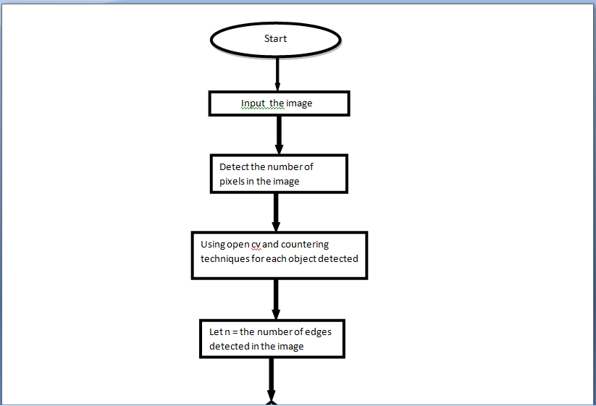

Slide 8
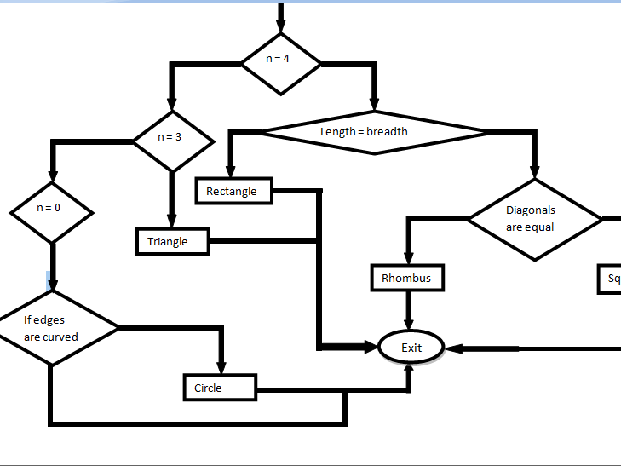

Slide 9
MODULE
Here we use two .py modules .In one of the module we have Detection.py which will store our implementation of the PolygonDetector class
Finally, we have the polygondetector.py driver script that we will use to load an image from disk and say which polygon is being detected.
Before we get started , make sure we have the imutils package installed on our system, a series of OpenCV convenience functions that will be using later.
Contour Approximation is actually already implemented in OpenCV via cv2.approxPolyDP method.

Slide 10
Main Code
Class PolygonDetector: polygon = "unidentified" peri = cv2.arcLength(c, True) approx = cv2.approxPolyDP(c, 0.04 * peri, True)
# if the polygon is a triangle, then it has 3 vertices if len(approx) == 3: polygon = "triangle“

Slide 11
Main code continued
We do the same for a circle and a pentagon but in case of square and rectangle we calculate the aspect ratio.
Aspect Ratio – is the ratio of the width to the height of an image or screen.
len(approx)==4: (x,y,w,h) = cv2.boundingRect(approx) aspect ratio = w / float(h) polygon = "square" if aspectratio >= 0.95 and aspectratio <= 1.05 else "rectangle"

Slide 12
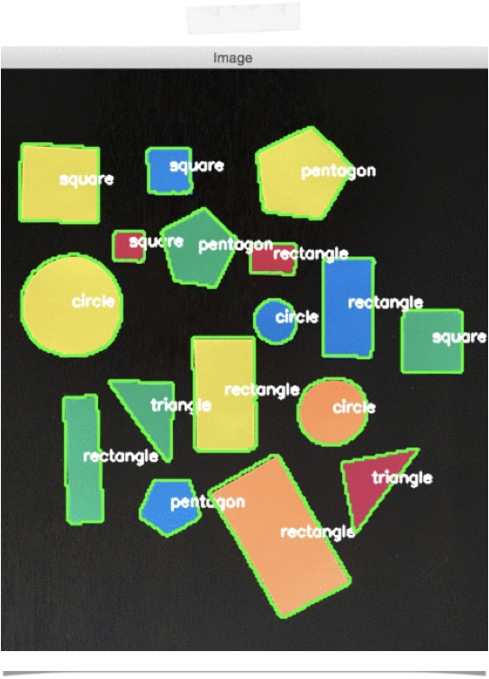
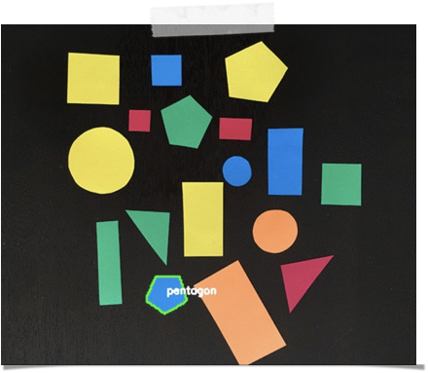
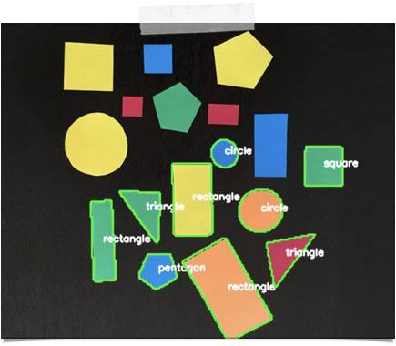
OUTPUTS

Slide 13
CONCLUSION
In the current paper we proposed a new algorithm to detect the shape from any photograph given and we could even recognize the kind of the shape given in the input photo and after applying our proposed algorithm on the image we see that the algorithm gives very good results even if they are many shapes in one photo by depending on the value of the shape factor which is proposed in the current paper and if we compare our work with other works we could see that most of other works are focusing on recognizing some specific shapes but our work is recognizing all the kinds of shapes and we can say that our system is working very well and gives good results finally.

Slide 14
References
F. Pedro, "Representation and Detection of Shapes in Images," Massachusetts Institute of Tecnology, 2003.
K. Karthik and ,. S. Wesley, "A Shape Recognition Algorithm Robust to Occlusion: Analysis and Performance Comparison," 2013.
K. M. S., "Shape recognition for image scene analysis," Université de Nice - Sophia-Antipolis, 2009.
M. Hankyu, C. Rama and R. Azriel, "Optimal Edge-Based Shape Detection," IEEE Transcations On Image Processing NG, vol. 11, no. 11, pp. 1209-1226, 2002.
R. Mar, c. D. Philippe and L. Josep, "Boundary Shape Recognition Using Accumulated Length and Angle Information," Pattern Recognition and Image Analysis, vol. 4478, no. 27, p. 210–217, 2007.
S. Konrad and S. David, "Object Detection by Global Contour Shape," Article published in Pattern Recognition, pp. 1-30, 2008.

