Slide 1
IBM University Engagement Project Submission
AI Mechanical Safety Compliance Advisor
Agentic AI + RAG for Industrial Machine Safety

Slide 2

Project Title – AI Mechanical Safety Compliance Advisor
Domain of Project – Industrial Safety / Manufacturing
Student Name | Recent Passport Photo | Email ID | Mobile number [WhatsApp]
ANUSHA GANGOOR |  | anushaaaa436@gmail.com | 8660493987
Project focus:
AI-assisted safety compliance checking for industrial machines using RAG, machine operating parameters, risk classification, and actionable safety recommendations.

Slide 3
Problem Statement – Industrial Machine Safety
THE CHALLENGE
Industrial machines can become unsafe when operating parameters move outside defined limits or safety devices are not in the required state. Manual checking can be slow, inconsistent, and difficult to document.
THE OBJECTIVE
Build an AI Mechanical Safety Compliance Advisor that:
• Accepts machine ID, machine type, temperature, pressure, RPM, guard status, emergency-stop status and operating condition.
• Retrieves relevant safety rules from a document knowledge base using RAG.
• Compares observed values with defined safety thresholds.
• Identifies risks and produces an overall LOW / MEDIUM / HIGH assessment.
• Generates COMPLIANT / NON-COMPLIANT findings and recommended actions.
• Maintains safety-check history, alerts and dashboard summaries.
CURRENT KNOWLEDGE BASE
5 safety documents • 75 indexed chunks • TF-IDF retrieval

Slide 4
Proposed Solution – AI Mechanical Safety Compliance Advisor
The solution is a Streamlit-based AI safety application that combines Retrieval-Augmented Generation (RAG) with machine-parameter analysis to support mechanical safety compliance checks.
WORKFLOW
1. Operator enters machine information and current operating parameters.
2. RAG retrieves relevant rules from the indexed safety documents.
3. AI analysis compares observations with retrieved safety requirements.
4. Risks are classified and compliance findings are generated.
5. The system recommends immediate, short-term or scheduled actions.
6. Results are stored in Safety Check History and reflected on the Dashboard.
KEY OUTPUTS
• Overall risk level and compliance status
• Detected risks with reasons and source documents
• Parameter-by-parameter compliance findings
• Recommended safety actions
• Safety alerts and historical reports
Example: M002 was flagged HIGH / NON-COMPLIANT because temperature, pressure and RPM exceeded defined limits and the safety guard was OPEN.

Slide 5
Technology Used
Python – Core application and safety-analysis logic
Streamlit – Interactive web dashboard and user interface
Groq API / LLM – Natural-language reasoning and generation for safety analysis
RAG Pipeline – Retrieves relevant safety rules before generating the response
TF-IDF (scikit-learn) – Document vectorization and similarity-based retrieval
Knowledge Base – 5 safety documents / 75 indexed chunks:
• safety_guidelines.txt
• machine_operation.txt
• maintenance_safety.txt
• emergency_procedures.txt
• safety_inspection_guidelines.txt
Application features – Safety Check, Safety Report, Knowledge Base, History, Alerts and Dashboard
Environment configuration – API credentials stored outside the public UI/source when deployed

Slide 6
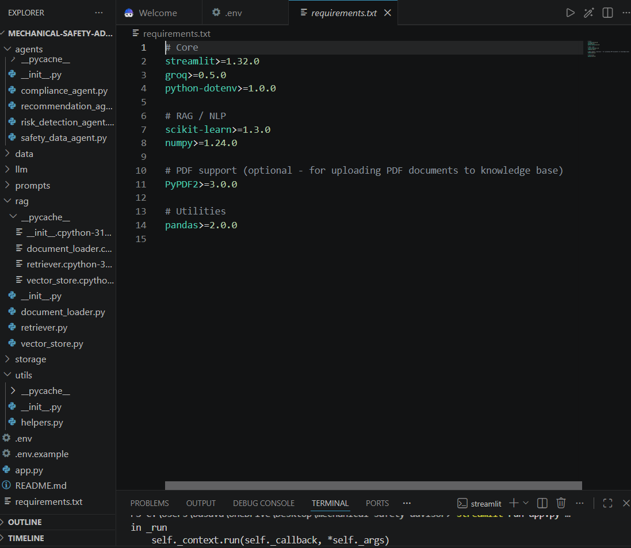
Project Files / Components
Core application
• app.py – Streamlit application and workflow
• requirements.txt – Python dependencies
• .env / secrets – API configuration
• Custom styling / CSS where applicable
Safety knowledge base
• safety_guidelines.txt
• machine_operation.txt
• maintenance_safety.txt
• emergency_procedures.txt
• safety_inspection_guidelines.txt
Functional modules
• Safety Check input and validation
• RAG retrieval
• AI compliance analysis
• Safety report generation
• History and alert tracking
• Dashboard summary

Slide 7
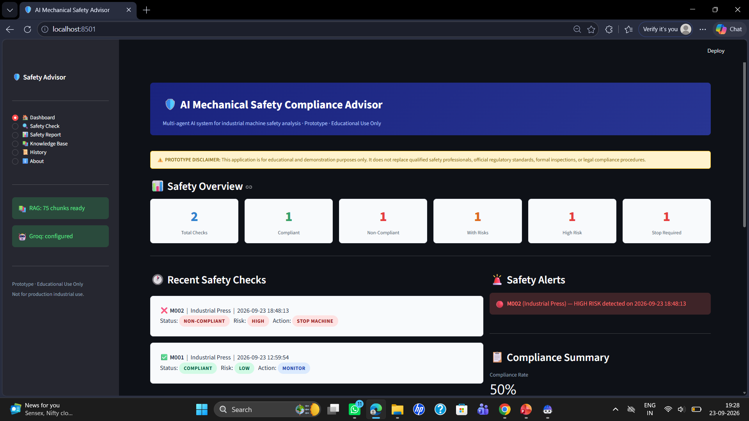
Application Screenshot – Dashboard

Slide 8
Knowledge Base & RAG Configuration
Indexed Safety Knowledge
• 5 source documents indexed
• 75 total text chunks available for retrieval
• TF-IDF / scikit-learn vectorization
• Relevant safety rules retrieved for each query
• Source document names are shown in compliance findings
Safety rules
↓
RAG retrieval
Machine observations
Temperature • Pressure • RPM
Guard • Emergency Stop
AI compliance analysis
Risk + findings + reasons
Actionable report
STOP / MONITOR / corrective actions

Slide 9
Architecture Blueprint
RAG Retrieval
TF-IDF + 75 chunks
Safety Report
& Findings
Operator /
Safety Engineer
Streamlit UI
Safety Check
Compliance /
Risk Engine
Groq LLM
AI Analysis
Dashboard /
History / Alerts
Knowledge sources → Retrieval → AI reasoning → Compliance decision → Actionable safety report

Slide 10

Role of Agentic AI in the Solution
Agentic AI enables the safety advisor to move beyond a simple question-and-answer chatbot by coordinating multiple analysis steps.
• Safety Assessment Agent – interprets machine inputs and operating conditions.
• Knowledge/RAG Agent – retrieves the most relevant safety rules from indexed documents.
• Compliance Analysis Agent – compares observations against retrieved requirements.
• Recommendation Agent – converts detected violations into prioritized corrective actions.
• Reporting Agent – produces the compliance report, risk summary, alerts and historical record.
The workflow uses the current machine context and retrieved safety guidance so the final response is tied to documented rules rather than generic advice.
Result: a structured, explainable safety-check workflow with traceable findings and recommended actions.

Slide 11
Prompt & AI Analysis Flow
BEFORE PROMPT / INPUT
Machine ID: M002
Machine Type: Industrial Press
Temperature: 120°C
Pressure: 250 PSI
RPM: 5000
Safety Guard: OPEN
Emergency Stop: FUNCTIONAL
Operating Condition: NORMAL
AFTER AI + RAG ANALYSIS
Risk: HIGH
Compliance: NON-COMPLIANT
Action: STOP MACHINE
Detected: temperature, pressure, RPM and safety-guard violations.
Output includes evidence, source documents and corrective actions.
RAG
+
LLM

Slide 12
Project Output Screenshot / Evidence
Dashboard output: 2 checks recorded • 1 compliant • 1 non-compliant • HIGH-RISK alert for M002

Slide 13
Project Output Screenshot / Evidence
M002 – Industrial Press | HIGH | NON-COMPLIANT | STOP MACHINE
Detected Risks
• Temperature: 120°C > 100°C limit
• Pressure: 250 PSI > 200 PSI limit
• RPM: 5000 > 4500 limit
• Safety Guard: OPEN during operation
• Emergency Stop: FUNCTIONAL
Generated Actions
• Immediate controlled shutdown
• Safely depressurize the system
• Cool the machine below the defined limit
• Inspect guard/interlock and drive system
• Verify emergency-stop functionality before restart
Report is tied to retrieved safety guidance and records the reason/source for each finding.

Slide 14
Project Output Screenshot / Evidence
M001
COMPLIANT • LOW RISK • MONITOR
M002
NON-COMPLIANT • HIGH RISK • STOP MACHINE
Dashboard / History Features
• Historical safety checks are retained by machine ID and timestamp.
• Safety alerts surface high-risk records.
• Compliance rate is calculated from recorded checks.
• Historical reports can be selected for detailed review.
• Recommended improvements can be tracked for follow-up maintenance.
Prototype result: 2 checks recorded → 1 compliant + 1 non-compliant → 50% compliance rate

Slide 15
Novelty and Uniqueness
The AI Mechanical Safety Compliance Advisor combines RAG, structured machine parameters and AI-generated recommendations in one safety workflow.
• Multi-step / Agentic Analysis – retrieval, compliance reasoning, recommendations and reporting.
• RAG-Based Evidence – uses a dedicated safety knowledge base instead of model memory alone.
• Parameter-Aware Checking – evaluates temperature, pressure and RPM against defined thresholds.
• Safety-Device Awareness – checks guard and emergency-stop states alongside numeric readings.
• Explainable Findings – reports observed value, required condition, reason and source document.
• Action Prioritization – produces IMMEDIATE, SHORT-TERM and SCHEDULED actions.
• History & Alerts – stores checks and highlights high-risk conditions.
• Human-in-the-Loop – supports qualified safety personnel rather than replacing formal inspections.
This makes the prototype a structured safety-compliance assistant rather than a generic chatbot.

Slide 16
GitHub / Project Repository
GitHub Repository
AI Mechanical Safety Compliance Advisor
🔗 https://github.com/Anusha-Gangoor/AI-Mechanical-Safety-Compliance-Advisor
Live Project Website
AI Mechanical Safety Advisor · Streamlit

Slide 17
Future Scope
1. Live Sensor Integration – connect temperature, pressure, RPM and guard/interlock sensors for real-time monitoring.
2. Predictive Maintenance – use historical readings and maintenance records to identify abnormal trends before failure.
3. Computer Vision Safety Checks – detect open guards, unsafe operator proximity or visible machine anomalies.
4. Automated Notifications – send alerts through email/SMS/Teams when critical thresholds are exceeded.
5. Role-Based Access & Audit Trail – provide operator, supervisor and safety-engineer views with traceable actions.
6. Standards & Document Expansion – add organization-approved SOPs, inspection checklists and applicable standards.
7. Multilingual Voice Interface – allow operators to interact with the safety advisor using voice and multiple languages.
8. Edge / IoT Deployment – run safety monitoring closer to machines for faster detection and reduced latency.
·
·
·

Slide 18
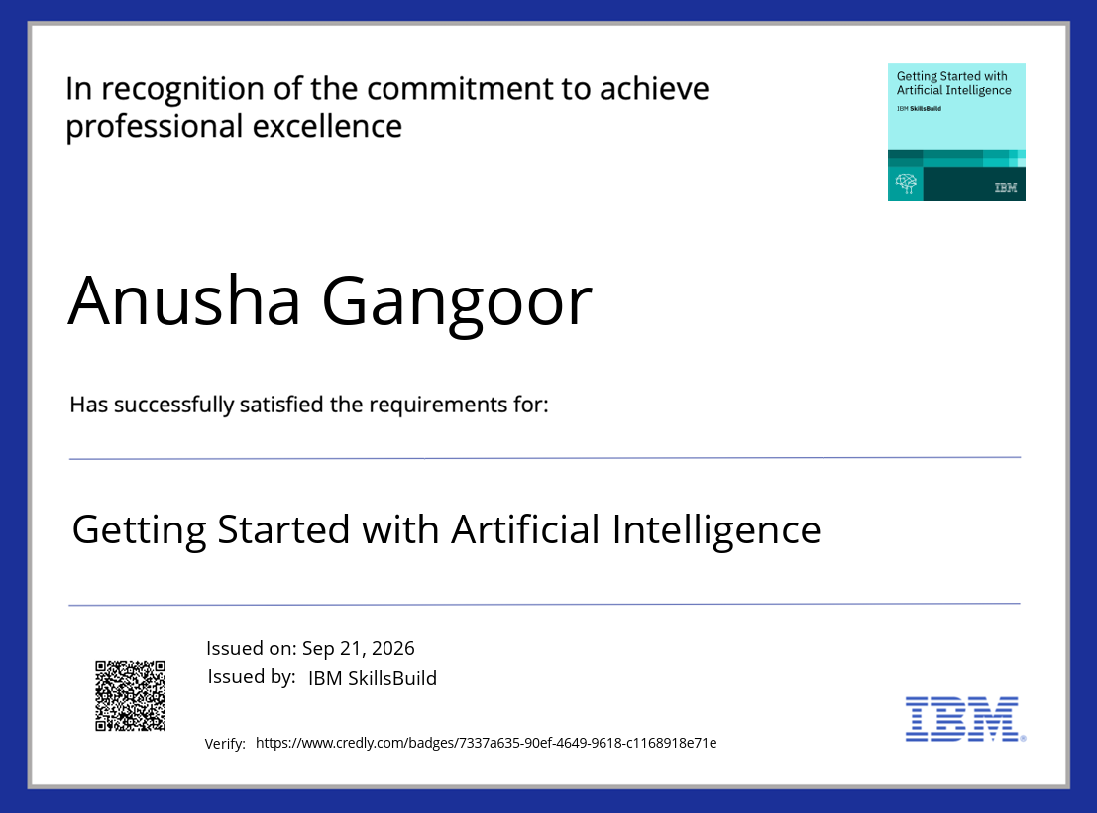

Credly / IBM course certificate screenshots

Slide 19
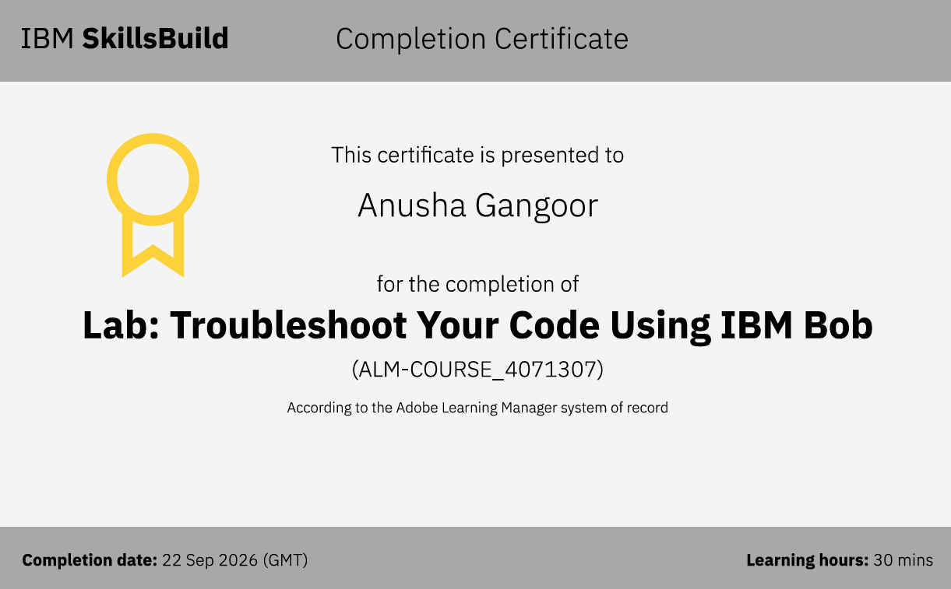


Slide 20
Thank You
AI Mechanical Safety Compliance Advisor

