Slide 1

FINANCIAL CONVERSATION
INTELLIGENCE SYSTEM
Transforming Everyday Financial Conversations into Actionable Insights
TEAM NAME- FinTalk AI
PRESENTED BY-
Anusha Gangoor
Amruta Karabasanavar
Pavitra Mindolli
Kavita Kokatnur

Slide 2

PROBLEM
AND
MOTIVATION
In real life, people discuss important financial decisions
through conversations — but these are never documented.
• No record of loans, EMI discussions, or investments
• People forget commitments and details
• Decisions are often emotional and untracked
• No structured way to analyze financial conversations
This creates confusion, poor planning, and financial mistakes.

Slide 3

Artificial Intelligence is already part of our daily lives:
• Voice assistants understand what we say
• Speech-to-text converts audio into text
• AI detects patterns and extracts useful data
But financial conversations are still unstructured
Our system brings AI into financial discussions by:
• Converting speech into text
• Detecting financial terms (EMI, Loan, SIP)
• Generating structured summaries
AI IN FINANCIAL CONVERSATIONS
However, real-world financial conversations remain unstructured and untracked

Slide 4
WHERE AI IMPACTS FINANCIAL DECISIONS
01
02
03
SMART CONVERSATIONS
AI can understand human speech and convert it into text in real-time.
Voice assistants and speech systems already process natural language.
But they don’t capture financial meaning.
DATA EXTRACTION
AI can identify patterns and extract useful information from unstructured data.
Used in chatbots, analytics, and automation systems.
But financial discussions remain unstructured.
FINANCIAL INTELLIGENCE
AI is used in fraud detection, credit scoring, and analytics.
However, it does not capture real-life financial conversations.
Our system fills this gap.
Yet, no system connects all these into real financial decision tracking

Slide 5
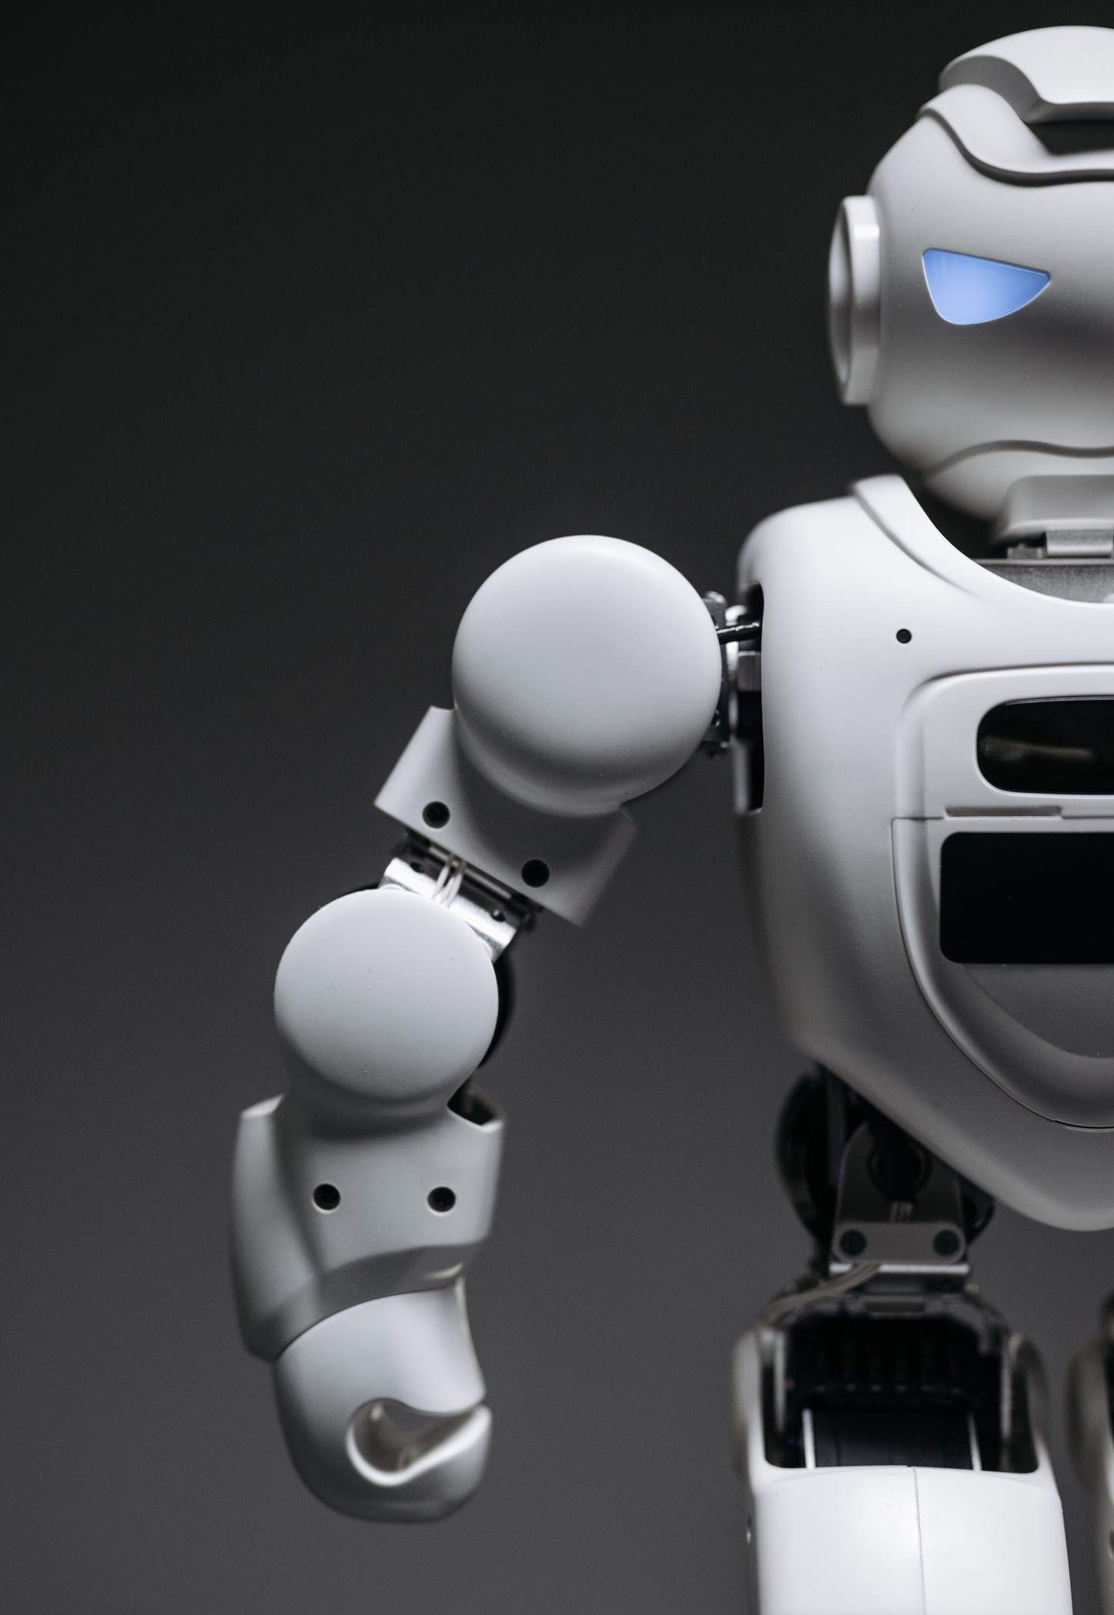
AI IN DAILY LIFE
EVERYDAY FINANCIAL DISCUSSIONS
People frequently discuss money in daily life:
• Loans and EMIs
• Investments and savings
• Expenses and planning
These conversations are never recorded or tracked
01
LACK OF STRUCTURED INSIGHTS
Financial conversations are:
• Informal and unorganized
• Easily forgotten
• Difficult to analyze later
No intelligent system converts them into actionable financial insights
02

Slide 6

FUTURE
OF FINANCIAL
CONVERSATION INTELLIGENCE

Slide 7
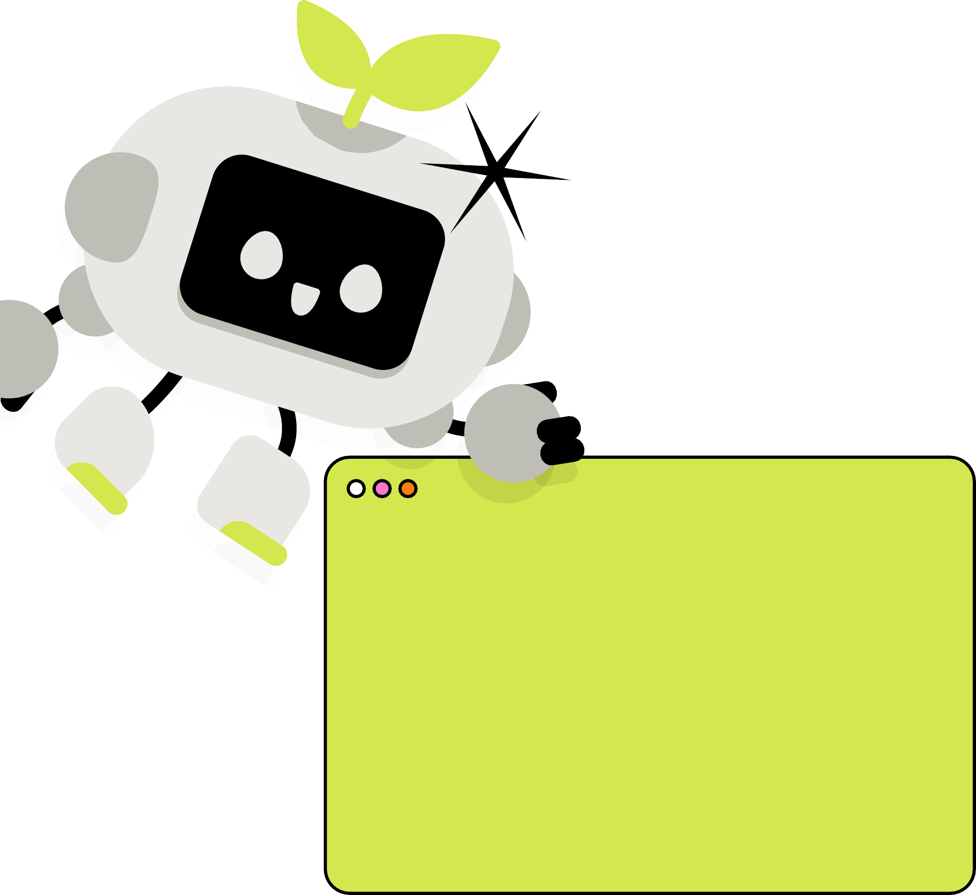



FUTURE SCOPE & IMPACT
ENTERPRISE & INDUSTRY APPLICATIONS
The system can be used by:
• Banks for customer interaction tracking
• Finance companies for loan discussions
• Businesses for financial decision analysis
Transforming conversations into valuable insights
AI-POWERED FINANCIAL ASSISTANT
Our system can evolve into a smart personal assistant:
• Tracks financial conversations in real-time
• Sends reminders for EMIs, loans, and payments
• Suggests better financial decisions
Making financial planning effortless

Slide 8



REAL-WORLD APPLICATIONS
PERSONAL FINANCIAL MANAGEMENT
• Tracks daily financial conversations
• Records commitments like loans, EMIs, and payments
• Helps users avoid missed deadlines
Improves financial discipline in everyday life
SMART FINANCIAL INSIGHTS
• Converts conversations into structured data
• Identifies spending patterns and risks
• Helps users make better financial decisions
Turns raw conversations into useful insights

Slide 9


Our system handles sensitive financial conversations, so key challenges include: • Ensuring user data privacy and secure storage • Accurately handling multilingual and code-mixed speech • Avoiding misinterpretation of financial discussions • Maintaining transparency in AI-generated insights - Building trust is critical for adoption
ETHICAL
CONSIDERATIONS AND CHALLENGES

Slide 10
CONCLUSION
AI can turn simple conversations into powerful financial insights. Our system helps people track commitments, plan better, and make smarter financial decisions. It improves financial awareness and reduces the chances of missing important discussions. This approach shows how AI can simplify everyday financial management and support better decision‑making.

Slide 11
THANK YOU

