Slide 1

Predicting “Customer Lifetime Value”
(MiTH)
24 Feb, 2018
Anusha Mudunuri
Batch- 37

Slide 2

Business Problem
To predict the Customer lifetime value for an auto insurance company based on different quantitative and qualitative features provided.
Forecasting is an important approach to take an optimal decision and implement appropriate action plans.
A major non-life insurance company wants to evaluate customer lifetime value based on each customer’s demographics and policy information including claim details. The CLV is a profitability metric in terms of a value placed by the company on each customer and can be conceived in two dimensions: the customer`s present Value and potential future Value.

Slide 3
Data Pre-processing (Steps on Train dataset)
02
Convert Features to appropriate type
04
Related Feature Imputation
To Categorical and Numeric data types
Replacing missing values in Policy. Type using Policy
06
KNN Imputation
There were no NAs in any Feature except Coverage, which are imputed using KNN, with K=3
01
03
05
Looking at each Feature in Raw data
Dealing with Missing Values
Intuitive Missing values replacement
Deleting the records with more than 30% missing values.
9806 records to 9559 records
Separating Latitude and Longitude from Location.Geo.
Replacing ‘?’ in ‘Income’ with NAs
Replacing NAs in Number.of.Open.Complaints with 0s.

Slide 4

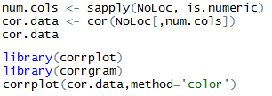
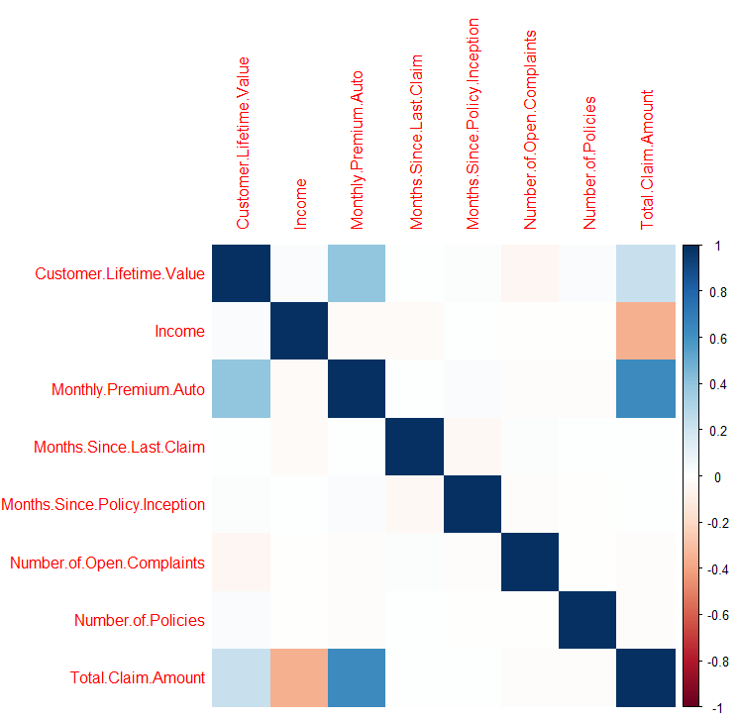
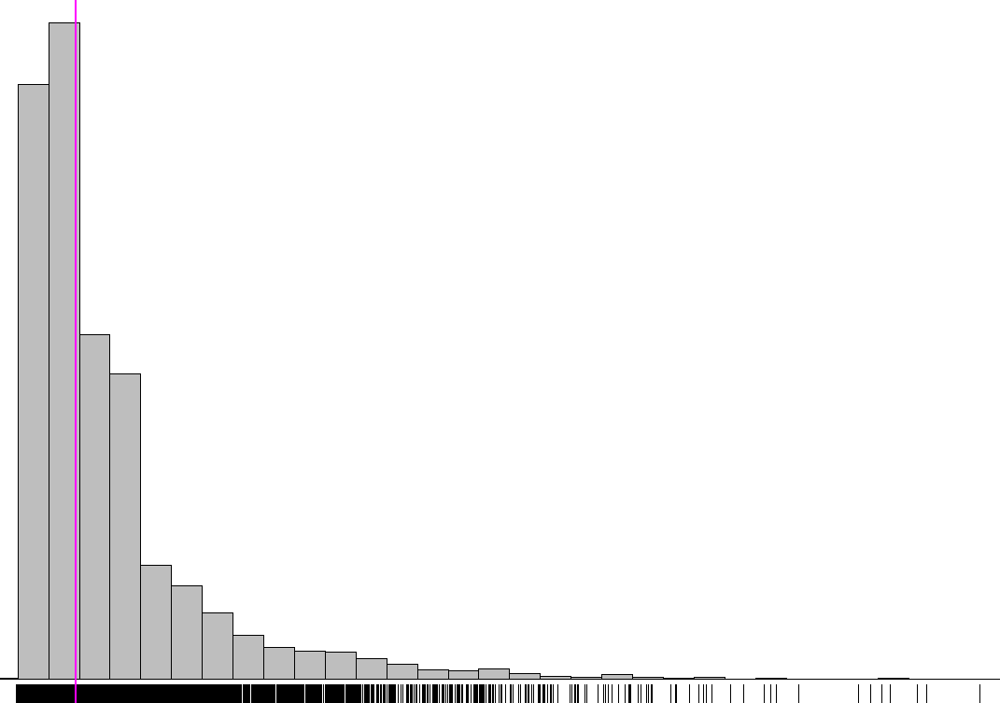
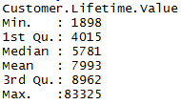
Exploratory Data Analysis
Correlation between Numeric Attributes
Understanding CLV (Train Data set)

Slide 5

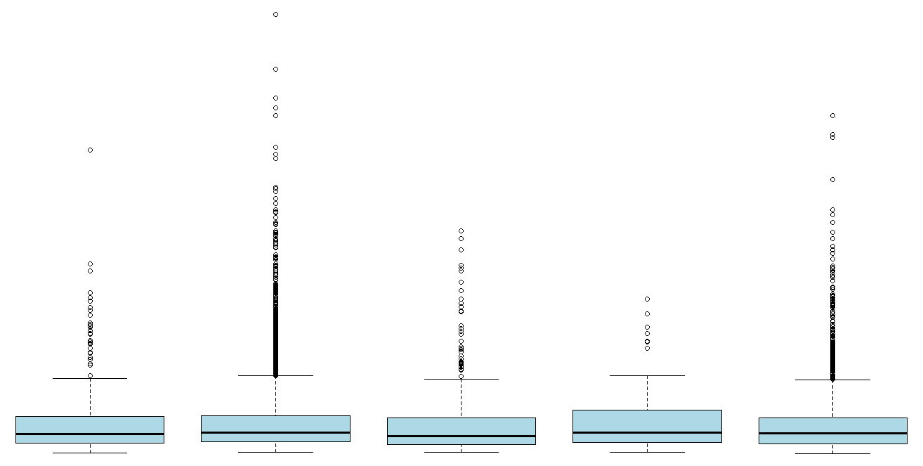
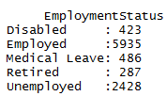
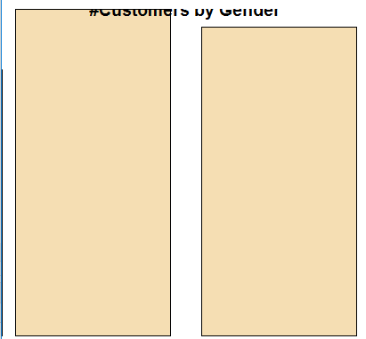
Exploratory Data Analysis (cont..)
CLV with respect to Employment Status
#Customers by Gender

Slide 6
Exploratory Data Analysis (cont..): through Excel
(As resolution of plots in R is not so good with know knowledge on Plotting tools)

Slide 7
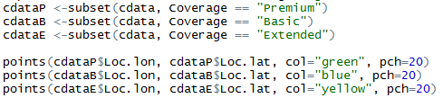
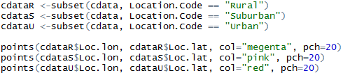
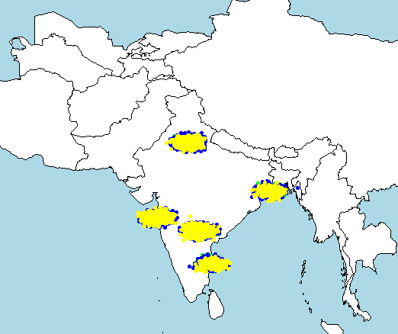
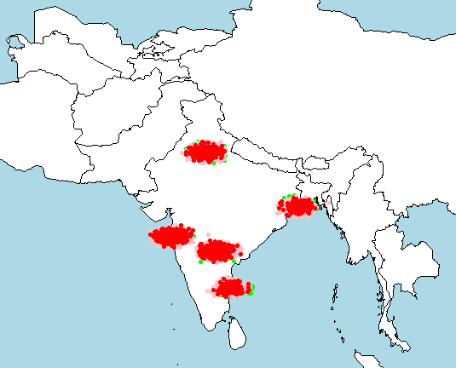
Exploratory Data Analysis (cont..)
Customers Spread by Coverage
Customers Spread by Region Category

Slide 8
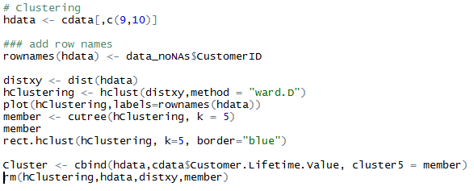
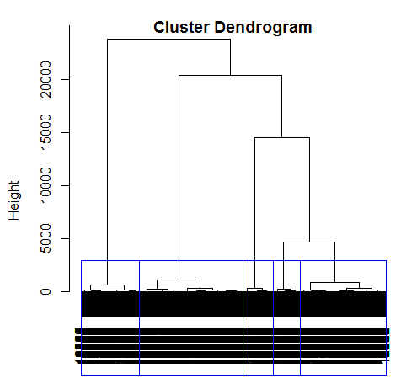
Clustering
Cluster | Region Identified
Cluster 1 | South Central
Cluster 2 | North
Cluster 3 | North East
Cluster 4 | West
Cluster 5 | South East

Slide 9
Insights from Clustering
Percent CLV from each Region (Cluster)

Slide 10
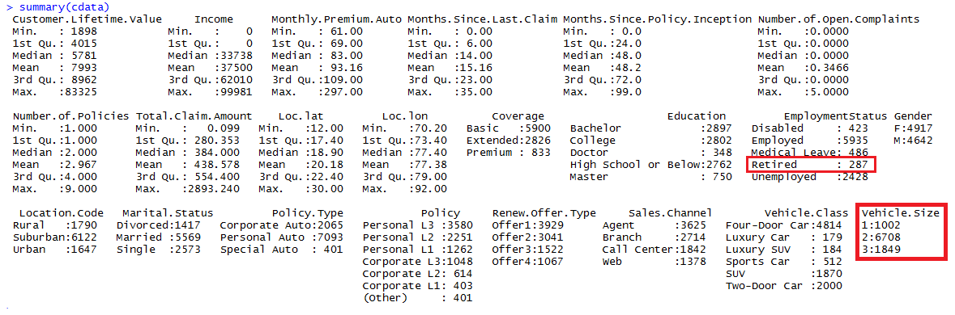
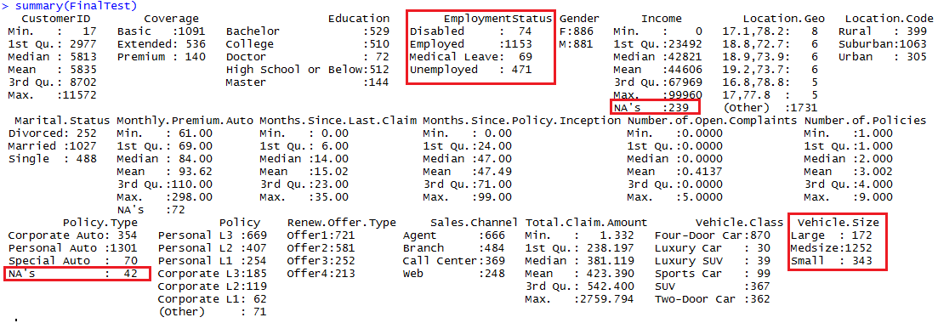
Test : Train data, Attributes Category Miss-match
Train data
Test data
Modifications
Test’s Vehicle.Size changes as per Train data’s format
Dummy Variable with ‘Retired’ in Train data Removed
NAs in Policy.Type in Test are imputed based on Policy Column
NAs in Income in Test are imputed using KNN.

Slide 11

Model Building
#1 Multiple Linear Regression
lm(formula = tempTrainTRG ~ ., data = train)
Output:
#2 Multiple Linear Regression with Log Transformation
lin_mod1 <- lm(log10(tempTrainTRG)~.,data = train)
Output:

Slide 12
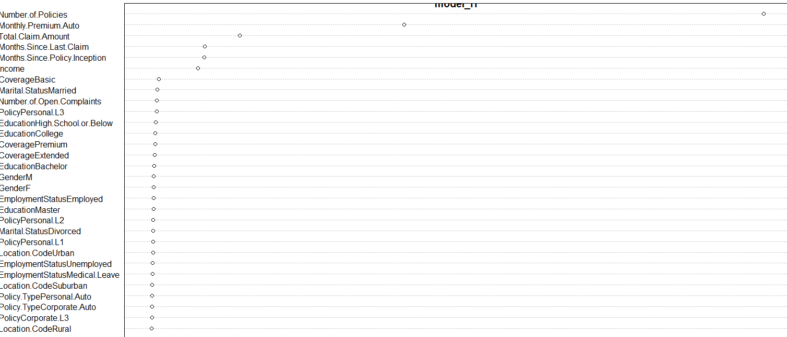
Model Building(cont..)
#3 Random Forest
Highest R square from RF
68.48%
Data Preparation for Random Forest:
Categorical Variables Dummified.
Numerical variables scaled.
model_rf <- randomForest(tempTrainTRG ~ . , cdatarf,ntree = 50,mtry = 20

Slide 13
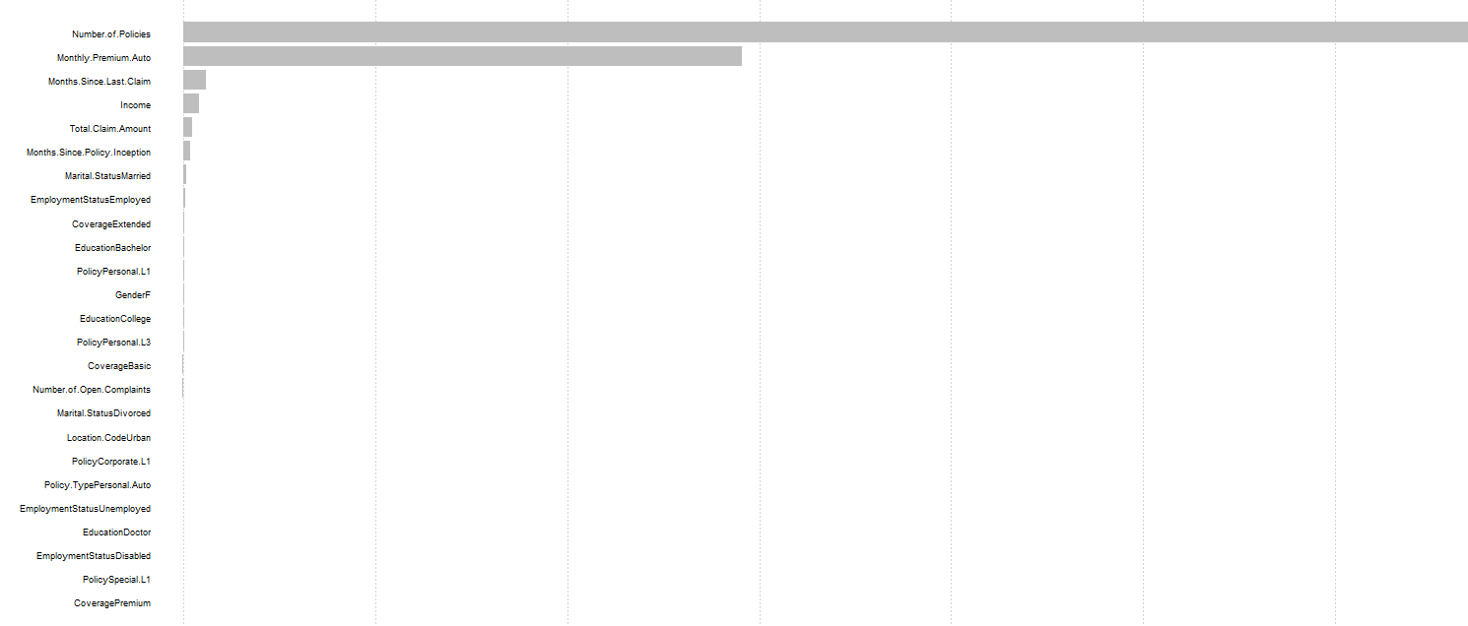
Model Building(cont..)
#4 XGBoost
Highest R square from XGBoost
69.03%
Data Preparation for XGBoost:
Categorical Variables Dummified.
Numerical variables scaled.
Converting Train and Test data to dense matrix format.
model = xgboost(data = dtrain, max.depth = 4, eta = 0.1, nthread = 4, nround = 40, objective = "reg:linear", verbose = 1)

Slide 14
Thank You

