Slide 1
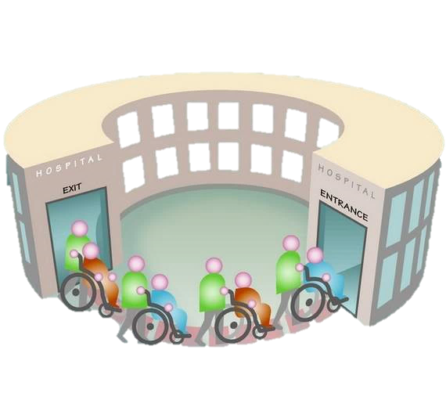
Predicting the “Re-admission possibility of a patient into the hospital”
Anusha Mudunuri
Batch 37
ID: 1728

Slide 2
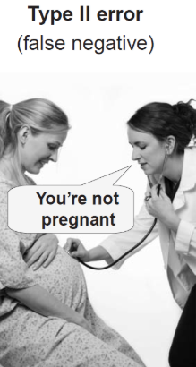

Business Rational
A leading hospital in the US is suddenly seeing increase in the patient readmission in less than 30 days. This is serious concern for the hospital as it may indicate insufficient treatment or diagnosis when the patient was admitted first and later released under clean bill of health. Not only the image of hospital’s healthcare provider is compromised, this is also increased cost to the entire medicare ecosystem inform of increased insurance claims.
Hospital want to classify their patients into two categories:
Readmitted within 30 days
Not readmitted.
Their focus is on RECALL with respect to ‘readmission within 30 days’, which the hospital wants to avoid the most.

Slide 3

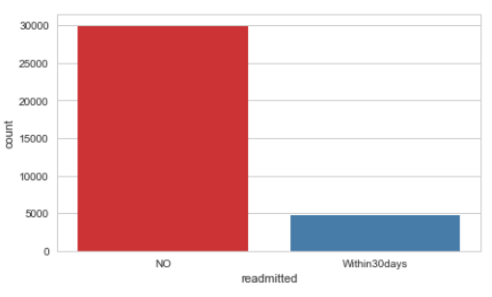
Data Exploration
There are 44 Independent features in the initial dataset, one dependent feature.
20 feature out of 44 independent features related to drugs
Class Imbalance:
13.7% : Within30days
86.3% : NO

Slide 4
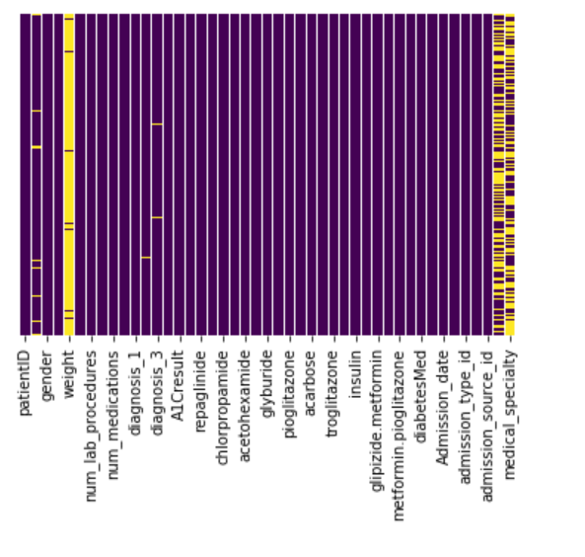
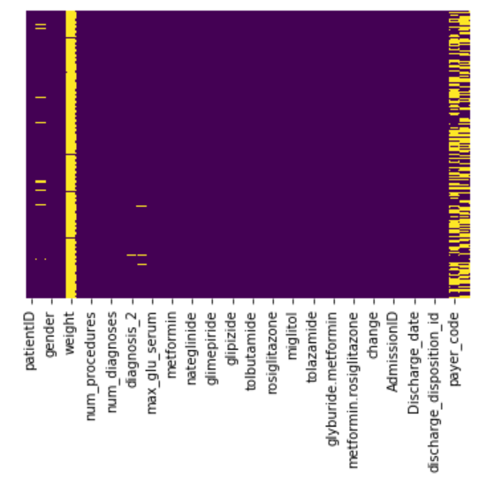
Data Exploration(cont..)
Few columns in dataset has many missing values
Weight -> 96%
Medical Specialty -> 47%
Payer Code -> 42.5%
Missing in Train
Missing in Test

Slide 5
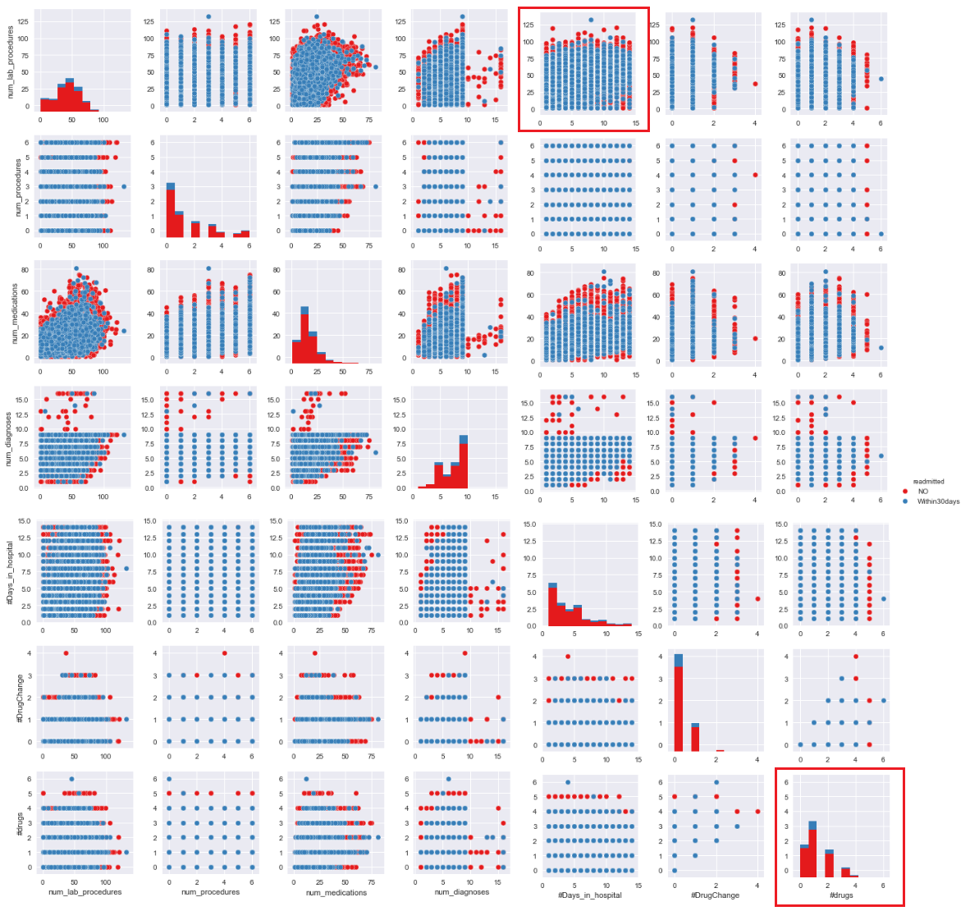
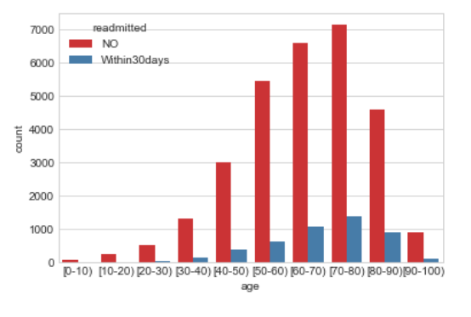
Data Exploration(cont..)
Patient numbers dramatically increase with age, and reaches a peak in the range of 70-80 years old.
From pair-plot, it is clear that, patients who are many drugs are likely to get readmitted.

Slide 6
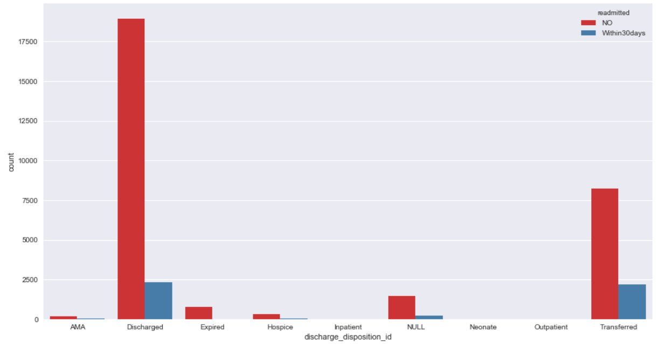
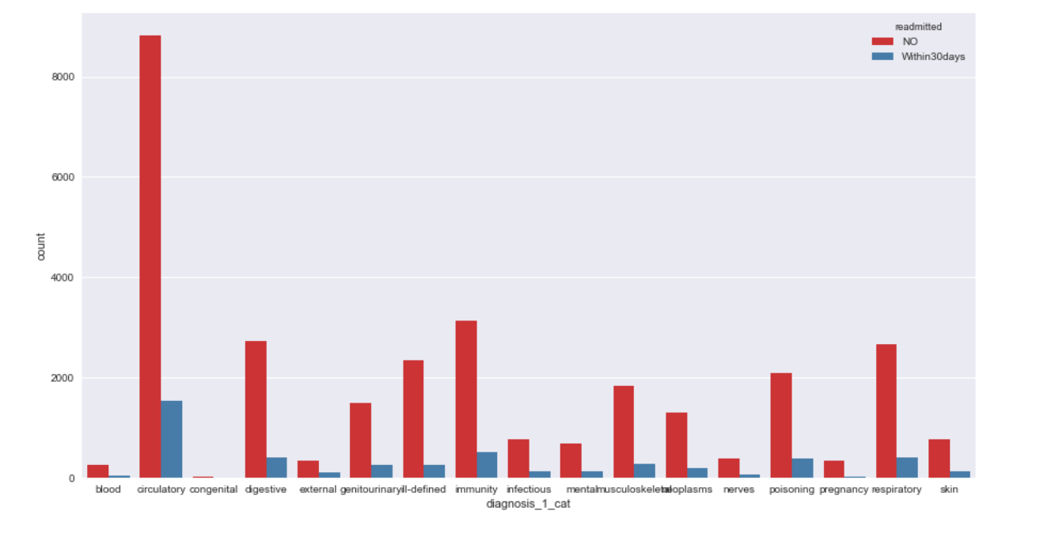
Data Exploration(cont..)
Patients in discharge_decomposition category, ‘Discharged’ and ‘Transfered’ could get readmitted.
Patients in diagnosis_1 category, ‘Circulatory’ and ‘Immunity’ could get readmitted.

Slide 7
Data Preprocessing
To manage the level discrepancies, Train and test sets are merged together and preprocessed.
Weight, Payer Code and Medical Speciality has high missing value. Atleast, around 50% of data in those columns is missing.
Days difference between Discharged and Admission dates is considered Days in Hospital.
Diagnosis_1, Diagnosis_2, Diagnosis_3 column codes are grouped into meaningful categories as per ICD-9 codes.
Levels of age, discharge_disposition_id, admission_type_id and admission_source_id are condensed to meaningful levels.
IDs and Dates are dropped.
Feature Engineering
#Drugs: Is derived out of drugs used on patient during treatment.
#DrugChange: Is the drug dosage change, i.e. number of Ups or Downs of drugs used on patient.
https://en.wikipedia.org/wiki/List_of_ICD-9_codes_001%E2%80%93139:_infectious_and_parasitic_diseases

Slide 8
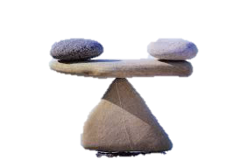
Handling Class Imbalance
SMOTE
Synthetic Minority Oversampling Technique is a statistical technique for increasing the number of cases in the dataset in a balanced way. The module works by generating new instances from existing minority cases that you supply as input.
Manual Up-sampling by duplicating records of Minority Class.
As a consequence of applying SMOTE, new dataset is generated where the columns names are no longer retained. As a result, explicability of feature importance after building the model is lost.
To overcome this issue, manually minority class records are duplicated to match majority class records.
(Minority class records are duplicated 6 times to match majority class records)
NO: 29,891
Within30days: 4,759
Manual Up-sampling: 4,759*7= 33,313

Slide 9
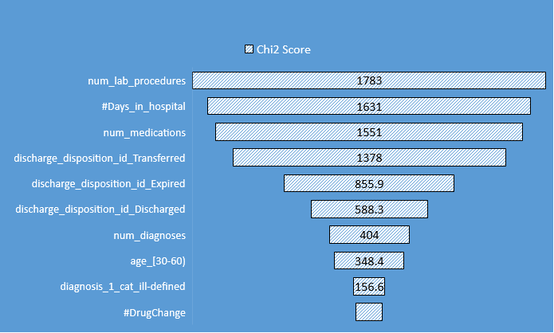
Feature Importance – ChiSquare Test
As there are many features in our dataset, it is important to understand significant features which influence the target variable.
Top 10 features with Chi-Square scores are arranged in descending order.

Slide 10

Modeling
The choice of models is governed primarily by aim to understand the most important factors, along with their relative effects on readmission.
Therefore, models that have little or no interpretability (neural networks, support vector machines, nearest neighbors, etc.) are given less precedence(at this stage).
Models Implemented:
Logistic Regression
Decision tree
Random Forest
Naïve Bayes
Gradient Boosting Classifier

Slide 11
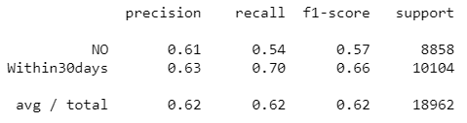
Logistic Regression
The model gave accuracy is 58% and recall is 70% on final test data.
Recursive Feature Elimination (RFE) is used to understand important features.
Top 5 features as per RFE ranking are
'discharge_disposition_id_Expired'
'medical_specialty_Otolaryngology'
'medical_specialty_Pediatrics-CriticalCare'
'medical_specialty_Pediatrics-Endocrinology'
'medical_specialty_Proctology‘.
Classification Report on Validation set:

Slide 12

Decision Tree
Parameter tuning is done based on grid search.
Hyperparameters used for decision tree are criterion='gini', max_depth=90, max_features=40, min_samples_split=2
Decision tree gave a recall of 35% on final test set.
Top 5 important attributes of decision tree are
Num_lab_procedures
Num_medications
#Days_in_hospital
Num_diagnosis
Num_procedures
Classification Report on Validation set:

Slide 13
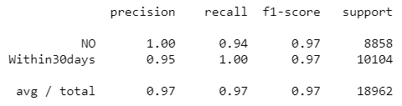
Random Forest
Hyperparameters used for random forest are criterion='gini', max_depth=90, max_features=40, min_samples_split=2, n_estimators=10
Random Forest gave a recall of 43% on final test set.
Top 5 important attributes of decision tree are
Num_lab_procedures
Num_medications
#Days_in_hospital
Num_diagnosis
Discharge_disposition_id_Transfered
Classification Report on Validation set:

Slide 14
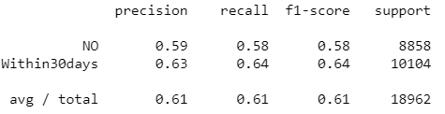
Naïve Bayes
Naive Bayes algorithm is a probabilistic model for classification. It assumes that given the class features are statistically independent of each other.
Naïve Bayes is used to improve recall.
Up-sampling with SMOTE, diagnosis_3_cat dropped with Naïve Bayes gave best recall of 75%.
Classification Report on Validation set:

Slide 15
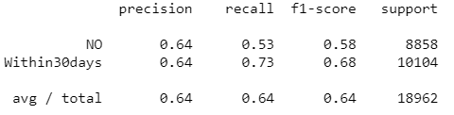
Gradient Boosting Classifier
Gradient boosting involves loss function to be optimized and allows weak learners to make predictions. This is an additive model to add weak learners to minimize the loss function.
Parameters used to train this model are criterion='mse', learning_rate=0.15, max_depth=3.
Up-sampling with SMOTE, with Gradient Boosting Classifier gave recall of 65%.
Classification Report on Validation set:

Slide 16
Model Comparison
(Recall with respect to Readmission within 30 days)
75%
35%
Naïve Bayes
Decision Tree
43%
58%
Random Forest
Logistic regression

Slide 17
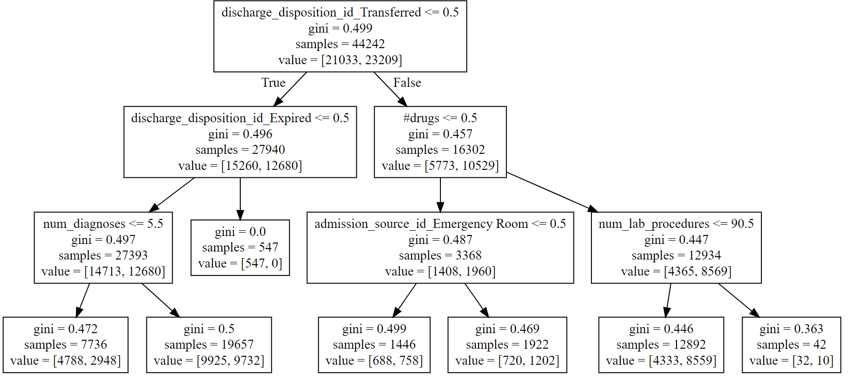
Analysis (To understand the rules a decision tree, a small tree with depth 3 is created)

Slide 18
Further Improvements
This work uncovers the features that are critical in identifying high risk of readmission.
Other Machine learning algorithms can also be used to predict readmission.
Some critical data which seems to missing in the original dataset can be collected for better recall prediction.
Your subtitle text here.
Thank You

