Slide 1
Programing
16-Sep-2023

Slide 2
Swap two number without using third varible
# Define two variables with values
a = 5
b = 10
# Swap the values without using a third variable
a, b = b, a
(Or)
a=a+b
b=a-b
a=a-b
# Now, 'a' will contain 10, and 'b' will contain 5
print("a =", a)
print("b =", b)

Slide 3
Reading integers and strings in python
integer = int(input("Enter an integer as input: "))
name = input("What is your name? ")
print("Hello, " + name + "!")
a=10,b=20
a=a+b=30
b=a-b=30-20=10
a=a-b=30-10=20

Slide 4
Reverse a number
number = int(input("Enter the integer number: "))
# Initiate value to null
revs_number = 0
# reverse the integer number using the while loop
while (number > 0):
# Logic
remainder = number % 10
revs_number = (revs_number * 10) + remainder
number = number // 10
# Display the result
print("The reverse number is : {}".format(revs_number))

Slide 5
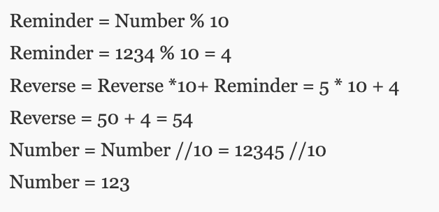
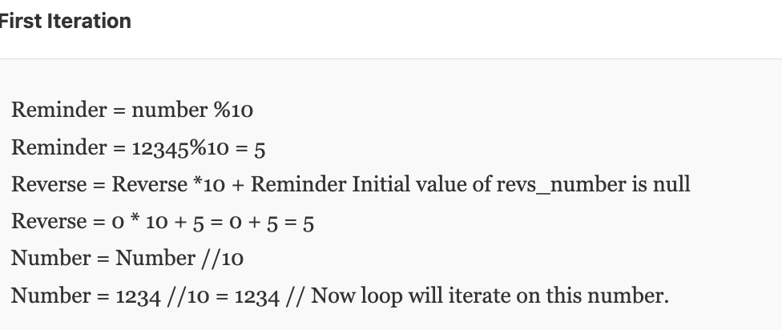
Reverse a number

Slide 6
Palindrom
Num = int(input("Enter a value:"))
Temp = num
Rev = 0
while(num > 0):
dig = num % 10
revrev = rev * 10 + dig
numnum = num // 10
if(temp == rev):
print("This value is a palindrome number!")
else:
print("This value is not a palindrome number!")

Slide 7
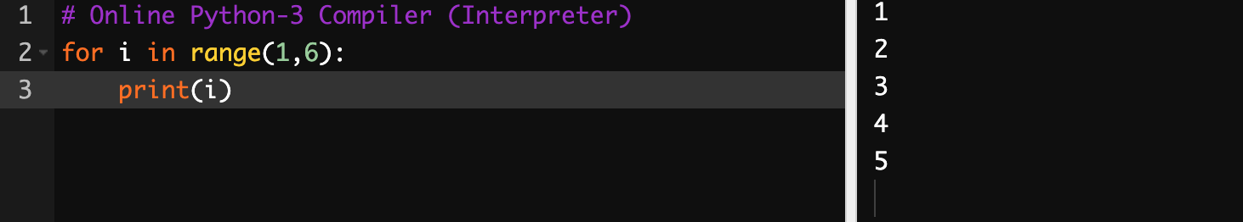
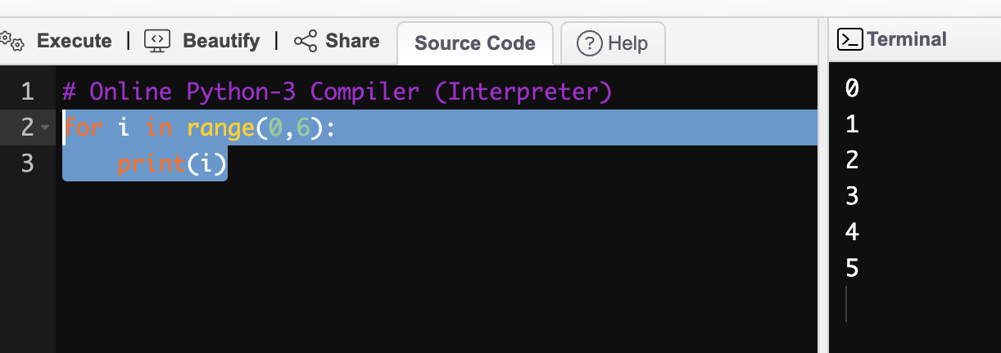
Range

Slide 8
Range
The range(0, 6) function generates a sequence of numbers starting from 0 (inclusive) up to 6 (exclusive), so it includes the numbers 0, 1, 2, 3, 4, and 5, which are then printed one at a time in the loop.

Slide 9
Fibonacci series
a = 0
b = 1
for i in range(0,n):
print(a, end = " ") # a:0; a:1; a:2
c = a+b #c=0+1=1; c= 1+1=2; c=1+2=3
a = b #a=1 ; a=1; a=2
b = c #b=1 ; b=2; b=3

Slide 10
Reverse a list in python
list=[1,2,3]
For i in list[::-1]:
print(i)
Factorial Number
num = int(input("Enter a number: "))
factorial = 1
if num < 0:
print(" Factorial does not exist for negative numbers")
elif num == 0:
print("The factorial of 0 is 1")
else:
for i in range(1,num + 1):
factorial = factorial*i
print("The factorial of",num,"is",factorial)
Output:
Enter a number: 10 The factorial of 10 is 3628800

Slide 11
Maximum element in python
numbers = [3, 7, 1, 9, 4, 2, 8, 5, 6]
# Initialize the maximum to the first element of the list
max_number = numbers[0]
# Iterate through the list and update max_number if a larger number is found
for num in numbers:
if num > max_number:
max_number = num
# max_number now contains the maximum number
print("The maximum number is:", max_number)

Slide 12
Armstrong number in python
lower = int(input("Enter lower range: "))
upper = int(input("Enter upper range: "))
for num in range(lower,upper + 1):
sum = 0
temp = num
while temp > 0:
digit = temp % 10
sum += digit ** 3
temp //= 10
if num == sum:
print(num)
The sum of the cubes of its digits is equal to the number itself. For example, 371 is an Armstrong number since 3**3 + 7**3 + 1**3 = 371.

Slide 13
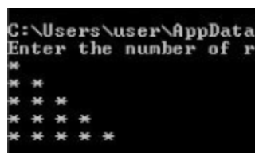
Left Half Pyramid
#Program to print Left Half Pyramid
num_rows = int(input("Enter the number of rows")); k = 1
for i in range(0, num_rows):
for j in range(0, k):
print("* ", end="")
k = k + 1
print()

Slide 14
Bubble Sort
# List of numbers to be sorted
numbers = [64, 25, 12, 22, 11]
# Get the length of the list
n = len(numbers)
for i in range(n):
# Last i elements are already in place, so we don't need to check them again
for j in range(0, n - i - 1):
# Swap if the element found is greater than the next element
if numbers[j] > numbers[j + 1]:
numbers[j], numbers[j + 1] = numbers[j + 1], numbers[j]
# Print the sorted list
print("Sorted list:")
for num in numbers:
print(num, end=" ")

Slide 15
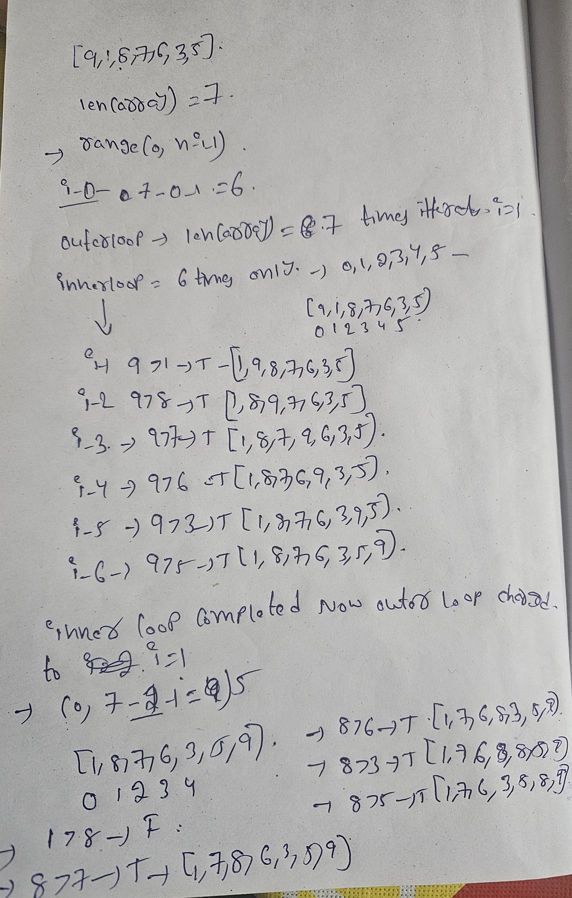
Bubble Sort

Slide 16
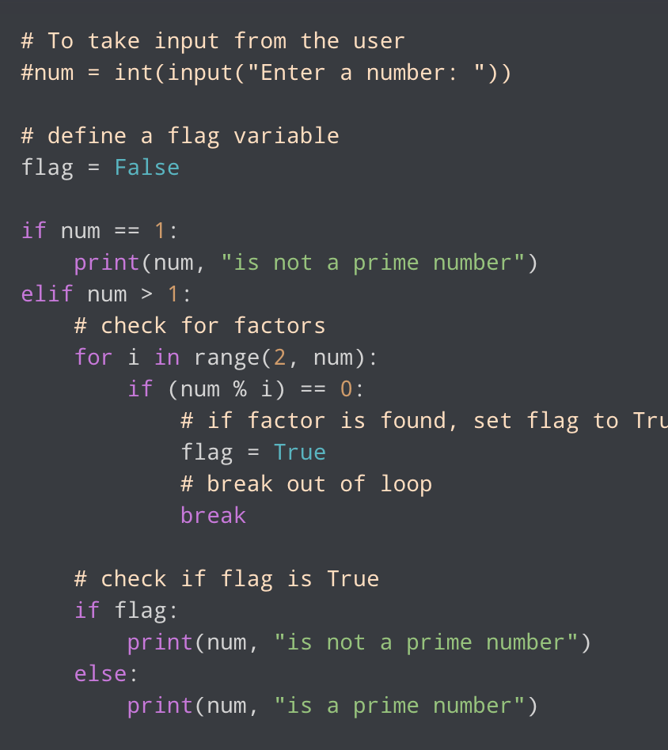
Prime number
A positive integer greater than 1 which has no other factors except 1 and the number itself is called a prime number. 2, 3, 5, 7 etc. are prime numbers as they do not have any other factors.

Slide 17
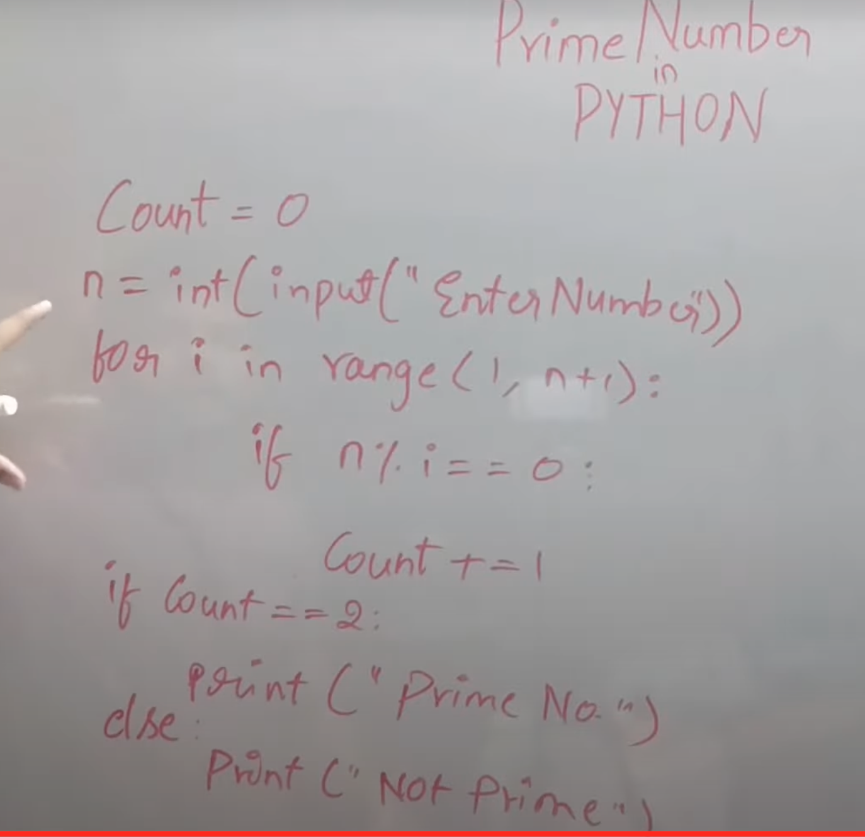
Prime number by giving a number as input n+1 if u give 5 as input and suppose if u give n as range it itterates till 4 only.

Slide 18
Prime numbers within a range
else block that executes when the loop completes its iterations without encountering a break statement.
for i in range(2, 2): ?
for i in range(2, 2): won't execute the loop because there are no elements within the range. There are no values between 2 and 2 (exclusive) to iterate over. Hence, it won't print anything or execute any code within the loop.
If you try for i in range(2, 1):, it won't print anything because the range is empty. The range(2, 1) specifies a range that starts at 2 but ends before reaching 1. Since the starting value (2) is greater than or equal to the ending value (1), it doesn't generate any values within the range. Empty range
There is line called for i in rage(2,num) here lets take 2,5 in this case loop will iterate till to 4 only lets take 5 as input 2,5 but it iterate over to 4 if condition checks >1 and it checks 3,4 in between these are not factors so its prime number we are not checking the number we give as prime number says its divisible by and itself if it found any other factors in between them break it out and say its not prime number.

Slide 19
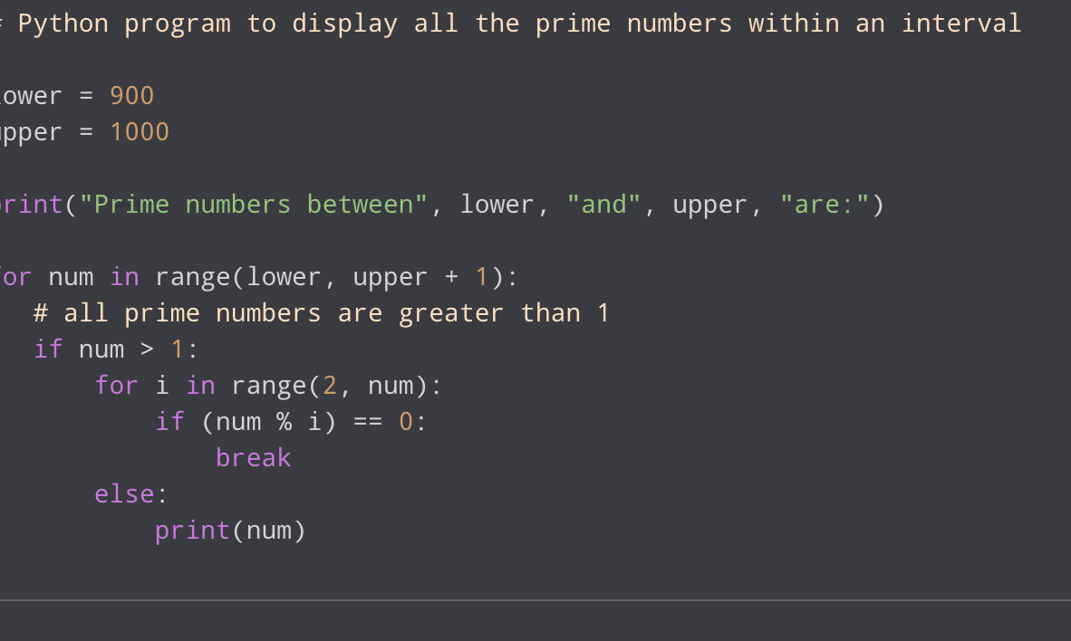

Slide 20
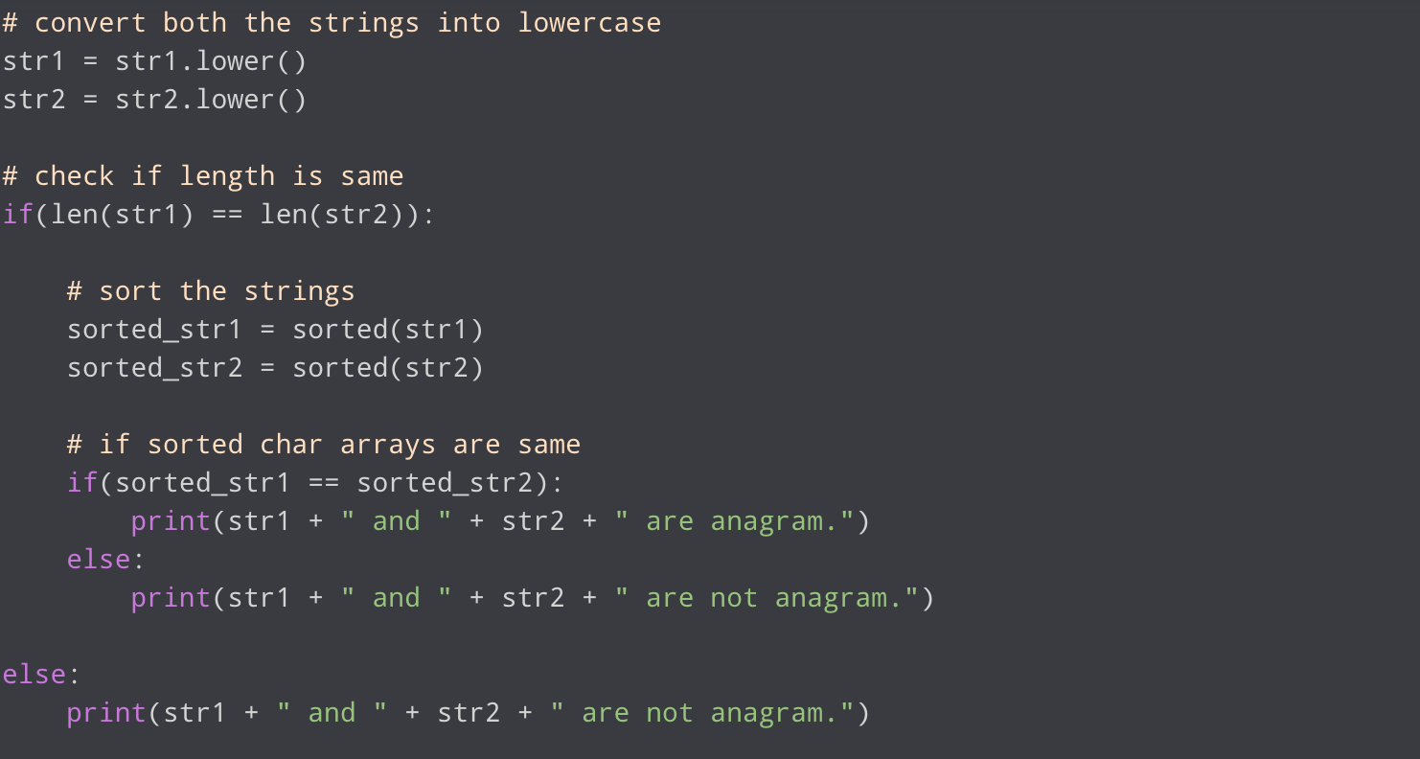
Anagram
An anagram of a string is another string that contains same characters, only the order of on both strings,characters can be different. For example, “abcd” and “dabc” are anagram of each other. Examples: Input : str1 = “abcd”, str2 = “dabc” Output : True Input : str1 = “abcf”, str2 = “kabc” Output : False.

Slide 21
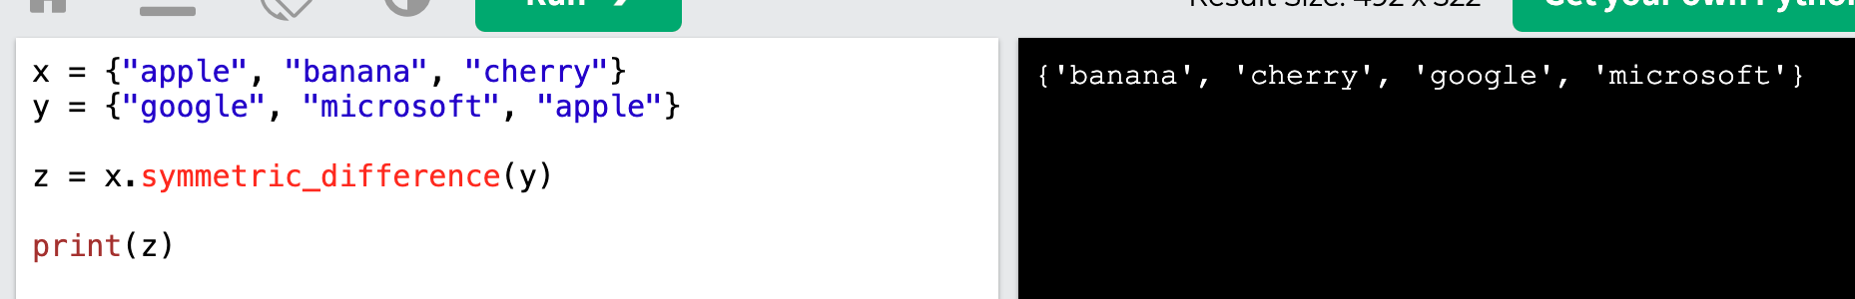
Symmetric Difference
Return a set that contains all items from both sets, except items that are present in both sets:

Slide 22
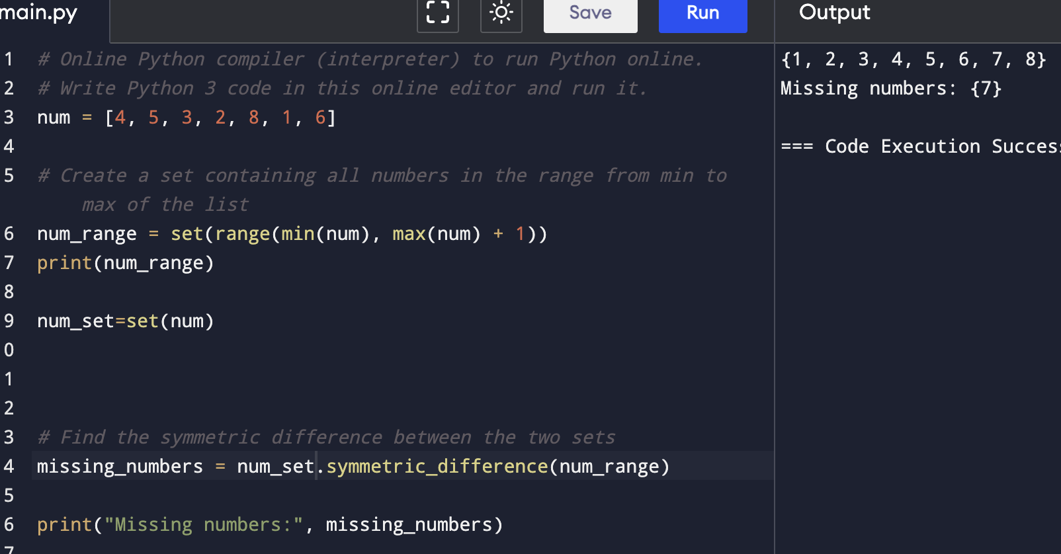
Find missing number in list

Slide 23
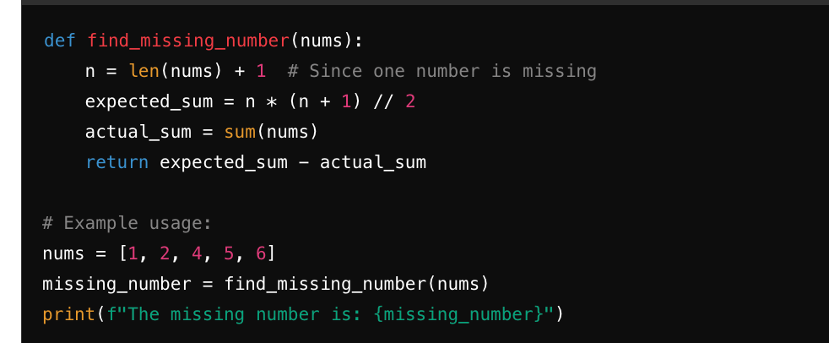
Find missing number in list

Slide 24
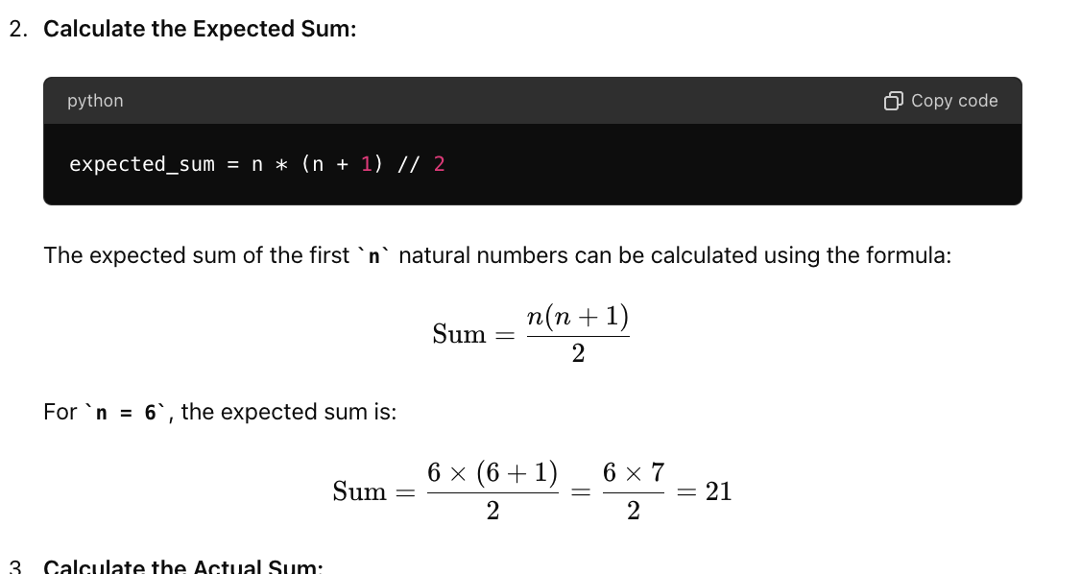
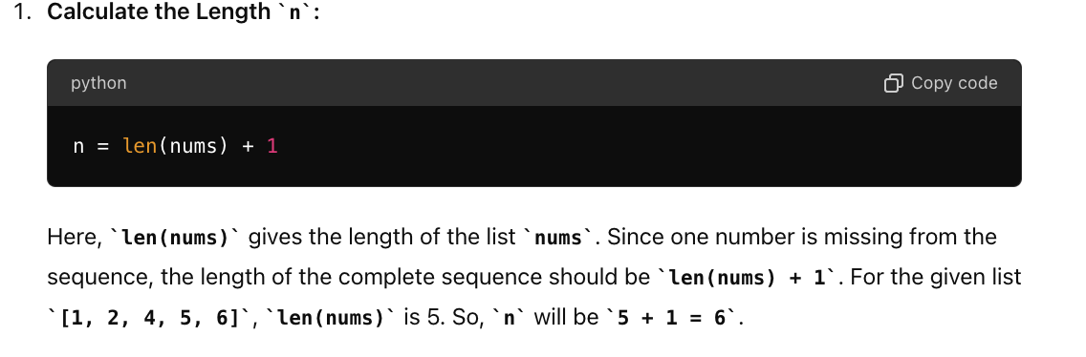
Find missing number in list

Slide 25
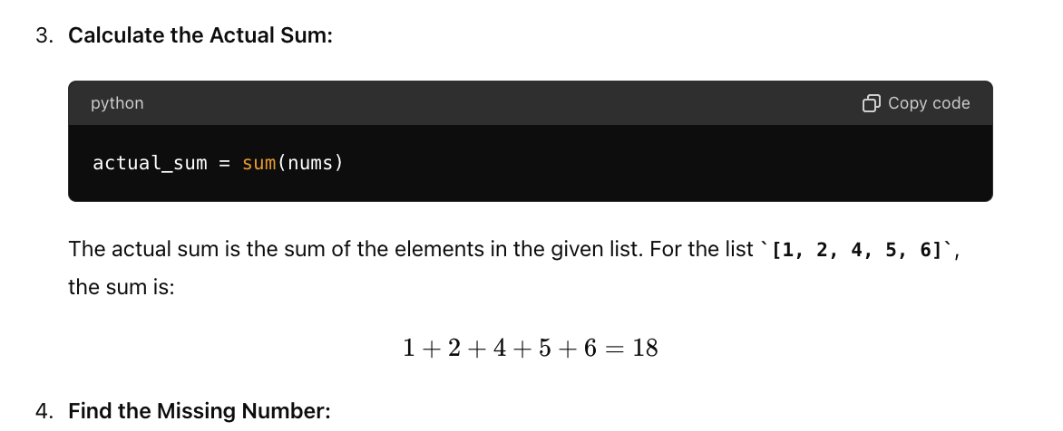
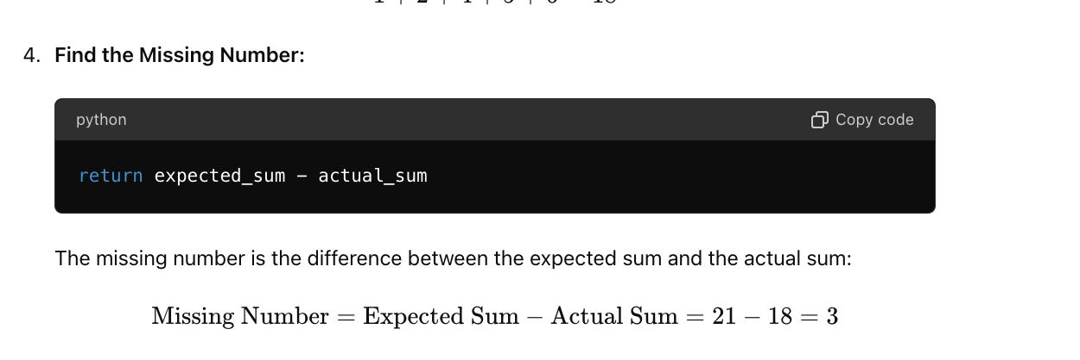
Find missing number in list

Slide 26
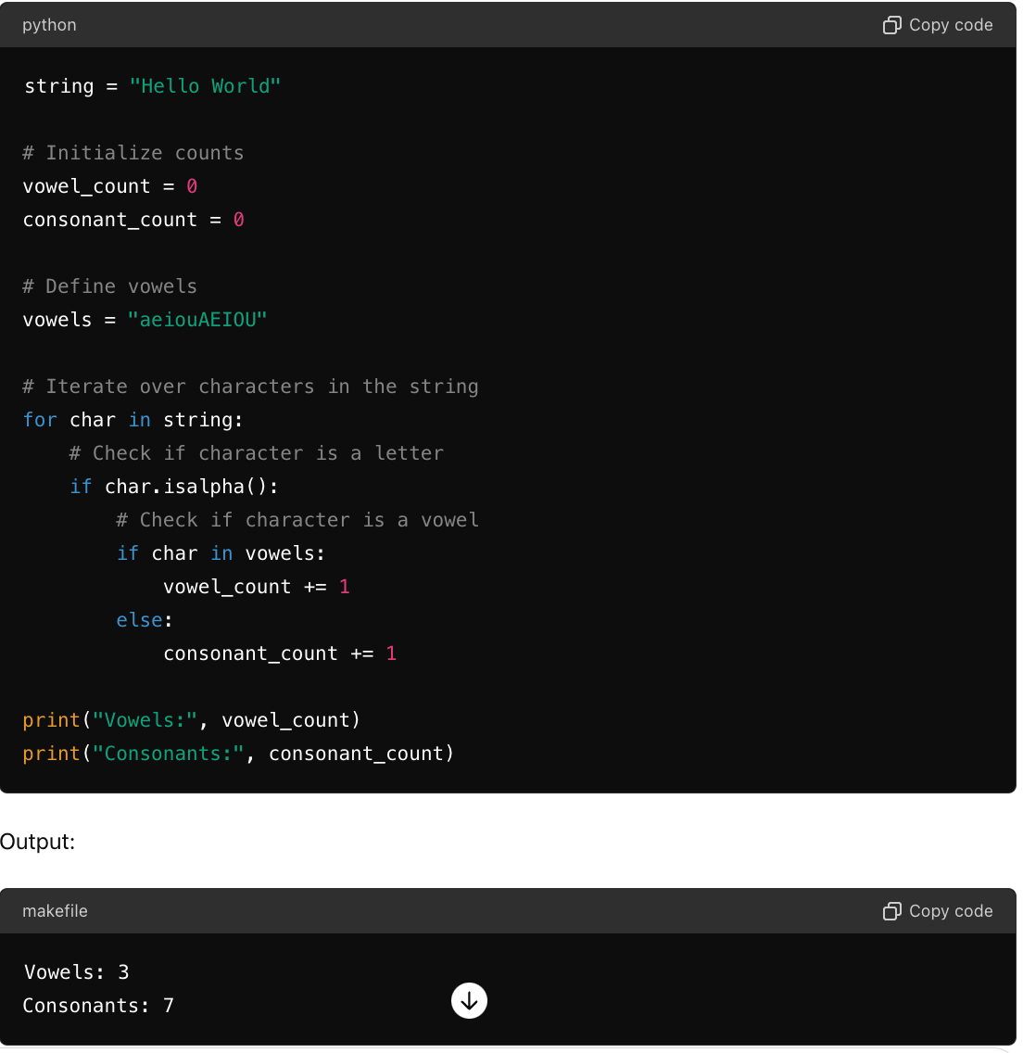
Find vowels and consonents counts

Slide 27
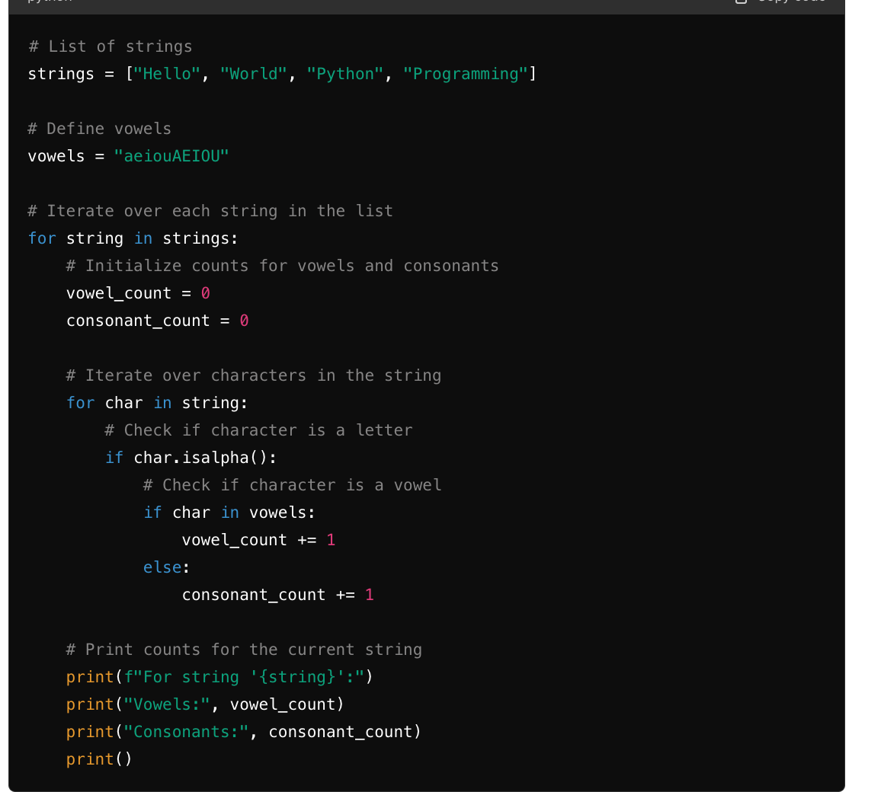
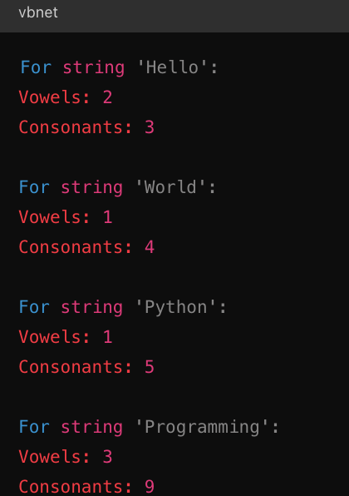
2nd type Input using list

Slide 28
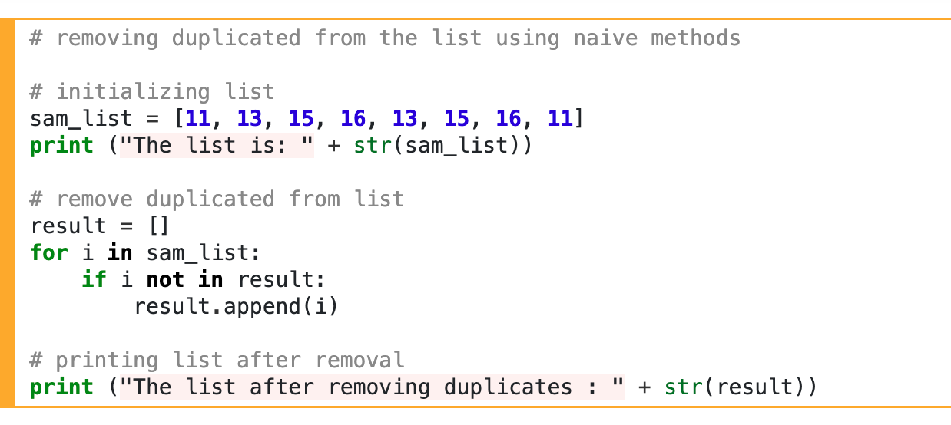
Remove duplicate elements

Slide 29
Find duplicates
l = [1, 2, 3, 4, 5, 2, 3, 4, 7, 9, 5]
l1 = []
duplicates = []
for i in l:
if i not in l1:
l1.append(i)
else:
duplicates.append(i)
print("Duplicated elements: ", " ".join(map(str, duplicates)))
Here, the list (l1) has no duplicates. The values printed are the duplicates from list (l).

Slide 30
Find Duplicates in String
input_string = 'geeksforgeeks’
O/P-egsk
# Create an empty list to store duplicates
x = []
for i in input_string:
# Check if the character is not already in the list and if it is repeated
if i not in x and input_string.count(i) = 1:
x.append(i)
# Print the repeated characters
print(" ".join(x))
The expression " ".join(x) is used to concatenate the elements of the list x into a single string, with each element separated by a space.

Slide 31
2nd largest number in list
def calc_largest(arr):
second_largest = arr[0]
largest_val = arr[0]
for i in range(len(arr)):
if arr[i] > largest_val:
largest_val = arr[i]
for i in range(len(arr)):
if arr[i] > second_largest and arr[i] != largest_val:
second_largest = arr[i]
return second_largest
print(calc_largest([20, 30, 40, 25, 10]))

Slide 32
Reverse string
In the first iteration, 'N' is added to reversed_str.
In the second iteration, 'i' is added before 'N' in reversed_str.
This process continues until all characters from my_string are added to reversed_str in reverse order.
my_string=("Nitesh Jhawar")
str=""
for i in my_string:
str=i+str
print("Reversed string:",str)
i-1->str=N+0
i-2>str=i+N

Slide 33
Question
d = {"name": "hello"}
Output-n:hello,a:hello,m:hello,e:hello
result_str = ",".join(f"{char}:{d['name']}" for char in "name")
print(result_str)

Slide 34
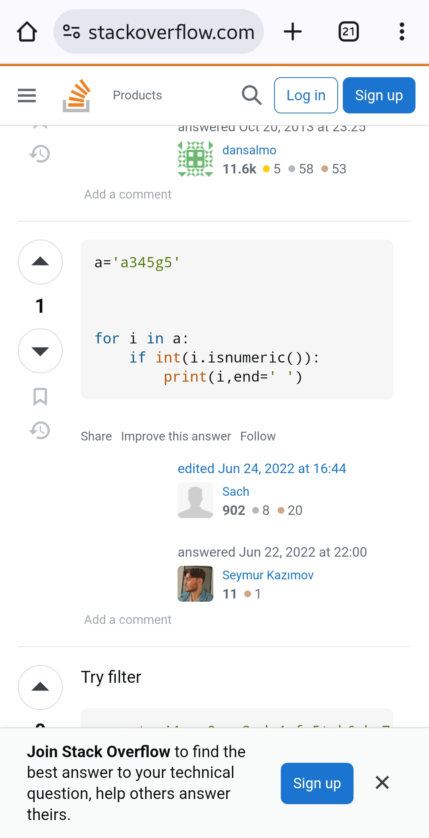
Print only numbers in list

Slide 35
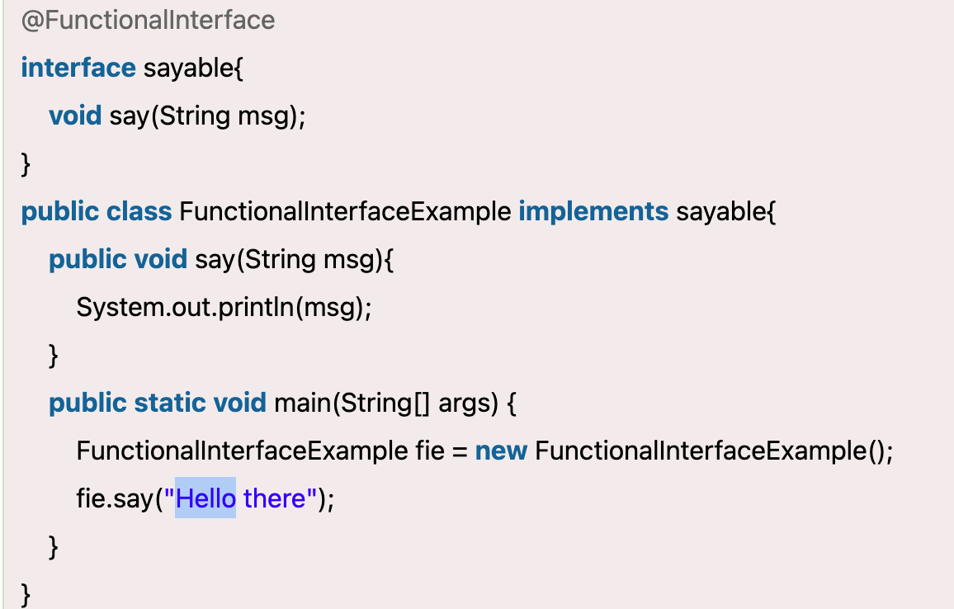
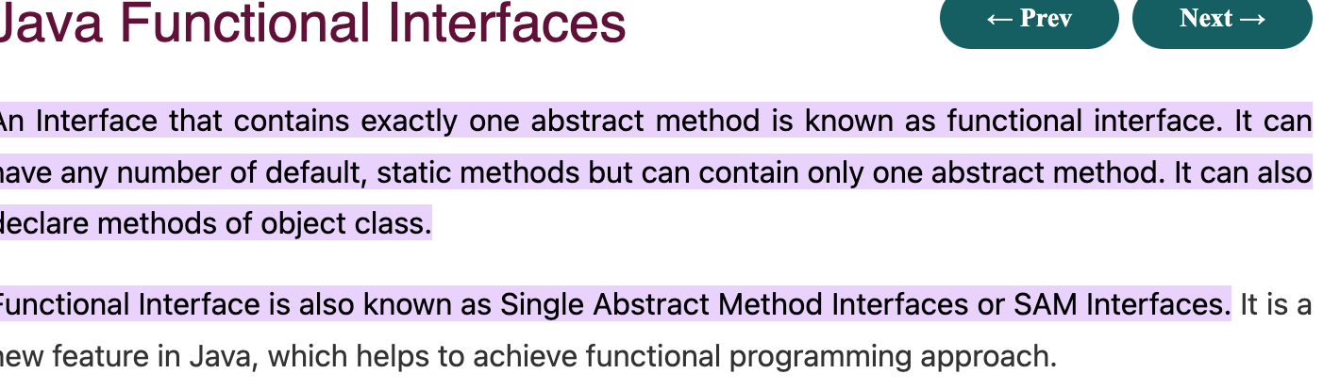
Functional Interfaces

Slide 36
Lambda Expression
Why use Lambda Expression
To provide the implementation of Functional interface.
Less coding.
(argument-list) -> {body}
A lambda expression is a short block of code which takes in parameters o no params and returns a value.
Lambda expressions are similar to methods, but they do not need a name and they can be implemented right in the body of a method.

Slide 37
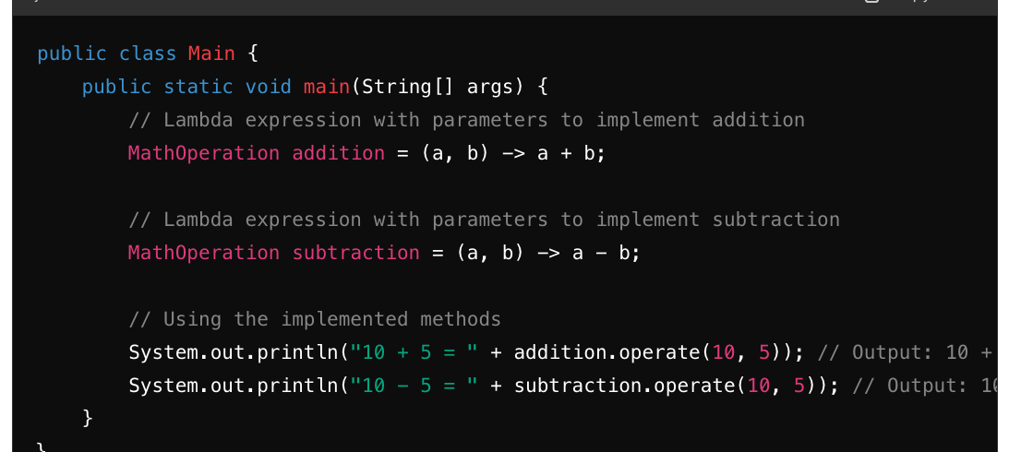
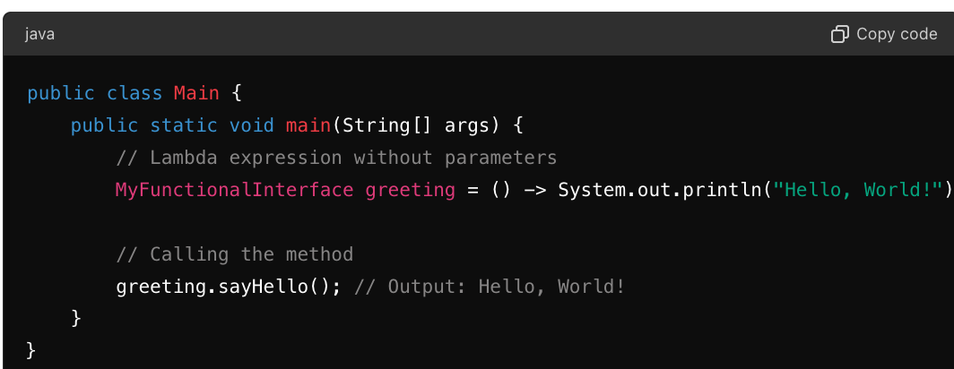
Lambda Expression

Slide 38
Java-8
In Java, a functional interface is an interface that has only one abstract method. These interfaces are also known as Single Abstract Method (SAM) interfaces
Single Abstract Method (SAM): A functional interface must have exactly one abstract method. It can have any number of default or static methods, but only one abstract method.
Lambda Expression Compatibility: Functional interfaces are designed to work seamlessly with lambda expressions. You can use a lambda expression to implement the single abstract method of a functional interface, providing a more concise way to create instances of the interface.

Slide 39
Java-8
In Java 8, lambda expressions were introduced as a way to write more concise and expressive code for working with functional interfaces (interfaces with a single abstract method). Lambda expressions allow you to define inline, anonymous functions without the need to create a separate class or method.
(parameters) -> expression
Using a lambda expression to define a Comparator for sorting strings in descending order
Comparator<String> descendingOrder = (s1, s2) -> s2.compareTo(s1);
List<String> names = Arrays.asList("Alice", "Bob", "Charlie", "David");
names.sort(descendingOrder);
System.out.println(names); // Output: [David, Charlie, Bob, Alice]

Slide 40
Abstraction
Syntax For Array
dataType[] arrayName = new dataType[size];
Abstraction
In object oriented programming, abstraction is defined as hiding the unnecessary details (implementation) from the user and to focus on essential details (functionality).
For loop
for (int i = 0; i < 5; i++) {
System.out.println(i);
}

Slide 41
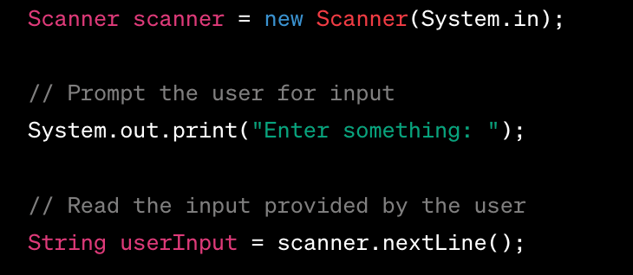
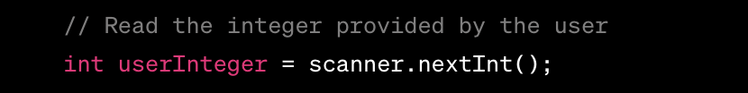
Scanner

Slide 42
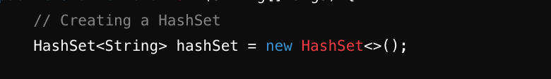
Collections
ArrayList: A resizable array implementation of the List interface.
A HashMap however, store items in "key/value" pairs, and you can access them by an index of another type (e.g. a String)
A HashSet is a collection of items where every item is unique
HashSet allows null value.
HashSet stores the elements by using a mechanism called hashing.
ArrayList in Java allows duplicates.

Slide 43
How Does Hashmap work internally
HashMap use singly linked list to store elements, these are called bins or buckets. When we call put method, hashCode of key is used to determine the bucket that will be used to store the mapping. Once bucket is identified, hashCode is used to check if there is already a key with same hashCode If there is an existing key with same hashCode, then value is overwritten, otherwise a new mapping is made to this singly linked list bucket

Slide 44
How does Arraylist increase
When we add an element to an ArrayList, it first checks to see whether the array has enough capacity to contain the new element.
If it doesn't, the new capacity is computed, which is 50% higher than the previous capacity, and the array is expanded by that amount
Internally an ArrayList uses an Object[] Array which is an array of objects. All operation like deleting, adding, and updating the elements happens in this Object[] array.
The default capacity of an ArrayList in Java is 10. This means that when an ArrayList is created using the default constructor, it initially allocates enough space to hold 10 elements.

Slide 45
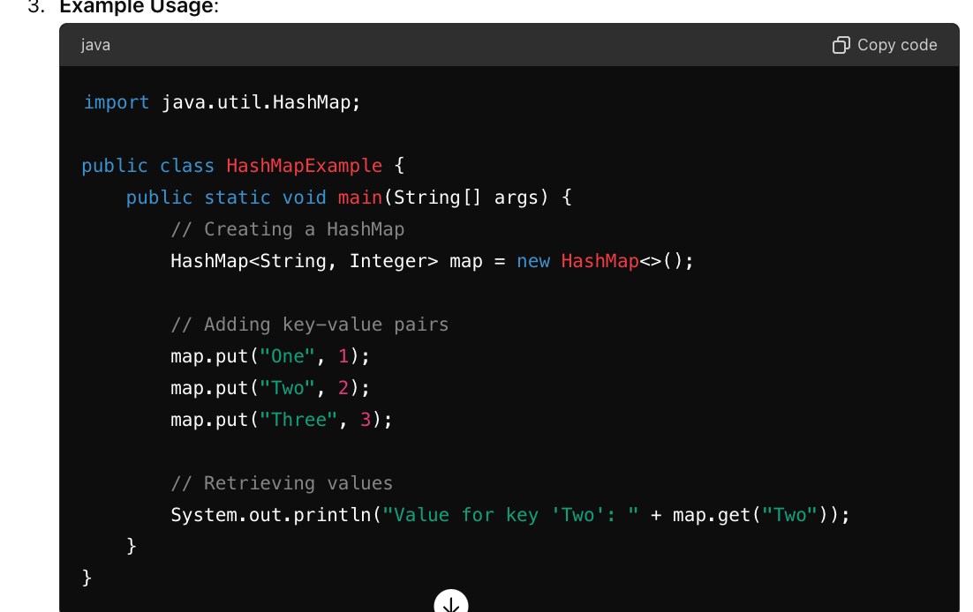
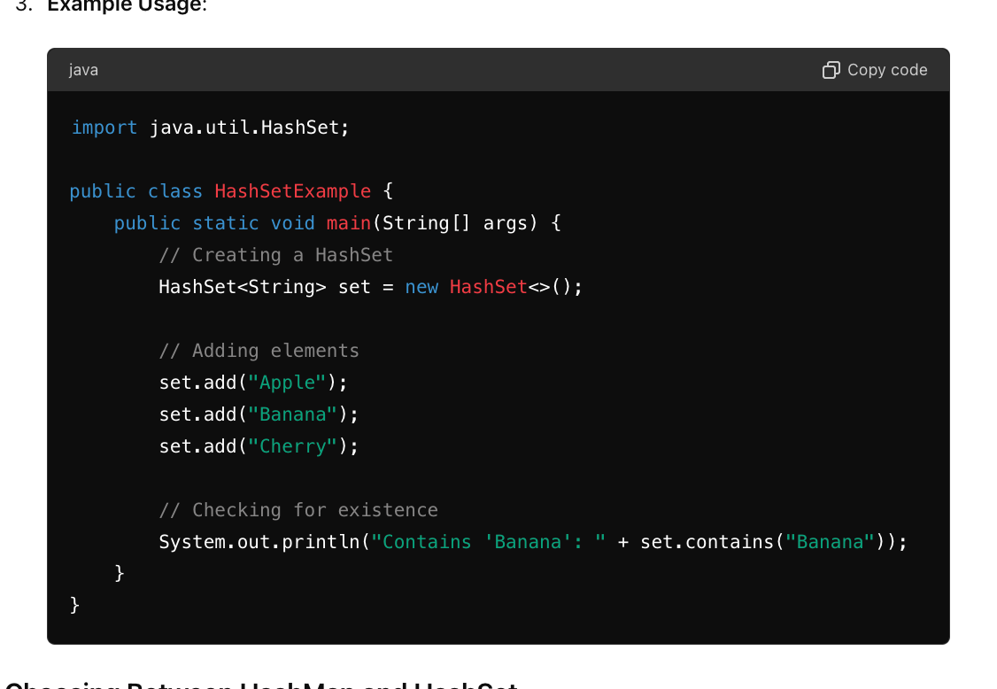
Collection

Slide 46
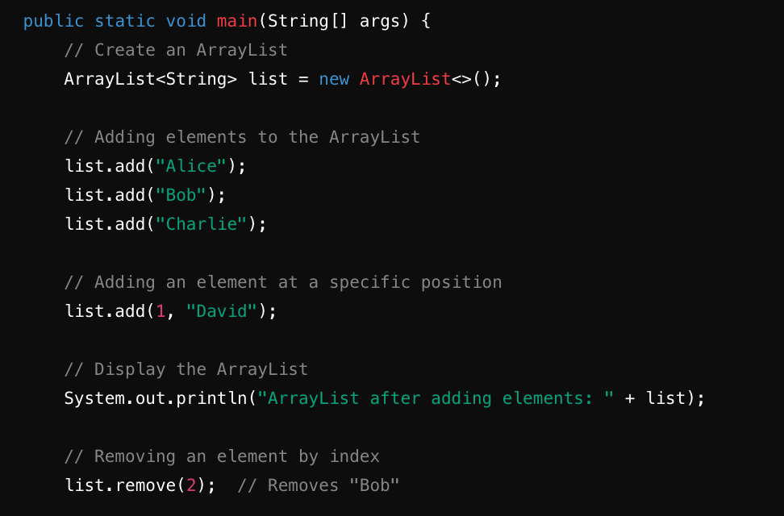
Collection

Slide 47
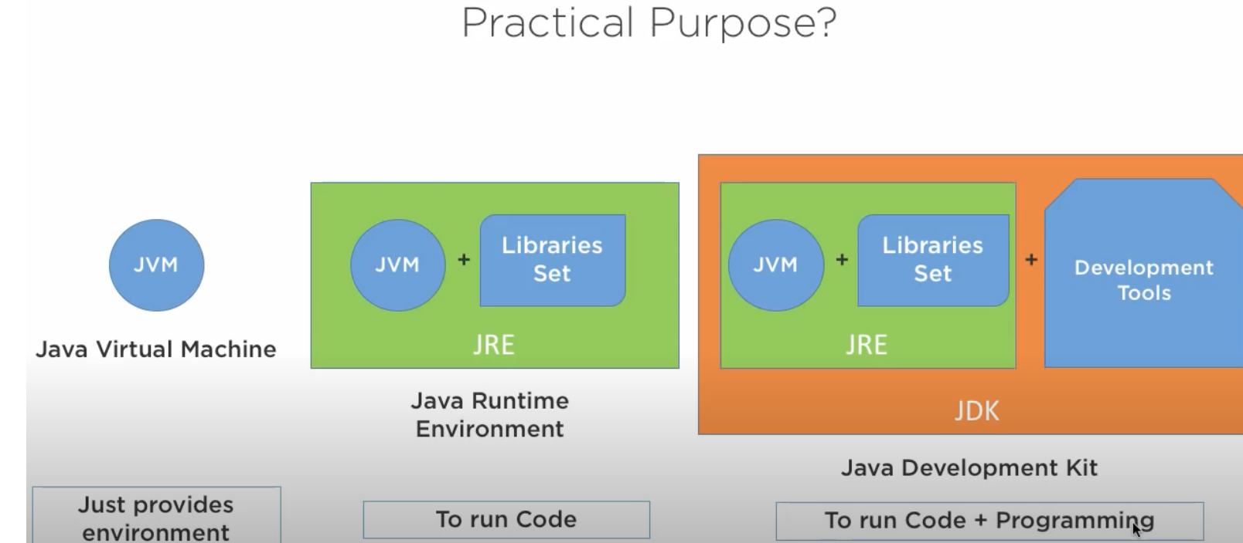
JDK VS JRE VS JVM

Slide 48
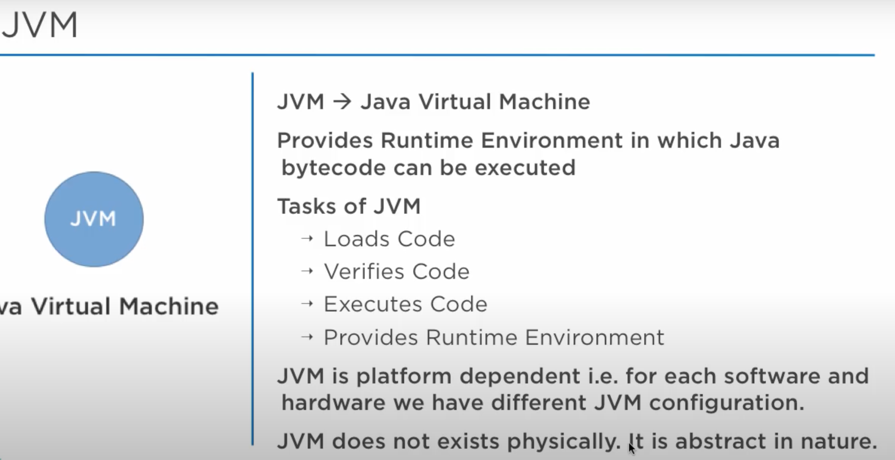
JDK VS JRE VS JVM

Slide 49
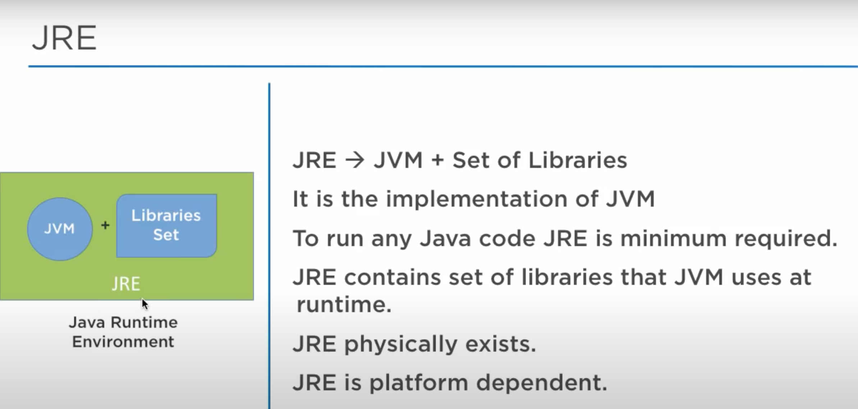
JRE- It is used to provide the runtime environment

Slide 50
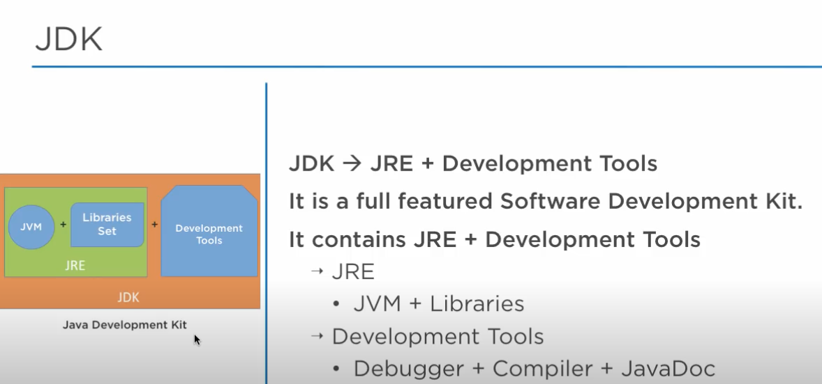
JDK VS JRE VS JVM

Slide 51
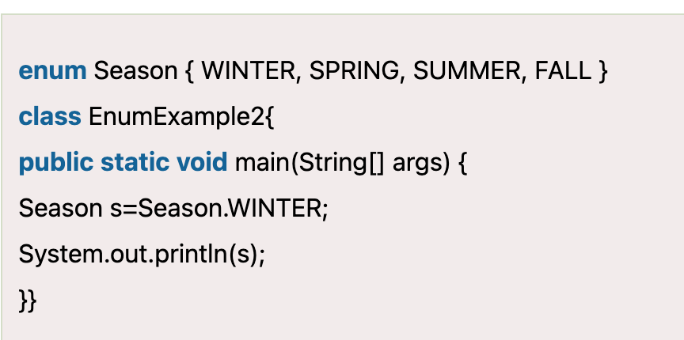
Enum
The Enum in Java is a data type which contains a fixed set of constants.
Ensures that variables only take predefined values.
Java Enum internally inherits the Enum class, so it cannot inherit any other class, but it can implement many interfaces. We can have fields, constructors, methods, and main methods in Java enum.
Readability: Enhances code readability by giving meaningful names to constants.
List of named constants.
Enum is a class that’s why we
have created & accessed with
the name of enum class

Slide 52
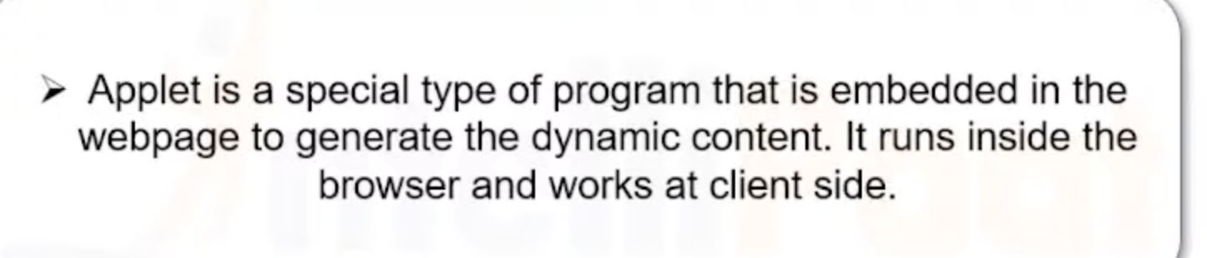
Applet

Slide 53
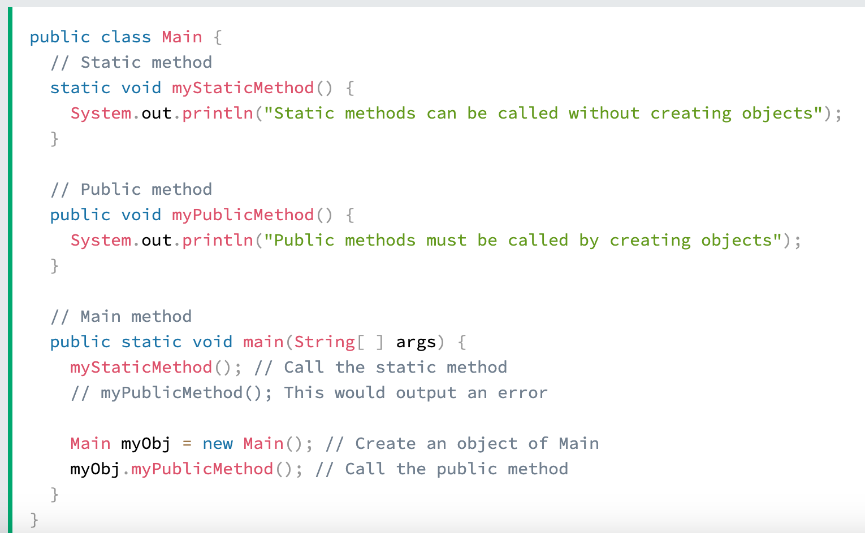
Static
The static keyword used for methods and attributes. Static methods/attributes can be accessed without creating an object of a class.
Static methods and static blocks cannot use the this or super keywords as they do not belong to any instance.

Slide 54
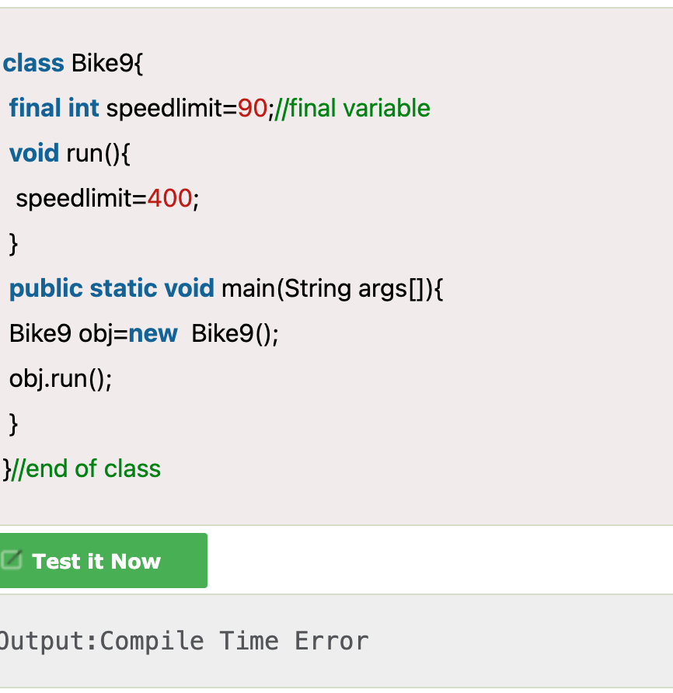
Final
If you make any variable as final, you cannot change the value of final variable(It will be constant).
If you make any class as final, you cannot extend it.
If you make any method as final, you cannot override it.
In Java, the final keyword is used to apply restrictions on classes, methods, and variables.
Python does not have a keyword "final".

Slide 55
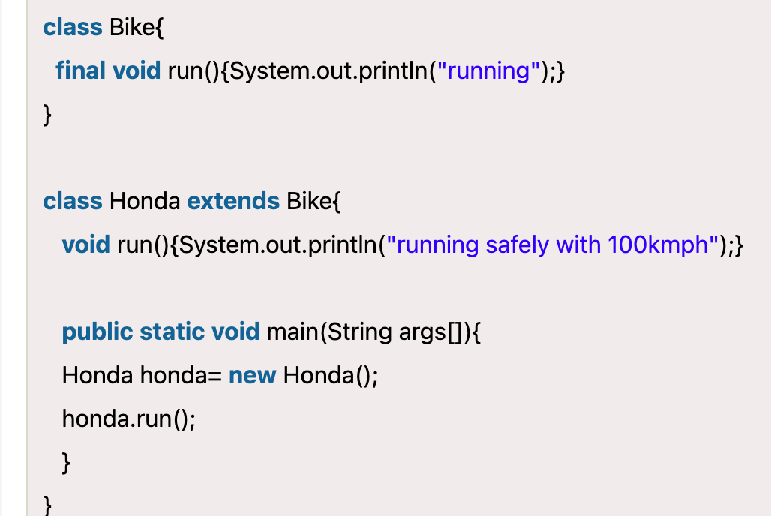
Final

Slide 56
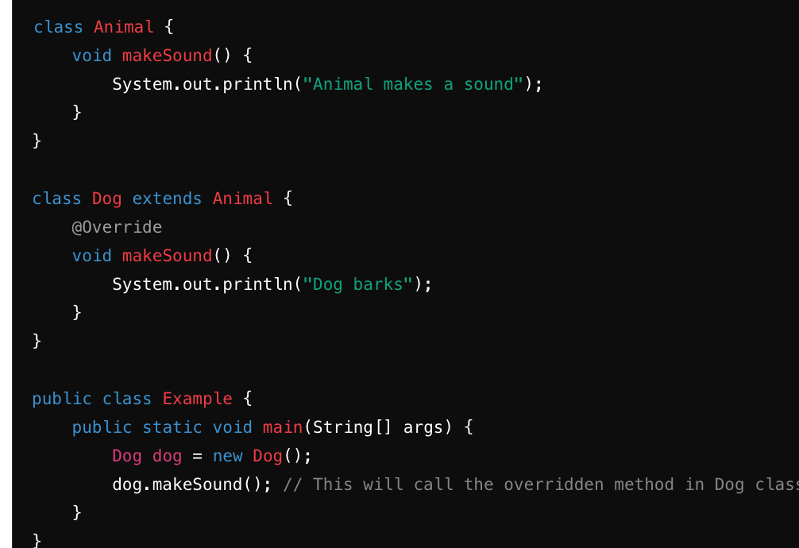
Method Overriding

Slide 57
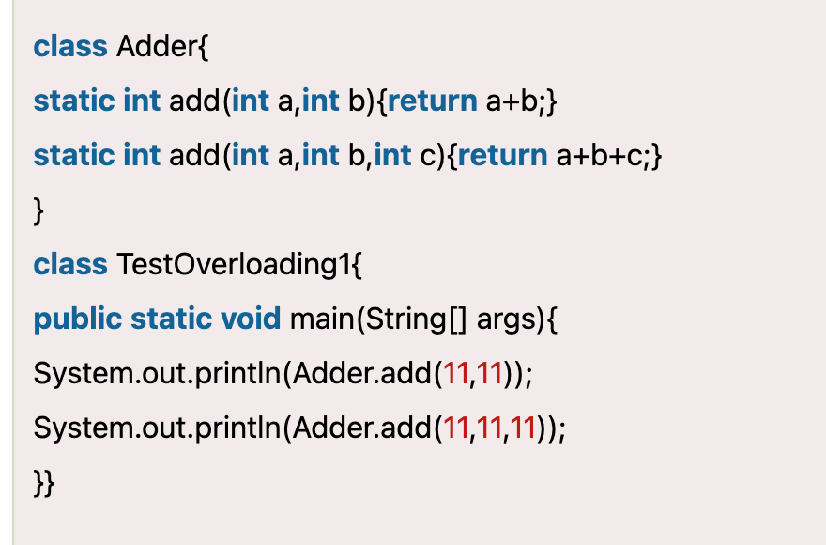
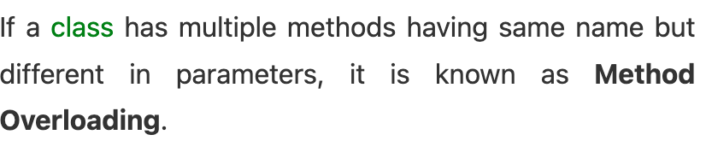
Method Overloading

Slide 58
Method Overloading
No, in Java, you cannot have a method in a subclass with the exact same name and parameter types as a method in its superclass. This violates the rule of method overriding, which requires that the overriding method in the subclass must have a signature (method name and parameter types) that matches exactly with the method being overridden in the superclass.

Slide 59
Encapsulation
Encapsulation in Java is a process of wrapping code and data together into a single unit, for example, a capsule which is mixed of several medicines.
We can create a fully encapsulated class in Java by making all the data members of the class private. Now we can use setter and getter methods to set and get the data in it.
In Java, getters and setters are methods used to access and modify the private fields (instance variables) of a class.
Access Control: Getters (or accessor methods) allow reading the value of a private variable, while setters (or mutator methods) allow modifying the value of a private variable. This indirect access ensures that internal state changes are controlled and validated.

Slide 60
Polymorphism
Polymorphism in Java is a concept by which we can perform a single action in different ways. Polymorphism is derived from 2 Greek words: poly and morphs. The word "poly" means many and "morphs" means forms. So polymorphism means many forms.
Polymorphism is achieved through method overriding and method overloading.

Slide 61
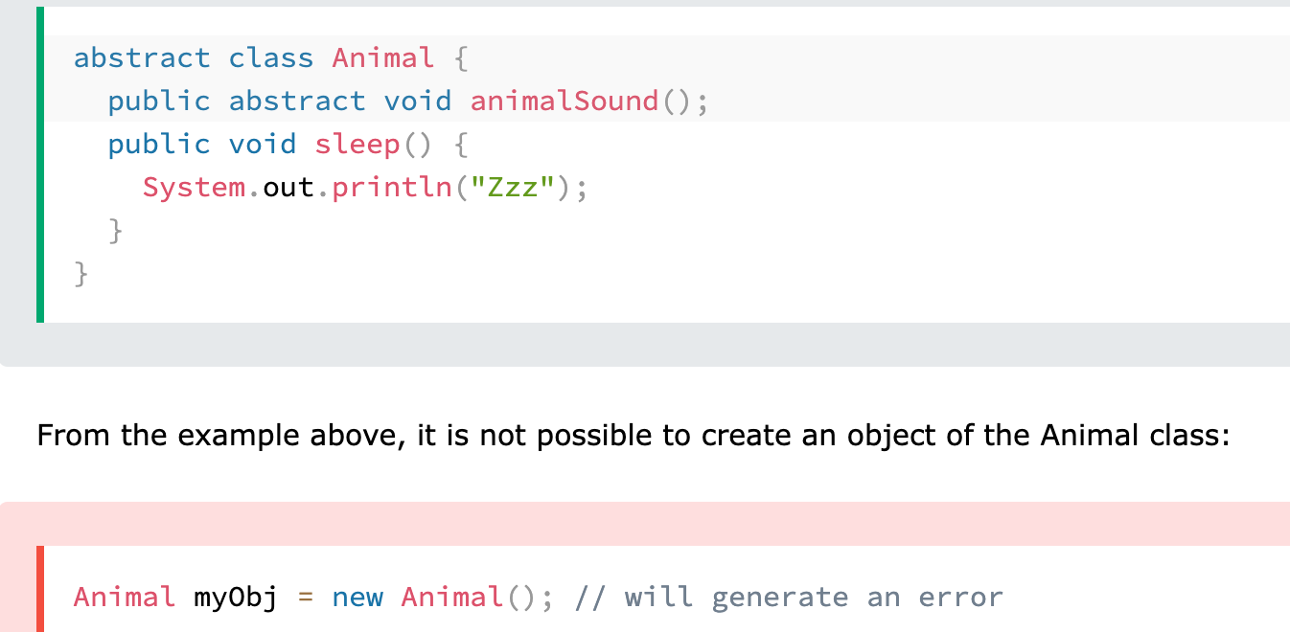
Abstraction
Data abstraction is the process of hiding certain details and showing only essential information to the user.
Abstract class: is a restricted class that cannot be used to create objects (to access it, it must be inherited from another class). Abstract method: can only be used in an abstract class, and it does not have a body. The body is provided by the subclass (inherited from).

Slide 62
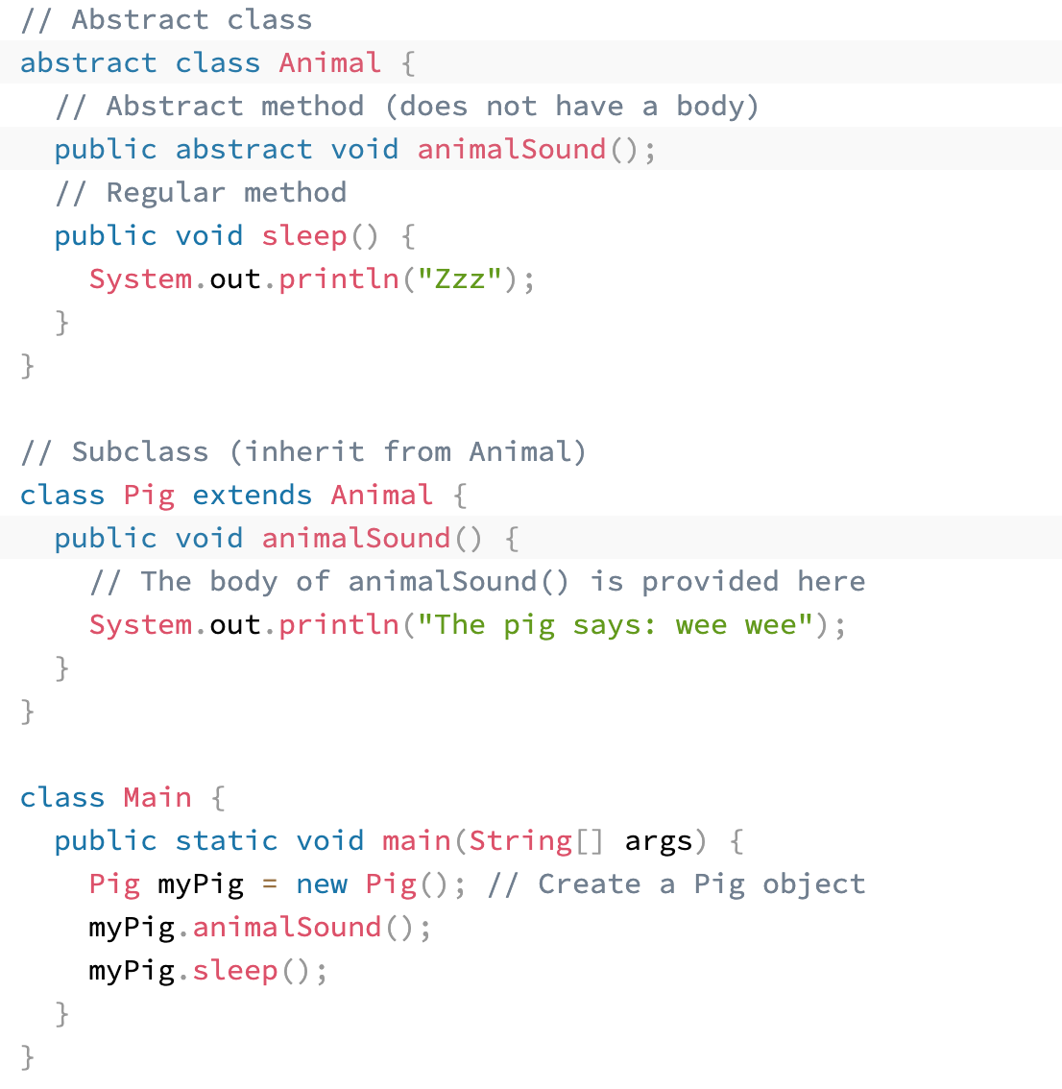
Abstraction

Slide 63
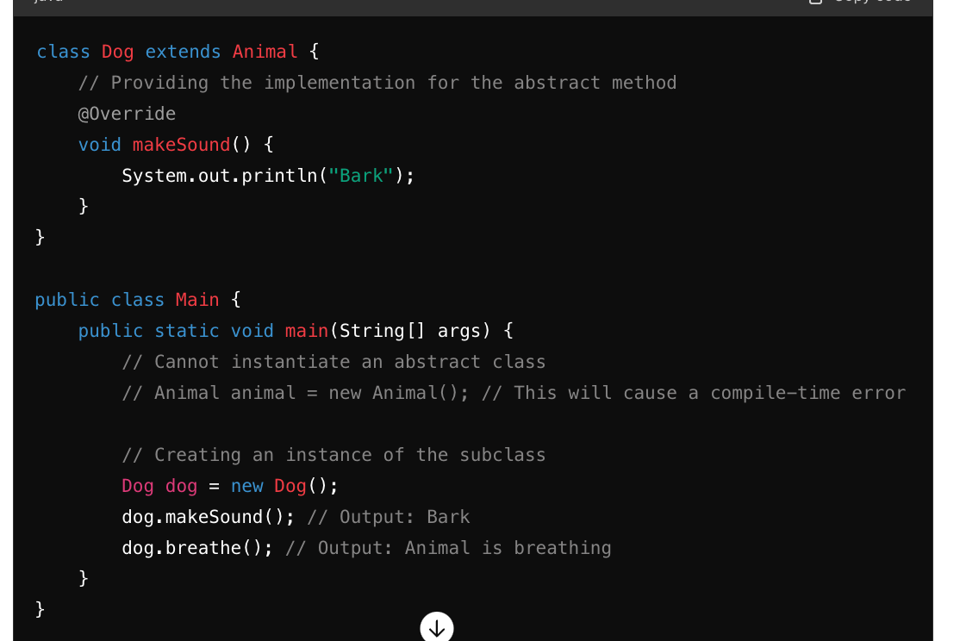
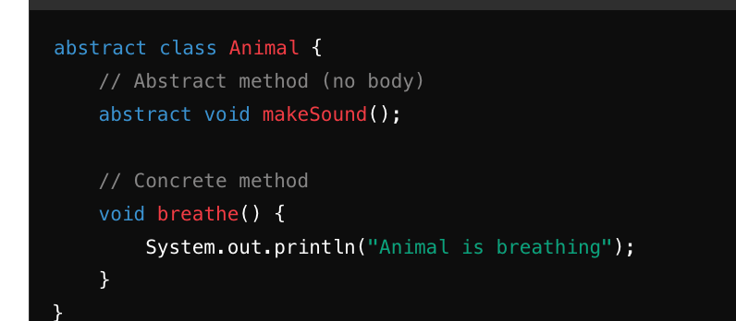
Abstract Methods

Slide 64
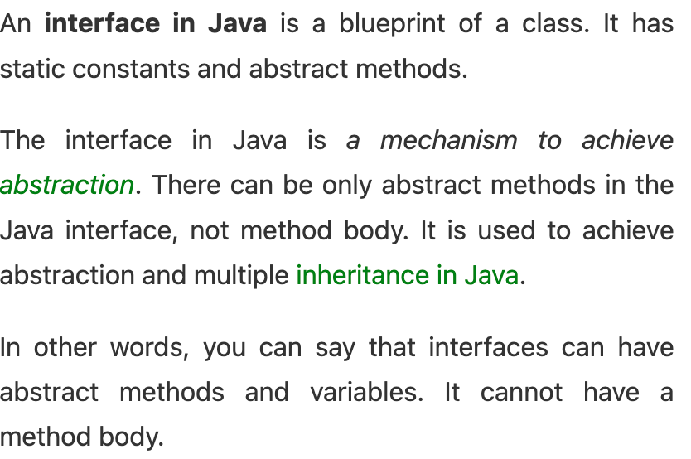
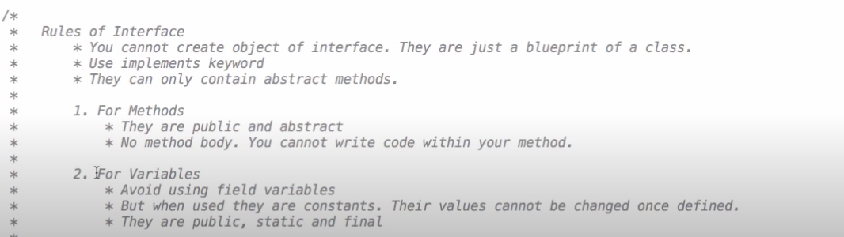
Intefaces

Slide 65


Interfaces

Slide 66

Multiple inheritance by interface

Slide 67

Instance varibles
These are declares inside a class but outside a method.

Slide 68


Cheked Exception

Slide 69


Unchecked exception

Slide 70
Decorators
def my_decorator(func):
def wrapper():
print("Something is happening before the function is called.")
func()
print("Something is happening after the function is called.")
return wrapper
@my_decorator
def say_hello():
print("Hello!")
say_hello()
https://www.youtube.com/watch?v=oAz8wz7ClMA

Slide 71
Wrapper and Decorators
They are functions themselves that take another function as an argument and typically return a new function,
A function that modifies the behaviour of other function
The wrapper function serves as an intermediate function that wraps around the original function being decorated. This intermediary allows the decorator to modify or enhance the behavior of the original function without directly altering its code.

Slide 72

Iterator
Lazy Evaluation: Iterators use lazy evaluation, meaning they produce values only when requested. This can be beneficial when dealing with large datasets or infinite sequences where loading all elements into memory at once is not feasible.
Memory Efficiency: Iterators can be more memory-efficient compared to creating an entire list or sequence in memory, especially when dealing with large datasets.

Slide 73

Iterator

Slide 74
Iterator-Example.

Slide 75

Generator
In Python, a generator is a special type of iterator that is created using functions and the yield keyword. Generators allow you to generate a sequence of values lazily, on-the-fly, rather than computing and storing the entire sequence in memory upfront.
https://www.youtube.com/watch?v=E20azLHxUH8

Slide 76


Generator

Slide 77


Generator

Slide 78


Generator
Produce items one at a time only when it called or required.
Only when next method called.

Slide 79

Generator
Return Value:
Normal Function: Returns a single value using the return statement.
Generator: Yields multiple values using the yield statement. It can yield values multiple times, allowing for the generation of sequences.

Slide 80
Generator
Generators save memory efficiently in Python due to their lazy evaluation nature and ability to generate values on-the-fly.
Lazy Evaluation: Generators use lazy evaluation, meaning they produce values only when requested. Unlike functions that compute and store all values in memory upfront, generators generate values one at a time as they are consumed. This avoids the need to allocate memory for the entire sequence upfront, which can be impractical or even impossible for large datasets.

Slide 81
Generator

Slide 82

Strftime
Strftime
The strftime converts date object to a string date.

Slide 83

Strptime
Strptime python is used to convert string to datetime object.

Slide 84

timedelta()
timedelta() function is present under datetime library which is generally used for calculating differences in dates and also can be used for date manipulations in Python. It is one of the easiest ways to perform date manipulations.
past_date1 = time_now - timedelta(days=189)
print(past_date1)
# Sample Output 2020-12-15 17:49:18.574503

Slide 85


datetime
The datetime class itself represents a specific point in time, including both a date and a time component.

Slide 86
Shallow copy vs deep copy
a=[1,2,3,4]
b=a
b[0]=0
print(a)
Output is [0,2,3,4] but if u print b also you will get same result as output [0,2,3,4] this is happening because both the lists refering to same memory so if u make any changes to any of the list it modifies another lists as well

Slide 87

Shallow copy vs deep copy
To avoid this and keeping list as orginal we have two types of copies
Shallow copy
In this example it does not
changed original list copy.
List a was copied to another
Memory location.

Slide 88

Shallow copy vs deep copy
In normal list both deep copy and shallow copy is same.
But when it comes to nested list here the difference comes.
In below example both the lists were modified by using copy method.

Slide 89

Shallow copy vs deep copy
But with deep copy the original list wont be modified.
https://www.youtube.com/watch?v=SgUwPDT9tEs

Slide 90

Shallow copy vs deep copy
Varible is changed it changes only the modified list and keeping other one as unchanged.

Slide 91

Merge two dictionaries in single line

Slide 92

Merge two dictionaries in single line

Slide 93

Merge two dictionaries in single line

Slide 94

Merge two dictionaries in single line-Method -2 Same it overwrites just like **

Slide 95

Sort a list of dictionary by a specific key

Slide 96



__new__
__new__ is a method that's called to create a new instance of a class.
It's responsible for creating and returning a new instance of the class.
The method takes the class as its first argument, followed by any additional arguments that need to be passed to it.

Slide 97

Call A Class Method From Another Class In Python
Let’s consider a scenario where we have two classes, ClassA and ClassB. We want to call a method of ClassA from within ClassB. Here’s how you can achieve this: In this example, ClassB has a method called call_method_from_class_a, and within this method, we call the method_in_class_a of ClassA using ClassA.method_in_class_a().

Slide 98

Super
Super() is used for invoking methods of a superclass within a subclass, extension in inheritance hierarchies.

Slide 99


Super

Slide 100

Codes
CREATE A LIST USING RANGE in python
# Create a list of numbers from 0 to 9 (excluding 10)
my_list = list(range(10))
print(my_list)
itterate over a list and find cubes

Slide 101

Codes
Insert the element at specified index

Slide 102


Append vs Extend

Slide 103
Remove Element At Specified Index
my_list = [1, 2, 3, 4, 5]
# Remove the element at index 2
removed_element = my_list.pop(2)
print("List after removal:", my_list)
# Output: List after removal: [1, 2, 4, 5]
Drop duplicates
from collections import OrderedDict my_list = [1, 2, 3, 2, 4, 3, 5] deduplicated_list = list(OrderedDict.fromkeys(my_list))

Slide 104

Square Of a number
result=[x ** 2 for x in range(5,20) if x%2 !=0]
Sort
Sorted(result)
Flatten the nested list
By using if isinstance(sublist, list):,It just checks whether the element is list or not, the code ensures that it only attempts to iterate over sublist if it is actually a list.
O/P- [1, 2, 3, 4, 5, 6, 7]

Slide 105
Reverse words in sentence
sentence = "Hello world from ChatGPT"
reversed_sentence = [word[::-1] for word in sentence.split()]
print(‘ ‘.join(reversed_sentence))

Slide 106
Codes
Drop duplicates
my_list = [1, 2, 3, 2, 4, 3, 5] deduplicated_list = list(set(my_list))
Read csv file in python
import csv
with open('Giants.csv', mode ='r')as file:
csvFile = csv.reader(file)
for lines in csvFile:
print(lines)

Slide 107
Write
with open('names.csv', 'w', newline='') as csvfile:
fieldnames = ['first_name', 'last_name’]
writer = csv.DictWriter(csvfile, fieldnames=fieldnames)

Slide 108
Python lists vs tuple In detail
Lists consume more memory than tuples because As the list grows, additional memory is allocated to accommodate more elements.
In tuples, Python can allocate exactly the amount of memory required for the elements they contain, with
Lists are designed to grow and shrink as elements are added or removed. To efficiently handle this, lists typically allocate more memory than currently needed to accommodate future growth without needing frequent reallocations. This extra allocated space is known as over-allocation.

Slide 109

Python lists vs tuple In detail

Slide 110
Python lists vs tuple In detail
Tuples does not have many in built methods because of immutability
Lists have several in built methods.
Tuples can be faster in accessing elements than lists in certain operations due to their immutability
Since, tuples cannot be modified, the interpreter can optimize their memory allocation, leading to faster access times.
The internal structure of tuples is simpler because they don’t need to handle dynamic resizing or modification. This simplicity can result in faster execution of certain operations, especially those involving iteration and access.

Slide 111


How to convert immutable tuple to mutable like adding or removing elements

Slide 112


How to convert immutable tuple to mutable like adding or removing elements

Slide 113

ZIP
Pairing Data: Useful for creating pairs of related data points.
This is especially useful for pairing elements from different sequences.
zip(iterable1, iterable2, ...)

Slide 114

ZIP

