Slide 1
CUSTOMER DATA
ANALYSIS
Retail transactions • Customer behaviour • Sales insights
Project Presentation
Prepared from the supplied customer transaction dataset

Slide 2
1. Project Overview
What this project is designed to answer
Compare transaction behaviour by gender and payment method.
Calculate sales KPIs such as total revenue, quantity sold and average transaction value.
Convert raw transaction data into clear insights that can support retail decisions.
Understand customer purchase patterns across product categories and shopping malls.
Tools: CSV dataset, data validation/calculations, and Power BI dashboard (uploaded PBIX).
Customer Data Analytics | 2

Slide 3
2. Dataset Description
Source: customers(3).csv supplied for this project
ROWS / TRANSACTIONS
COLUMNS
UNIQUE CUSTOMER IDS
DATE RANGE
99,457
10
99,457
2021–2023
Records in CSV
10 original fields + derived revenue
IDs in this dataset
Transaction dates
Main fields: invoice_no, customer_id, gender, age, category, quantity, price, payment_method, invoice_date,
shopping_mall.
Derived metric: Revenue = Quantity × Price.
Important interpretation: each row is a transaction record; do not assume it represents a unique person beyond
the ID field.
Customer Data Analytics | 3

Slide 4
3. Data Preparation & Cleaning
Quality checks performed on the supplied CSV
Imported the semicolon-separated CSV correctly into a structured table.
Checked the dataset shape: 99,457 rows and 10 original columns.
Checked missing values: no missing values were detected in the 10 original fields.
Converted invoice_date to a date type for time-based analysis.
Created a Revenue field using quantity × price.
Before final submission, also check duplicates, age range, negative/zero quantity or price, and category
spelling in Power BI.
Customer Data Analytics | 4

Slide 5
4. Key Performance Indicators
Computed from the transaction data
TOTAL REVENUE
QUANTITY SOLD
AVERAGE TRANSACTION
251.51M
298,712
2,528.79
Dataset currency; quantity × price
Total units across transactions
Revenue per row on average
AVERAGE AGE
FEMALE TRANSACTIONS
CASH PAYMENTS
43.4
59,482
44,447
Years
59.8% of records
44.7% of records
Note: currency symbol is not added because the source file does not specify the currency.
Customer Data Analytics | 5

Slide 6
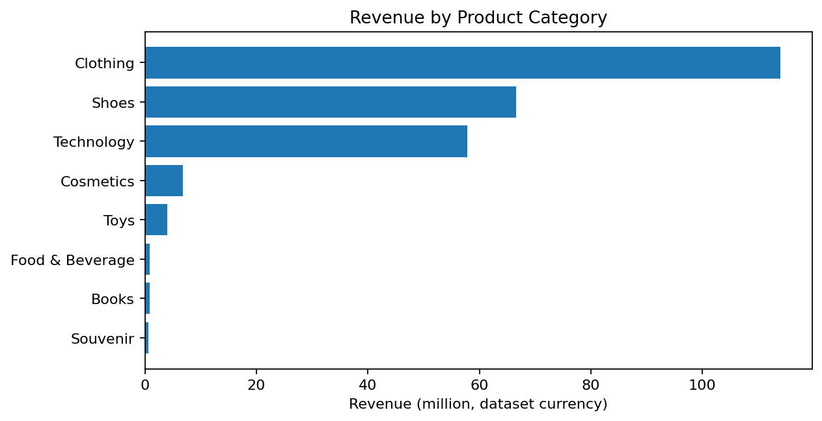
5. Product Category Analysis
Revenue contribution by category
Key findings
Clothing is the top revenue category at
114.00M.
Shoes is the second-highest category at
66.55M.
Lower-revenue categories may benefit
from bundles, targeted promotions, or
assortment review.
Customer Data Analytics | 6

Slide 7
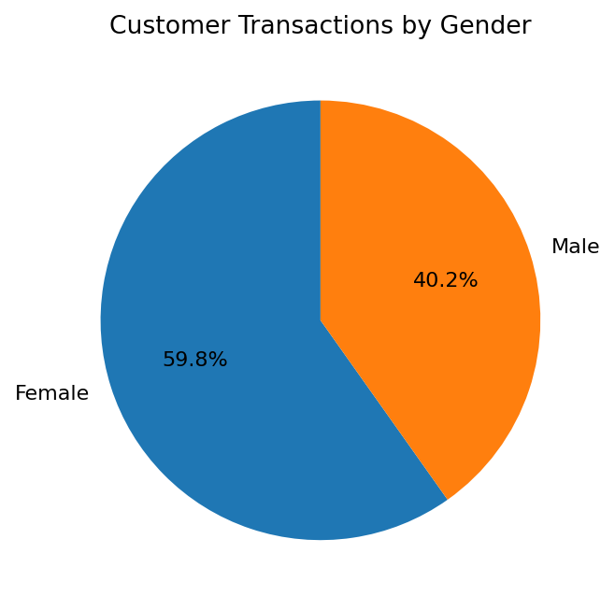
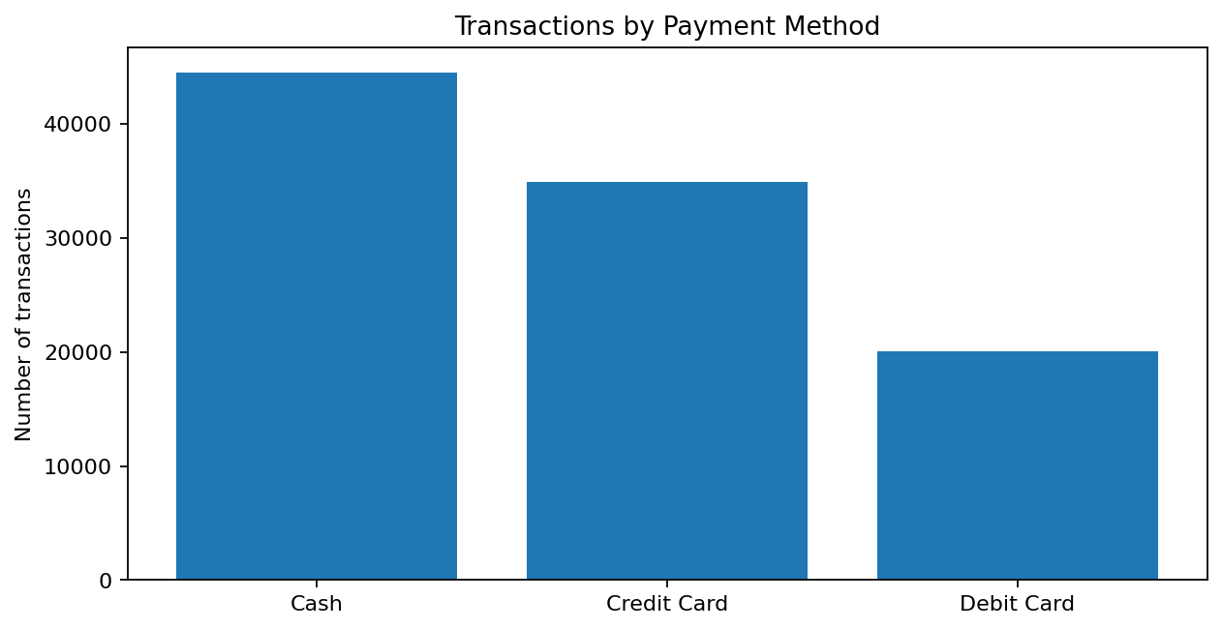
6. Customer & Payment Patterns
Transaction count by gender and payment method
Female records: 59,482 (59.8%)
Most used payment: Cash (44,447 transactions)
Customer Data Analytics | 7

Slide 8
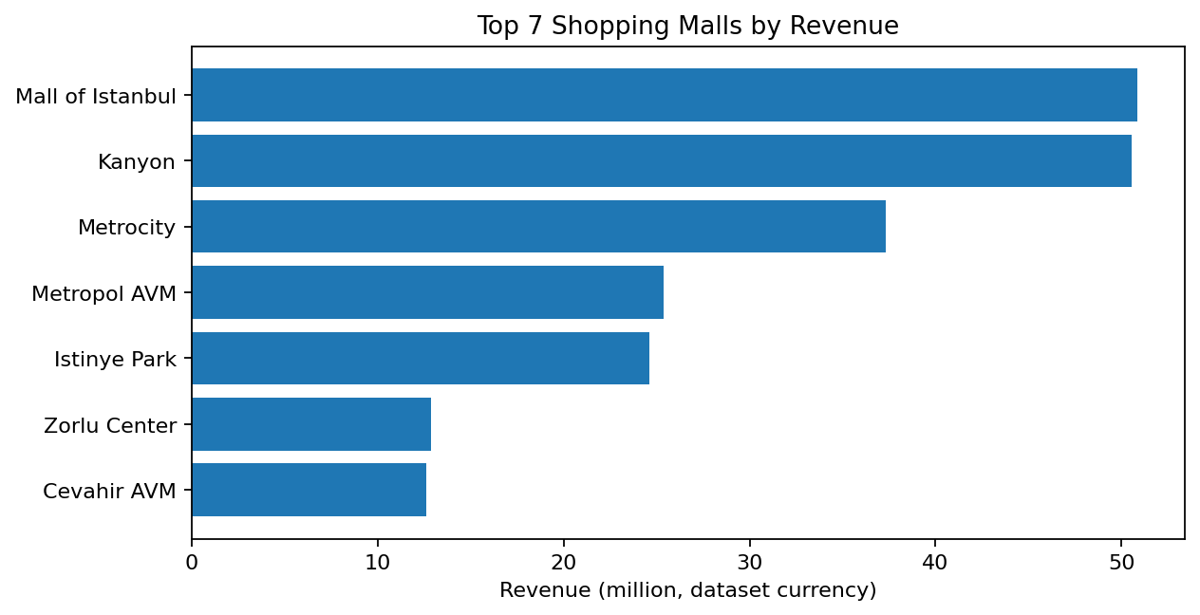
7. Shopping Mall Performance
Highest revenue malls in the dataset
What this suggests
Mall of Istanbul has the highest recorded
revenue (50.87M).
Kanyon is close behind (50.55M).
Compare product mix, footfall, and
promotion timing across malls before
making resource decisions.
Customer Data Analytics | 8

Slide 9
8. Recommendations
Actions suggested by the observed patterns
Protect availability and visibility of Clothing and Shoes, the leading revenue categories.
Test targeted campaigns for lower-revenue categories and measure uplift rather than assuming they
will improve.
Keep cash and card payment experiences reliable; cash is the most frequent method in these
records.
Review performance by mall and category together to identify which products work best at each
location.
Add monthly trends, age bands and repeat-customer analysis to the dashboard for deeper insight.
Customer Data Analytics | 9

Slide 10
9. How to Explain the Power BI Dashboard
Use this sequence during your project review
Start with KPI cards: total revenue, quantity sold and average transaction value.
Explain the category chart: Clothing contributes the most revenue.
Show the gender and payment visuals to explain transaction mix.
Use the mall chart to compare locations and point out the top two malls.
Demonstrate slicers/filters if present in your PBIX (date, category, gender, mall).
Close with recommendations and mention that patterns are descriptive, not proof of cause.
Customer Data Analytics | 10

Slide 11
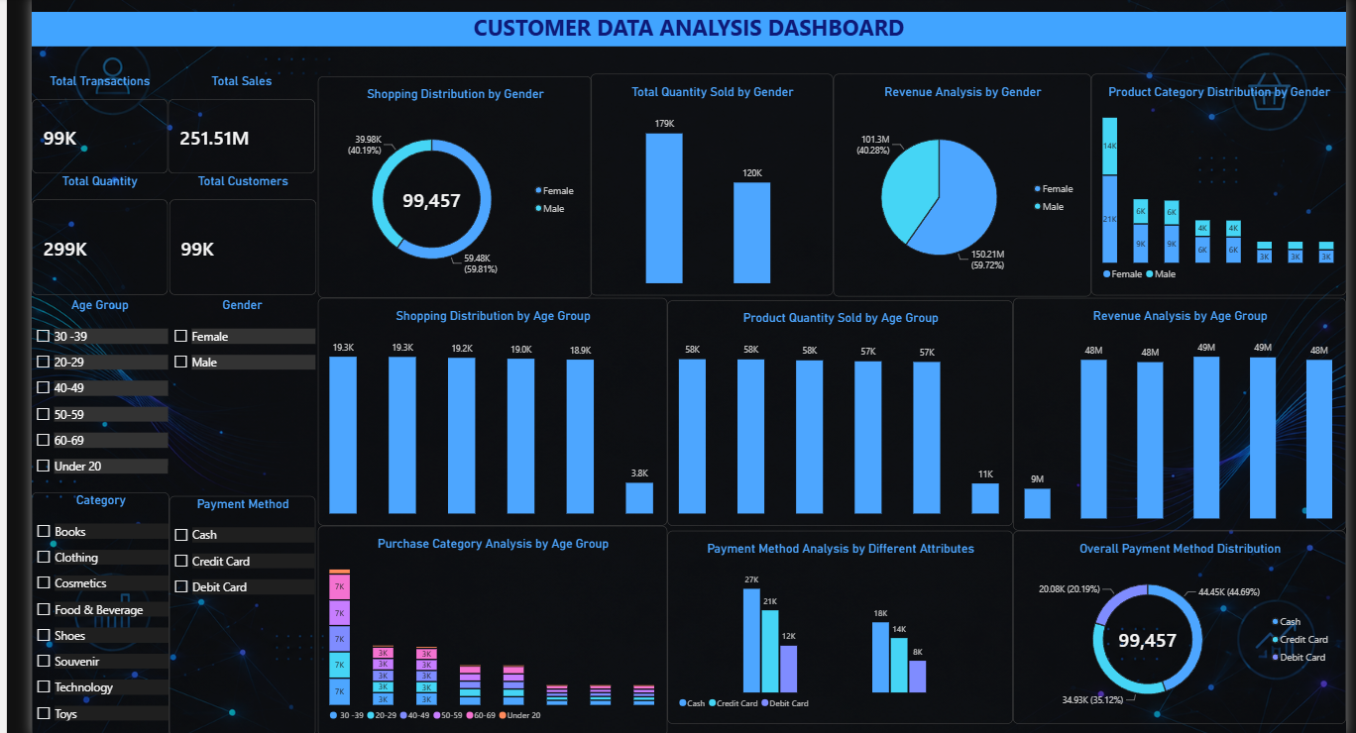

Slide 12
CONCLUSION
Calculated key performance indicators such as Total Revenue, Quantity Sold, and Average Transaction Value.
Identified the best-performing product categories based on revenue.
Compared customer transactions by gender, payment method, and shopping mall.
Created a Power BI dashboard to present insights through interactive visualizations.
The analysis helps businesses improve sales strategies and make data-driven decisions.
99,457 records analysed • 251.51M total revenue • Clothing is the leading category

Slide 13
Thank you

