Slide 1

Project Title -Seasonal Agriculture Performance Analysis
Student Name : Thotakura Anusha
College Name- Malla Reddy University
AICTE STU ID :STU6a645f7106bc81784962929

Slide 2

PROBLEM STATEMENT
Agricultural activities are influenced by seasonal variations in environmental conditions, farming practices, resource availability and market conditions. As a result, agricultural performance may differ from one season to another. However, raw agricultural data does not clearly explain how agricultural performance changes across seasons or what patterns can be observed in different seasonal conditions. The problem is to analyze the given agricultural dataset and investigate seasonal differences in agricultural performance by identifying meaningful patterns, trends, relationships and variations within the available data.

Slide 3
Project Description
My project is about understanding how agricultural performance changes across different seasons. I used an agricultural dataset containing information about crops, weather conditions, irrigation, yield and profit. I analyzed this data using Python and created different graphs to identify patterns and relationships. The main purpose is to turn the raw agricultural data into simple insights that can help us better understand seasonal farming performance.

Slide 4

WHO ARE THE END USERS?
The project can be useful for:
Farmers – to understand seasonal yield and profit patterns.
Agricultural planners – to support better seasonal planning using data.
Government & agricultural organizations – to study agricultural trends and performance.
Agricultural researchers – to analyze relationships between environmental conditions, farming practices and crop performance.
Data analysts & students – to understand how data analytics can be applied to real-world agricultural data.

Slide 5

Technology Used
Python – Main programming language for data analysis.
Pandas – Used for data loading, cleaning, grouping and analysis.
NumPy – Used for numerical calculations.
Matplotlib – Used to create graphs and charts.
Seaborn – Used for statistical visualizations such as heatmaps.
Jupyter Notebook / Google Colab – Used to perform and document the analysis.
Microsoft Excel – Used as the dataset source.

Slide 6
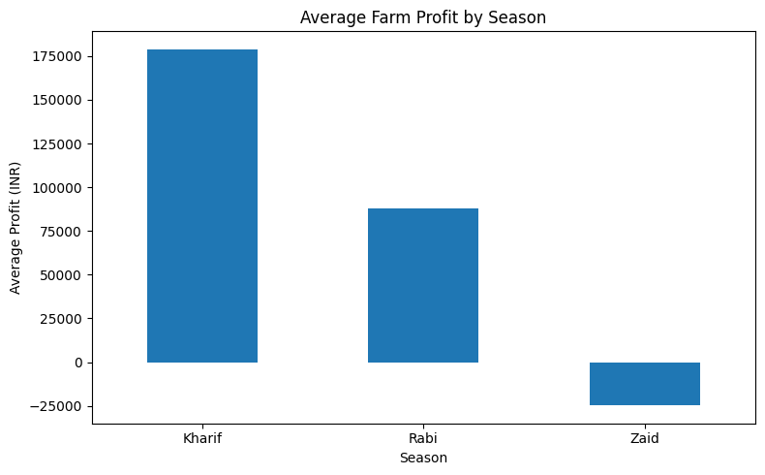
RESULTS
1. Average Profit by Season
Season
Kharif 178914.647555
Rabi 87689.470191
Zaid -24804.824916
Name: Profit_INR, dtype: float64

Slide 7
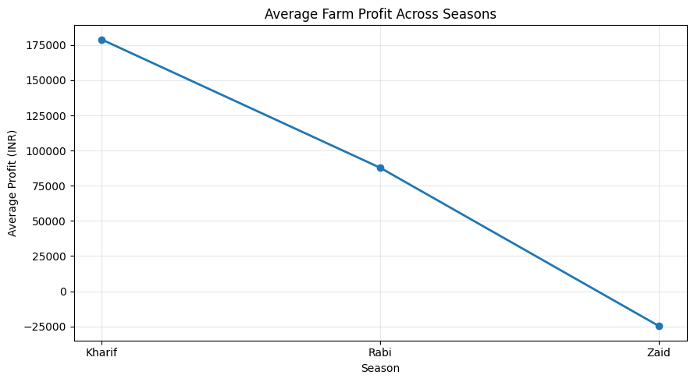
RESULTS
2.Average Farm Profit Across Season

Slide 8
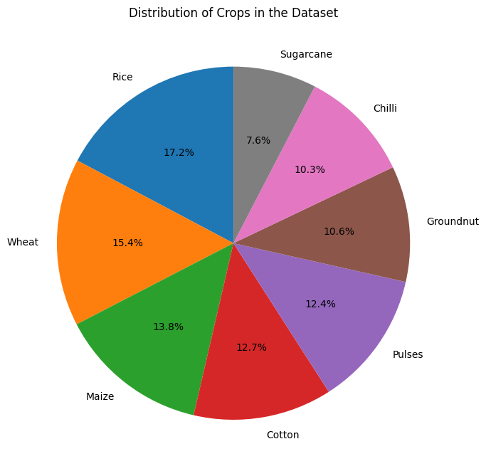
RESULTS
3.Crop Distribution:

Slide 9
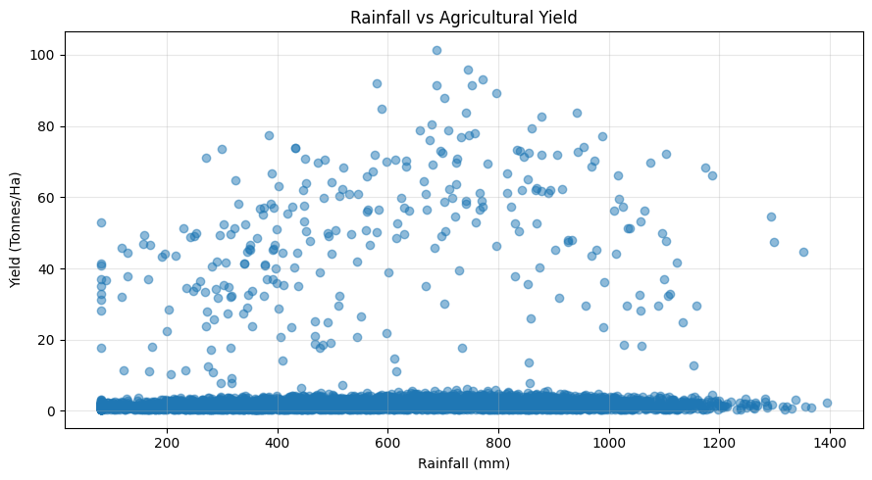
RESULTS
4.Rainfall vs Agricultural Yield

Slide 10
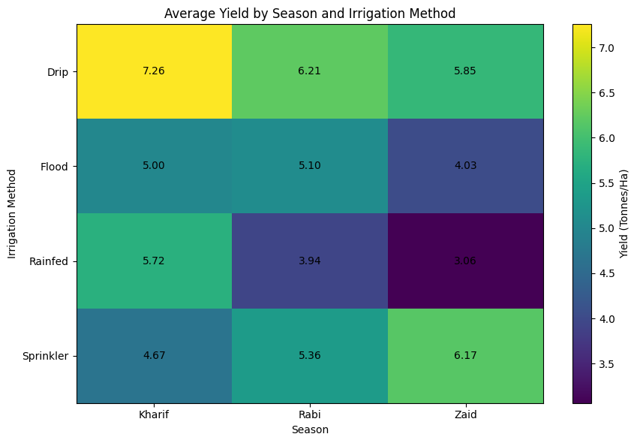
RESULTS
5.Average Yield by Irrigation Method and season

Slide 11
Future scope
Currently, my project mainly focuses on analyzing the available agricultural data and finding patterns. In the future, I would like to expand it with more years and locations, and use machine learning to make predictions. I would also like to create an interactive dashboard so that the insights are easier for farmers and agricultural planners to understand and use.

Slide 12
GitHub Link
https://github.com/Anusha-Thotakura/Seasonal-Agriculture-Performance-Analysis

Slide 13
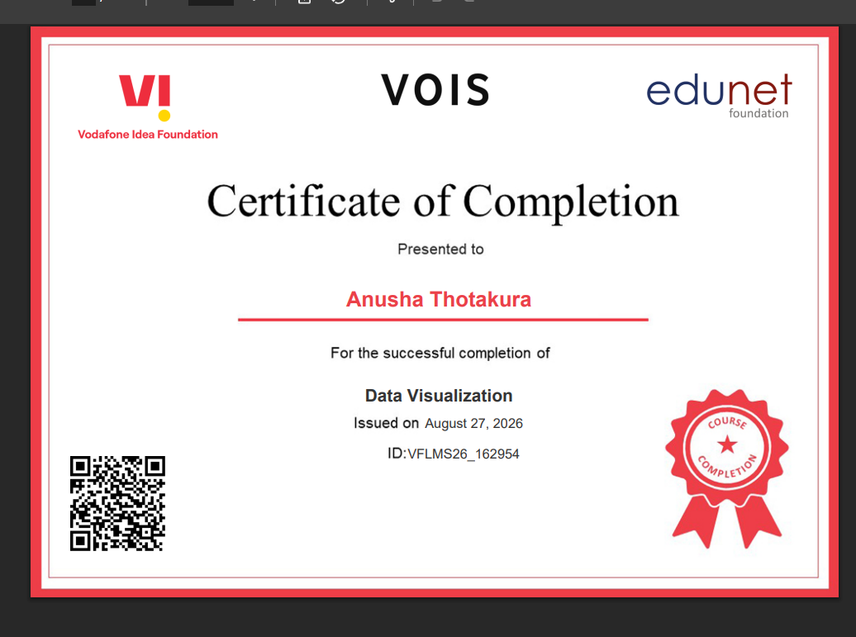
VOIS Course completion certificate -
Course name- Data Visualization

Slide 14
Thank you
.
.

