Slide 1
IBM University Engagement Project Submission
“Exploring the Power of Agentic AI with IBM Granite and IBM Bob”

Slide 2

Project Tile – [AI Agent for Digital Financial Literacy ]
Domain of Project – [Education]
Student Name | Recent Passport Photo | Email ID | Mobile number [WhatsApp]
ANUSHA S
shankar93622@gmail.com
9945309777
Recommended font style and size: Font Style: Arial Font Size (Heading): 28
Font Size (Content): 20

Slide 3
Problem Statement - AI Agent for Digital Financial Literacy
The Challenge
The primary challenge lies in the fact that many individuals have limited awareness of digital financial tools, which makes it difficult for them to confidently use UPI, manage budgets, or understand concepts like interest rates. India’s multilingual and culturally diverse population adds another layer of complexity, since financial literacy resources are not always available in local languages or tailored to cultural contexts.
The Objective :
Provide multilingual support so users can interact in their native language.
Enhance digital confidence by guiding users through safe UPI transactions, budgeting, and loan practices.
Protect against fraud by teaching scam awareness and safe online behavior.
Bridge knowledge gaps by retrieving content from trusted government, banking, and educational portals using RAG.
Promote inclusivity by making financial literacy culturally relevant and accessible to diverse backgrounds.
Leverage IBM technology (Cloud Lite + Granite) to deliver scalable, AI-powered financial education with secure retrieval and generation.

Slide 4
Proposed Solution - AI-Powered Digital Financial Literacy Agent
Imagine a friendly digital companion that sits beside you whenever you’re navigating the world of online finance. This AI-powered Financial Literacy Agent, built on IBM Cloud Lite services, watsonx.ai, and Granite Models, is designed to make digital money management simple, safe, and personalized.
At its heart, the agent uses a Retrieval-Augmented Generation (RAG) pipeline to pull reliable information from trusted sources like RBI guidelines, government portals, and banking websites
The system is powered by four specialized agents, each acting like a helpful teammate:
Financial Knowledge Agent: Your explainer-in-chief, breaking down complex financial terms into clear, everyday language.
Transaction Guidance Agent: A step-by-step coach that walks you through UPI payments, fund transfers, and digital wallet usage.
Fraud Awareness & Advisory Agent: A vigilant protector that teaches you how to spot scams, phishing attempts, and unsafe practices online.
Budgeting & Personal Finance Agent: Your planner, helping you set budgets, track expenses, and understand loans or EMIs with practical insights.

Slide 5
Technology Used
IBM Bob platform – For designing and orchestrating multi-agent workflows visually, ensuring smooth coordination between knowledge retrieval, fraud detection, transaction guidance, and budgeting agents.
IBM Granite model (e.g., ibm-granite-3-2-8b) – Powers natural language understanding, reasoning, and personalization, enabling the agent to explain financial concepts clearly and adapt responses to diverse user needs.
IBM Cloud – Provides the infrastructure to build, deploy, and scale the Financial Literacy Agent efficiently. It ensures a reliable, secure, and scalable environment for delivering financial guidance
RAG (Retrieval-Augmented Generation) – Fetches real financial data first (from RBI guidelines, government portals, and banking websites), then generates intelligent answers, making the agent trustworthy and authoritative.
IBM Watsonx.ai – Handles model deployment, embeddings, and AI governance, ensuring compliance, scalability, and responsible AI use in financial education.
Vector Database (FAISS/Chroma) – Stores embedded financial knowledge for RAG-based retrieval, enabling fast, accurate responses to queries about UPI, budgeting, loans, and fraud prevention.

Slide 6
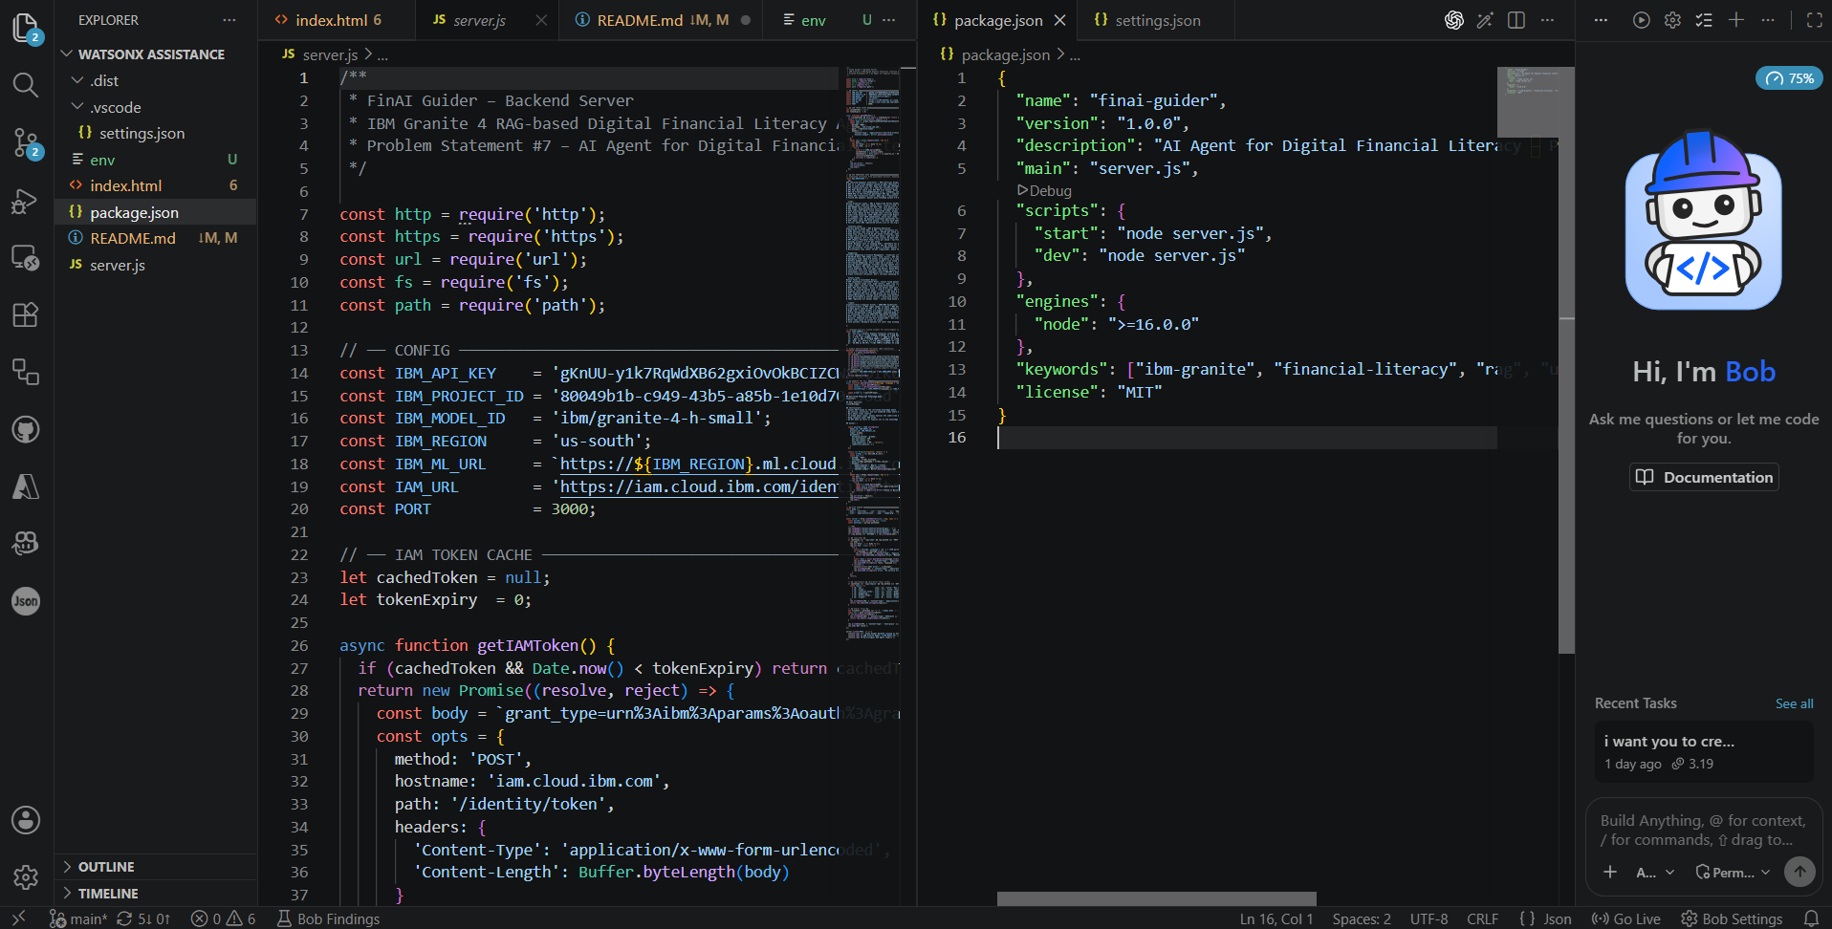
Required Files created using IBM bob -
server.js
settings.json
Package.json
.env
Index.html

Slide 7
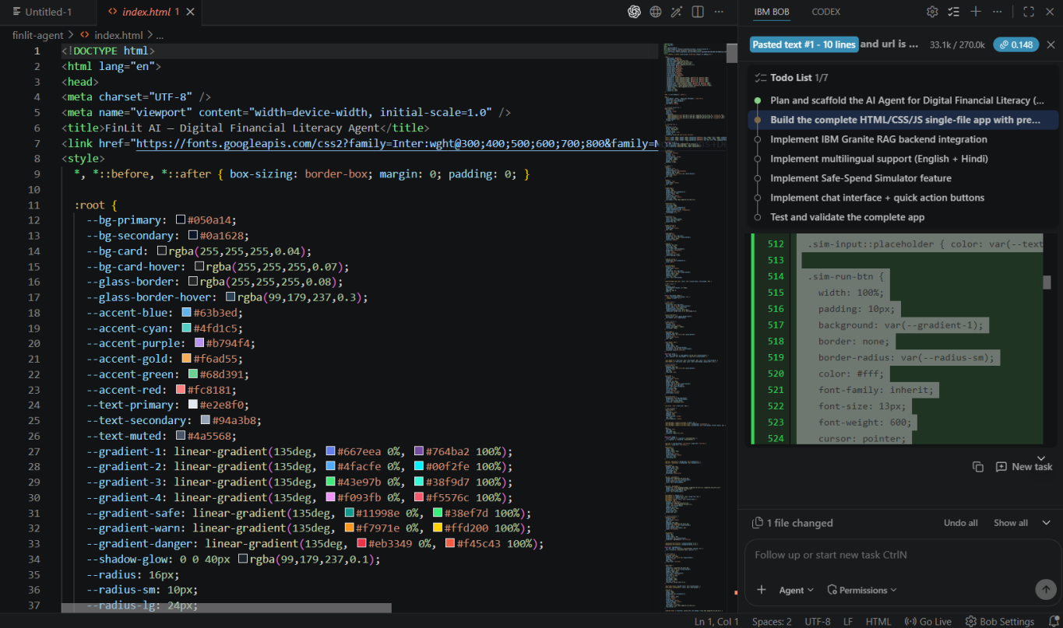
IBM Bob Screenshots:

Slide 8
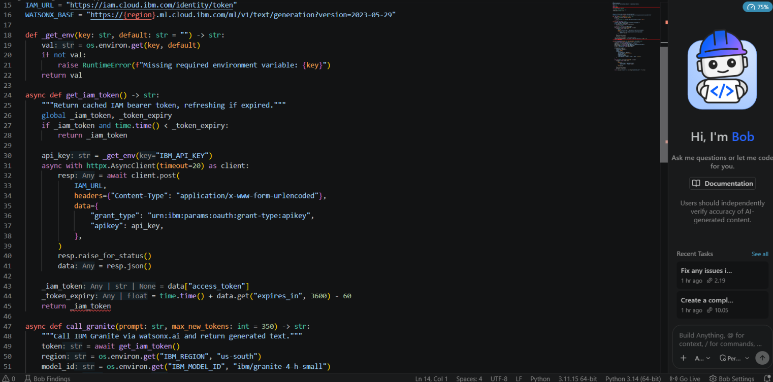

Slide 9
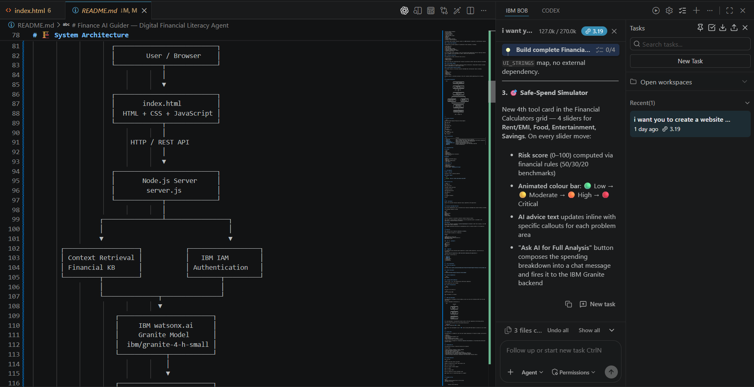
Architecture blueprint for IBM bob:

Slide 10

Role of Agentic AI in Digital Financial Literacy Agent
Agentic AI transforms the Financial Literacy Agent from being just a chatbot into a smart, autonomous financial guide. Powered by IBM watsonx.ai and IBM Granite models, it coordinates multiple specialized agents that work together to deliver clear, personalized financial support.
What makes Agentic AI special is its context awareness. It doesn’t just give generic advice—it adapts to the user’s background, language, and financial needs.The system also supports real-time adaptation. As users interact—logging expenses, asking questions, or updating their financial goals—the agents continuously refine their guidance. Agentic AI makes the Financial Literacy Agent proactive, personalized, and goal-driven. It acts less like a machine and more like a trusted digital mentor, empowering users to navigate digital finance with confidence, safety, and clarity.

Slide 11
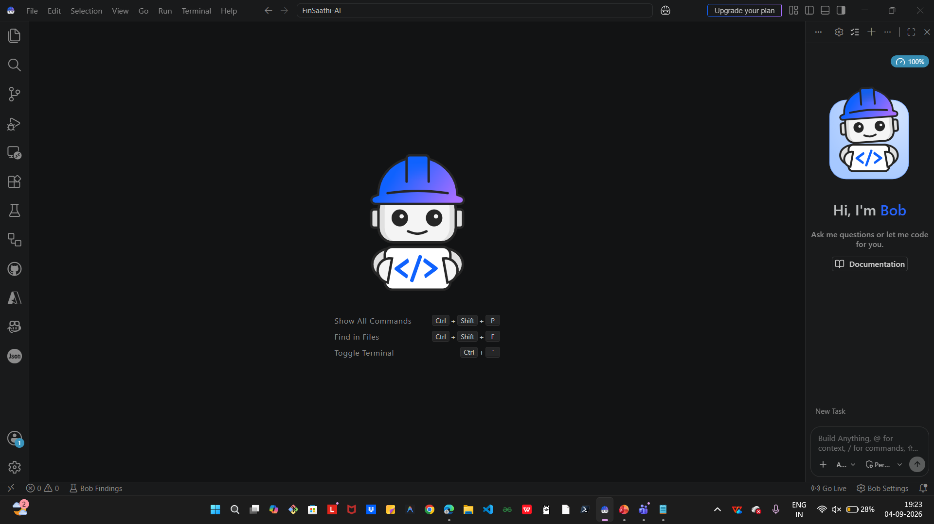
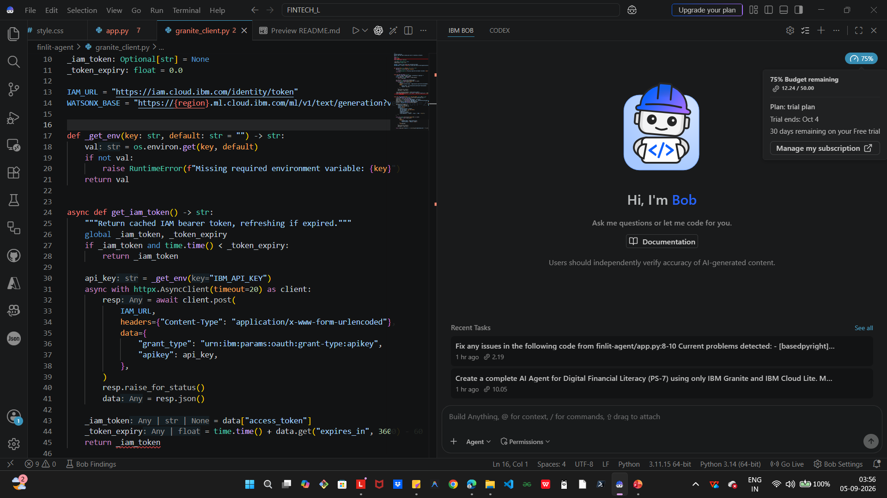
Token Usage
11,761 token are used
Before Prompt
After the Prompt
·
·
·

Slide 12
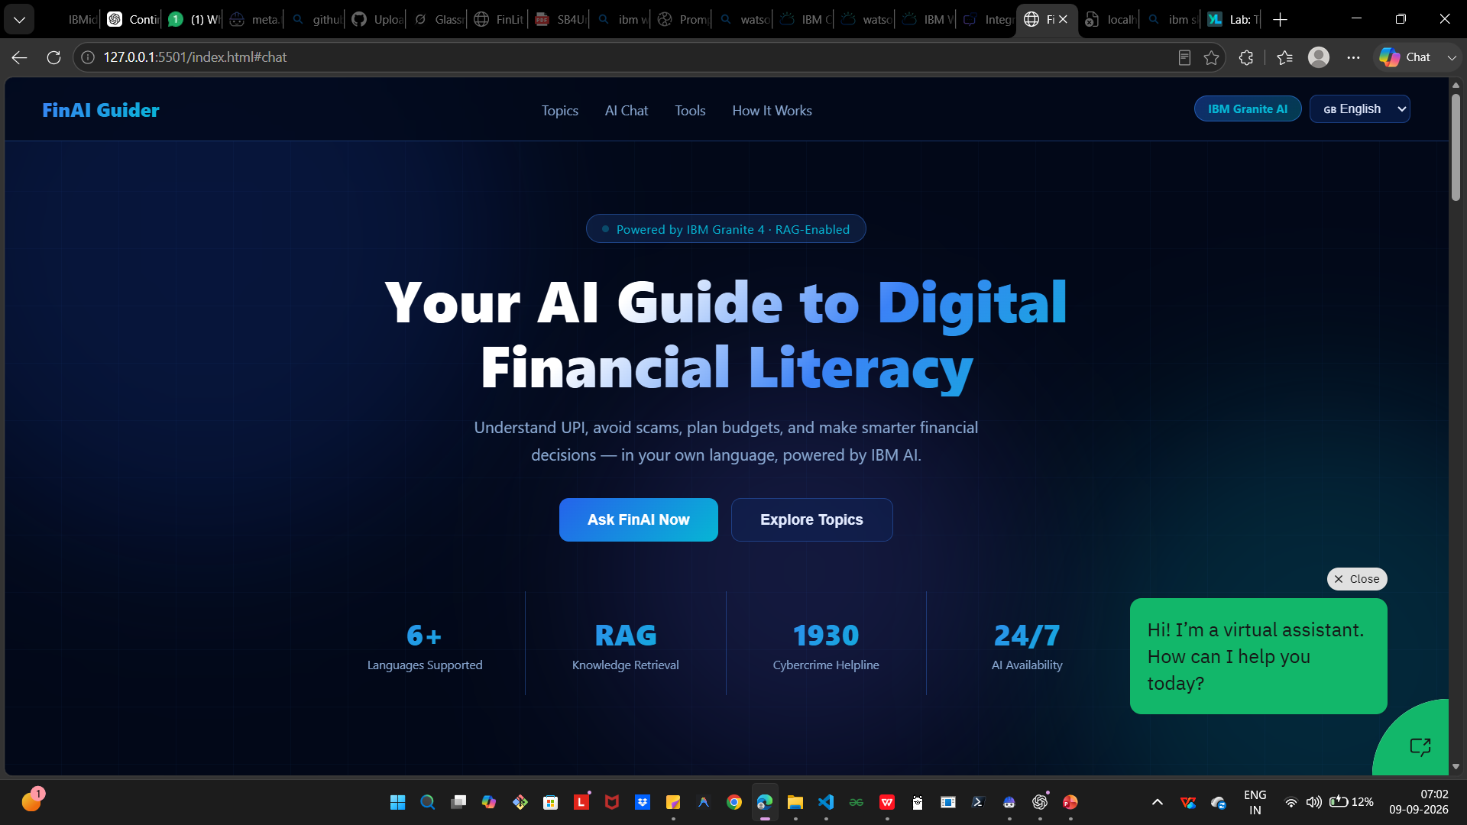
Project Output Screenshot
Please put IBM Bob output screenshots with 2-3 prompts.
You can take 2-3 more slides for each screenshot
·
·
·

Slide 13
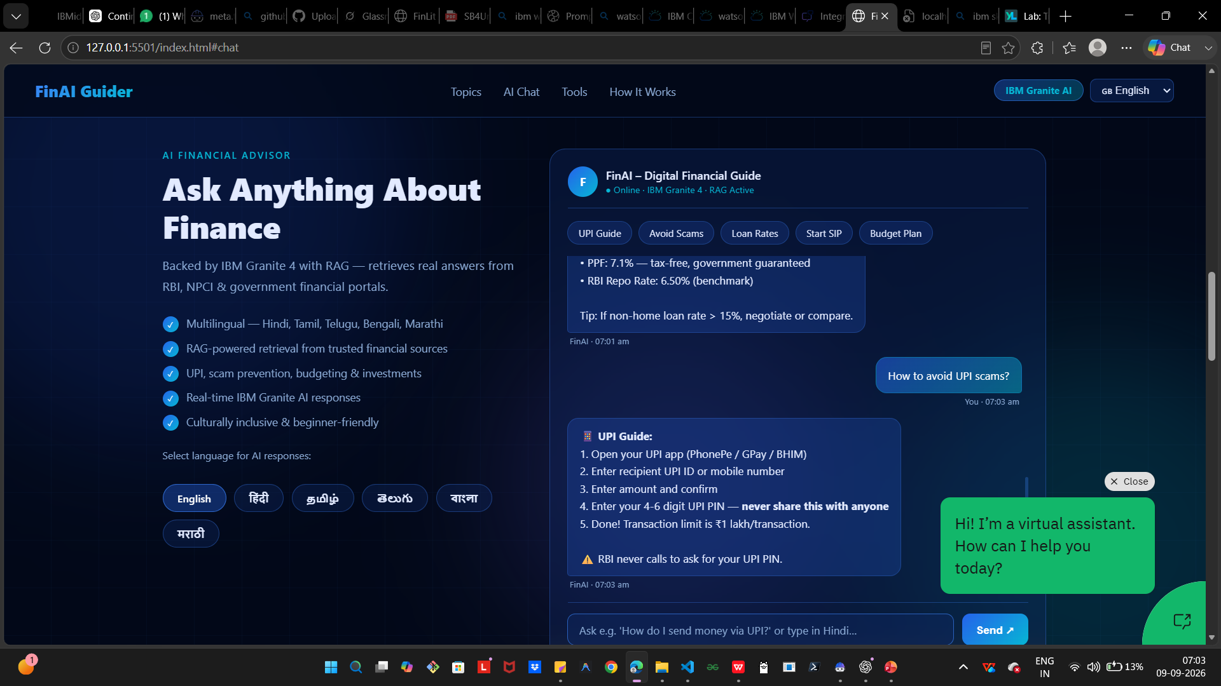
Project Output Screenshot
Please put IBM Bob output screenshots with 2-3 prompts.
You can take 2-3 more slides for each screenshot
·
·
·

Slide 14
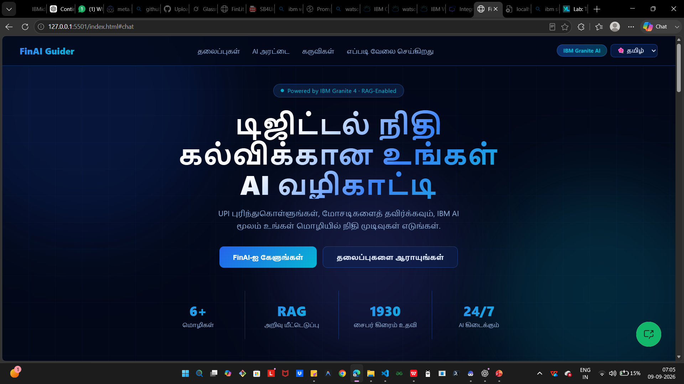
Project Output Screenshot
Please put IBM Bob output screenshots with 2-3 prompts.
You can take 2-3 more slides for each screenshot
·
·
·

Slide 15
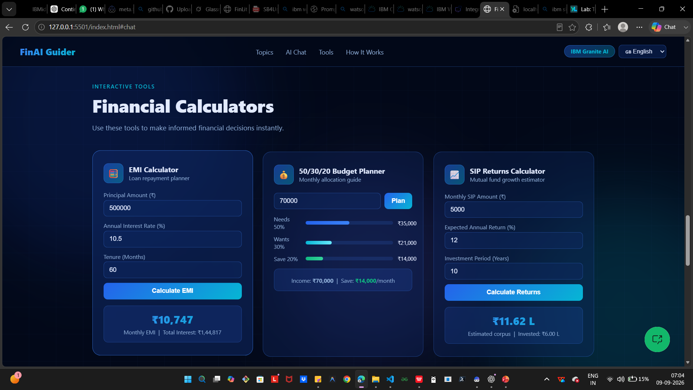
Project Output Screenshot
Please put IBM Bob output screenshots with 2-3 prompts.
You can take 2-3 more slides for each screenshot
·
·
·

Slide 16
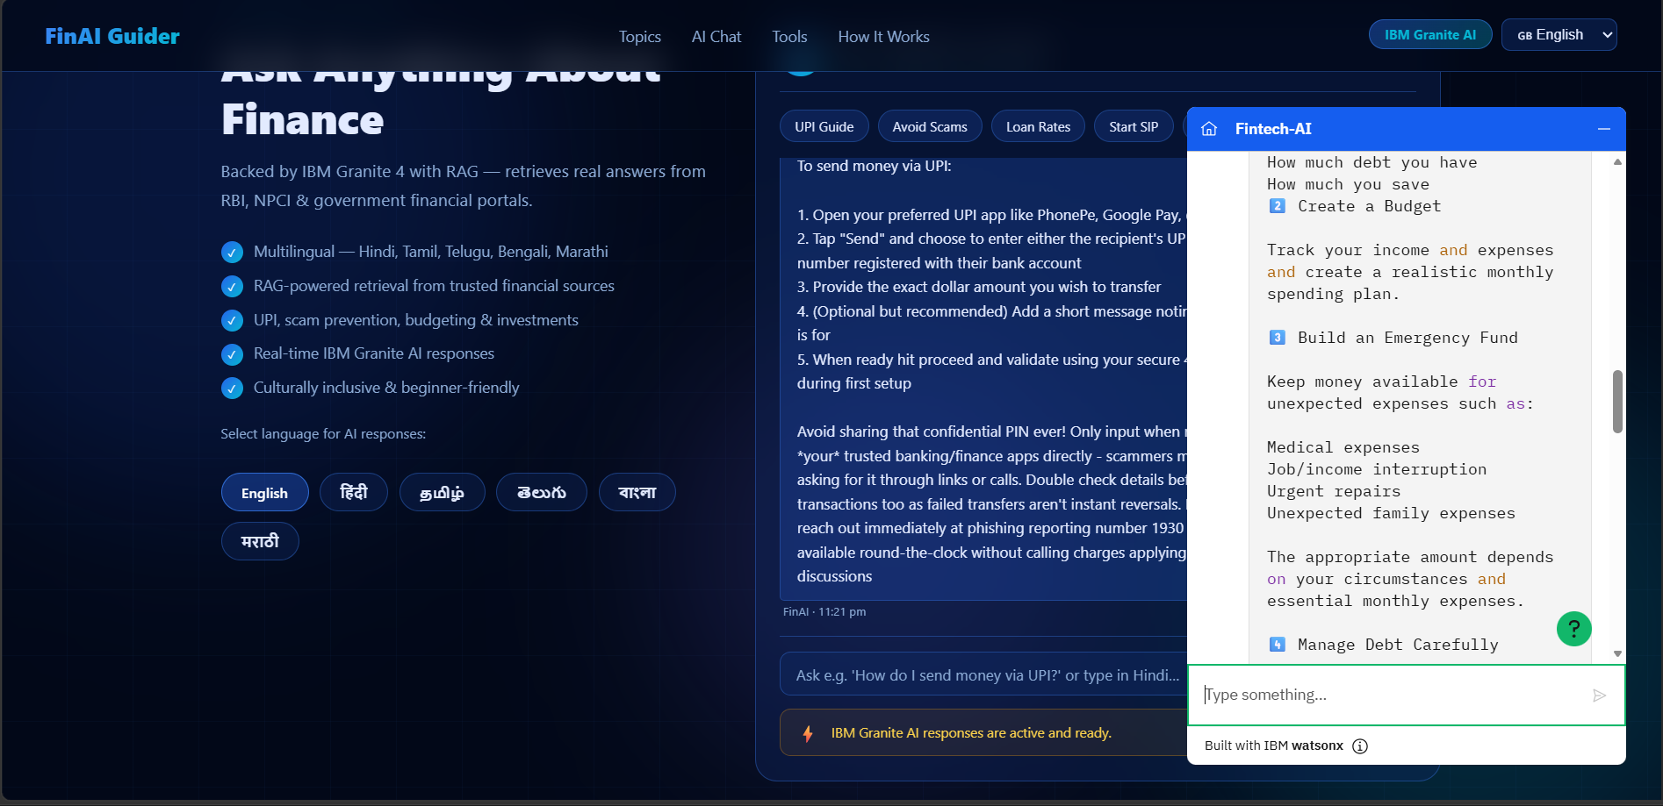
Project Output Screenshot
Please put IBM Bob output screenshots with 2-3 prompts.
You can take 2-3 more slides for each screenshot
·
·
·

Slide 17
Novelty and Uniqueness
Why the Digital Financial Literacy Agent Stands Out
The proposed Financial Literacy Agent combines Agentic AI, RAG, and personalization into one intelligent, trustworthy system.
Multi-Agent Intelligence – Instead of being just a chatbot, multiple specialized agents collaborate to deliver accurate, context-aware financial guidance.
RAG-Based Accuracy – Real-time retrieval from RBI guidelines, government portals, and banking sites ensures trustworthy answers, reducing misinformation.
Hyper-Personalization – Tailors financial advice based on user background, language, spending habits, and financial goals.
Real-Time Feedback Loop – Continuously adapts recommendations based on user activity, transactions, and evolving financial needs.
Multi-Modal Input – Supports text, voice, and even integration with financial apps or smart devices for seamless interaction.
Fraud Prevention Focus – Goes beyond basic literacy to proactively warn users about scams, phishing, and unsafe practices.

Slide 18
Git Hub Link
· Please create public github repository (Enable Add README button while creating repository) with format – https://github.com/Anusha-demonslayer/Finance-AI-Guider-Digital-Financial-Literacy-Agent/blob/main/README.md
Please test and Paste the working Github URL – https://github.com/Anusha-demonslayer/Finance-AI-Guider-Digital-Financial-Literacy-Agent.git
Make sure you have Uploaded following three files into your github repository 1) All Agent relevant files of IBM Cloud , 2) yourproblemstatement.pdf file 3) your projectpresntation.pptx file 4)any other files
·
·
·

Slide 19
Future Scope
Integration with Financial Apps & Smart Devices
The Financial Literacy Agent can be integrated with mobile banking apps, digital wallets, and even smart devices like payment-enabled wearables. This allows it to collect real-time transaction data, spending habits, and savings activity. With this live feed, the agent can provide dynamic budgeting tips, instant fraud alerts, and personalized financial guidance based on actual user behavior. Instead of static advice, it becomes a living financial coach that adapts to how you spend and save every day.
AI-Powered Voice Assistant & Multilingual Support
To make financial literacy truly inclusive, the agent can be enhanced with a voice-enabled assistant and multilingual support. Users can simply speak naturally in their preferred language—whether it’s English, Hindi, Kannada, or any other—and get clear, personalized financial guidance. This breaks down barriers for people who may not be comfortable with text-heavy interfaces or who come from diverse linguistic backgrounds. It ensures that digital finance feels approachable, accessible, and empowering for everyone, no matter where they live or what language they speak.
·
·
·

Slide 20
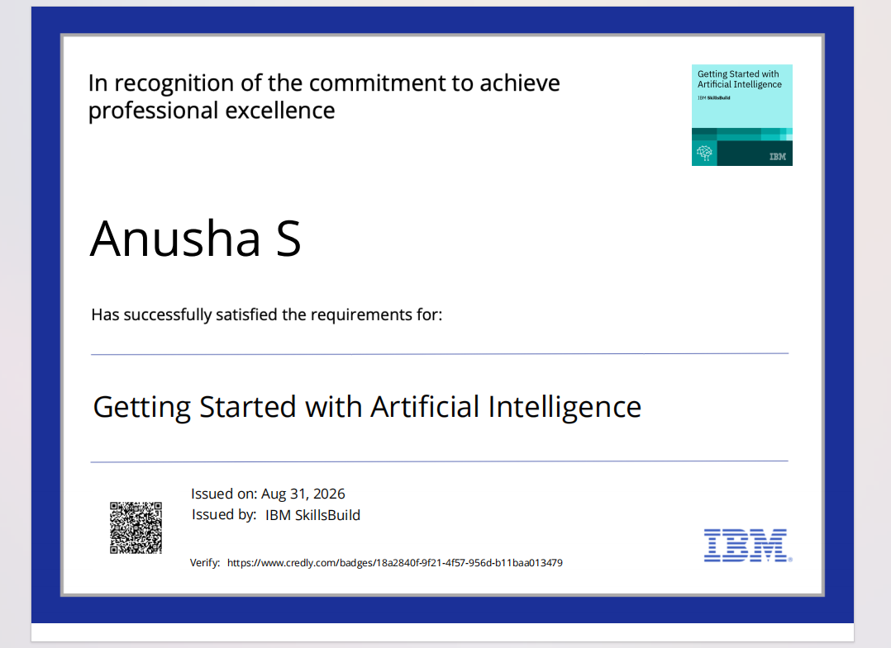
Certificates Earned:
Please add your credly certificate(Getting Started with Artificial Intelligence)

Slide 21

Certificates Earned:​
Add your IBM BOB Certificate

Slide 22


