Slide 1
BMS INSTITUTE OF TECHNOLOGY AND MANAGEMENT
Department of Master of Computer Applications · Project Work Phase I · MMCA34 · 2025–27
Incident Analysis and Hotspot Identification
for Security Provision Against Women
Harassment in Public Spaces
SafeHer — a crowdsourced reporting system with geospatial analysis and a self-serve authority dashboard
Submitted by
Anusha K 1BY25MC017 Module 1 — Analysis and hotspot identification
Aman Yadav 1BY25MC012 Module 2 — Mobile application and dashboard
Under the guidance of
Dr. M Sridevi
Aligned to SDG 5 — Gender Equality, Target 5.2
BMS Institute of Technology and Management · Department of MCA · Phase I Interim Review · 2025–27
01 / 23

Slide 2
CONTENTS
Sequence of this review
01
Organisation
02
Problem and objectives
One project, two modules, shared title
Why a self-serve system is required
03
End-to-end process
04
Analysis pipeline
How a report reaches the officer
Ingest, classify, 1 km cluster, risk, alerts
05
Authority dashboard
06
Security and results
Independent access to maps, filters and patrol lists
Controls implemented, current numbers, scope
BMS Institute of Technology and Management · Department of MCA · Phase I Interim Review · 2025–27
02 / 23

Slide 3
PROJECT ORGANISATION
One system. Two complementary modules.
Module 1 — Anusha K · 1BY25MC017
Module 2 — Aman Yadav · 1BY25MC012
Incident analysis, geospatial clustering and hotspot identification.
Folder: analysis/
Command: python3 analysis/pipeline.py
Inputs: Karnataka OSM workbook (30 districts), app reports, KSP district context.
Outputs: incident view, hotspots, area risk, patrol alerts.
The pipeline is rule-based and auditable. It does not predict crime.
Expo mobile application and Next.js authority dashboard.
The application captures GPS, area, incident type and context, and writes to Supabase.
The dashboard at /admin presents live community KPIs, analysis overlays, filters and alerts.
Authorised officers retrieve the picture themselves. They do not wait for another desk to send a file.
BMS Institute of Technology and Management · Department of MCA · Phase I Interim Review · 2025–27
03 / 23

Slide 4
PROBLEM STATEMENT
Street-level harassment is reported; concentrated locations are not available in time
Present difficulty
Need
Scope of this work
Incidents reach stations through registers, helplines or informal messages.
A duty officer often depends on another person to compile “the latest list”.
There is no shared map of where reports concentrate this week.
Patrol planning therefore remains generic rather than location-specific.
Residents must be able to report from a telephone, with GPS, without filling a paper form first.
Analysis must convert those points into hotspots and risk labels using published rules.
Authorities must open one dashboard and obtain maps, filters and alerts without requesting data from the project team or from another desk.
Historical concentration of community reports — not crime prediction.
No live police CCTV streams.
No facial recognition.
Karnataka State Police tables are used only as district-level context. They are never plotted as street dots.
BMS Institute of Technology and Management · Department of MCA · Phase I Interim Review · 2025–27
04 / 23

Slide 5
OBJECTIVES
What the system is built to achieve
Aligned to SDG 5 — Gender Equality, Target 5.2 (eliminate violence against women)
01
Collect
02
Store
03
Analyse
Capture location, time, incident class and street context from the mobile application over HTTPS.
Persist approved reports in a central table with Row Level Security so the public cannot read rejected rows.
Clean, classify and cluster incident-like reports on a ~1 km grid; assign Low / Medium / High risk.
04
Alert
05
Present
06
Protect
Produce a patrol list for High-risk or recently active cells, with area, coordinates and last seen.
Give authorities a login-protected dashboard with filters, map layers and KPIs they operate themselves.
Keep reporting anonymous-first; keep the command view closed behind authentication.
BMS Institute of Technology and Management · Department of MCA · Phase I Interim Review · 2025–27
05 / 23

Slide 6
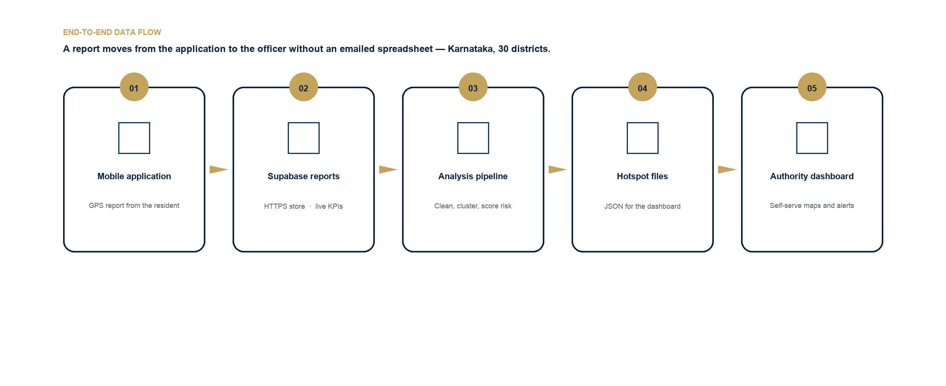
END-TO-END PROCESS
How data is gathered, stored, analysed and shown
No emailed spreadsheet is required at any step
BMS Institute of Technology and Management · Department of MCA · Phase I Interim Review · 2025–27
06 / 23

Slide 7
DATA GATHERING FROM THE APPLICATION
The telephone is the sensor. Each successful submit starts the pipeline.
Location
GPS latitude and longitude are captured automatically and matched to one of 30 Karnataka districts (example: Mysuru, Belagavi, Bengaluru Urban).
Classification
Safe / Unsafe. Incident-like rows are those marked unsafe, or flagged as harassment, or given an incident type.
Time
Server timestamp (created_at) plus time of day: morning, afternoon, evening, night.
Street context
Lighting, crowd level, CCTV seen, police nearby, transport nearby, optional comment.
Identity
Name is not required. A device identifier is stored only to enforce a limit of five reports per hour.
Transport
HTTPS insert into the Supabase table reports. Default status is approved; it may be held as pending.
BMS Institute of Technology and Management · Department of MCA · Phase I Interim Review · 2025–27
07 / 23

Slide 8
HOW THE DASHBOARD STAYS CURRENT
Two complementary paths. Officers are never blocked waiting for an export.
Path A — live community view
Path B — analysis refresh
Latency: seconds after submit
Hotspots and patrol alerts
• The application writes one row into reports.
• Row Level Security permits public read of approved rows only.
• The dashboard Community page and map query the table and the area_safety view.
• A new marker and updated KPIs appear without any file being emailed.
• This is how an officer sees what arrived today.
• Approved reports are read by Module 1 from analysis/input/.
• analysis/pipeline.py cleans, classifies, clusters and scores risk.
• It writes hotspots.json, alerts.json, areas.json and summary.json.
• Those files are published to the dashboard at /admin.
• The same rules apply to demo rows and to live rows. Coordinates are never recoded by hand.
BMS Institute of Technology and Management · Department of MCA · Phase I Interim Review · 2025–27
08 / 23

Slide 9
MODULE 1 · ANALYSIS METHOD
Eight recorded steps. Each count is written to pipeline_log.json.
1 Ingest
2 Preprocess
3 Classify
4 Geospatial
Load Karnataka OSM District Summary + app reports + live_reports.json. Keep approved rows with GPS. Load KSP district context without using it as points.
Drop duplicates, invalid coordinates and points outside Karnataka (lat 11.5–18.6, lon 74.0–78.6). Log before / after / dropped.
Incident-like = unsafe, or harassment flagged, or an incident type is set. Safe rows remain as context.
Snap each incident to a 0.01° cell (~1.1 km). Count type, time of day and area inside the cell.
5 Hotspot
6 Risk
7 Alerts
8 Publish
A cell with three or more incident-like reports is a hotspot. This measures concentration, not a forecast.
High / Medium / Low from count and harassment share. Rules are on the next slide.
High-risk cells, and cells active in the last 14 days of the dataset, become the patrol list with a location hint.
Write analysis/output/ and copy summary, hotspots, alerts and areas into the dashboard for /admin.
BMS Institute of Technology and Management · Department of MCA · Phase I Interim Review · 2025–27
09 / 23

Slide 10
ANALYSIS ARTEFACTS
All required files live in analysis/ — OSM dumps and camera inventories are not part of this module
Input (analysis/input/)
Output (analysis/output/)
• Dataset: PBL/Dataset/Karnataka — 30 districts, 604,573 OSM streets.
• reports.json — 1,079 approved app-schema demo reports across Karnataka.
• osm_districts.json — Safe / Moderate / Unsafe street counts per district.
• crime_context.json — KSP totals for all 30 districts. Not hotspot coordinates.
• SOURCES.json — provenance of each input.
• incident_view.json — classified incidents with 1 km cell.
• hotspots.json — 26 cells with count, type mix, peak time, first/last seen.
• alerts.json — 21 patrol items with a location hint.
• areas.json — area-level risk joined to OSM scores.
• summary.json — counts and honesty notes.
• pipeline_log.json — step-by-step record of the last run.
BMS Institute of Technology and Management · Department of MCA · Phase I Interim Review · 2025–27
10 / 23

Slide 11
RISK MODEL
Explainable rules. An officer can defend the label in a briefing.
High
Eight or more incident-like reports in the cell, or five or more with harassment share ≥ 40%.
Medium
Four or more incident-like reports in the cell, below the High threshold.
Low
The cell is a hotspot (three or more reports) but remains below Medium.
OSM street scores (lighting, cameras, police proximity) are joined on the same area as context. They do not invent crime counts.
KSP 2023–24 tables remain at district grain. The pipeline sets crime_used_as_coordinates = false.
A hotspot is a concentration of community reports. It is not a predicted future offence.
BMS Institute of Technology and Management · Department of MCA · Phase I Interim Review · 2025–27
11 / 23

Slide 12
CURRENT ANALYSIS RESULT
Last run of analysis/pipeline.py · Karnataka · 1,079 demo reports · 0 live rows
1079
534
72
55
Reports after clean
Incident-like
Hotspot cells
Patrol alerts
Risk split of the 72 hotspot cells
High 30
Medium 19
Low 23
Highest incident-like districts in this run: Kolar (31), Bengaluru Urban (27), Mandya (26), Tumakuru (26), Belagavi (25), Kalaburagi (25).
Time of day among incident-like reports is even — morning 143, afternoon 140, evening 119, night 132 — so night is not the only pattern.
Type mix: unsafe feeling 287 · harassment 247. Preprocess dropped 0 duplicates and 0 invalid coordinates.
OSM layer: 604,573 Karnataka streets, avg score 4.16. Live app rows go in live_reports.json; the same pipeline is re-run.
BMS Institute of Technology and Management · Department of MCA · Phase I Interim Review · 2025–27
12 / 23

Slide 13
SELF-SERVE FOR AUTHORITIES
The dashboard is the source. Officers do not depend on anyone to send them data.
Independent access
No request to another desk
One operational picture
An authorised officer logs in at /admin. Maps, KPIs, hotspots and alerts are already loaded.
Filters replace a request for last week’s spreadsheet. Area, incident type, date, time of day and risk are selected on screen.
OSM infrastructure, community reports and analysis circles sit on the same map.
Actionable output
Stable rules
Audit trail
Each High-risk cell carries a patrol hint: area, coordinates and last seen — ready for the day’s briefing.
Risk labels come from the published pipeline, not from whoever last coloured a sheet.
Every hotspot stores count, type mix, peak time, first seen and last seen.
BMS Institute of Technology and Management · Department of MCA · Phase I Interim Review · 2025–27
13 / 23

Slide 14
AUTHORITY WORKFLOW
Intended morning use. No telephone call is required to obtain the data.
01
02
03
04
Authenticate
Read the KPIs
Filter
Brief and act
The officer signs in at /admin. The session is an HttpOnly cookie. Sign-out clears it.
Hotspot count, High-risk cells and alert count indicate whether the day is ordinary or elevated.
Area, incident type, from/to date, time of day and risk. The table and the map follow the same filters.
High circles are inspected on the map. Patrol hints are copied into the day’s briefing.
BMS Institute of Technology and Management · Department of MCA · Phase I Interim Review · 2025–27
14 / 23

Slide 15
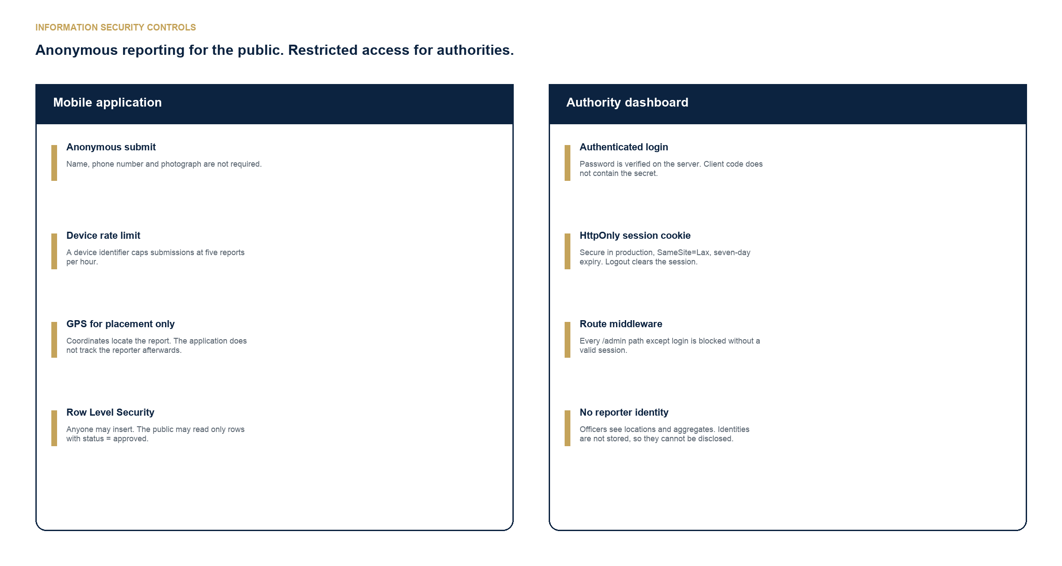
SECURITY OVERVIEW
Anonymous-first reporting. Closed command view.
BMS Institute of Technology and Management · Department of MCA · Phase I Interim Review · 2025–27
15 / 23

Slide 16
SECURITY CONTROLS IMPLEMENTED
These controls exist in the current codebase. They are not a future proposal.
Public reporting
Authority dashboard
No name, telephone number or photograph is required.
A device identifier is used only to cap five reports per hour.
Transport is HTTPS into Supabase.
Row Level Security: insert is allowed; SELECT is allowed only where status = approved. Rejected rows never appear on maps.
GPS places the report. The system does not retain a tracking trail of the reporter.
Next.js middleware blocks every /admin route except login unless a valid session cookie is present.
The password is checked on the server. ADMIN_PASSWORD is an environment variable, not a client constant.
The session cookie is HttpOnly, SameSite=Lax, Secure in production, with a seven-day expiry.
Sign-out deletes the session.
Officers see locations and aggregates. Reporter identities cannot be disclosed because they are not stored.
BMS Institute of Technology and Management · Department of MCA · Phase I Interim Review · 2025–27
16 / 23

Slide 17
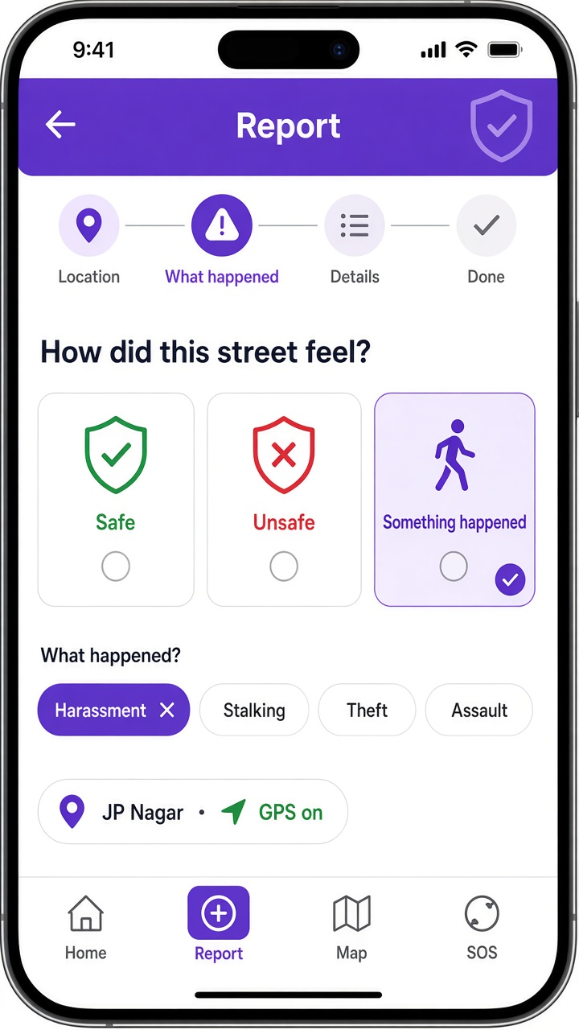
MOBILE APPLICATION
Four steps: location → what happened → details → confirmation
• Tabs: Home, Report, Map, SOS.
• Built with Expo so the same codebase targets iOS and Android.
• The Karnataka district is confirmed from GPS before submit.
• Incident types are requested only when something happened.
• Context fields: lighting, crowd, CCTV, police, transport, optional comment.
• SOS keeps helpline numbers one tap away.
• A successful submit is the start of the whole pipeline.
BMS Institute of Technology and Management · Department of MCA · Phase I Interim Review · 2025–27
17 / 23

Slide 18
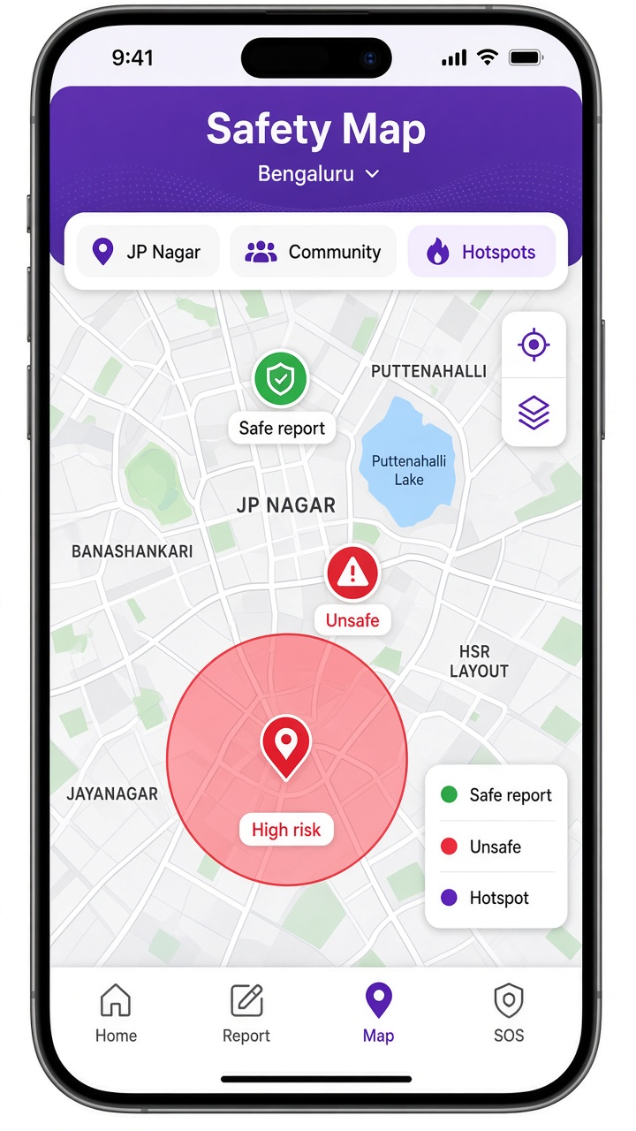
MOBILE APPLICATION · COMMUNITY MAP
Residents see community signal. The command view remains on /admin.
• Green markers indicate a safe feeling.
• Red markers indicate unsafe or incident-like reports.
• Larger circles mark analysis hotspots.
• Demo points are labelled so live police data is not implied.
• Filters, patrol alerts and full KPIs are reserved for authenticated officers.
BMS Institute of Technology and Management · Department of MCA · Phase I Interim Review · 2025–27
18 / 23

Slide 19
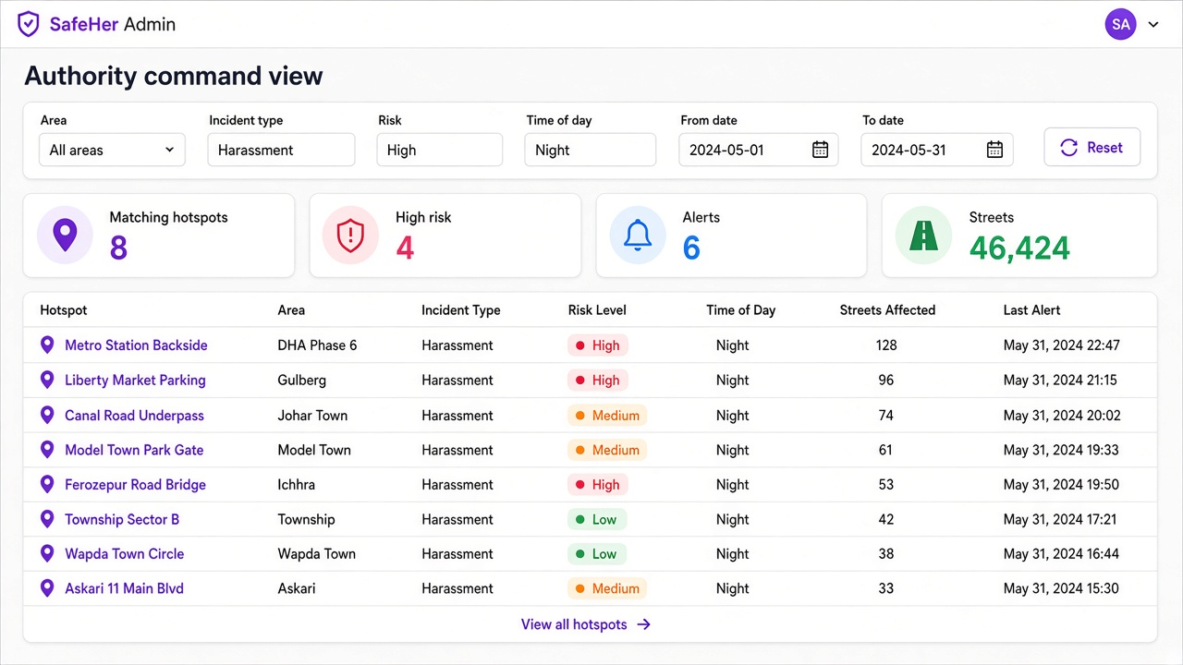
AUTHORITY DASHBOARD · FILTERS
Area · incident type · date range · time of day · risk · reset — table and map follow the same selection
BMS Institute of Technology and Management · Department of MCA · Phase I Interim Review · 2025–27
19 / 23

Slide 20
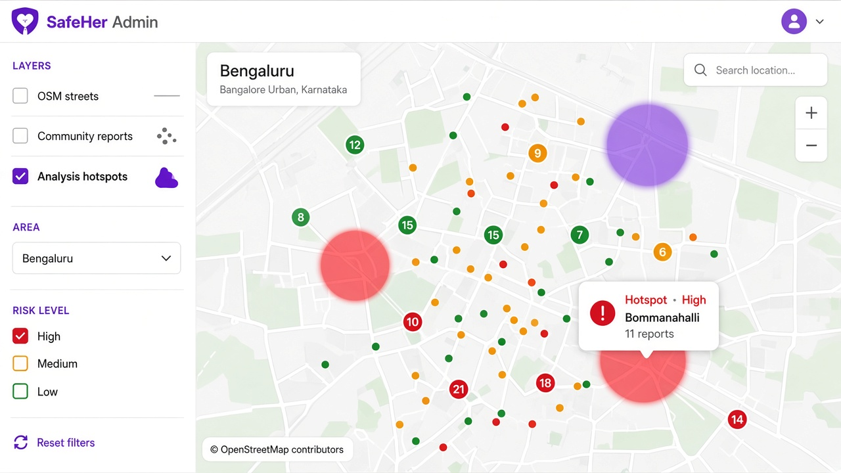
AUTHORITY DASHBOARD · MAP
Streets, community reports and analysis hotspots on one screen
• Each layer can be toggled.
• Filters match the hotspot table.
• A circle shows area, count, peak time and risk.
• The patrol hint is available for the briefing.
• GIS export from another team is not required.
BMS Institute of Technology and Management · Department of MCA · Phase I Interim Review · 2025–27
20 / 23

Slide 21
DATA SOURCES AND LIMITATIONS
What each layer is, and what it is not
OSM streets and camera locations
Observed geography
604,573 Karnataka streets across 30 districts; 5,578 cameras. Used as infrastructure context.
Street safety score
Modelled proxy
Nine infrastructure factors. Statewide average 4.16 / 10. It is not a crime rate.
Application reports (this run)
Synthetic, live-ready
1,079 demo rows across 30 districts. Live rows use the same table and the same pipeline.
Hotspots and alerts
Derived
1 km clusters of incident-like reports. Historical concentration, not a forecast.
KSP 2023–24 tables
Official, district grain
All 30 Karnataka districts. Never drawn as street dots.
CCTV video
Out of scope
Camera locations may be shown. Live Safe City streams are not used.
BMS Institute of Technology and Management · Department of MCA · Phase I Interim Review · 2025–27
21 / 23

Slide 22
STATUS AT INTERIM
The process is defined and implemented for local demonstration
Completed
Remaining after interim
• Shared title, module split and synopsis.
• OSM infrastructure dataset for Karnataka (30 districts, 604,573 streets).
• Application schema, HTTPS submit and Row Level Security.
• Analysis pipeline with self-check: 72 hotspots, 55 alerts, 30 districts.
• Authority dashboard: login, filters, hotspots, map.
• Security: anonymous reports, rate limit, admin session cookie.
• Run the Expo application and Next.js dashboard live in the laboratory.
• Feed live approved rows into analysis/input/live_reports.json on a schedule.
• Optional: hold new reports as pending until moderation.
• Public store deployment is optional. It is not required to demonstrate the process.
BMS Institute of Technology and Management · Department of MCA · Phase I Interim Review · 2025–27
22 / 23

Slide 23
Thank you
SafeHer gives authorities maps, filters and patrol alerts they can retrieve themselves —
without depending on anyone else to send the data.
Anusha K · 1BY25MC017 Aman Yadav · 1BY25MC012
Guide: Dr. M Sridevi Department of MCA, BMS Institute of Technology and Management
BMS Institute of Technology and Management · Department of MCA · Phase I Interim Review · 2025–27
23 / 23

