Slide 1
BMS INSTITUTE OF TECHNOLOGY AND MANAGEMENT
Department of Master of Computer Applications · Project Work Phase I (MMCA34) · Batch 2025–2027
SafeHer
— Dynamic Security Monitoring & Women’s Safety System
MODULE 1 · Anusha K (USN: 1BY25MC017) · Presenter
“Security Provision through Hotspot Identification and Risk Assessment for Women’s Safety in Public Spaces”
MODULE 2 · Aman Yadav (USN: 1BY25MC012)
“Women’s Safety and Dynamic Security Monitoring Mobile Application”
PROJECT GUIDANCE
UNITED NATIONS SUSTAINABLE DEVELOPMENT GOALS
Dr. M Sridevi
SDG 5: Gender Equality · Target 5.2
Department of Master of Computer Applications
BMS Institute of Technology & Management
Objective: Eliminate all forms of violence against all women and girls in public and private spheres.
BMS Institute of Technology & Management · Department of MCA · SafeHer · Phase I Interim Review
Slide 01 / 13
Notes:
Good morning, ma’am and respected evaluators. We are from the Department of MCA, BMS Institute of Technology and Management. Our complete project is titled SafeHer: an integrated data-driven platform for women’s safety in public spaces. SafeHer combines crowdsourced citizen incident reporting with backend geospatial analysis, hotspot identification, and risk assessment to provide law enforcement authorities with actionable, preventive patrol intelligence. Our project is guided by Dr. M Sridevi, and directly aligns with United Nations Sustainable Development Goal 5 — Gender Equality, particularly Target 5.2 to eliminate violence against women and girls. To implement this comprehensive solution, our project is divided into two complementary modules: Module 1 is my module: “Security provision through hotspot identification and risk assessment for women’s safety in public spaces.” I am Anusha K, 1BY25MC017, and my scope covers the analytical engine—including data cleaning, spatial clustering, hotspot identification, and risk scoring. Module 2 is “Women’s safety and dynamic security monitoring mobile application,” handled by Aman Yadav, 1BY25MC012, which focuses on the citizen mobile client and the administrative Authority Dashboard. Both modules communicate seamlessly through REST APIs to deliver the unified SafeHer platform.

Slide 2
INTRODUCTION & PROJECT CONTEXT
Data-Driven Safety Provision in Public Spaces
Moving from isolated, delayed incident records to proactive hotspot identification and risk assessment
1. The Existing Difficulty
2. The SafeHer Solution
3. Impact & Authority Value
Fragmented Incident Logging: Incidents are recorded across isolated police registers, helplines, and FIRs without unified spatial synthesis.
Lack of Spatial Concentration: Duty officers cannot readily identify WHERE repeated incidents concentrate; coarse city totals fail to pinpoint vulnerable streets.
Delayed Response: Traditional reporting is retrospective and bureaucratic, leaving law enforcement without actionable real-time spatial intelligence.
Patrol Resource Challenge: Without street-level recurrence insights, police patrol allocation remains arbitrary rather than evidence-based.
Four Integrated Pillars: Unites Mobile Incident Reporting, Location-Based Analysis, Hotspot Identification, and Risk Assessment.
Citizen Mobile Intake: Enables women to record incident type, timestamp, description, and high-accuracy GPS coordinates on the spot.
Spatial Processing Engine: Module 1 analyzes frequency, spatial concentration, and temporal recurrence across street grids.
Dynamic Dual Modules: Module 1 generates analytical intelligence; Module 2 delivers the mobile reporting app & authority dashboard.
Actionable Intelligence: Converts raw crowdsourced reports into categorized risk zones (Low, Medium, High) for clear situational awareness.
Preventive Patrolling: Enables law enforcement to focus patrol units on repeatedly affected locations before further incident escalation.
Centralized Monitoring: Equips authorities with interactive maps, filtering by region, incident type, date, and risk.
SDG 5.2 Contribution: Direct technological intervention to eliminate public violence against women and girls.
BMS Institute of Technology & Management · Department of MCA · SafeHer · Phase I Interim Review
Slide 02 / 13
Notes:
The main objective of our project is to improve women’s safety in public spaces using a data-driven approach. In the existing system, incidents may be reported through different sources, but it can be difficult to identify where incidents are repeatedly occurring and which locations require more attention. Our project combines incident reporting, location-based analysis, hotspot identification and risk assessment. The mobile application allows users to report safety-related incidents by providing details such as the incident type, date, time, description and geographical location. The reported information is then processed and analysed. Module 1 focuses on analysing the incidents and identifying hotspots and risk levels, while Module 2 focuses on the mobile application and authority dashboard. The main purpose is to provide useful information for authorities so that they can take preventive actions such as better monitoring and patrolling in repeatedly affected areas.

Slide 3
LITERATURE SURVEY & RESEARCH FOUNDATION
Theoretical Foundations & Academic Benchmarks
Grounded in environmental criminology, GIS hotspot clustering, and civic safety audits
1. Hotspot Theory & Spatial Concentration (Sherman, 1989)
2. GIS Crime Mapping & Patrol Allocation (Chainey & Ratcliffe, 2005)
Micro-Place Concentration: Landmark research establishes that crime and safety risks do not scatter uniformly; up to 50% of incidents concentrate in less than 3% of micro-places.
Scientific Justification: Validates hotspot mapping as an empirically sound planning methodology rather than subjective visualization.
Planning Benchmark: Hotspot grids represent legitimate operational units for municipal intervention and civic resource allocation.
Evidence-Based Dispatch: Demonstrates the efficacy of spatial clustering algorithms to deploy limited police patrols to high-density recurrence zones.
Grid-Based Density Modeling: Establishes standard methodologies for spatial density aggregation, inspiring SafeHer's 1 km analytical cell structure.
Operational Transparency: Spatial models provide transparent, defensible rationales for police administration briefings.
3. Built Environment Determinants (Nehme et al., 2017 & Safetipin Audits)
4. Research Gap & The SafeHer Technological Advance
Environmental Vulnerability: Quantifies how physical infrastructure—such as unlit street stretches, blind alleys, and isolated transit stops—directly shapes danger.
Perceptual Safety Factors: Validates collecting feeling safe/unsafe perceptions alongside formal crime reports.
Multivariate Risk Fusion: Supports SafeHer's methodology of integrating crowd reports with street lighting and police proximity layers.
Commercial SOS Limitations: Existing safety mobile apps rely almost exclusively on reactive SOS buttons, offering no preventive spatial insights.
Bureaucratic Delay Gap: Official police FIR records are retrospective, coarse, and delayed by weeks or months.
SafeHer Innovation: Delivers an automated, self-serve, rule-based geospatial hotspot and risk engine converting crowdsourced mobile GPS into daily patrol alerts.
BMS Institute of Technology & Management · Department of MCA · SafeHer · Phase I Interim Review
Slide 03 / 13
Notes:
Now I will present the literature survey and theoretical foundation of our project. Our work is grounded on well-established research in GIS crime mapping and environmental criminology. First, research by Sherman in 1989 on hotspot theory proved that crime is not distributed evenly across a city, but concentrates heavily in specific micro-places. This justifies why hotspot identification is a scientifically valid planning tool. Second, Chainey and Ratcliffe in 2005 demonstrated that GIS-based hotspot detection allows law enforcement to allocate patrolling and civic resources efficiently. In SafeHer, we use a 1-kilometer spatial grid to evaluate spatial density and recurrence. Third, environmental studies, such as Nehme et al. in 2017 and Safetipin audit studies, show that physical infrastructure like street lighting, CCTV surveillance, and police proximity strongly influence women’s perceived and actual safety. Finally, the research gap we address is that existing mobile applications are mostly reactive SOS panic buttons, while official police records are delayed and coarse. SafeHer bridges this gap by providing a proactive, rule-based, street-level geospatial hotspot and risk assessment platform using crowdsourced community data.

Slide 4
DATASETS & GEOGRAPHICAL RESOURCES
Fusing Incident Intelligence with Street Infrastructure
Grounding analysis on OpenStreetMap geography, Bengaluru datasets, and dynamic mobile reporting
Source A: Incident Data & Real-Time Reporting
Geographical Framework & Infrastructure Fusion
Incident Attributes: Captures incident category (harassment, feeling unsafe, stalking), date, time of day, description, and GPS coordinates.
Historical Baseline: Synthesized incident records linked directly to street geometries rather than aggregated district sums.
Dynamic Mobile Reports: Mobile application continuously feeds fresh citizen reports into the database, keeping spatial analysis alive.
OpenStreetMap (OSM) Integration: Uses OpenStreetMap through Overpass API for real-world geometry, road classes, and public POIs.
Street-Level Resolution: Pins every record to precise street segments rather than misleading broad district polygons.
Infrastructure Safety Determinants: Evaluates physical urban safety determinants:
• Public Lighting Condition: Assesses lit streets vs. unlit stretches to quantify darkness vulnerability.
• CCTV Surveillance Density: Surveillance camera locations to evaluate deterrence factors.
• Police Station Proximity: Distance in meters to nearest law enforcement post.
Continuous Data Fusion: As new incidents arrive via mobile app, they immediately fuse with the underlying infrastructure layer for unified re-scoring.
Source B: Bengaluru Street Safety Dataset
Current Focus: Bengaluru: Structured Excel dataset ('bengaluru_street_safety_REAL.xlsx') tailored to Bengaluru public spaces.
Built Environment: Encompasses roads, streets, intersections, and public transit nodes.
Infrastructure Indicators: Includes prototype & assumed safety attributes: street lighting condition, surveillance presence, and police proximity.
Demonstration Model: Serves as the empirical foundation for testing hotspot clustering and risk scoring algorithms.
BMS Institute of Technology & Management · Department of MCA · SafeHer · Phase I Interim Review
Slide 04 / 13
Notes:
For our project, we use different types of data and resources. The first important source is the incident data. This contains information related to reported incidents, including their location, date, time and type. We also use geographical and public infrastructure information. For geographical information, we use OpenStreetMap and related geographical resources. The available Excel dataset is currently focused on Bengaluru. The dataset contains information related to roads, streets and buildings, along with prototype or assumed infrastructure attributes such as lighting and surveillance. These infrastructure attributes are used for the project analysis and demonstration. In addition to the existing dataset, new incident information can come from the mobile application. This allows the system to combine existing data with newly reported incidents.

Slide 5
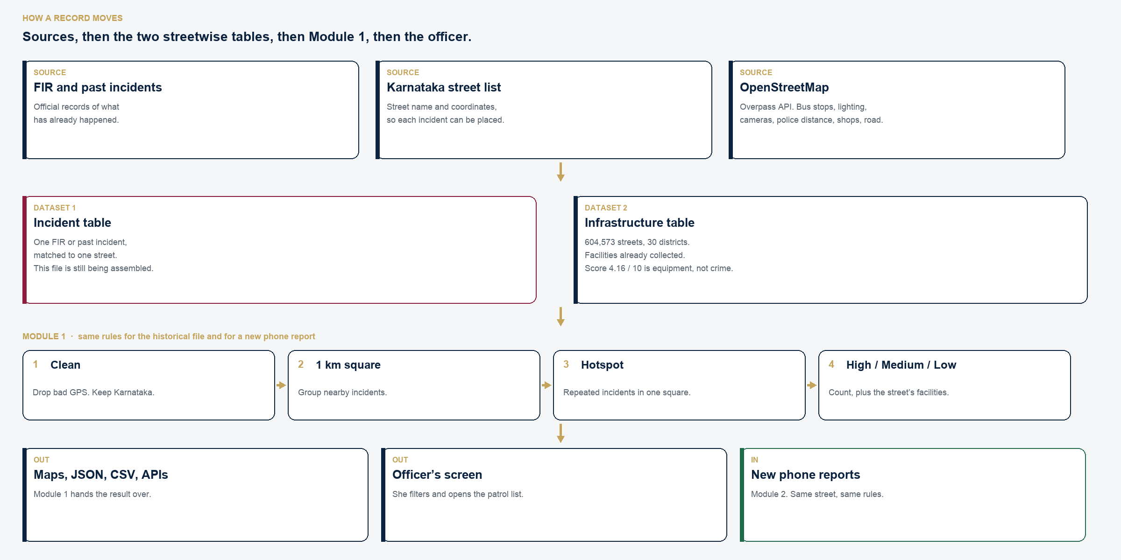
COMPLETE SYSTEM DATA FLOW
From Mobile Capture to Authority Decision-Making
End-to-end data pipeline from citizen input through FastAPI, Module 1 analytics, to the Authority Dashboard
BMS Institute of Technology & Management · Department of MCA · SafeHer · Phase I Interim Review
Slide 05 / 13
Notes:
This slide shows the complete data flow of our project. First, we have the existing data and the new incident data collected through the mobile application. The incident information is sent through an API to the backend. The backend stores the information in the database. After that, Module 1 performs data preprocessing and incident analysis. The data is analysed based on factors such as incident type, date, time, location, frequency and recurrence. Then we perform geospatial analysis to understand where incidents are concentrated. Based on this analysis, we identify hotspots and assign different risk levels such as Low, Medium and High. The analytical results are then provided through APIs to the Authority Dashboard. The dashboard allows authorities to view the information using maps, charts and filters. The system can also support alerts and preventive patrolling based on repeated or concentrated historical incidents.

Slide 6
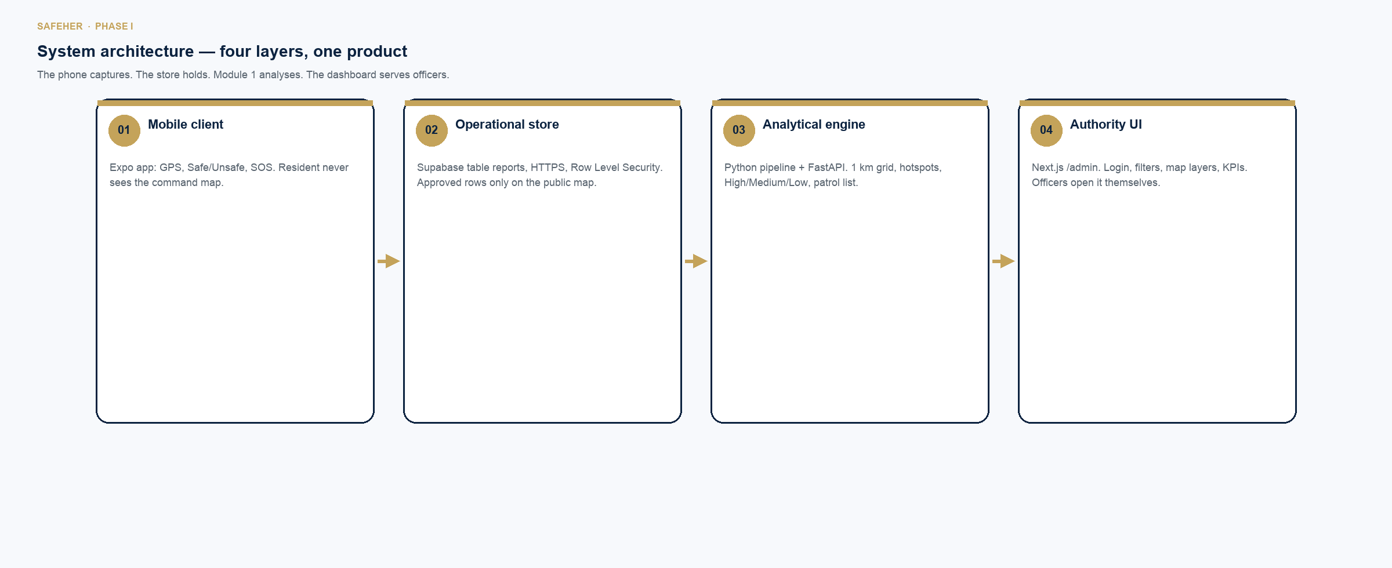
ARCHITECTURE & TECHNOLOGY STACK
Robust, Decoupled Full-Stack Architecture
Cross-platform client applications, Python analytical backend, and modern web dashboards
MOBILE CLIENT · React Native / Expo / Flutter
Cross-platform mobile client with GPS geolocation & offline safety caching
BACKEND SERVICES · Python 3 & FastAPI
High-performance asynchronous REST API handling report ingestion & pipeline triggers
DATABASE LAYER · MongoDB / JSON Store
Document database for flexible incident schemas and geospatial indices
ANALYTICS & GIS · Pandas, NumPy & GeoPandas
Data wrangling, spatial bounding, grid clustering, and risk scoring
MAPPING & VISUALS · Leaflet, Folium & Matplotlib
OpenStreetMap rendering, interactive risk markers, and analytical SVG charts
AUTHORITY DASHBOARD · React / Next.js, HTML5 & CSS3
Centralized administrative interface with multi-filter maps and patrol lists
BMS Institute of Technology & Management · Department of MCA · SafeHer · Phase I Interim Review
Slide 06 / 13
Notes:
This slide shows the architecture and technologies used in our project. For the mobile application, we can use a cross-platform framework such as Flutter or React Native. For the backend, we use Python and FastAPI. The database layer uses MongoDB for storing incident information. For data processing and analysis, we use libraries such as Pandas, NumPy and GeoPandas. For geographical visualization, we use OpenStreetMap along with Leaflet or Folium. For charts and analysis visualizations, we use Matplotlib or Plotly. The authority dashboard can be developed using technologies such as HTML, CSS, JavaScript and React. The communication between different components is handled using REST APIs and JSON. We can use tools such as Postman for API testing, and development tools such as VS Code and Android Studio.

Slide 7
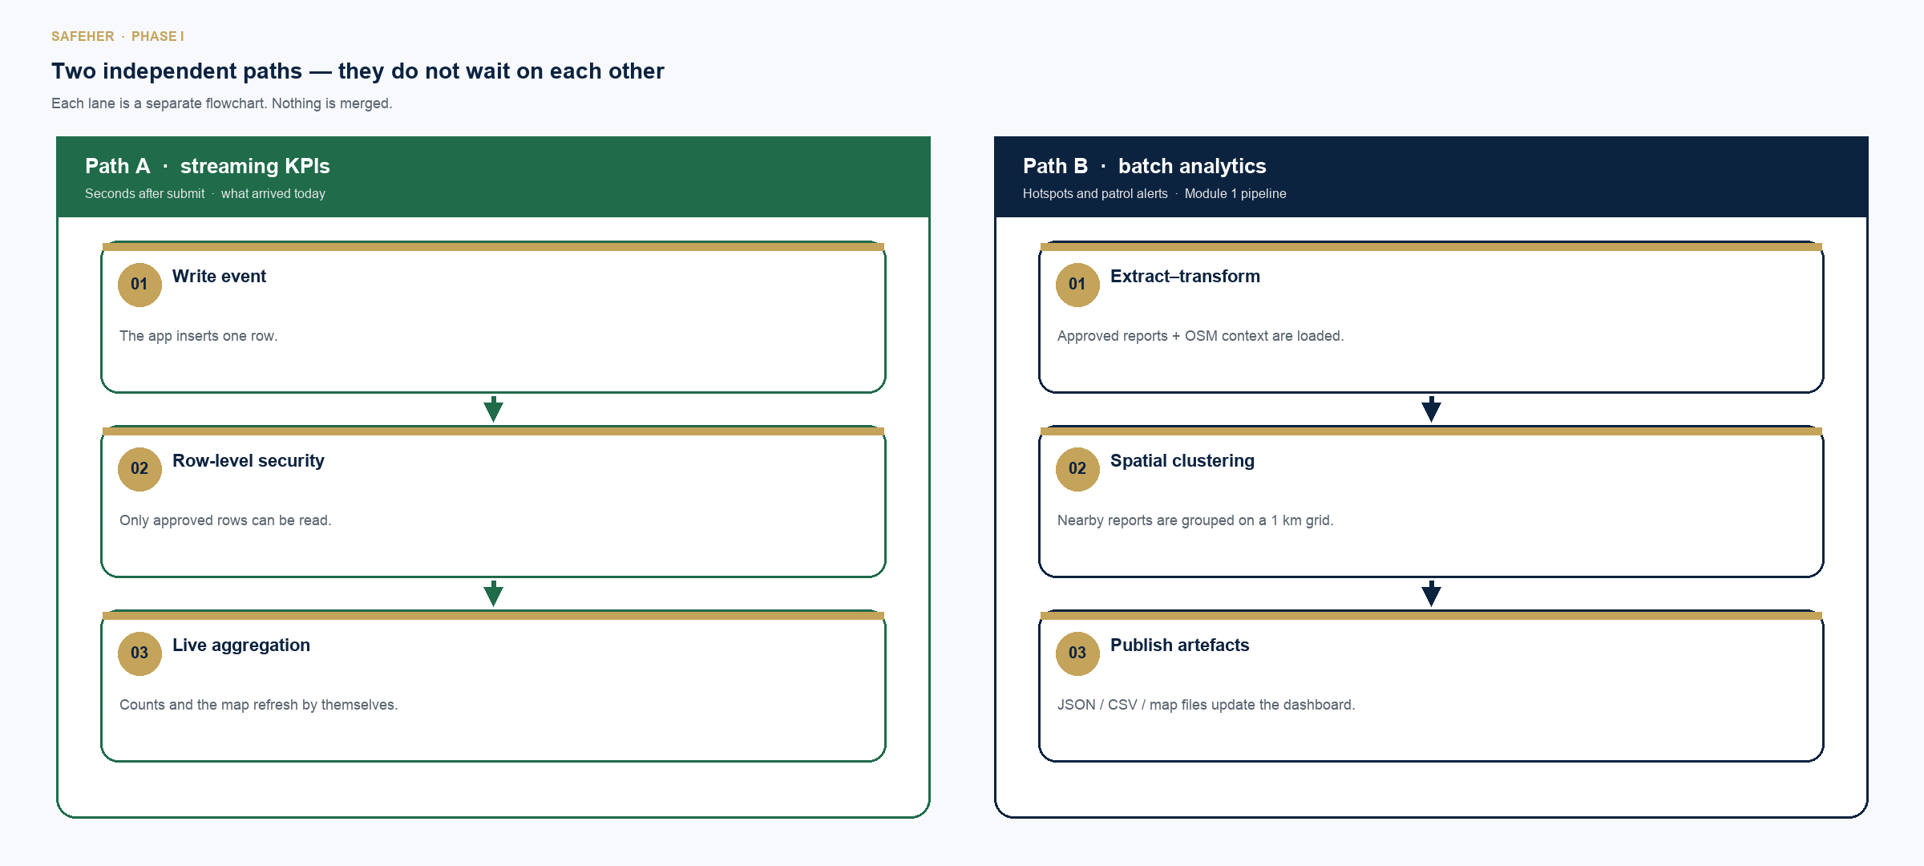
PROJECT MODULARIZATION & SCOPE DIVISION
Two Independent Modules · One Seamless System
Decoupled responsibilities enabling rigorous academic evaluation and robust production integration
BMS Institute of Technology & Management · Department of MCA · SafeHer · Phase I Interim Review
Slide 07 / 13
Notes:
Our project is divided into two major modules, but both modules work together as a single system. Module 1 is my module. It focuses on incident analysis, geospatial analysis, hotspot identification and risk-level assessment. My module takes the available incident and geographical data, processes it, identifies areas where incidents are concentrated or repeatedly reported, and produces the analytical results. Module 2 is handled by Aman. It focuses on the women’s safety mobile application and the authority dashboard. The mobile application allows users to submit incident reports. The authority dashboard allows authorized personnel to monitor the reported incidents, view maps and charts, apply filters and see hotspot and risk information. So, Module 1 provides the analytical results, while Module 2 provides the reporting and monitoring interface.

Slide 8
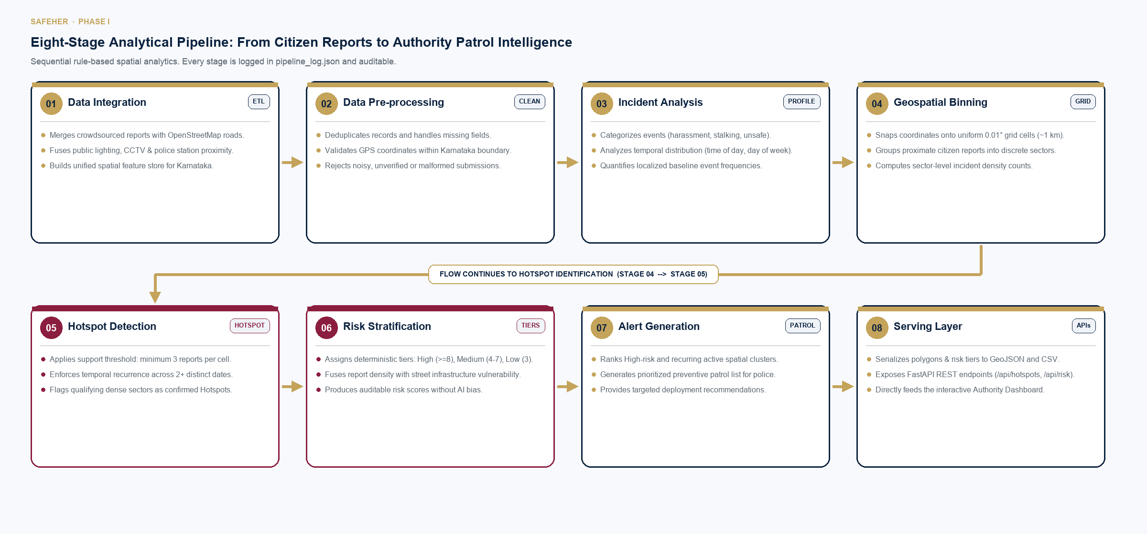
MODULE 1 METHODOLOGY: HOTSPOT & RISK ASSESSMENT
Eight-Stage Analytical Pipeline for Public Safety
Rule-based spatial clustering and multi-factor risk categorization based on historical incident density
BMS Institute of Technology & Management · Department of MCA · SafeHer · Phase I Interim Review
Slide 08 / 13
Notes:
Now I will explain my module in more detail through its eight-stage analytical pipeline. The first step is data integration, where we combine geographical context with incident reports received from the mobile app. Second is data preprocessing, handling missing values, deduplication, and validating GPS coordinates. Third is incident analysis, categorizing event types, temporal patterns, and recurrence. Fourth is geospatial binning, mapping reports onto a 1-kilometer spatial grid. From Step 4, the workflow moves directly into Step 5: hotspot detection, flagging areas with 3 or more incidents across distinct dates. Sixth is risk stratification, assigning Low, Medium, or High risk tiers using rule-based criteria. Seventh is alert generation, ranking high-risk areas to produce a preventive patrol list. Finally, eighth is the serving layer, publishing GeoJSON and REST APIs so that analytical results seamlessly feed the Authority Dashboard.

Slide 9
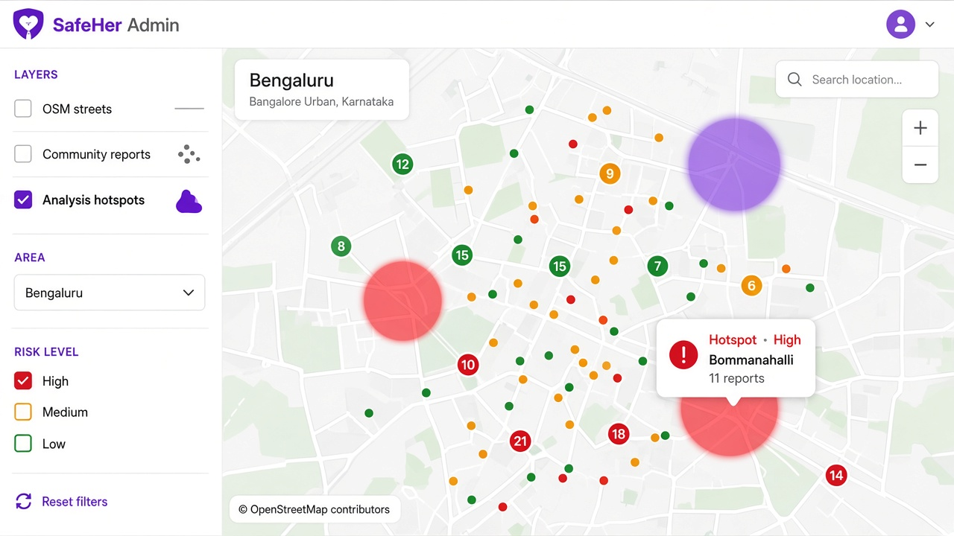
MODULE 1 SAMPLE ANALYTICAL RESULTS
Spatial Hotspot Visualization & Risk Classification
Demonstrating pipeline outputs on a 1,079-report validation run across surveyed public areas
Validation Run Summary Statistics
Total Community Reports: 1,079 citizen inputs processed through Module 1 pipeline.
Verified Incident Records: 534 safety events extracted (247 harassment, 287 unsafe perceptions).
Identified Hotspot Cells: 72 spatial grid cells (~1 km resolution) meeting recurrence thresholds.
Actionable Patrol Alerts: 55 priority security alerts generated for law enforcement deployment.
Risk Level Classification Breakdown
High Risk (30 Hotspots): Severe spatial clustering & harassment recurrence; priority for immediate police patrols.
Medium Risk (19 Hotspots): Moderate recurrence; scheduled for civic lighting upgrades and surveillance reviews.
Low Risk (23 Hotspots): Baseline risk zones (>=3 incidents); designated for ongoing monitoring.
OPERATIONAL VALUE FOR LAW ENFORCEMENT
Instead of sifting through voluminous paper registers, duty officers inspect a visual color-coded map and patrol list, directing personnel to verified recurring risk zones.
BMS Institute of Technology & Management · Department of MCA · SafeHer · Phase I Interim Review
Slide 09 / 13
Notes:
This slide shows the type of output produced by Module 1. The purpose of this output is to make the incident analysis easier to understand visually. Instead of looking at individual incident records, authorities can see where incidents are concentrated. The hotspot information can be represented on a map, along with the corresponding risk level. The system can categorize identified areas into Low, Medium and High risk levels. This makes it easier for authorities to focus their attention on areas with repeated or concentrated incidents. The results can also support preventive patrolling and security planning. So, the main output of Module 1 is not just the raw incident data, but a more useful representation of the data through statistics, geographical information, hotspots and risk levels.

Slide 10
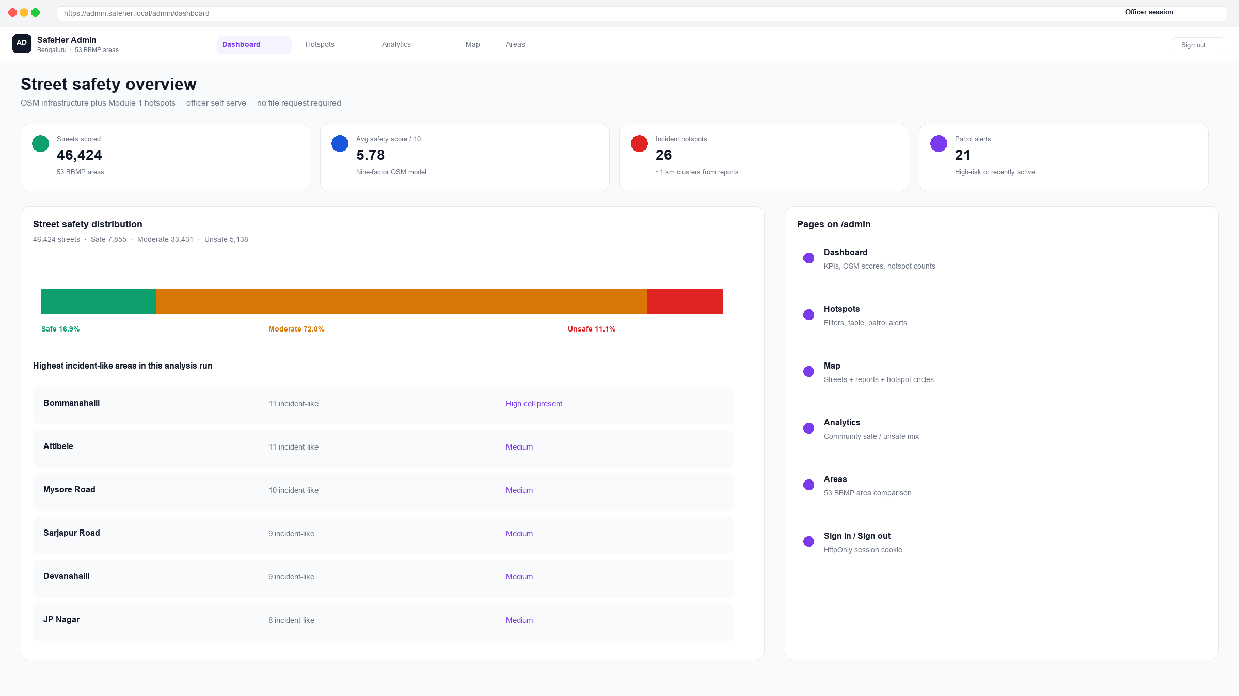
MODULE 2: MOBILE APPLICATION & AUTHORITY DASHBOARD
Dynamic Crowdsourced Reporting & Centralized Monitoring
Continuous incident intake and administrative oversight handled by Aman Yadav (1BY25MC012)
1. Citizen Mobile Reporting Application
Low-Friction Reporting: Quick report logging: incident category, date, time, description, and GPS coordinates.
Ambient Perceptions: Enables women to mark feeling safe or unsafe without requiring an overt crime event.
Privacy-First Ingestion: Anonymous submission protects citizen identity, encouraging honest reporting.
2. Dynamic Security Monitoring
Continuous Intake: System does not freeze on static historical files; new reports arrive live via API.
Dynamic Re-Clustering: Fresh reports automatically update Module 1 datasets for refreshed hotspot scoring.
Adaptive Heatmaps: Visual risk tiers evolve dynamically as neighborhood safety patterns shift.
3. Authority Monitoring & Daily Alerts
Multi-Dimensional Filtering: Filter incidents by district/region, incident type, date range, and risk tier.
Operational Patrol Alerts: Generates daily targeted alerts directing police units to recurring risk zones.
Centralized Command: Provides officers with unified administrative maps and actionable metric lists.
BMS Institute of Technology & Management · Department of MCA · SafeHer · Phase I Interim Review
Slide 10 / 13
Notes:
Now I will explain Module 2. Module 2 focuses on the Women’s Safety and Dynamic Security Monitoring Mobile Application. The application allows users to report women-safety-related incidents. While submitting a report, the user can provide information such as the incident type, date, time, description and geographical location. The information is sent through the API to the backend and stored in the database. The important feature is that new reports can continuously enter the system. This is why the system supports dynamic security monitoring. The new incident information can then be processed by Module 1. The Authority Dashboard provides authorized personnel with a centralized view of the information. Authorities can view incident statistics, geographical information, hotspots and risk levels. They can also filter the information based on factors such as region or city, incident type, date, time and risk level. The system can also generate daily alerts based on recent or recurring incidents to support preventive patrolling.

Slide 11
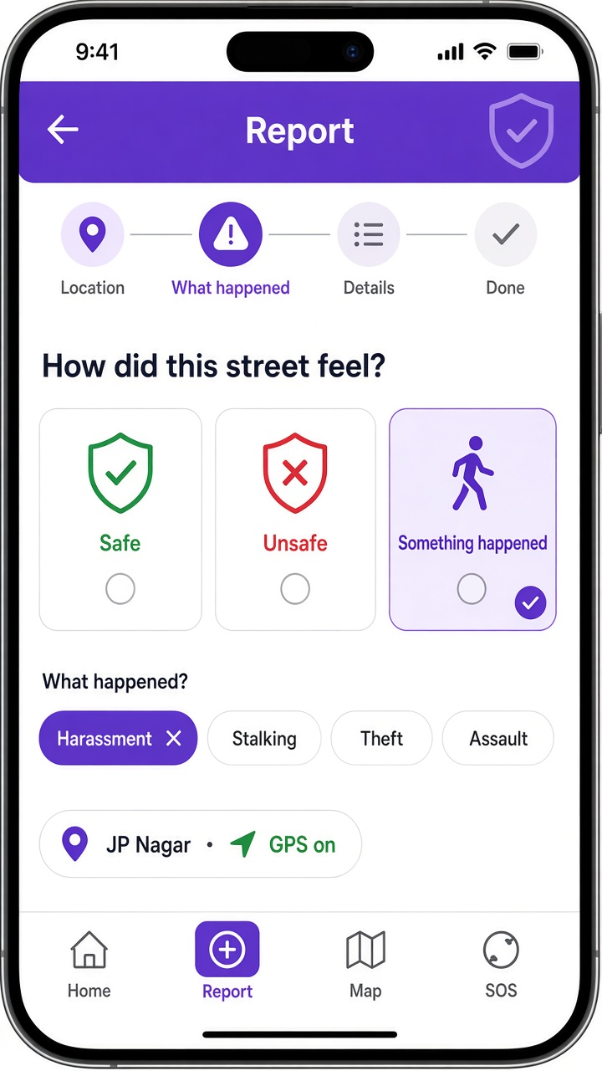
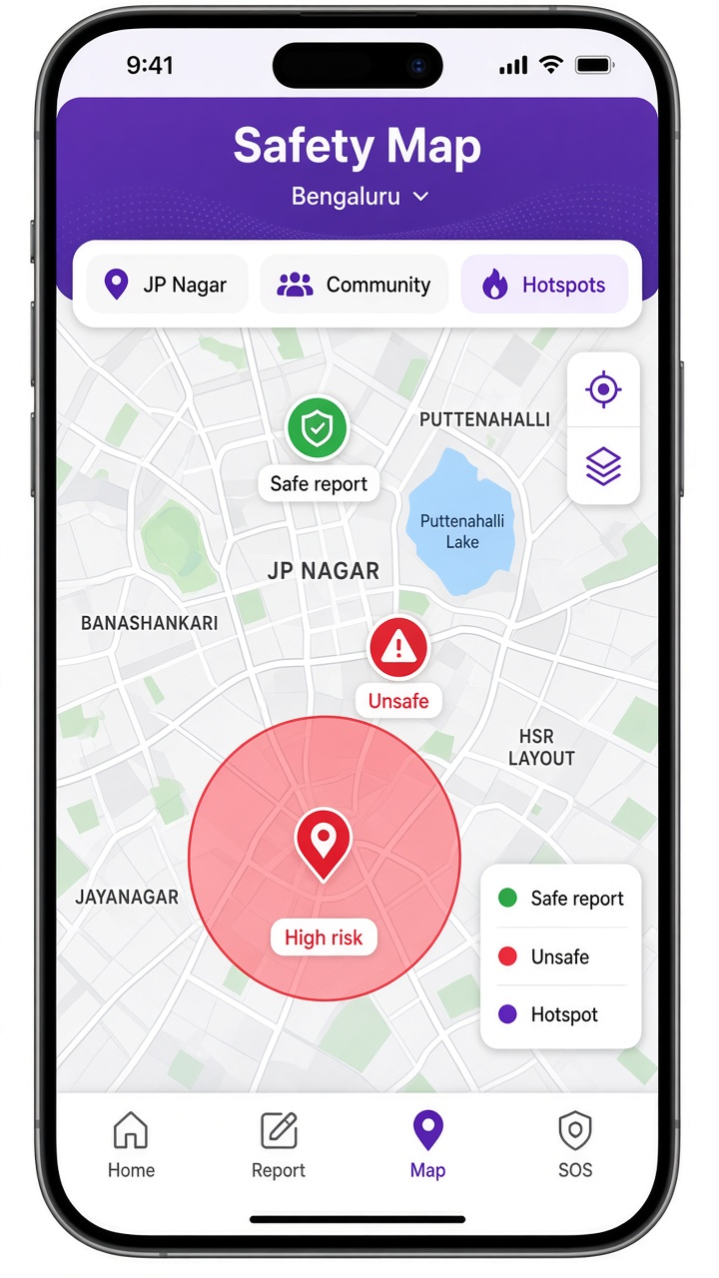
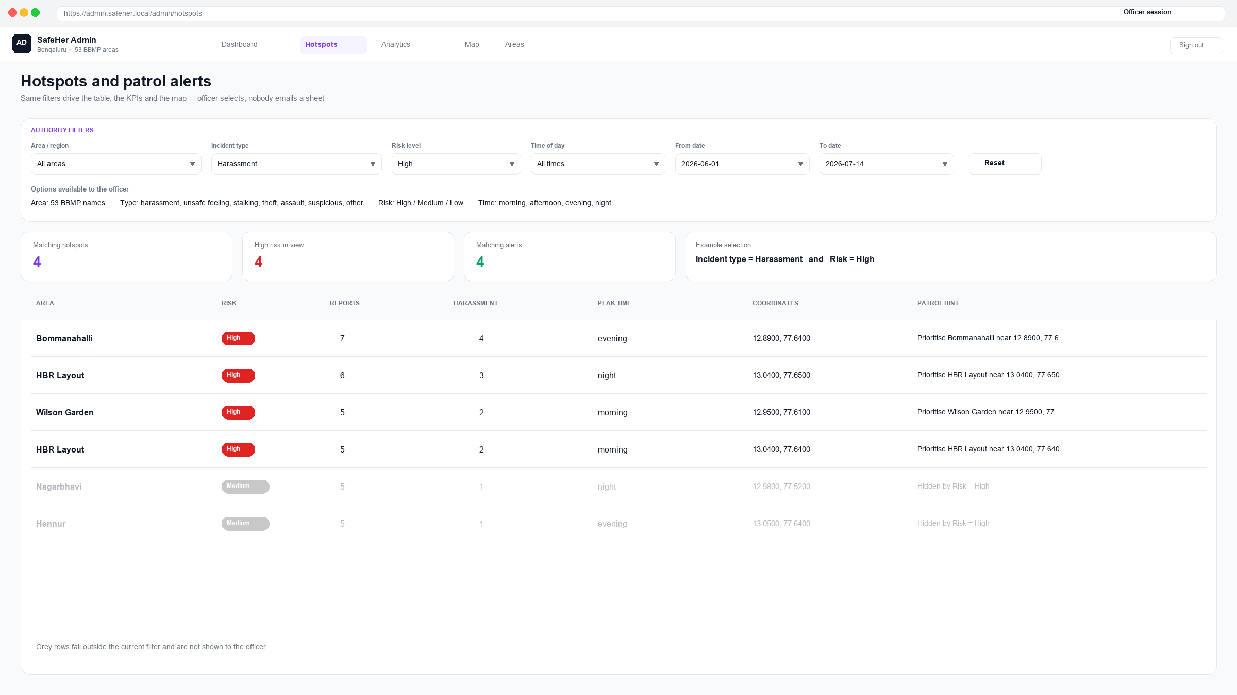
SAFEHER SYSTEM INTERFACES & USER EXPERIENCE
Integrated Mobile Client & Authority Command Center
Clean citizen-facing reporting screens paired with a multi-layered administrative dashboard
Authority Command Dashboard & Filtering Suite
• Centralized interface displaying incident statistics, heatmaps, and spatial clusters.
• Multi-dimensional filters: query by region/district, incident category, time of day, and risk tier.
• Automated dispatch recommendations: visualizes 55 daily patrol alerts without manual compilation.
Mobile Report Screen
Citizen Community Map
Allows citizens to select incident type, rating, note, and auto-populate GPS location.
Shows verified safe routes, community flags, and active hotspot zones for transit safety.
BMS Institute of Technology & Management · Department of MCA · SafeHer · Phase I Interim Review
Slide 11 / 13
Notes:
This slide shows the main screens or interfaces of our proposed system. The first part is the mobile application. The user can access the application and submit an incident report by providing the required information and geographical location. The second part is the Authority Dashboard. The dashboard provides a centralized interface for authorized personnel. It can display incident information using maps, charts and statistics. The authority can apply filters to focus on a particular region, incident type, date, time or risk level. The hotspot and risk information generated by Module 1 can also be visualized on the dashboard. This makes the system easier to use because the authority does not have to manually analyse individual incident records.

Slide 12
CONCLUSION & PROJECT CONTRIBUTIONS
Synthesizing Incident Intelligence for Public Safety
A validated end-to-end framework uniting citizen reporting, spatial analytics, and preventive patrolling
1. Unified Two-Module Platform
2. Actionable Preventive Policing
Seamless Integration: Successfully couples Module 1 (geospatial hotspot & risk engine) with Module 2 (mobile app & authority dashboard) via REST APIs.
Collaborative Division: Clear division of roles: analytical intelligence by Anusha K, client applications and dashboard by Aman Yadav.
End-to-End Pipeline: From a citizen tap on a phone screen to an officer's interactive patrol map, no manual intermediary is needed.
Beyond Reactive Logging: Transitions public safety from post-event FIR paperwork to proactive spatial awareness.
Clear Hotspots & Risk Tiers: Identifies 72 hotspots and categorizes 30 High, 19 Medium, and 23 Low risk zones with 55 daily alerts.
Optimized Resource Deployment: Enables police departments to focus limited patrol units where incidents repeatedly concentrate.
3. Dataset Validation & Scalability
4. Direct SDG 5 Alignment
Bengaluru Validation: Demonstrated and validated on Bengaluru street safety dataset ('bengaluru_street_safety_REAL.xlsx') and OSM infrastructure.
State-Wide Scalability: Modular architecture designed to seamlessly ingest additional Karnataka districts and municipal jurisdictions.
Extensible Features: Standardized JSON schemas ensure easy addition of future environmental sensor or lighting feeds.
Target 5.2 Elimination of Violence: Direct technological contribution to eliminating violence against women and girls in public spaces.
Empowering Citizens: Provides women with safe transit route visibility and an accessible voice to report safety concerns.
Civic Accountability: Supplies objective spatial evidence to support urban infrastructure upgrades and civic safety investments.
BMS Institute of Technology & Management · Department of MCA · SafeHer · Phase I Interim Review
Slide 12 / 13
Notes:
To conclude, our project combines women-safety incident reporting with data analysis and security monitoring. Module 1 focuses on analysing historical incidents, performing geospatial analysis, identifying hotspots and assigning risk levels. Module 2 provides the mobile application and Authority Dashboard through which incidents can be reported and monitored. The two modules are connected through the backend and APIs. The main benefit of the system is that it converts incident data into useful information such as hotspots, risk levels, geographical visualizations and alerts. This information can help authorities understand areas where incidents are repeatedly or heavily concentrated and support preventive patrolling and safety planning. Our current available dataset is focused on Bengaluru, while the overall system architecture can be extended to other regions or cities when suitable data is available. The project contributes to SDG 5 – Gender Equality, especially by supporting efforts to address violence and improve safety for women in public spaces. Thank you.

Slide 13
BMS INSTITUTE OF TECHNOLOGY AND MANAGEMENT · DEPARTMENT OF MCA
Thank You
We are ready to answer your questions.
PROJECT DETAILS
PROJECT TEAM & MODULE OWNERSHIP
SafeHer
Anusha K · 1BY25MC017 (Module 1 Lead)
Women’s Safety & Dynamic Security Monitoring System
Project Work Phase I · Subject Code: MMCA34
Academic Batch: 2025–2027
“Security provision through hotspot identification and risk assessment for women’s safety in public spaces.”
PROJECT GUIDE
Dr. M Sridevi
Aman Yadav · 1BY25MC012 (Module 2 Lead)
Department of Master of Computer Applications
BMS Institute of Technology & Management
“Women’s safety and dynamic security monitoring mobile application.”
BMS Institute of Technology & Management · Department of MCA · SafeHer · Phase I Interim Review
Slide 13 / 13
Notes:
Thank you, ma’am. I am ready to answer any questions.

