Slide 1
BRIDGE
Bridging Roles and Responsibilities through Interdisciplinary Dialogue and Agent Engagement
A Multi-Agent Retrieval-Augmented System for Interprofessional Healthcare Education
Anusha Umashankar · Hari Prasannaa Thangavel Ravi
Data Science Program, George Washington University

Slide 2
Problem Statement
Healthcare is a team sport. Training for it usually is not.
Interprofessional Education Challenge
Interprofessional Education (IPE) requires students from nursing, medicine, social work, public health, and allied fields to learn together, but coordinating schedules, standardized patients, and facilitators across schools is expensive and rarely happens at scale.
LLM-Based Alternative
LLM-based tutors are an obvious alternative: always available, infinitely patient, tunable by system prompt.
Two Critical Risks
Knowledge drift — clinical guidelines change faster than model training cycles.
Confident hallucination — LLMs state wrong doses with fluent certainty.
Imagine a student asking, "What's the naloxone dose for Julia?" and the AI confidently answers wrong.
Research Gap
No published system combines multi-agent role simulation with evidence-grounded retrieval for IPE and no one has measured the retrieval-layer design choices that matter for this setting.

Slide 3

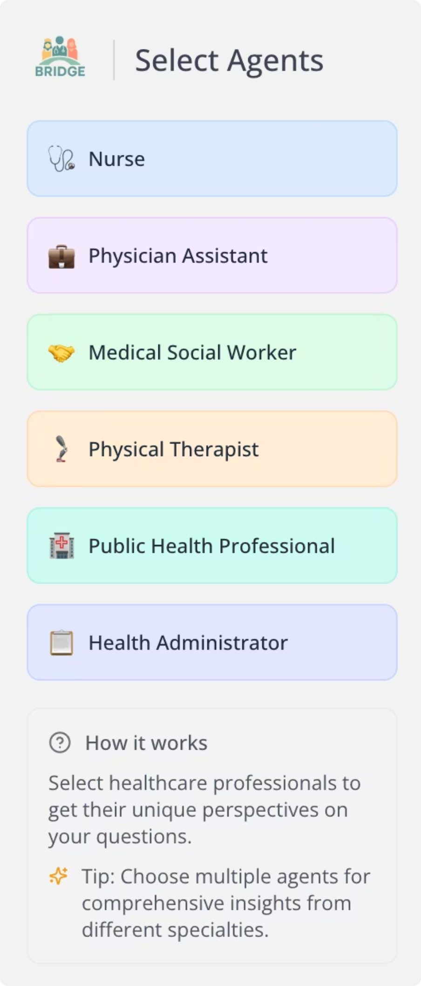
The Current BRIDGE System
Six specialized agents respond in parallel to every student question, each bringing their profession's perspective.
Six Role-Specific Agents
Agent Role
Focus Area
Nurse
Patient care, nursing observations
Physician Assistant
Diagnostics, treatment planning
Medical Social Worker
Social care, community resources
Physical Therapist
Rehabilitation, recovery
Public Health Professional
Prevention, population health
Health Administrator
Policy, resource coordination
Personalization
A student intake form (role, years of experience, academic credentials, opioid-related clinical exposure) is injected into every agent's system prompt. A nursing student with one year of experience gets explanations framed differently than a practicing public-health professional asking the same question.

Slide 4
What's Broken in Baseline BRIDGE
Four limitations motivate this work
1
No External Grounding
2
Single Hard-Coded Case
Responses come from model memory, not current clinical guidelines.
Only one opioid scenario; adding new cases requires a developer.
3
Unreliable Referral Behavior
4
No Evaluation Framework
Inter-agent handoffs break because text parsing is fragile.
No measurement of response quality or learning outcomes.

Slide 5


From Generic Answers to Evidence-Grounded Guidance
A demo of the quality jump BRIDGE delivers
Before RAG (Baseline)
After RAG (BRIDGE)
Student question: “What medications are used for opioid use disorder?”
Same student question
Agent response: “According to SAMHSA guidelines, buprenorphine is a first-line treatment. The typical induction dose is 2–4 mg sublingual on day one, increased to 8–16 mg daily by day three. It has a lower overdose risk than methadone and is preferred for office-based treatment.”
Agent response: “There are several medications that can help with opioid use disorder, including methadone and buprenorphine. These are commonly used in treatment programs.”
[Vague, generic, sometimes incorrect]
[Specific, evidence-grounded, cites sources]
How It Works
Each agent retrieves evidence only from its own profession’s curated sources: a nurse sees nursing literature, a physician sees clinical guidelines, a social worker sees community resources. Same question, six different evidence-grounded perspectives.

Slide 6
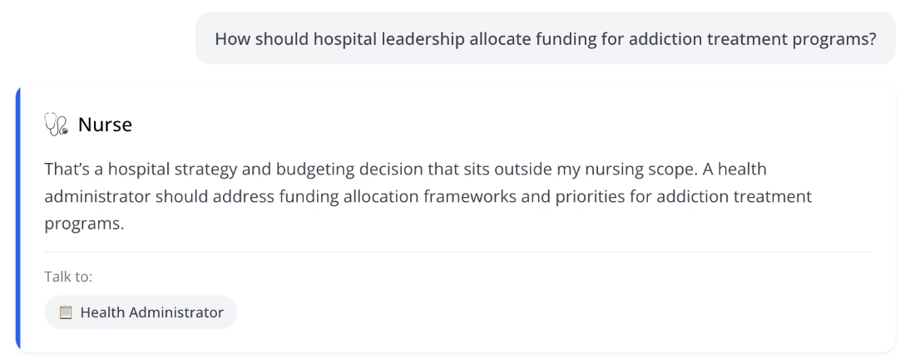
Structured-Output Referral System
Making expert handoffs feel seamless for students
The Problem
Unreliable Referral Behavior - Mimic the real clinical setting
Reliable Handoffs in Action
Student asks the Nurse agent: “How should hospital leadership allocate funding for addiction treatment programs?”
Nurse responds: “That’s a hospital strategy and budgeting decision that sits outside my nursing scope. A health administrator should address funding allocation frameworks”
A button appears: Talk to Health Administrator
Student clicks and the Health Administrator responds with a policy-grounded answer about liability protection and Good Samaritan laws.
Why It Matters
Students get a smooth, trustworthy experience: the right question reaches the right expert, every time, regardless of which model is responding.

Slide 7

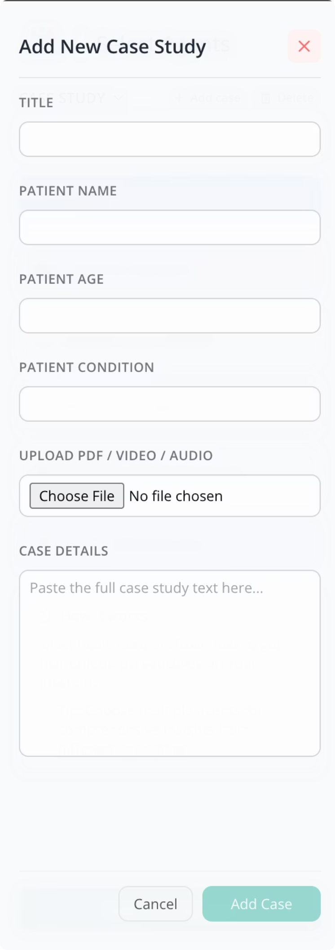
Admin-Driven Case Study Expansion
Unlocking BRIDGE beyond Julia Baker
The Problem
Baseline BRIDGE ships with a single opioid overdose scenario. Adding new cases required a code deploy and developer involvement.
The Solution
Instructors add new patient cases from a sidebar form: no code, no developer needed. New cases go live instantly for all students.
Supported case types:
Text-based scenarios (HPI, exam findings, labs)
Audio recordings of patient interviews
Video of clinical simulations or procedures
Impact
Separates content authoring from software engineering: instructors own the curriculum. Future-proofs BRIDGE for new domains: diabetes management, pediatric emergency, multi-morbidity cases.

Slide 8
How We Validated It
Systematic testing across chunking, retrieval, and filtering
We tested the system rigorously across three dimensions to make sure the results were reliable, repeatable, and cost-aware.
Chunking strategies — 5 approaches × 4 token budgets × 4 retrieval depths = 80 configurations tested to find the best balance between quality and cost.
Retrieval models — 7 embedding and search models, spanning dense neural and sparse lexical methods, to determine what performs best on clinical text.
Filtering approaches — Topic-based vs. profession-based filtering to identify which metadata strategy improves retrieval accuracy.
Result
Recursive chunking at 7000 tokens with k=7 retrieval depth, using BGE-M3 embeddings and profession-based filtering, delivered the best trade-off between response quality and computational cost.

Slide 9
Personalization in Action
The same question gets different answers depending on who's asking and which agent responds.
Example 1: User Profile Matters
Question: “How do you see your role as a nursing professional as it relates to the opioid crisis in this community”?
First-year nursing student gets:
Practicing Nurse with 5 years of experience gets:
"benzodiazepines plus opioids greatly raise overdose risk."
”watching for recurrent hypoventilation, aspiration, and polysubstance effects given the benzodiazepine screen.”
Example 2: Agent Role Matters
Same overdose scenario, different professional lenses:
Nurse response
Social Worker response
Physician response
"Check airway, breathing, circulation. Administer naloxone IM or IV. Monitor for re-sedation."
"Connect patient with harm reduction services, housing support, and community recovery programs. Assess for trauma and mental health needs."
"Assess for other drug involvement. Consider ICU admission if respiratory depression severe. Plan medication-assisted treatment."
Why It Works
Each agent draws from its own profession's evidence base. Students see how different healthcare roles approach the same clinical situation and that's interprofessional education.

Slide 10
Conclusion & Future Work
What BRIDGE Delivers
BRIDGE gives every healthcare student access to a full interprofessional team — available 24/7, grounded in real clinical guidelines, and personalized to their experience level.
It solves the IPE coordination problem: no need to schedule across schools, no need to hire standardized patients, and no need to coordinate facilitators. The result is a training experience that scales infinitely, while cost per student approaches zero.
What's Next
01
02
Clinical validation — User study with healthcare students measuring outcomes vs. traditional IPE formats. This is the credibility milestone.
Domain expansion — Extend beyond opioid education to diabetes management and other high-priority clinical domains.
03
Adaptive learning — System prompts that respond to student performance in real time, not just static intake data. Personalization gets smarter as students progress.
In short, BRIDGE turns interprofessional education from a logistics challenge into a scalable, always-available learning platform.

Slide 11
Experience BRIDGE
See the Interprofessional team in action
BRIDGE is live and ready to use. Ask a clinical question and watch six healthcare professionals respond from their unique perspectives: all grounded in real evidence, all personalized to your experience level.
Visit the live demo:
http://35.169.252.108:8080/
Ask any clinical question
See how different professionals approach the same case
Experience personalized explanations based on your role

Slide 12
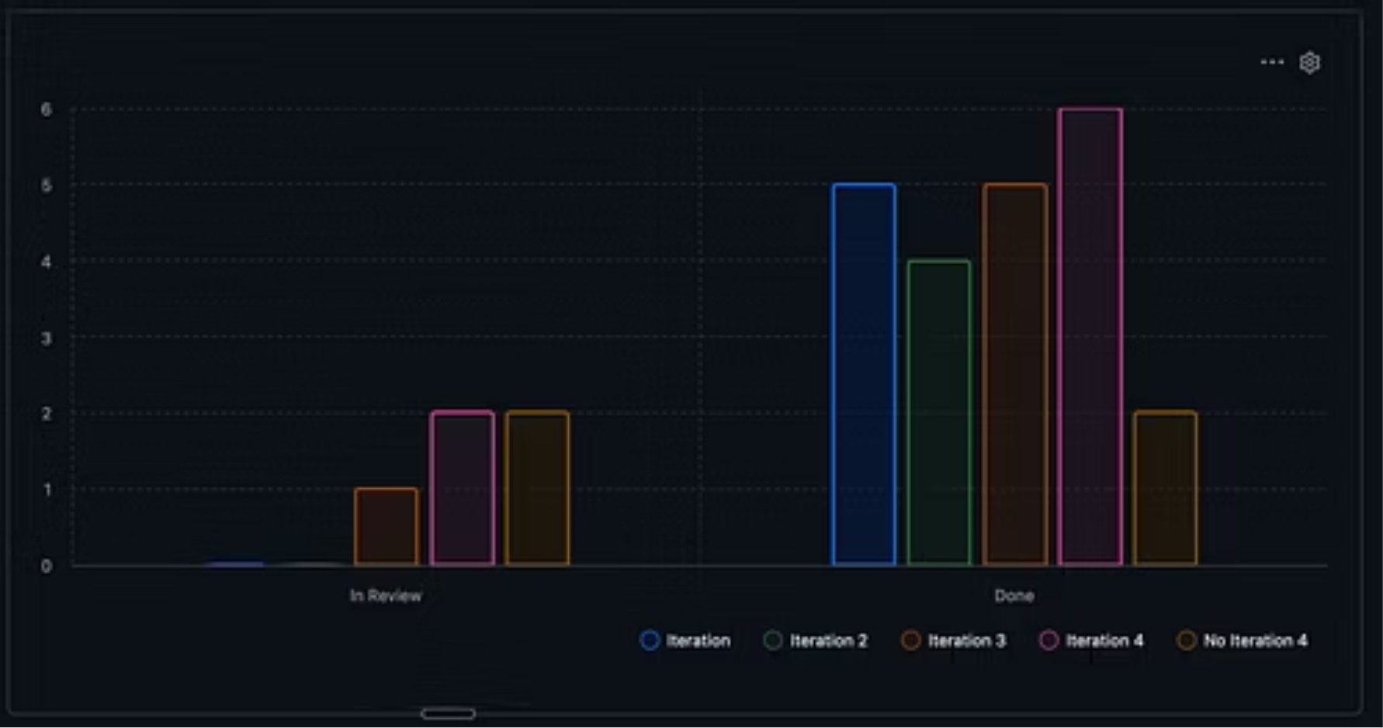
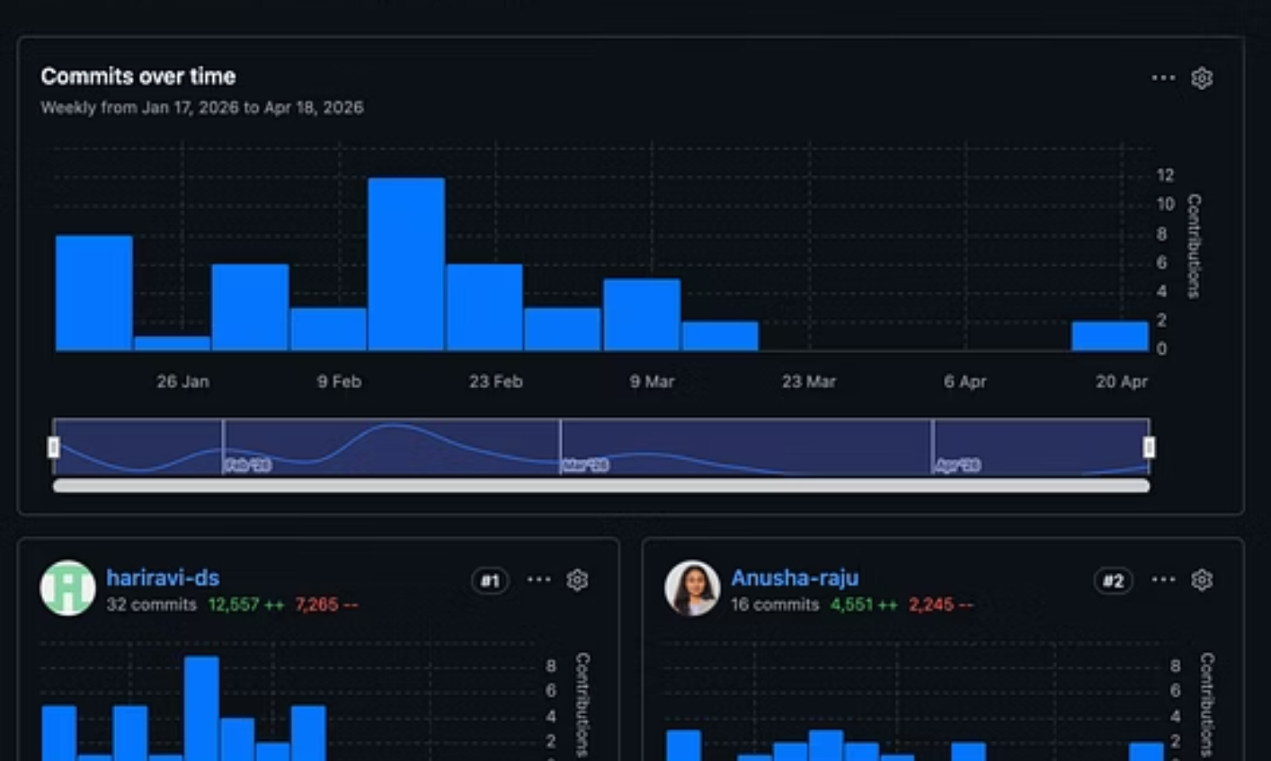
Status Chart
Contributions Chart

Slide 13
Thank You!
For your time and attention.
We are excited about the future of interprofessional education with BRIDGE.
Feel free to reach out with any questions.

