Slide 1
Smart Parking: Parking Space Detection Using Computer Vision

Slide 2
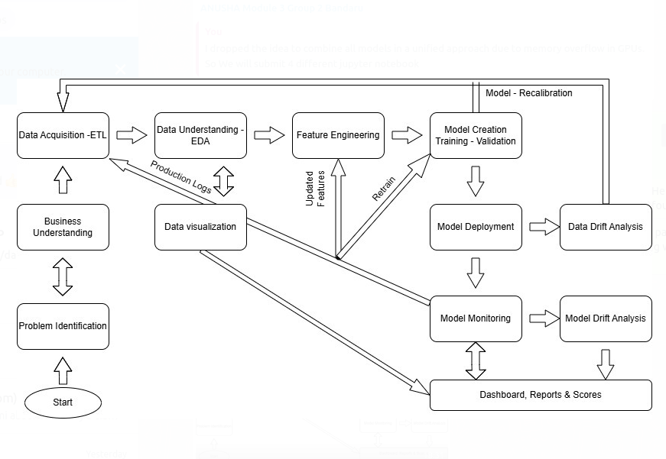

Slide 3
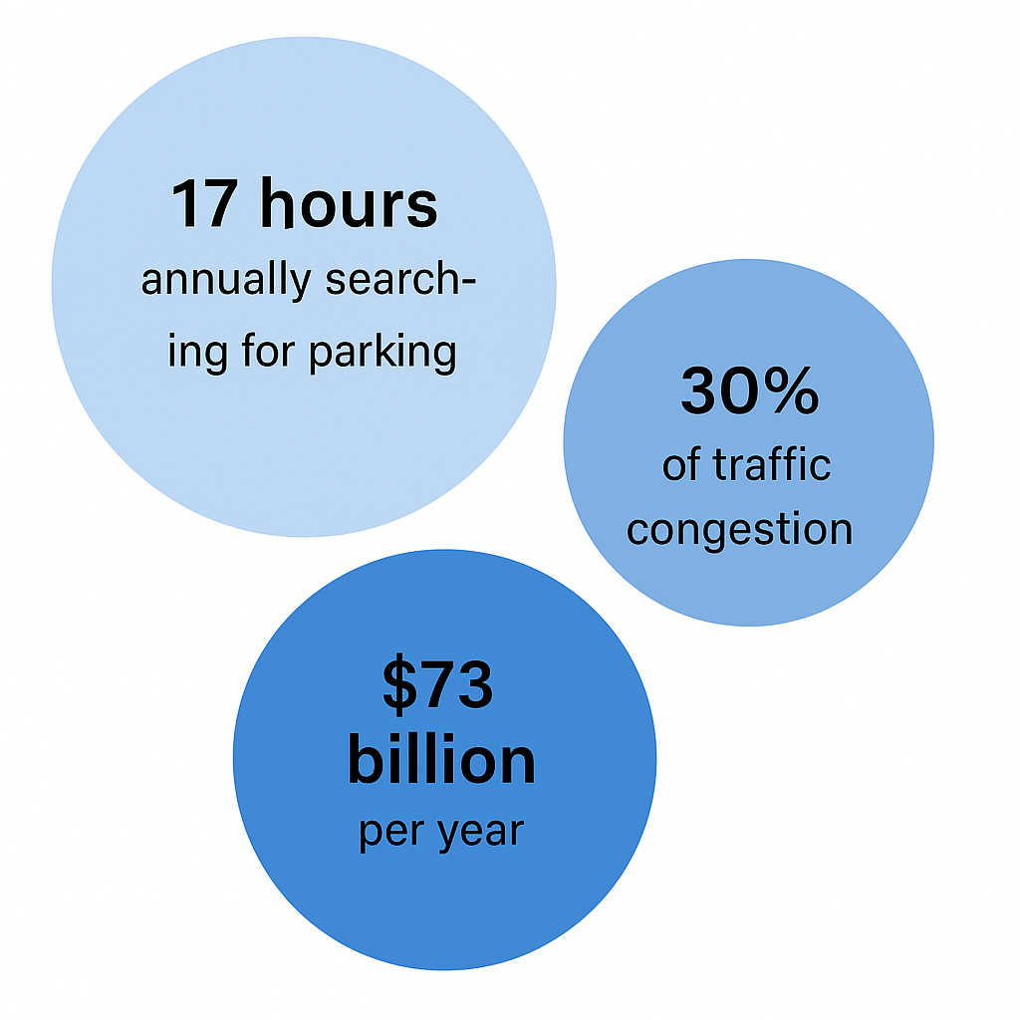
Problem Identification
Urban parking scarcity is a major issue in densely populated cities.
U.S. drivers spend 17 hours/year searching for parking, costing $73 billion annually.
Cruising for parking" accounts for up to 30% of urban traffic congestion.
Prolonged idling and circling cause increased emissions and air pollution.
High parking demand impacts urban planning — e.g., monthly parking in NYC exceeds $700.
Need for intelligent parking systems to:
Optimize space usage
Reduce environmental impact
Improve urban transport efficiency

Slide 4
Translating the Problem into a Data Science Challenge
Parking detection = a computer vision (CV) problem.
Core task: Binary classification — Is a parking slot occupied or vacant?
CV techniques involved:
Image Classification for static frames
Object Detection (e.g., YOLO) for more dynamic scenarios (not in scope)
Image Segmentation for pixel-level detail (also out of scope)
Solution uses supervised deep learning trained on labeled image patches.

Slide 5
Data Acquisition
Dataset used: PKLot (Public Benchmark Dataset)
Total: 12,417 high-resolution images (1280×720)
Captured via HD-5000 webcams from rooftops
Time span: 30+ days, captured every 5 minutes
Covered 3 locations, multiple floors, and varied weather conditions

Slide 6
Data Understanding
Images labeled using an interactive annotation tool
Dataset includes:
Balanced classes: ~48.5% occupied, ~51.5% vacant
Environmental diversity: Sunny, rainy, overcast
Visual challenges: Shadows, reflections, overexposed/rainy areas
Annotations provided in XML format:
Bounding boxes + occupancy status
Total: ~695,000 cropped parking slot images with binary labels
Pre-processed using skew correction for consistency
Eliminates need for manual annotation or YOLO training

Slide 7
AlGorithm Discussion
For brevity, I am discussing only the finally selected transformer model for deployment.
The Vision Transformer (ViT) is a deep learning architecture introduced by Dosovitskiy et al. in 2020
It is based on transformer model architecture (developed for NLP)
ViTs treat images as a sequence of patches and process them using global self-attention mechanisms
It demonstrates that a pure transformer applied directly to sequences of image patches can work exceptionally well on image classification tasks (does not process local spatial neighborhoods using convolutions like CNN

Slide 8
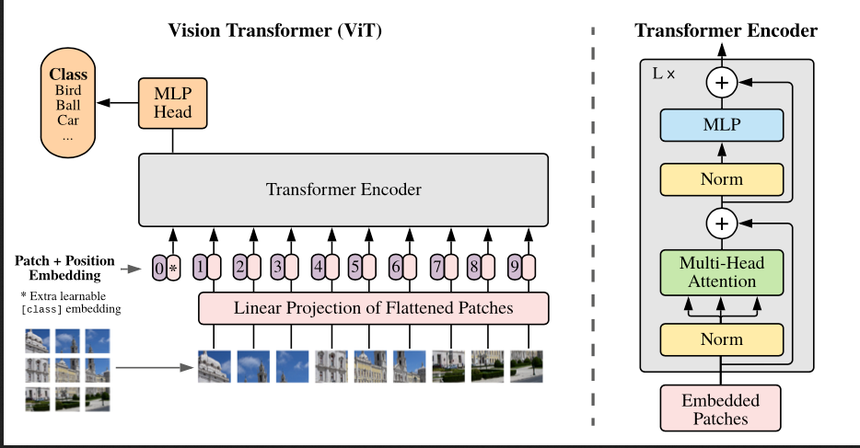
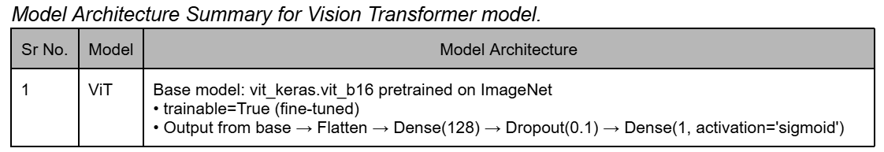
Core architecture
Core Architecture:
(a) Image to Patch Embedding
(b) Positional Embeddings
(c) Transformer Encoder
(d) Classification Head

Slide 9
Feature engineering
Image Resizing :
Normalization :
Data Augmentation:
Label Encoding:
Dropout:
Early Stopping:
Input Format:

Slide 10
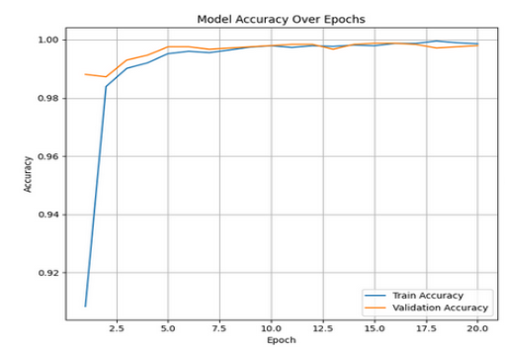
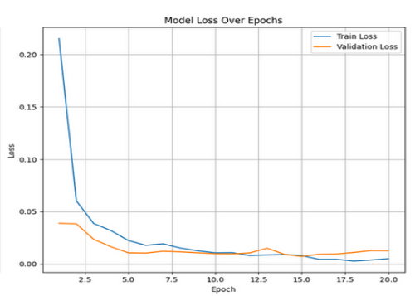
model training
Highlights of Model Training Across Experiments
Models improved steadily, with no signs of overfitting—validation accuracy stayed high.
Data augmentation, dropout, and learning rate scheduling enhanced generalization.
Early stopping was used to restore the best model weights.
Vision Transformer had the best performance, peaking at 99.88% accuracy with a validation loss of 0.0072.

Slide 11
Strengths and weaknesses of vIT
Strengths of ViT
Global context modeling: Self-attention allows ViTs to consider long-range dependencies without inductive biases like locality.
High accuracy on large datasets: With sufficient data and compute, ViTs outperform CNNs on large-scale image recognition tasks.
Flexibility: Can generalize to multi-modal data and integrate with text or language inputs in vision-language tasks.
Limitations
Data-hungry: ViTs require much larger datasets than CNNs to achieve comparable performance when trained from scratch.
Compute-intensive: Transformers are slower and more memory-heavy due to quadratic complexity of self-attention.
No built-in spatial hierarchy: Unlike CNNs, ViTs don’t inherently learn low-level to high-level features unless explicitly augmented.

Slide 12
Evaluation metrics
We evaluated all our four models based on the following metrics:
Precision
Recall
F1 Score
AUC-ROC

Slide 13
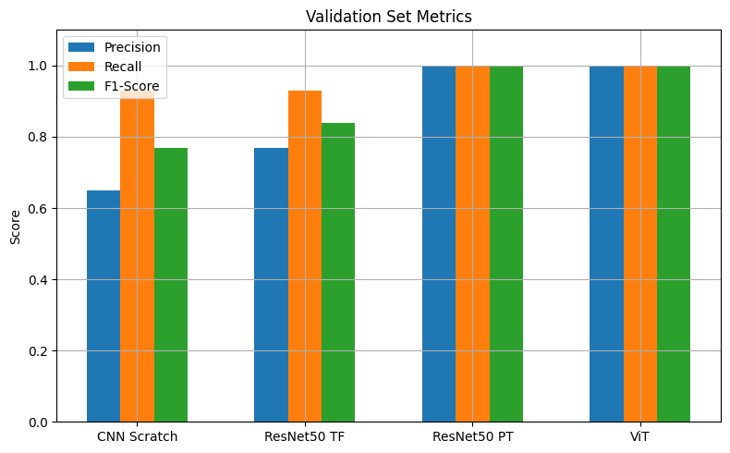
Validation Set metrics

Slide 14
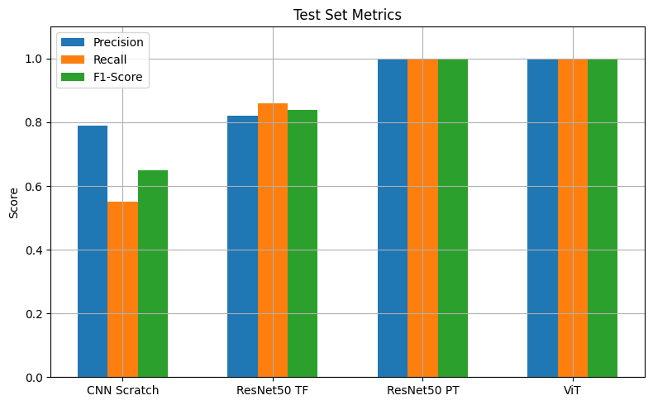
Test Set metrics

Slide 15
Auc-roc overview
Model | AUC-ROC (Validation) | AUC-ROC (Test)
CNN from Scratch | 0.9438 | 0.9494
ResNet50 (TensorFlow) | 0.9687 | 0.9695
ResNet50 (PyTorch) | 0.9999 | 1.0000
Vision Transformer (ViT) | 0.9998 | 1.0000

Slide 16
Performance summary
Model | Best F1 Score | AUC-ROC | Best Threshold
CNN from Scratch | 0.93 | 0.9438 | 0.32
ResNet50 (TensorFlow) | 0.96 | 0.9695 | 0.55
ResNet50 (PyTorch) | 1.00 | 0.9999 | 0.03
Vision Transformer (ViT) | 1.00 | 0.9998 | 0.57
All models showed strong training behavior; no signs of overfitting.
ViT selected for deployment due to high accuracy, interpretability, and stability.

Slide 17
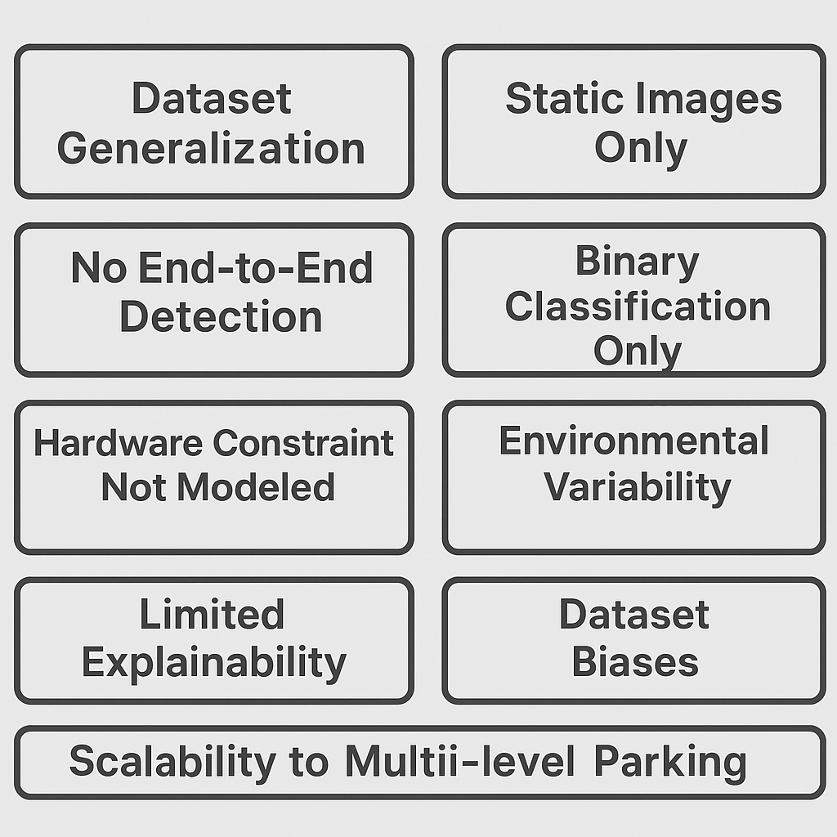
limitations

Slide 18
Future Scope
Technical Enhancements
Area | Future Direction
End-to-End Detection | Use YOLO/SSD to detect & classify in raw parking lot images
Real-Time Processing | Extend to video feed analysis for live parking status updates
Robustness | Train with data in night, fog, snow, motion blur, etc.
Edge Deployment | Deploy on Jetson Nano, Raspberry Pi using quantization/pruning

Slide 19
Future Scope
User Experience & Integration
Area | Future Direction
Mobile App | Live slot status, navigation, and reservations
Explainability | Use Grad-CAM or attention maps for ViT decision analysis
Smart City Integration | Connect to municipal dashboards and traffic systems
Model Monitoring | Use tools like MLFlow, Airflow to detect drift and retrain

Slide 20
Conclusion
Explored 4 deep learning models for detecting empty vs. occupied parking spaces using the PKLot-v2 640 dataset.
Models compared:
CNN from scratch (TensorFlow): Custom-built CNN without transfer learning
ResNet50 + Custom Classifier (TensorFlow)
ResNet50 (PyTorch)
Vision Transformer (ViT)
Built a Gradio-based Web UI for demo and local deployment.

Slide 21
Thank you
Anusha Bandaru| Rakesh Bhatija| Tejas Desai

