Slide 1

Analytical CRM Development for a Bank

Slide 2
Data Introduction
RowNumber: Used for reference or indexing within the dataset
CustomerId: A unique identifier assigned to each customer
CreditScore: This numerical value represents a customer’s creditworthiness. The credit scores are categorized as follows:
Excellent: 800–850, Very Good: 740–799, Good: 670–739, Fair: 580–669, Poor: 300–579
GeographyID: A numerical identifier corresponding to the customer’s geographical location
GenderID: A numerical code representing the customer's gender (e.g., '1' for male and '2' for female)
Age: The age of the customer
Tenure: The number of years the customer has been with the bank
Balance: The current balance in the customer’s account.
NumOfProducts: The number of products a customer has purchased through the bank
HasCrCard: Indicates whether a customer has a credit card (1 for yes, 0 for no)
IsActiveMember: Identifies if a customer is active (1 for active, 0 for inactive)
Estimated Salary: The estimated salary of the customer
Exited: Indicates if the customer left the bank (1 for exited, 0 for retained)
Bank DOJ: The date when the customer joined the bank

Slide 3
Understanding Customer Churn and Its Impact
Customer churn or the rate at which customers stop using a company’s products or services, is a critical metric for banks as it directly impacts revenue and profitability. In this presentation, we will analyze our bank's customer churn rates, focusing on factors such as gender, credit card ownership, number of products used, credit score, and geography. Our goal is to identify the factors contributing to churn and propose strategies to improve customer retention and satisfaction.

Slide 4

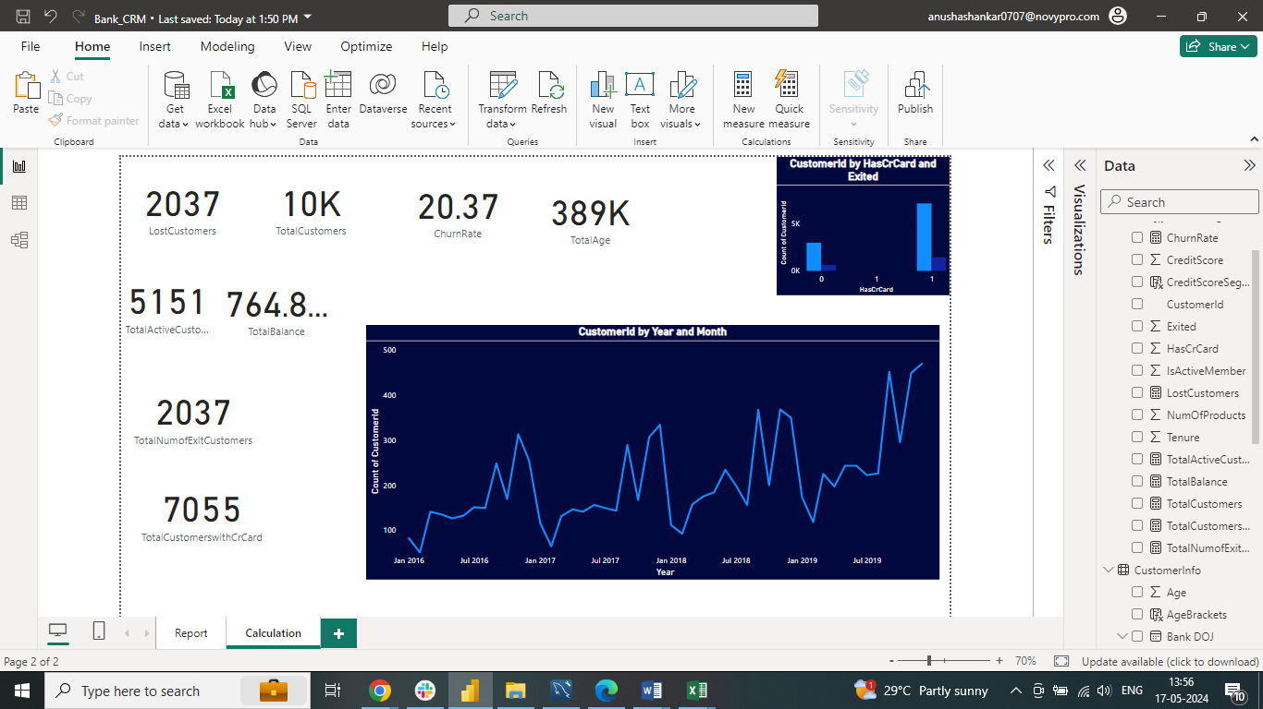
Churn Rate Trends
Our analysis reveals a significant increase in churn in 2017, which then stabilized in 2018 and 2019. To address this, we recommend closely monitoring for emerging trends and implementing targeted strategies to maintain stability.

Slide 5

Churn Analysis by Age
When we analyze churn by age groups, we observe distinct patterns:
Older Customers (45+): High churn rates suggest potential dissatisfaction or unmet needs, possibly due to a lack of personalized services or better offers from competitors.
Middle-Aged Customers (20-45): Significant churn rates indicate possible issues such as retirement planning or changing financial priorities.

Slide 6
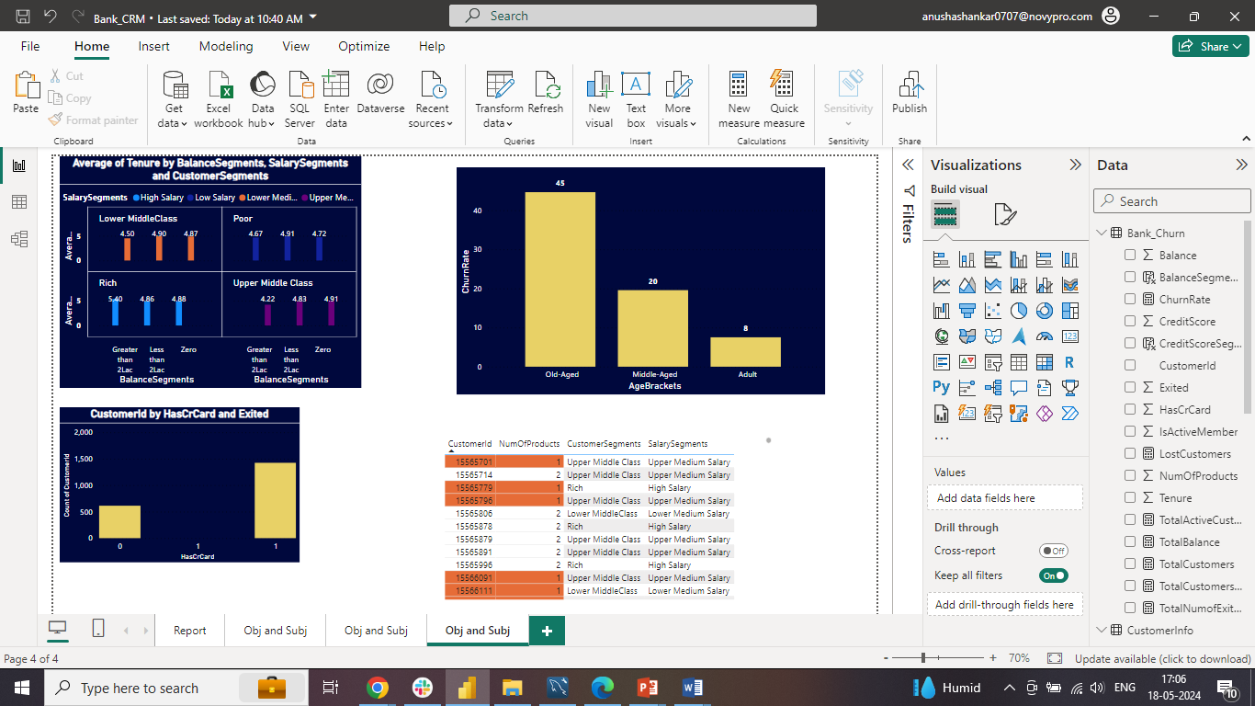
Recommendations for Age-Based Churn
To address these age-specific churn issues, we propose the following strategies:
Targeted Marketing and Communication: Develop campaigns focused on the financial goals of different age groups, such as retirement planning and investment options.
Customer Loyalty Programs: Implement programs that reward long-term customers.
Personalized Offers and Services: Offer tailored product bundles and exclusive discounts.
Improved Customer Service: Enhance support for older customers and train representatives to address their unique concerns.

Slide 7
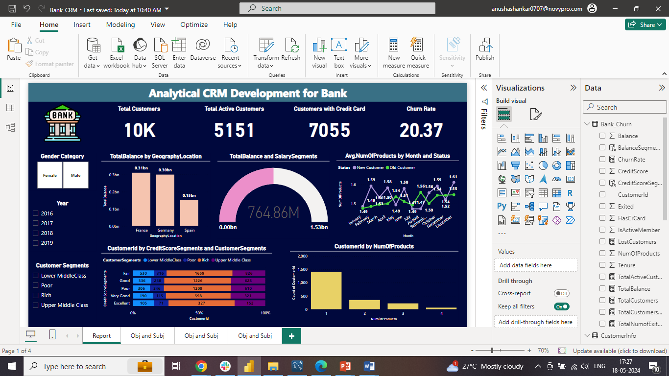
Churn Analysis by Number of Products
Our data shows that customers using only one product have the highest churn count (1409). Churn rates decrease as the number of products used increases, indicating a need to encourage product diversification to improve retention.

Slide 8
Recommendations for Product Usage
To reduce churn among single-product users, we recommend:
Offer Bundled Products: Provide incentives for customers to adopt multiple products.
Educate Customers: Highlight the benefits of using various banking products.
Enhance Value Proposition: Ensure customers see the value in using multiple products.
Targeted Retention Campaigns: Focus on single-product customers with personalized offers and incentives.

Slide 9
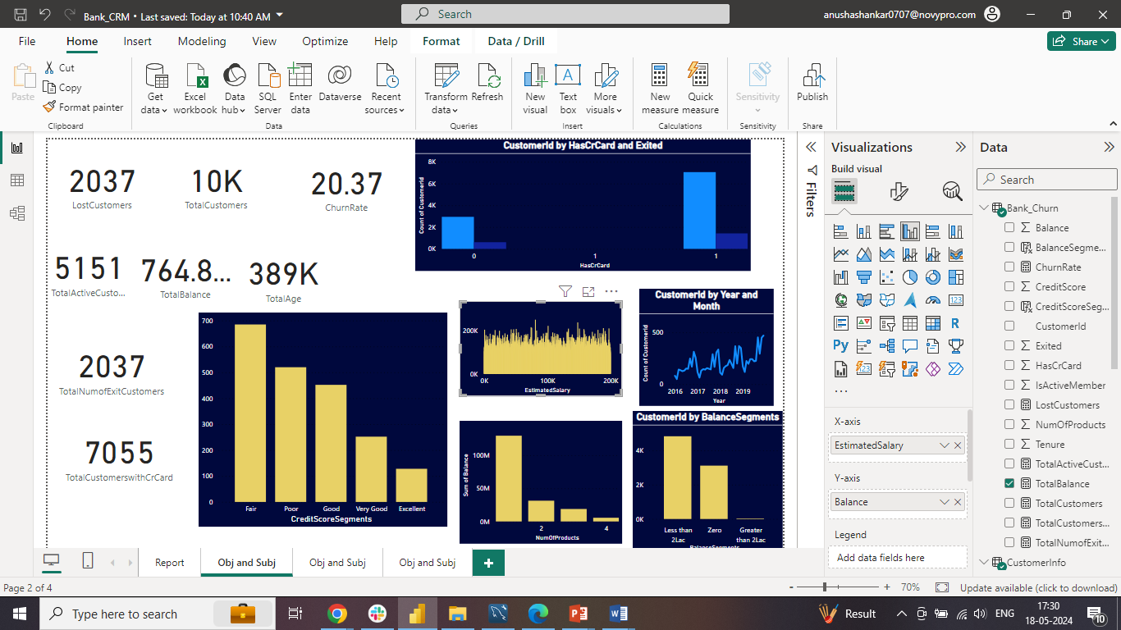
Credit Card Ownership and Churn
Our analysis shows that 6,000 credit card holders have churned compared to 1,000 non-credit card holders. This suggests that credit card ownership significantly impacts customer retention rates.

Slide 10
Strategies to Reduce Churn
The main reasons for churn include lack of engagement, poor customer service, and competitive offers. To mitigate these, we recommend:
Improve Customer Engagement: Foster stronger relationships with customers.
Enhance Customer Service: Provide exceptional support.
Competitive Product Offerings: Develop attractive and competitive products.
Financial Education: Educate customers about financial products and services.
Feedback Mechanism: Implement a system for continuous feedback and improvement.

Slide 11
Customer Acquisition vs. Retention
While the bank has seen an increase in new customers each year, the steady churn rate suggests retention challenges. Despite fluctuations, the churn rate has stabilized, highlighting the need for targeted strategies to retain customers.

Slide 12
Analysis and Recommendations of Account Balance and Number of Products
Our analysis indicates that customers with higher product usage tend to have higher account balances. However, single-product users still significantly contribute to the total balance, emphasizing the need for encouraging multiple product usage.
To increase overall account balances and reduce churn, we recommend encouraging customers to use multiple products by offering incentives or rewards for adopting additional banking products.

Slide 13
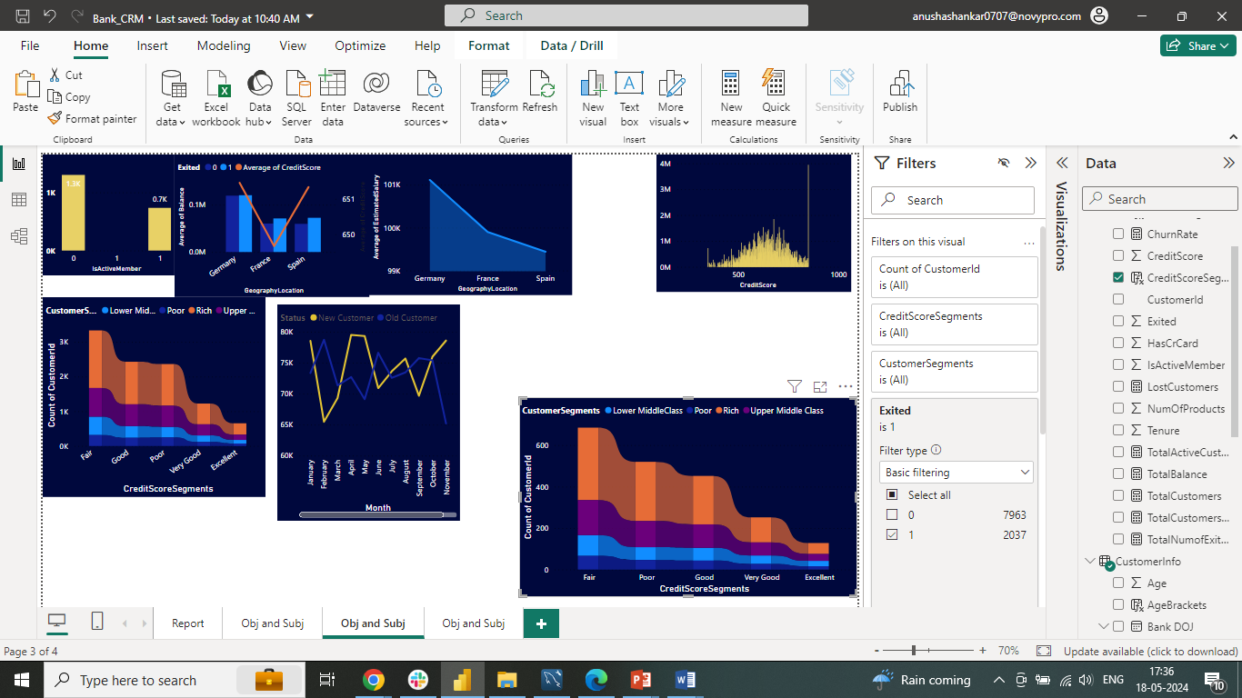
Analysis and Recommendations of Credit Score vs Customer Churn
Customers with higher credit scores tend to have lower churn rates. The highest churn is observed in the 'Fair' and 'Poor' credit score groups.
Focus retention efforts on customers with 'Fair' and 'Poor' credit scores by offering targeted incentives and loyalty programs to encourage their loyalty and reduce churn in these segments.

Slide 14
Conclusion
The bank has experienced a consistent churn rate over the years despite a steady increase in customer acquisition. Key findings include:
Customers with lower credit scores and those using fewer products are more likely to churn.
Age groups 'Old' and 'Middle' have the highest churn rates, indicating specific retention challenges.
To address these issues, we need to:
Improve customer engagement.
Enhance customer service.
Offer competitive and personalized products/services.
Implement targeted marketing and personalized offers for critical age and credit score groups.
By focusing on customer engagement, service enhancement, and targeted strategies for specific customer segments, the bank can reduce churn, improve customer retention, and foster long-term customer loyalty, leading to sustainable growth.

Slide 15
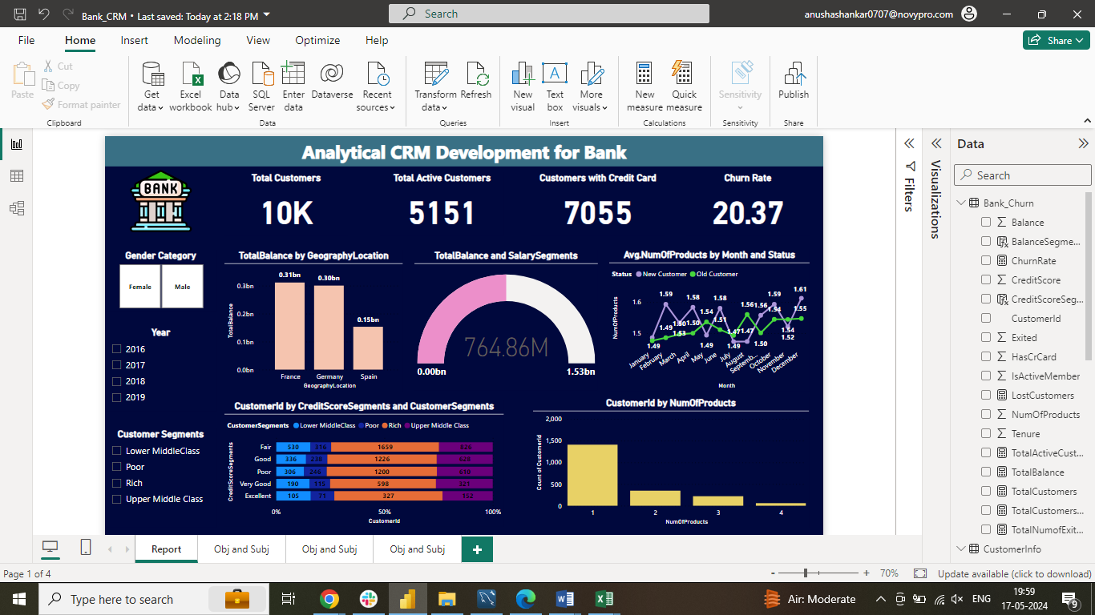
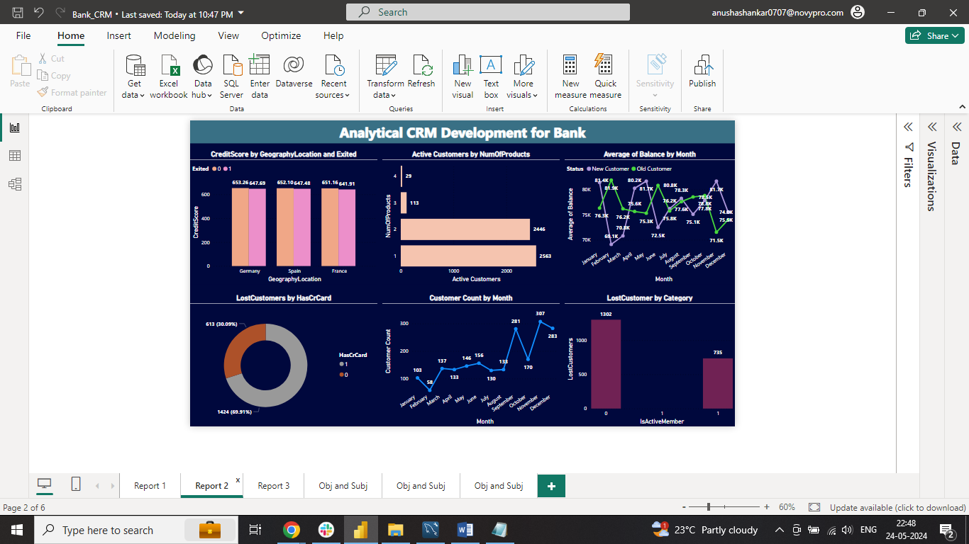
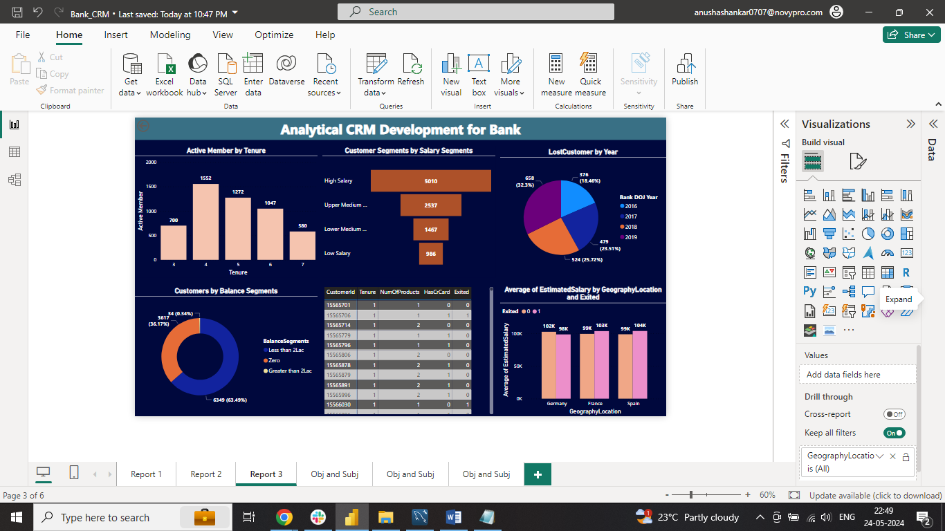
Dashboard

Slide 16
Thank You Anusha Sundaram

