Slide 1
PROJECT TEAM
M. Purnasri
MACHINE LEARNING PROJECT · CUSTOMER ANALYTICS
23341A05F0
Online Retail Customer Segmentation
K. Anusha
23341A05D3
S. Jyotsna
23341A05A8
RFM Analysis & K-Means Clustering on the Online Retail II Dataset
P. Jahnavi
23341A05J5
K. Neelima
23341A4258
1.07M
K = 4
0.365
Ch. Sai Madhuri
23341A4226
TRANSACTIONS
SEGMENTS
SILHOUETTE SCORE
K. Pranathi
23341A4242
01

Slide 2
ROADMAP
Agenda
A clear path from raw transactions to actionable customer segments.
01
02
03
04
Objective
→
Data
→
Explore
→
RFM
Why segmentation matters
Raw transactions to valid sales
Country, sales & product patterns
Recency, Frequency & Monetary
05
06
07
08
Feature Eng.
→
K-Means
→
Segments
→
Action
Log transform & scaling
Choosing K & evaluating
Four business-friendly personas
Targeted marketing strategy
Visualization and RFM detail are presented across dedicated slides for readability.
ONLINE RETAIL CUSTOMER SEGMENTATION
02

Slide 3
WHY THIS PROJECT
Project Objective
Not every customer is worth the same marketing effort. Treated in bulk, two years of online retail transactions hide who is driving revenue — and who is about to churn.
1
2
3
4
Measure Behaviour
Segment with K-Means
Build Personas
Target Strategy
Quantify each customer using Recency, Frequency & Monetary value.
Group customers into meaningful segments via unsupervised clustering.
Turn statistical clusters into business-friendly customer personas.
Recommend targeted retention, loyalty and win-back actions.
FINAL MODEL
MODEL QUALITY
K-Means · K = 4
Silhouette Score = 0.365
ONLINE RETAIL CUSTOMER SEGMENTATION
03

Slide 4
THE DATA
Dataset Overview — Online Retail II
Transaction-level records from a UK-based online gift retailer, spanning Dec 2009 – Dec 2011, with invoices, products, quantities, prices, customers and countries.
1,067,371
8
43
5,878
RAW TRANSACTION ROWS
ORIGINAL COLUMNS
COUNTRIES REPRESENTED
UNIQUE CUSTOMERS (CLEANED)
CORE COLUMNS
KEY OBSERVATIONS
Invoice
StockCode
243,007 rows are missing a Customer ID
Description
Quantity
34,335 fully duplicate rows were found
InvoiceDate
Price
Negative Quantity / Price values indicate returns
Customer ID
Country
Invoices starting with “C” are cancellations
ONLINE RETAIL CUSTOMER SEGMENTATION
04

Slide 5
PREPARING THE DATA
Data Cleaning Pipeline
1
2
3
Fix Data Types
→
Remove Duplicates
→
Handle Missing Values
Cast Invoice to string; parse InvoiceDate to datetime.
34,335 fully duplicated rows dropped.
Rows missing Customer ID, InvoiceDate, Quantity or Price removed.
4
5
6
Exclude Cancellations
→
Keep Valid Sales
→
Engineer TotalAmount
Invoices starting with “C” (returns) filtered out.
Kept rows with Quantity > 0 and Price > 0.
TotalAmount = Quantity × Price, used for Monetary value.
1,067,371 raw rows → 779,425 clean transaction rows across 5,878 unique customers
ONLINE RETAIL CUSTOMER SEGMENTATION
05

Slide 6
DATA VISUALIZATION
Top 10 Countries by Transactions
Transaction activity is concentrated in a small number of markets, with the UK dominating the dataset.
DOMINANT MARKET
United
Kingdom
~700,000
TRANSACTIONS
More than 30x the volume of the next closest market — shown separately so the remaining nine stay readable.
ONLINE RETAIL CUSTOMER SEGMENTATION
06

Slide 7
DATA VISUALIZATION
Monthly Sales Trend
Monthly sales fluctuate over time, revealing strong changes in purchase intensity and seasonality.
KEY TAKEAWAYS
Sales rise sharply into Oct–Nov 2010, peaking near November.
A similar year-end uplift appears in Sep–Nov 2011.
Peak sales occur around October–November, indicating strong seasonality.
ONLINE RETAIL CUSTOMER SEGMENTATION
07

Slide 8
DATA VISUALIZATION
Top 10 Products by Sales
A small group of products contributes disproportionately to total sales value.
ONLINE RETAIL CUSTOMER SEGMENTATION
08

Slide 9
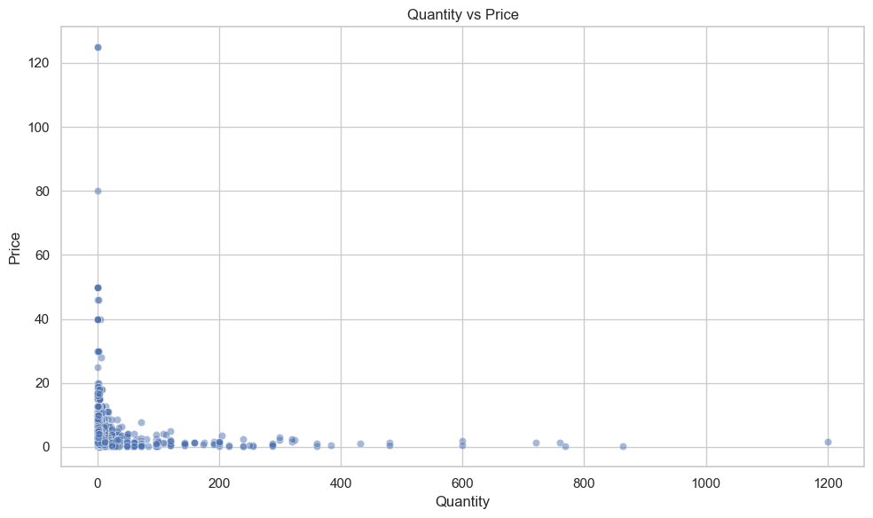
DATA VISUALIZATION
Quantity vs Price
Most transactions sit at lower quantities and prices, with a small number of visible outliers.
KEY TAKEAWAYS
Most transactions have low quantity and low price.
A few extreme transactions create outliers.
Preprocessing is necessary before clustering.
ONLINE RETAIL CUSTOMER SEGMENTATION
09

Slide 10
THE FRAMEWORK
RFM Analysis
Three behavioural measures convert transaction history into customer-level signals.
R
F
M
Recency
Frequency
Monetary
Days since the customer's most recent purchase
Number of unique orders (invoices) placed
Total amount spent across all orders
Lower is better — recently active
Higher is better — repeat buyer
Higher is better — high revenue value
Transaction History → RFM Features → Customer Behaviour
ONLINE RETAIL CUSTOMER SEGMENTATION
10

Slide 11
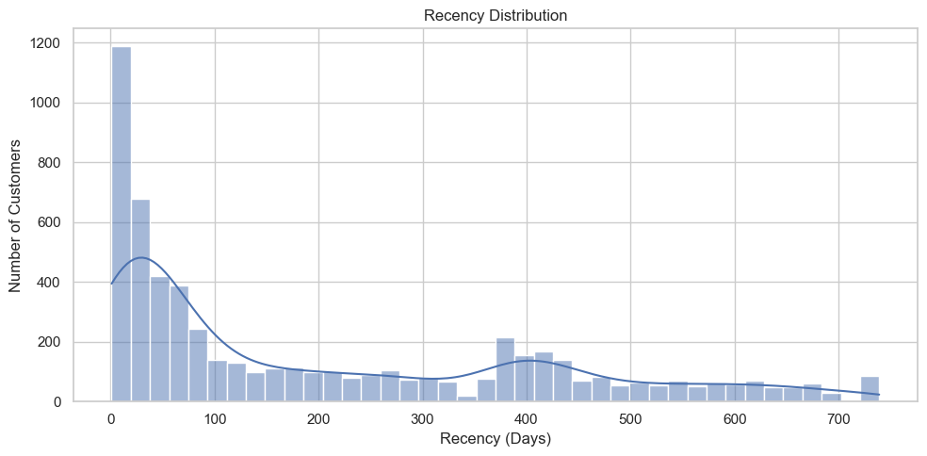
DATA VISUALIZATION
Recency Distribution
Recency measures how many days have passed since each customer's most recent purchase.
KEY TAKEAWAYS
Concentrated at low recency — many recently active customers.
A long right tail extends to very high recency (fading customers).
Lower recency is favourable and key to identifying churn risk.
ONLINE RETAIL CUSTOMER SEGMENTATION
11

Slide 12
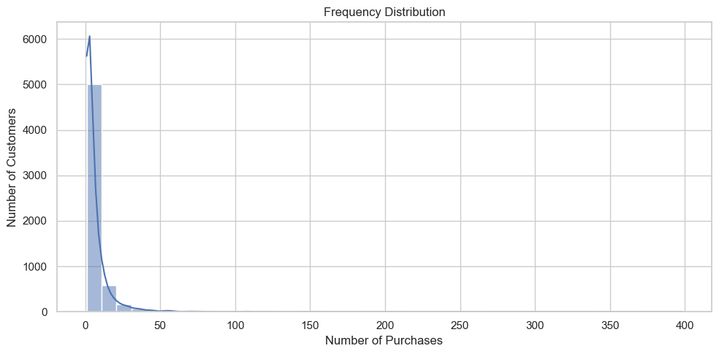
DATA VISUALIZATION
Frequency Distribution
Frequency counts the number of unique orders placed by each customer.
KEY TAKEAWAYS
Most customers have a small number of purchases.
Only a relatively small group orders very frequently.
Strong right-skew separates occasional shoppers from repeat buyers.
ONLINE RETAIL CUSTOMER SEGMENTATION
12

Slide 13
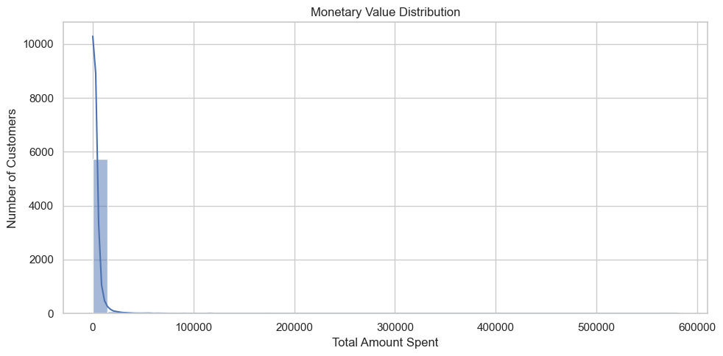
DATA VISUALIZATION
Monetary Value Distribution
Monetary value represents the total amount spent by each customer.
KEY TAKEAWAYS
Most customers are concentrated at lower spending levels.
A small number of high-value customers create a long right tail.
Log transformation prevents extreme spenders from dominating distance calculations.
ONLINE RETAIL CUSTOMER SEGMENTATION
13

Slide 14
PREPARING FOR CLUSTERING
Feature Engineering: Transform & Scale
RFM values are heavily right-skewed — a few customers spend or order far more than the rest. Two steps make the data cluster-ready.
Raw RFM
→
Log Transformation
→
Reduce Skew
→
Standard Scaling
→
K-Means Ready
1
Log Transformation
2
Standard Scaling
np.log1p() is applied to Recency, Frequency and Monetary to compress extreme values and reduce skew.
StandardScaler centers each feature to mean 0 and standard deviation 1, so no single feature dominates distance calculations.
RECENCY (mean)
FREQUENCY (mean)
MONETARY (mean)
201.3 days
6.3 orders
$2,955.90
ONLINE RETAIL CUSTOMER SEGMENTATION
14

Slide 15
CHOOSING K
The Elbow Method
HOW IT WORKS
K-Means was trained for K = 2 through 10, plotting inertia against K. Inertia always decreases as K grows — the goal is the point where more clusters stop giving a meaningful improvement.
Elbow Point
K = 4
The bend appears at K = 4
Inertia drops sharply from K=2 to K=4, then flattens. Four clusters capture the natural structure in customer behaviour without over-fragmenting the base.
ONLINE RETAIL CUSTOMER SEGMENTATION
15

Slide 16
BUILDING THE MODEL
K-Means Clustering & Evaluation
CUSTOMERS PER CLUSTER
SILHOUETTE SCORE
0.365
Indicates reasonably well-separated, cohesive clusters — solid performance for real-world behavioural data.
ALGORITHM
CLUSTERS (K)
K-Means
4
N_INIT
RANDOM_STATE
5,878 customers were assigned to exactly one of four clusters based on scaled, log-transformed RFM values.
20
42
ONLINE RETAIL CUSTOMER SEGMENTATION
16

Slide 17
FROM CLUSTERS TO PERSONAS
The 4 Customer Segments
Champions / High Value
Loyal Customers
Cluster 0 · 1,192 customers
Cluster 3 · 1,465 customers
27.5 days
19.3 orders
$10,756
228.3 days
5.1 orders
$1,957
RECENCY
FREQUENCY
MONETARY
RECENCY
FREQUENCY
MONETARY
Bought very recently, order often, and spend the most by far.
Moderate recency with steady order history and solid spend.
Recent / Developing
At Risk / Low Value
Cluster 2 · 1,249 customers
Cluster 1 · 1,972 customers
28.4 days
3.0 orders
$848
395.9 days
1.4 orders
$318
RECENCY
FREQUENCY
MONETARY
RECENCY
FREQUENCY
MONETARY
Recently active but still building frequency and spend.
Longest time since last purchase, rarely order — in danger of churning.
ONLINE RETAIL CUSTOMER SEGMENTATION
17

Slide 18
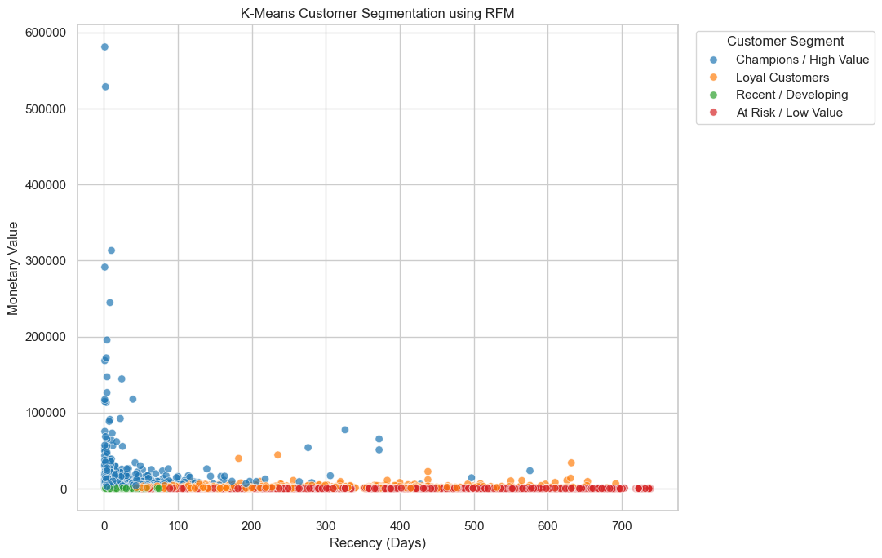
SEEING THE SEGMENTS
Cluster Visualization — Recency vs Monetary
READING THE PLOT
Each dot is one customer, plotted by days since last purchase (x-axis) against total amount spent (y-axis), colored by assigned segment.
Champions (blue)
Highest spend, most recent purchases — including outliers above $100k.
Loyal Customers (orange)
Wide recency range with visibly higher spend than green/red at same recency.
Recent / Developing (green)
Packed near recent purchases but low on spend so far.
At Risk / Low Value (red)
Dense band at high recency, flat near zero spend.
ONLINE RETAIL CUSTOMER SEGMENTATION
18

Slide 19
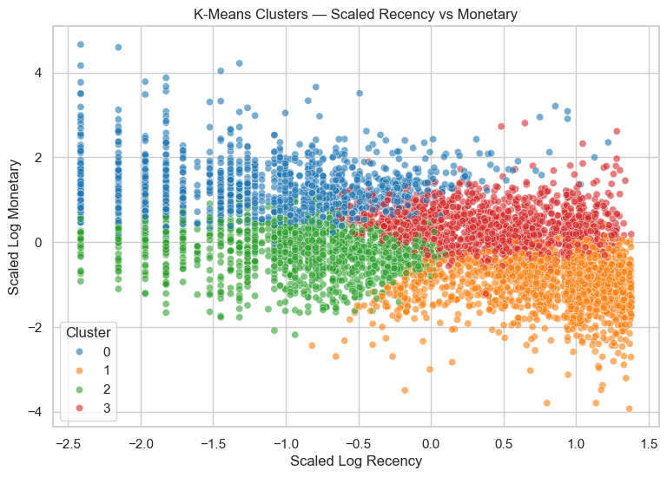
UNDER THE HOOD
K-Means Cluster Separation
Customers after log transformation and standard scaling.
WHY THIS VIEW
This is the exact space K-Means clusters in. It shows how cleanly the algorithm separates customers once extreme values are compressed and features are on equal footing.
Blue (0 / Champions): high scaled monetary value across the recency range.
Orange (1 / At Risk): dominates high scaled recency, low monetary.
Green (2 / Recent/Developing): clusters left, low-to-mid monetary.
Red (3 / Loyal): middle-right band with moderate monetary value.
Clear, mostly non-overlapping regions confirm the segments are behaviourally distinct — consistent with the 0.365 silhouette score.
ONLINE RETAIL CUSTOMER SEGMENTATION
19

Slide 20
FROM INSIGHT TO ACTION
Segment Distribution & Recommendations
Champions
RETAIN
VIP rewards & early access
Loyal Customers
GROW
Cross-sell & loyalty points
Recent / Developing
DEVELOP
First-repeat purchase incentives
At Risk / Low Value
REACTIVATE
Win-back campaigns & discounts
At Risk / Low Value is the largest segment — 1,972 customers — the biggest re-engagement opportunity.
ONLINE RETAIL CUSTOMER SEGMENTATION
20

Slide 21
CONCLUSION
From Raw Transactions to Actionable Customer Segments
1.07M
Transactions
→
779K
Clean
→
5,878
Customers
→
RFM
→
K = 4
→
4 Segments
→
Targeted
Action
K-Means, K = 4
0.365
5,878
FINAL MODEL
SILHOUETTE SCORE
CUSTOMERS SEGMENTED
“RFM + K-Means converts transaction data into actionable customer strategies.”
Thank You
21

