Slide 1
INTERNSHIP REPORT & PROJECT REVIEW-1
Project: AI Resume Screening System
Internship Period: [18-05-2026] to [17-07-2026]
[B . Chennakesavulu] – [24691A2838] – III CST Sec A
Review Date: [21-10-2026]
Internship Mentor: [Mr . M . Shankar, Asst. Professor of CST ]

Slide 2
About Industry / Organization Details
Organization name: [MOTHERSON automotive technologies]
What it does: [Motherson Technology Services Limited is a public, non‑government technology and industrial solutions company within the Motherson Group, offering digital, cloud, AI, and IT services while also being legally classified under security‑dealing activities as per MCA filings.]
Address: [4th Floor, Wing C, Tower 3, Casagrand Ecotech, 475‑A, Wipro Street, Sholinganallur, Chennai – 600119, Tamil Nadu]
Project domain: Web Development and Resume Screening
Project type: Flask-based web application for initial resume review

Slide 3
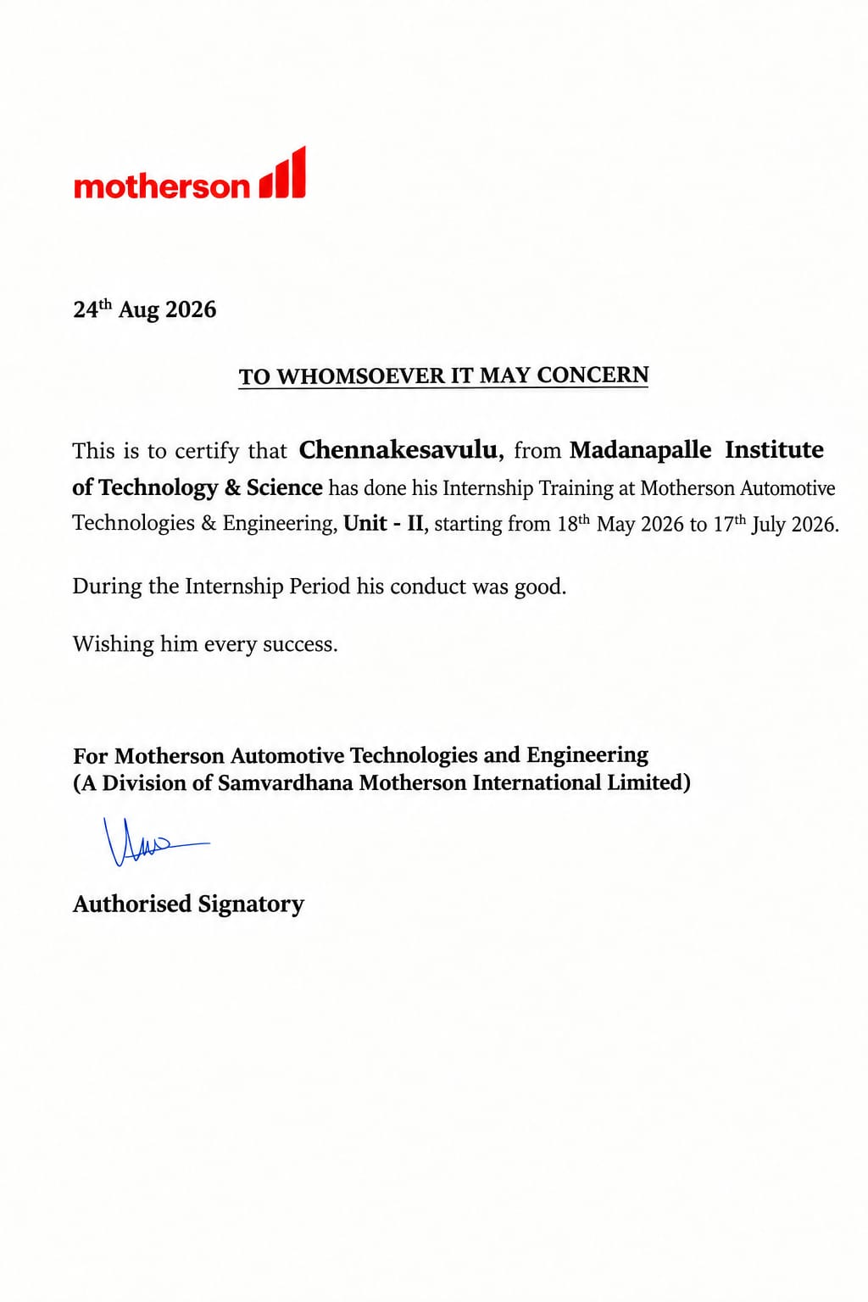
Internship Certificate
INSERT YOUR ORIGINAL
INTERNSHIP CERTIFICATE HERE

Slide 4
My Internship
Project Description
Things Learned
Project: AI Resume Screening System
Purpose: Compare PDF resumes with a job description
Technologies: Python, Flask, HTML, CSS, JavaScript, SQLite, pypdf
Building Flask routes and web pages
Uploading and reading PDF files
Finding skill keywords with rules
Calculating match scores
Saving records and exporting CSV

Slide 5
Specific Tasks
Week 1
Reviewed the resume-screening workflow and project requirements.
Week 2
Created job-title and job-description inputs with PDF upload validation.
Week 3
Extracted readable PDF text and identified recognized skill keywords.
Week 4
Compared required skills and calculated matched and missing skills.
Week 5
Saved candidate details in SQLite and tested dashboard and CSV export.

Slide 6
The Project Proposal
AI Resume Screening System

Slide 7
Title of Our Project
AI Resume Screening System
PDF Resume Skill Extraction and Keyword-Based Job Matching

Slide 8
Objective of the Project
1
Upload: Accept a job title, job description, and multiple PDF resumes.
2
Extract: Read text from supported, text-based PDF resumes.
3
Match: Identify recognized skills and find matched or missing skills.
4
Display: Show a keyword-based score and save candidate results.

Slide 9
Abstract
The AI Resume Screening System is a web-based application that helps recruiters review resumes easily. Recruiters enter the job title and job description and upload PDF resumes.
The system uses Python Flask to process the uploaded resumes. The pypdf library extracts text, and predefined keywords are used to identify candidate skills.
The system compares the candidate’s skills with the required job skills and calculates a matching percentage. Candidate details, scores, matched skills, and missing skills are stored in an SQLite database.
Recruiters can view candidate records and export the results as a CSV file. The system uses keyword matching, not a trained AI model, so recruiters must manually review every resume before making hiring decisions.

Slide 10
Existing System and Its Disadvantages
Existing approaches
Disadvantages
Manual reading of each resume
Comparing resumes with job requirements by hand
Tracking candidates in separate files or spreadsheets
Searching for skills one resume at a time
Takes more time for many resumes
Repeated checking of similar skills
Important skills may be overlooked
Candidate records can be difficult to organize
Manual comparison may be inconsistent

Slide 11
Proposed System with Advantages
Proposed system
Advantages
Upload up to 20 PDF resumes per batch
Extract text using the pypdf library
Identify recognized skills with keyword rules
Show matched skills, missing skills, and score
Store candidates in SQLite and export CSV
Organizes screening in one interface
Reduces repeated manual comparison
Makes skill gaps easier to review
Keeps candidate records together
Supports quick CSV-based reporting

Slide 12
Hardware & Software Requirements
Hardware
Software
Laptop or desktop computer
Keyboard, monitor, and storage
Internet connection for setup
Recommended: 4 GB RAM or more
OS: Windows or Linux
Language: Python 3.10+
Backend: Flask
Frontend: HTML, CSS, JavaScript
Database: SQLite
PDF library: pypdf
Code Editor: Visual Studio Code
Web Browser: Google Chrome or Microsoft Edge

Slide 13
System Architecture
User / Recruiter
Job title + description + PDFs
Flask Backend
Validate inputs and files
PDF Text Extraction
pypdf reads page text
Skill Identification
Keyword / regex rules
Match Score
Matched required skills
CSV Export
Download results
Candidate Details
Matched / missing skills
Dashboard
View candidates and skills
SQLite Database
Jobs and candidates
Save Results
Candidate records
Flow: User input → Flask validation → PDF text extraction → skill matching → score calculation → SQLite storage → dashboard and CSV export.

Slide 14
Methodologies Used for Implementation (1/2)
Input and preprocessing
Skill identification
Enter the job title and job description
Upload PDF resumes (maximum 20 per batch)
Validate PDF file type, signature, and size
Extract readable text from PDF pages with pypdf
Search text for recognized skills using keyword rules
Use regular expressions for selected skill names and aliases
Compare resume skills with skills in the job description
Record matched and missing required skills

Slide 15
Methodologies Used for Implementation (2/2)
Scoring and output
Limitations and future work
Score = matched required skills ÷ recognized required skills × 100
Store job and candidate information in SQLite
Display skills, scores, and candidate details
Export candidate records to CSV
This version uses keyword rules, not a trained ML model
Scanned PDFs need OCR; text-based PDFs are supported
The score is not a hiring recommendation
Future work: DOCX, OCR, better skill extraction, access control

Slide 16
References
Python Software Foundation. Python Documentation. https://docs.python.org/3/
Pallets Projects. Flask Documentation. https://flask.palletsprojects.com/
SQLite. SQLite Documentation. https://www.sqlite.org/docs.html
pypdf contributors. pypdf Documentation. https://pypdf.readthedocs.io/
MDN Web Docs. HTML, CSS and JavaScript. https://developer.mozilla.org/
W3C. CSV on the Web: A Primer. https://www.w3.org/TR/tabular-data-primer/

Slide 17
Conclusion
The system organizes the initial screening of PDF resumes.
It extracts resume text and identifies candidate skills.
It compares skills with job requirements and displays a keyword-based score.
Candidate details are stored in SQLite, with options to view records and export CSV files.
It reduces repetitive manual work but does not use a trained AI model or make hiring decisions.
Future Enhancement: Add DOCX support, OCR for scanned resumes, better privacy controls, and advanced skill extraction.

Slide 18
THANK YOU

