Slide 1
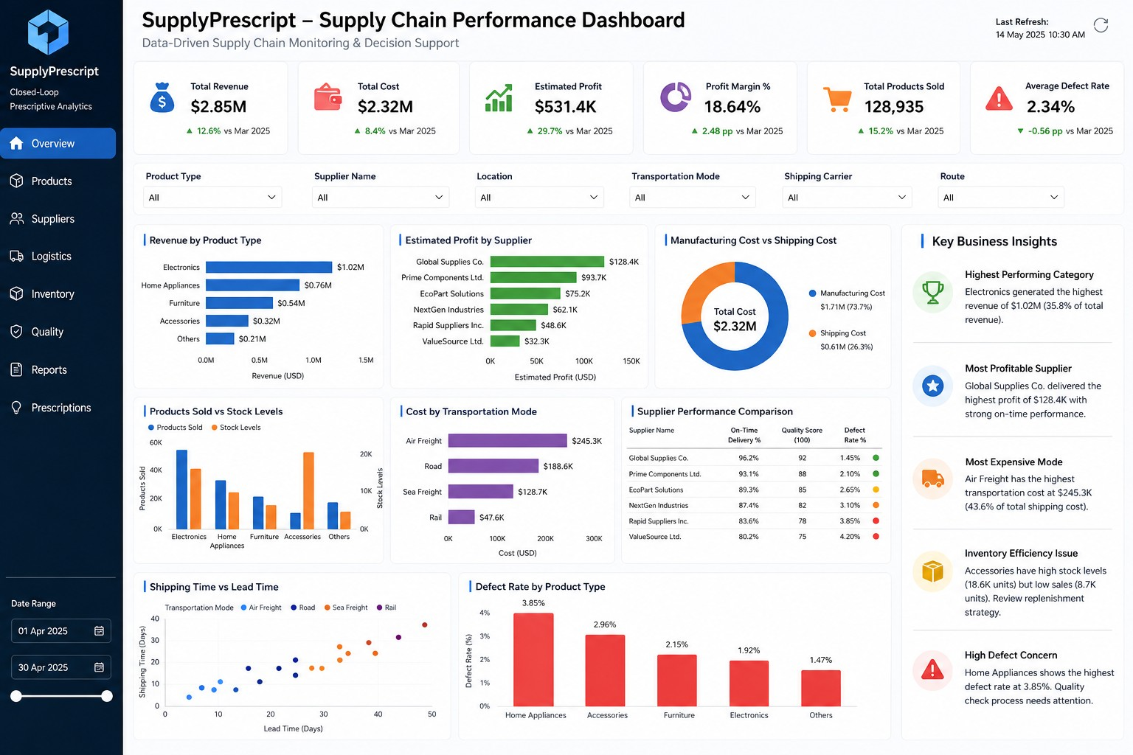
SUPPLYPRESCRIPT
Closed-Loop Prescriptive Analytics – Supply Chain Performance
Submitted By: Chukka Reddy Anusha | 15 August 2026

Slide 2
1. Project Overview
From raw supply-chain data to actionable business intelligence
• SupplyPrescript analyzes supply-chain operations across revenue, costs, inventory, suppliers, logistics,
production, and quality.
• The data-analysis workstream prepares reliable analytical data and converts findings into business-oriented
insights.
• Power BI provides an interactive management view of the resulting KPIs and operational findings.
• The wider project can extend these insights into predictive and prescriptive decision support.
Enable data-driven monitoring and decision support across the supply chain.
SupplyPrescript | Data Analysis Workstream | 2

Slide 3
2. Objectives & Scope
• Understand and validate the Kaggle supply-chain dataset.
• Clean and prepare data for downstream analysis.
• Perform EDA to discover patterns and operational trends.
• Engineer meaningful supply-chain performance features.
• Analyze correlations among numerical variables.
• Translate results into business insights and recommendations.
• Present findings through an interactive Power BI dashboard.
Product
Sales & Revenue
Inventory
Suppliers
Logistics
Production
Costs
Quality
Output: reproducible notebooks + business dashboard
SupplyPrescript | Data Analysis Workstream | 3

Slide 4
3. Dataset & Variables
Kaggle supply-chain dataset used for the analysis
Product
Sales
Product type, SKU, price, availability
Products sold, revenue generated
Inventory
Supplier
Stock levels, order quantities
Supplier name, location, lead time
Logistics
Production
Shipping time, carrier, route, transportation mode
Production volumes, manufacturing lead time
Cost
Quality
Shipping costs, manufacturing costs, route costs
Inspection results, defect rates
SupplyPrescript | Data Analysis Workstream | 4

Slide 5
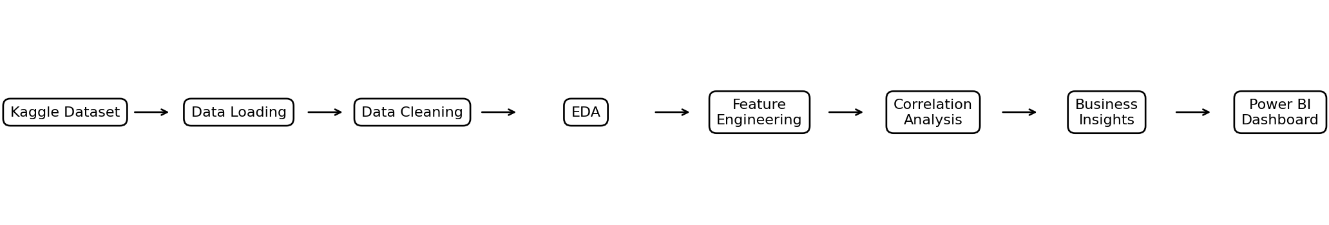
4. End-to-End Data Analysis Workflow
Dataset → Cleaning → EDA → Features → Correlation → Insights → Dashboard
SupplyPrescript | Data Analysis Workstream | 5

Slide 6
5. Notebook-Based Implementation
01_data_loading.ipynb
Load CSV; inspect head, info, shape, and descriptive statistics.
02_data_cleaning.ipynb
Missing values, duplicates, data types, and preparation.
03_EDA.ipynb
Distributions, categorical/numerical analysis, and visualizations.
04_feature_engineering.ipynb
Derived cost, efficiency, and performance measures.
05_correlation_analysis.ipynb
Correlation matrix, heatmap, and relationship analysis.
06_business_insights.ipynb
Product, supplier, cost, logistics, and quality findings.
SupplyPrescript | Data Analysis Workstream | 6

Slide 7
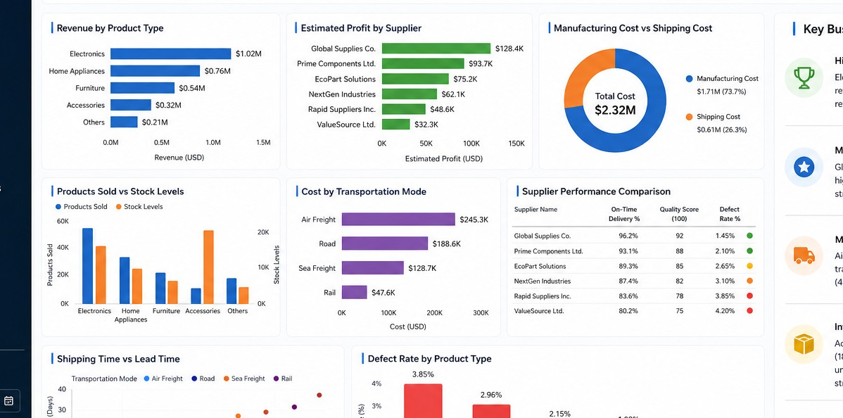
6. Exploratory Data Analysis
• Reviewed numerical and categorical variables before modelling or dashboarding.
• Checked distributions, summary statistics, duplicates, missing values, and potential outliers.
• Used charts to understand product, supplier, sales, inventory, logistics, cost, and quality patterns.
• EDA findings guided feature engineering and business interpretation.
Completed dashboard analytical views
SupplyPrescript | Data Analysis Workstream | 7

Slide 8
7. Feature Engineering & Correlation Analysis
FEATURE ENGINEERING
CORRELATION ANALYSIS
• Create derived metrics from raw operational fields.
• Analyze sales and inventory efficiency.
• Combine relevant cost components where supported.
• Prepare variables for later modelling and dashboard interpretation.
• Calculate correlations among numerical variables.
• Use a correlation matrix and heatmap.
• Use correlation as a guide for feature selection, not causation.
• Investigate relationships among revenue, production, sales, shipping, lead time, and cost.
Outcome: cleaner analytical features + clearer understanding of variable relationships.
SupplyPrescript | Data Analysis Workstream | 8

Slide 9
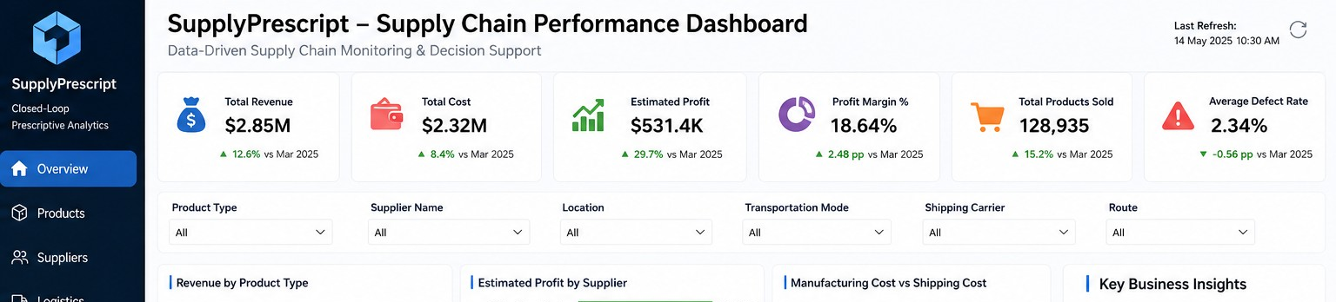
8. Power BI Dashboard – KPI Layer
Management-style monitoring of supply-chain performance
KPIs: Total Revenue | Total Cost | Estimated Profit | Profit Margin % | Total Products Sold | Average Defect Rate
Filters: Product Type | Supplier | Location | Transportation Mode | Shipping Carrier | Route | Date Range
SupplyPrescript | Data Analysis Workstream | 9

Slide 10
9. Power BI Dashboard – Analytics
Revenue | Supplier Profitability | Cost Structure | Inventory | Transportation | Shipping & Lead Time | Quality
SupplyPrescript | Data Analysis Workstream | 10

Slide 11
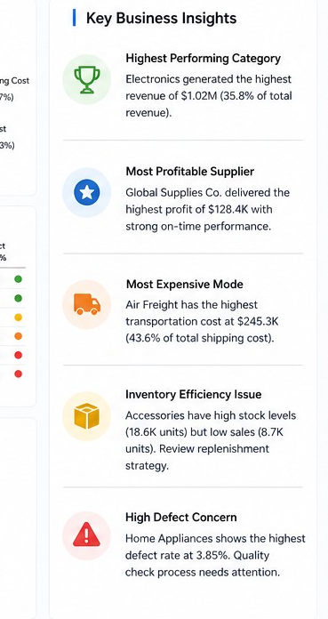
10. Business Insights & Decision Support
• Product performance: identify categories contributing the largest share of sales
or revenue.
• Supplier performance: compare profitability, delivery, quality, and defect indicators.
• Transportation cost: identify expensive modes and investigate route-level drivers.
• Inventory efficiency: compare stock levels with sales activity to identify potential
imbalance.
• Quality management: prioritize categories with consistently higher defect rates.
SupplyPrescript | Data Analysis Workstream | 11

Slide 12
11. GitHub & Project Deliverables
• Six Jupyter Notebooks documenting analysis from loading through business insights.
• README.md describing project purpose, workflow, technologies, and repository structure.
• requirements.txt specifying Python dependencies.
• Power BI dashboard file and preview image, subject to team/company sharing rules.
• Professional project report documenting methodology, dashboard, insights, and future scope.
• Meaningful Git commits should reflect genuine development activity and progress.
Repository: https://github.com/Anusha2863/SupplyPrescript-Data-Analysis
SupplyPrescript | Data Analysis Workstream | 12

Slide 13
12. Future Scope – Closing the Analytics Loop
• Develop and validate predictive models for relevant supply-chain targets.
• Compare baseline models with XGBoost where appropriate.
• Use feature importance to explain model drivers.
• Add an optimization layer that converts predictions into recommended actions.
• Monitor decisions and outcomes through the Power BI dashboard.
• Create a closed-loop feedback process so outcomes improve future decisions.
Predict → Recommend → Act → Monitor → Learn → Improve
SupplyPrescript | Data Analysis Workstream | 13

Slide 14
THANK YOU
SupplyPrescript – Closed-Loop Prescriptive Analytics
Data Analysis Workstream
Chukka Reddy Anusha | 15 August 2026

