Slide 1
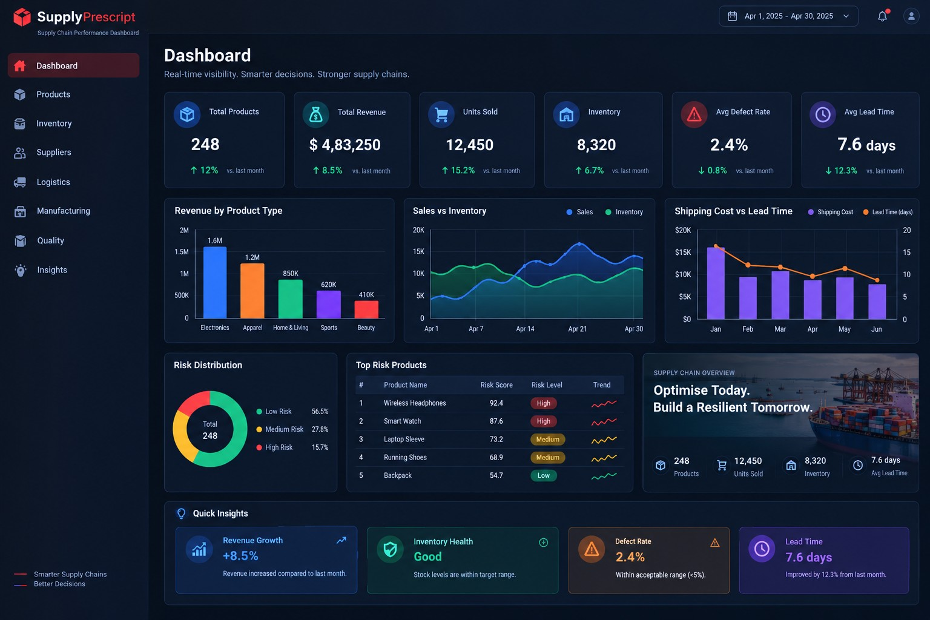
SUPPLYPRESCRIPT
Supply Chain
Intelligence Dashboard
Data-driven visibility for products, inventory, suppliers,
logistics, manufacturing, quality and operational risk.
React + Vite
FastAPI
PostgreSQL
Random Forest
Project Presentation
SupplyPrescript – Supply Chain Performance Dashboard
SUPPLYPRESCRIPT • SUPPLY CHAIN INTELLIGENCE
01

Slide 2
PROJECT OVERVIEW
One operating view of the supply chain
The dashboard consolidates operational data into a single decision-support layer.
DATASET
PAGES
BACKEND
ML
100 records
8 modules
FastAPI
Random Forest
24 source columns
Executive + functional views
REST endpoints
Risk prediction service
Core coverage
Decision layer
• Products and demand
• Inventory health and stock risk
• Supplier performance and segmentation
• Logistics and shipping efficiency
• Manufacturing cost and production
• Quality and inspection outcomes
• Rule-based supply-chain risk scoring
• Random Forest ML risk predictions
• Statistical anomaly alerts
• Operational recommendations
• Filter-driven views by product, supplier and location
SUPPLYPRESCRIPT • SUPPLY CHAIN INTELLIGENCE
02

Slide 3
PROBLEM STATEMENT
Why SupplyPrescript?
Supply-chain teams need faster visibility across fragmented operational signals.
Fragmented data
Product, stock, supplier, delivery, production and quality signals are difficult to view together.
Hidden operational risk
Low stock, delays, defects and cost pressure can appear separately even when they affect the same SKU.
Slow decision cycles
Static tables alone make it harder to prioritize which records need attention first.
SUPPLYPRESCRIPT • SUPPLY CHAIN INTELLIGENCE
03

Slide 4
OBJECTIVES
From raw records to actionable visibility
The implementation focuses on transparent analytics rather than black-box decisions.
01
02
03
Unify
Analyze
Prioritize
Bring major supply-chain functions into one dashboard.
Use descriptive analytics, comparisons and trends to expose operational patterns.
Calculate transparent rule-based risk scores for operational attention.
04
05
06
Predict
Alert
Recommend
Use a Random Forest model to estimate ML risk scores.
Surface statistical anomalies in inventory, shipping and manufacturing cost.
Turn risk and anomaly signals into practical review actions.
SUPPLYPRESCRIPT • SUPPLY CHAIN INTELLIGENCE
04

Slide 5
DATA
Dataset structure
The dashboard works with the supplied 100-row, 24-column supply-chain dataset.
ROWS
COLUMNS
KEY
SCOPE
100
24
SKU
Operations
Source records
Operational attributes
Record identifier
sales • stock • supplier • logistics • quality
Commercial & inventory fields
Supplier, logistics & operations
• Product type, SKU, price, availability
• Products sold and revenue generated
• Stock levels, lead times and order quantities
• Customer demographics
• Supplier name and location
• Shipping time, carrier, cost, mode and route
• Production volume and manufacturing cost/lead time
• Inspection results and defect rates
SUPPLYPRESCRIPT • SUPPLY CHAIN INTELLIGENCE
05

Slide 6
WORKFLOW
Data-to-decision pipeline
The application combines preprocessing, analytics, APIs and model outputs.
1
2
3
4
5
6
Load
Prepare
Analyze
Score
Predict
Present
CSV / database
Clean + transform
KPIs + EDA + groups
Rules + anomalies
Random Forest ML
React dashboard
The UI is filter-driven: Product • Supplier • Location
SUPPLYPRESCRIPT • SUPPLY CHAIN INTELLIGENCE
06

Slide 7
ARCHITECTURE
Application architecture
Two FastAPI services separate operational APIs from the ML prediction service.
React + Vite
FastAPI
PostgreSQL
ML FastAPI
8-page analytics UI
Data + rule engine
supply_chain_data
Random Forest risk
ML API endpoints
/ • /health • /api/ml-risk-scores • /api/ml-summary
SUPPLYPRESCRIPT • SUPPLY CHAIN INTELLIGENCE
07

Slide 8
TECHNOLOGY
Technology stack
Tools visible in the supplied implementation.
Frontend
Backend
React • Vite • Recharts • Lucide
Python • FastAPI • Pandas
Database
Machine Learning
PostgreSQL • SQLAlchemy • psycopg2
scikit-learn • Random Forest
Analytics
API layer
Grouping • KPIs • statistical anomaly scoring
Operational APIs + ML prediction APIs
SUPPLYPRESCRIPT • SUPPLY CHAIN INTELLIGENCE
08

Slide 9
DASHBOARD
Executive control tower
The presentation uses the same dark navy / cyan / purple / teal / orange visual language as the dashboard.
SUPPLYPRESCRIPT • SUPPLY CHAIN INTELLIGENCE
09

Slide 10
MODULES
Eight functional views
Each page focuses on a different operational decision area.
Dashboard
Products
Inventory
Suppliers
Executive overview
Demand & revenue
Stock health
Performance & reliability
Logistics
Manufacturing
Quality
Insights
Shipping efficiency
Production & cost
Defect management
Risk & recommendations
SUPPLYPRESCRIPT • SUPPLY CHAIN INTELLIGENCE
10

Slide 11
ANALYTICS
Operational analytics & anomaly detection
Statistical anomaly scoring is implemented for inventory, shipping time and manufacturing cost.
METHOD
INVENTORY
LOGISTICS
COST
Z-score
Stock levels
Shipping time
Manufacturing
threshold: 1.75σ
low-stock threshold < 10
delivery-time outliers
cost outliers
1.75
1.75
1.75
How it helps
• Flags unusually high/low values
• Ranks the strongest alerts
• Feeds the Insights page
• Supports review before action
Inventory
Shipping
Mfg Cost
SUPPLYPRESCRIPT • SUPPLY CHAIN INTELLIGENCE
11

Slide 12
SUPPLIERS
Supplier performance & segmentation
Supplier analysis combines performance, lead time, defects and cost signals.
Supplier Performance
K-Means Supplier Segmentation
Unsupervised grouping across:
82
76
• Supplier performance score
• Lead time
• Defect rate
• Manufacturing cost
71
68
63
S1
S2
S3
S4
S5
Segment 1
Segment 2
Segment 3
Purpose: compare supplier operating profiles rather than rely on one KPI.
Comparative visual; actual values respond to selected data.
SUPPLYPRESCRIPT • SUPPLY CHAIN INTELLIGENCE
12

Slide 13
OPERATIONS
Logistics • Manufacturing • Quality
The functional pages expose the operational drivers behind supply-chain performance.
LOGISTICS
MANUFACTURING
QUALITY
Average shipping time & cost
Production volume analysis
Pass / Fail / Pending outcomes
• Carrier and route comparison
• Transportation mode distribution
• Shipping-time anomaly detection
• Manufacturing cost by supplier/type
• Production vs cost relationship
• Manufacturing-cost anomaly detection
• Defect rate by product type
• Supplier quality comparison
• Quality trend
Operational view
Operational view
Operational view
SUPPLYPRESCRIPT • SUPPLY CHAIN INTELLIGENCE
13

Slide 14
RISK ENGINE
Transparent rule-based risk scoring
The main FastAPI risk engine produces a score and category for each record.
AVG RISK SCORE
HIGH
MEDIUM
LOW
50.73
15
73
12
current observed output
records
records
records
Risk distribution
Operational signals used by the rule layer
73
• Inventory pressure: stock below 10 units
• Quality exposure: defect rate at or above 4%
• Shipping delay: shipping time at or above 7 days
• Inspection failures: failed inspection results
15
12
High
Medium
Low
SUPPLYPRESCRIPT • SUPPLY CHAIN INTELLIGENCE
14

Slide 15
MACHINE LEARNING
Random Forest risk prediction
The ML service predicts an operational risk score independently from the rule-based engine.
AVG ML RISK
HIGH
MEDIUM
LOW
MODEL
35.41
1
38
61
Random
Forest
100 predictions
record
records
records
61
Observed model evaluation
38
MAE
RMSE
R²
7.54
8.96
0.56
1
High
Medium
Low
SUPPLYPRESCRIPT • SUPPLY CHAIN INTELLIGENCE
15

Slide 16
INSIGHTS
Decision-support layer
Rule-based risk, ML predictions, anomaly alerts and recommendations are brought together in one page.
Rule-Based Risk
ML Risk Prediction
Anomaly Alerts
Transparent operational thresholds
Random Forest output
Inventory • shipping • cost
Risk Factors
Priority Records
Recommendations
Observed operational signals
Highest-risk SKUs first
Review actions for operations
SUPPLYPRESCRIPT • SUPPLY CHAIN INTELLIGENCE
16

Slide 17
RESULTS
What the current implementation delivers
The supplied implementation is functional across the dashboard, APIs and ML risk service.
8
functional dashboard pages
100
records analyzed
24
dataset columns
2
risk layers: rules + ML
3
anomaly domains
4
ML API endpoints
SUPPLYPRESCRIPT • SUPPLY CHAIN INTELLIGENCE
17

Slide 18
FUTURE SCOPE
Potential next enhancements
These are future directions, not claims about the current implementation.
01
Prediction confidence and calibrated probabilities
02
Role-based access and authentication
03
Historical trend storage for time-based monitoring
04
Automated alerts / email or notification workflows
05
Model monitoring and periodic retraining
06
Cloud deployment and production observability
SUPPLYPRESCRIPT • SUPPLY CHAIN INTELLIGENCE
18

Slide 19
CONCLUSION
SupplyPrescript turns supply-chain records into a practical
analytics and risk decision layer.
It combines operational dashboards, transparent risk rules,
statistical anomaly detection and Random Forest predictions
while keeping the visual experience focused and readable.
Analytics
Risk
ML
Decision Support
Thank you
SUPPLYPRESCRIPT • SUPPLY CHAIN INTELLIGENCE
19

