Slide 1
B.TECH MINOR PROJECT
AI Chatbot for
Student Support Services
An offline, NLP-based chatbot using TF-IDF and Cosine Similarity to answer common student queries — no paid APIs, no internet required.
Presented by: [Your Name] | Roll No: [xxxx] | Guide: [Guide Name]

Slide 2
The Problem
1
2
3
4
Repetitive Queries
Slow Response
High Staff Workload
Costly Alternatives
Students ask the same questions (fees, hostel, exams) again and again to office staff.
Manual replies via email/phone are slow, especially outside office hours.
Administrative staff spend significant time answering routine questions.
Cloud AI chatbots need paid APIs, internet access, and raise data-privacy concerns.
2

Slide 3
Objectives
1
Build a CSV-based knowledge base covering common student query categories
2
Preprocess text using standard NLP techniques (lowercasing, punctuation & stopword removal)
3
Match user queries using TF-IDF vectorization + Cosine Similarity
4
Handle greetings, farewells, and out-of-scope questions gracefully
5
Tolerate minor spelling mistakes for a smoother user experience
6
Log every conversation for future dataset improvement
7
Keep the entire solution free, offline, and beginner-friendly
3

Slide 4
Technology Stack
Python 3
Jupyter Notebook
pandas / numpy
Core programming language
Development environment
Data loading & handling
nltk
scikit-learn
CSV files
Stopword removal, tokenization
TF-IDF vectorizer, cosine similarity
Knowledge base + conversation logs
4

Slide 5
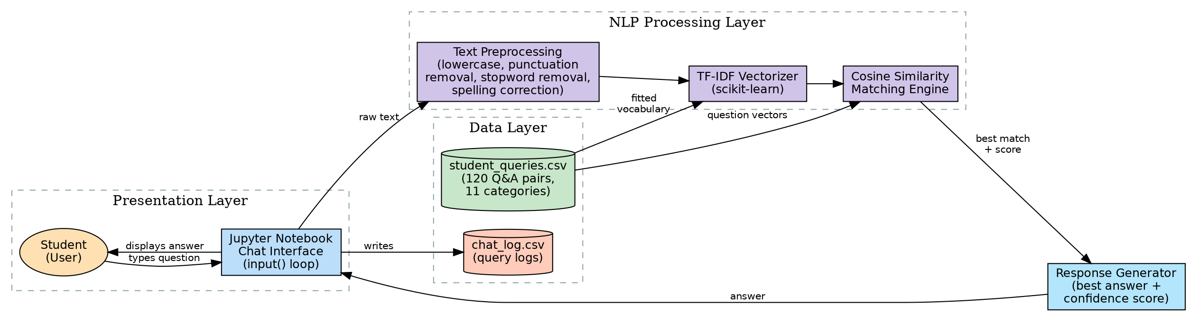
System Architecture
5

Slide 6
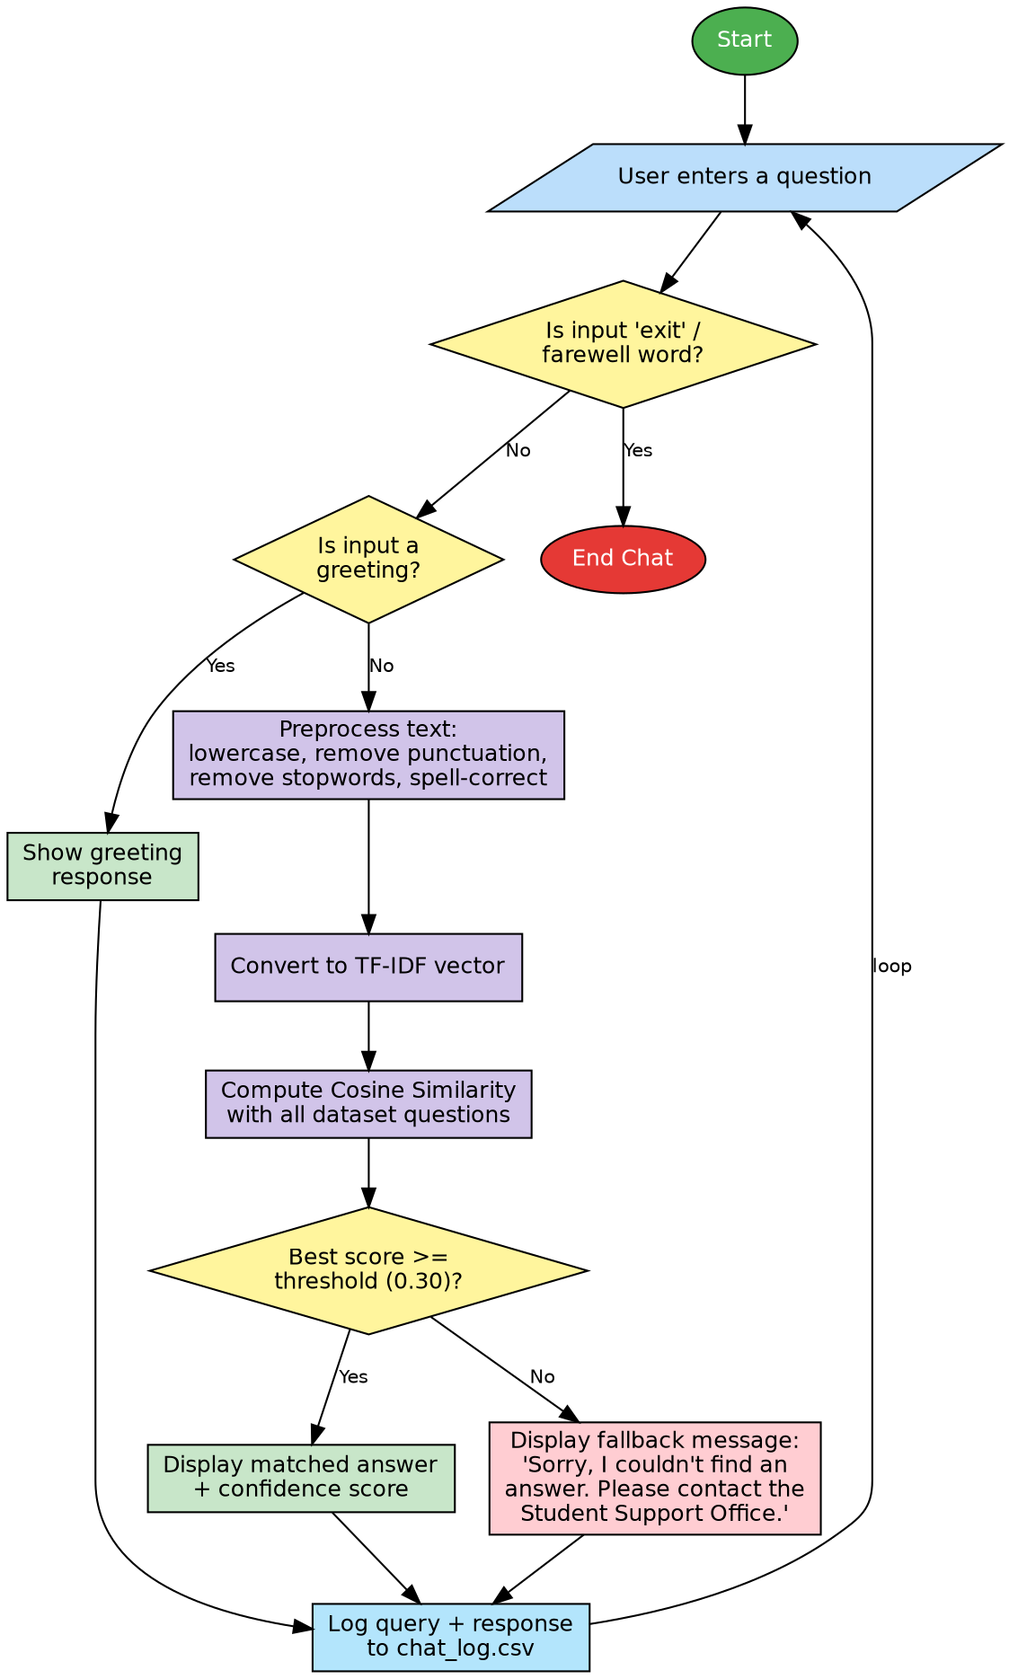
Chatbot Working - Flowchart
6

Slide 7
The Dataset
student_queries.csv
Categories Covered
Admissions
Fees
Hostel
120
Question-Answer Pairs
Library
Examination
Placements
Scholarships
Faculty
11
Query Categories
Academic Calendar
College Timings
Student Support
3
Columns: category, question, answer
7

Slide 8
How It Works: The NLP Pipeline
User Input
→
Preprocess
(lowercase, remove
punctuation & stopwords)
→
TF-IDF
Vectorization
→
Cosine
Similarity Match
→
Return Best
Answer + Score
TF-IDF = Term Frequency - Inverse Document Frequency | Cosine Similarity measures the angle between two text vectors (0 to 1)
If the best similarity score is below 0.30, the chatbot returns:
"Sorry, I couldn't find an answer. Please contact the Student Support Office."
8

Slide 9
Key Features
Offline & Free
Confidence Score
No paid API, no internet connection needed
Every answer shown with a similarity confidence score
Greeting Detection
Spelling Tolerance
Responds naturally to hi, hello, good morning, etc.
Corrects minor typos using difflib close-word matching
Conversation Logging
Safe Fallback
Every query logged with timestamp to chat_log.csv
Politely redirects unanswerable queries to the support office
9

Slide 10
Sample Conversation
You:
hi
Bot:
Hello! I am your Student Support Assistant. How can I help you today?
You:
How can I apply for admission?
Bot:
You can apply online through the official college admission portal... (confidence: 0.83)
You:
wat is da libary timing
Bot:
The library is open from 8:00 AM to 8:00 PM on all working days... (confidence: 0.61)
You:
bye
Bot:
Thank you for using the Student Support Chatbot. Goodbye!
10

Slide 11
Testing & Results
Test Case | Input | Result
TC01 | hi | Pass
TC02 | How can I apply for admission? | Pass
TC03 | wat is da libary timing | Pass
TC04 | how is the weather today (out of scope) | Pass (fallback shown)
TC05 | bye | Pass
8 / 8
Test cases passed
Well-formed & paraphrased questions matched with high confidence; out-of-scope questions correctly triggered the fallback message.
11

Slide 12
Advantages & Limitations
Advantages
Limitations
✓ Completely offline & free
✗ Limited to dataset scope
✓ Simple, interpretable algorithm
✗ No deep semantic understanding
✓ Easy to extend (edit CSV)
✗ No multi-turn context memory
✓ Protects student data privacy
✗ Accuracy depends on dataset size
✓ Confidence scoring
✗ Notebook UI, not production-ready
✓ Spelling-mistake tolerant
12

Slide 13
Future Scope
Deploy as a web app using Flask / Streamlit
Expand dataset using real logged queries
Use word embeddings for better semantic matching
Add multi-turn conversational context
Support Hindi & regional languages
Add voice input/output (offline)
Build an admin analytics dashboard
13

Slide 14
Conclusion
An offline, NLP-based chatbot using TF-IDF and Cosine Similarity can accurately answer common student queries — without paid APIs, internet dependency, or complex infrastructure — making it a practical, extensible tool for real academic institutions.
Thank You
Questions & Viva Discussion

