Slide 1
SQL SCRIPTING
ANUSHA ANAGANI

Slide 2
SQL scripts to answer few business questions
Which five products are ordered more in America?
Sales Reps who sold more products?(Top 3)
What is the total amount spent by customers? List it by state and month.
Which months are the more profitable for online sales?
Which months are the more profitable for direct sales?

Slide 3
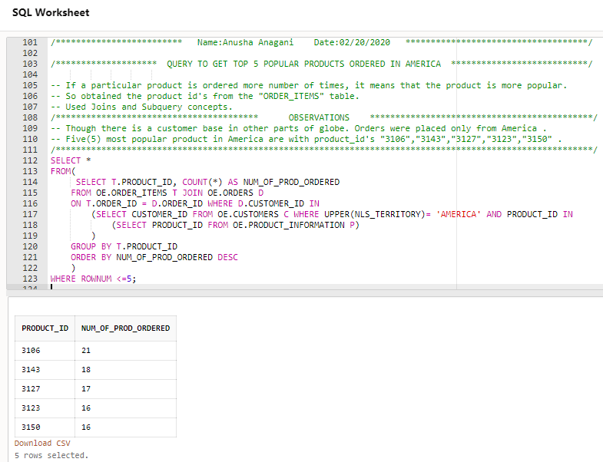
Top 5 products ordered in America

Slide 4
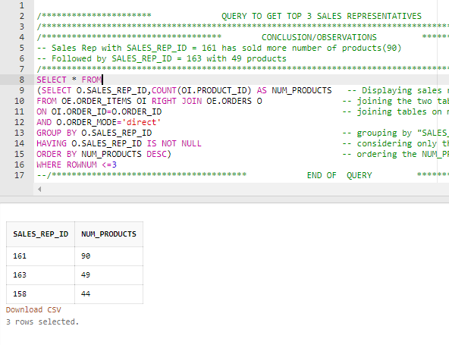
Top 3 Sales Representatives

Slide 5
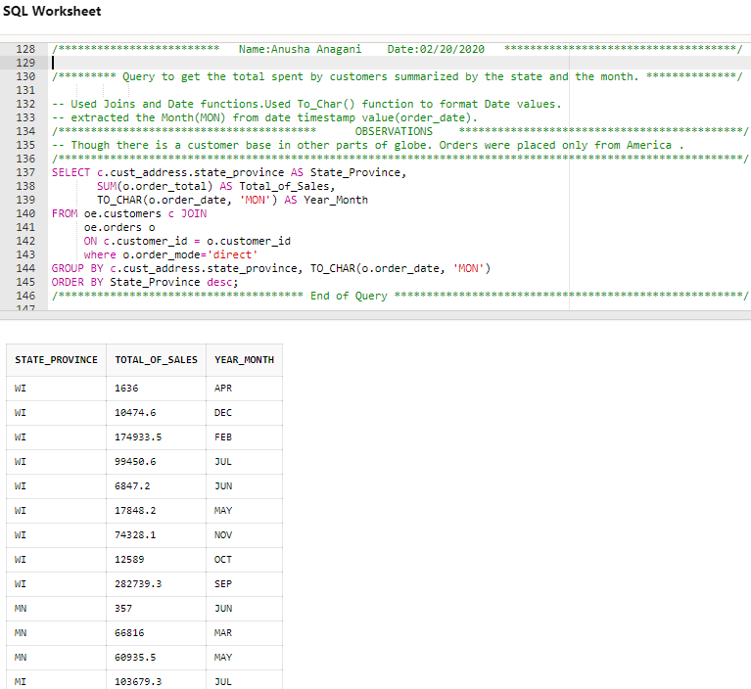
Total amount spent summarized by state and month

Slide 6
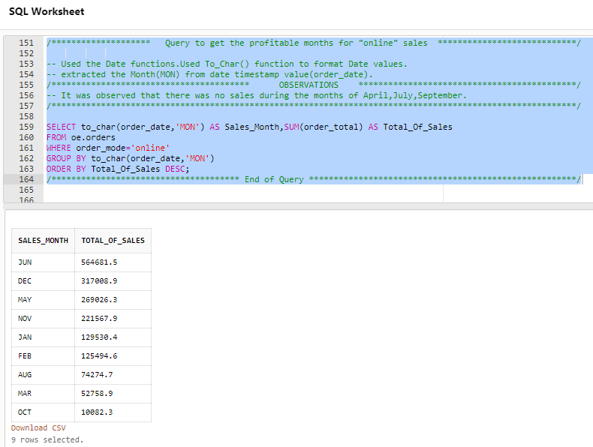
Total monthly online sales

Slide 7
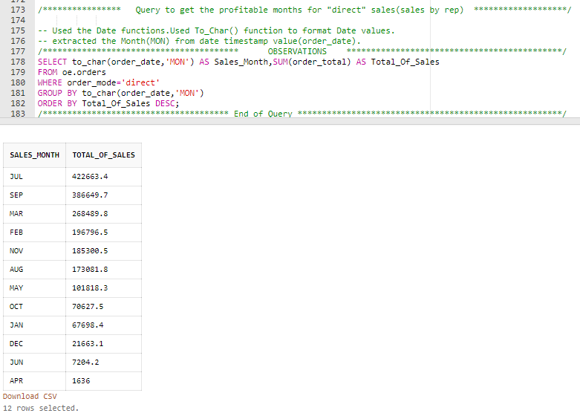
Total monthly direct sales

