Slide 1
Capgemini Learning & Development with AI
09/27/2018, L&D team

Slide 2



Meet the Team!
Insert Image Here
Aditi Dalvi
Anusha Baddam
Benis Tambe
Business Analyst
Located in Bloomington, IL
Java Developer
Located in Bloomington, IL
Lead UI developer
Currently located in ATL, GA
5 years of development experience

Slide 3



Meet the Team!
Insert Image Here
Anantha Sure
Tejasri Satyavarapu
Shruthi Patil
Mainframe Developer
Located in Hyderabad, India
Java Developer
Located in Hyderabad, India
Java Developer
Located in Hyderabad, India

Slide 4
Learning and Development research statistics.
68%
9 in 10
2 in 3
of employees have changed jobs because of a lack of learning and development opportunities
employees want their employer to offer more training courses to develop new skills
employees believe training is more important today than it was two years ago
Statistics according to www.onrec.com

Slide 5
Problem to solve.
Some employers have an extensive curriculum and great live courses
But skillset specific trainings are not presented to employees
Employers spend lot of time to make employee aware of these courses.
Our Approach(Using AI):
Collect Data
Match Skillset
Recommend
Collect Employee data such as;
Employee Id, Name, Skills, Role, & Years of experience
Collect Course data i.e.;
Course name, skill, and duration
Identify and match employees with courses based on skillset
Provide useful course recommendations to each employees based on data collected

Slide 6
Architecture & Technology stack
Technologies:
Python Language
Anaconda Navigator
Jupyter notebook
Employee Data
Training Data
Recommendation System
Recommended Courses
Feedback Data

Slide 7
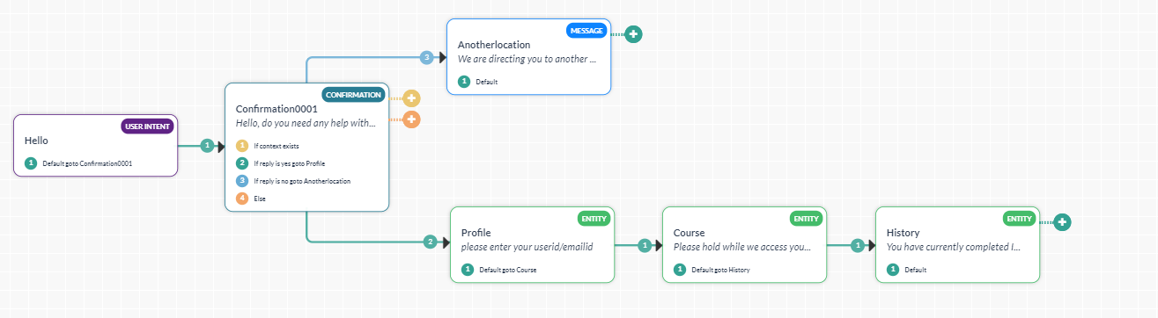
Chatbot Design.

Slide 8
Demonstration

Slide 9
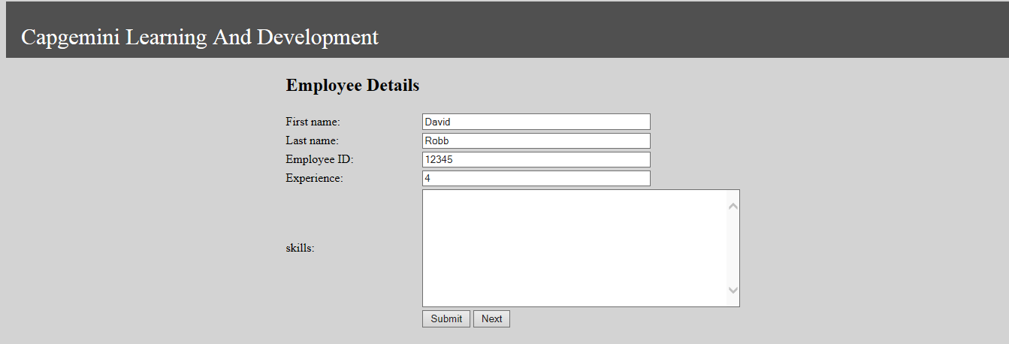
Demonstration- Employee Information
On this screen Employees skills will be captured.

Slide 10
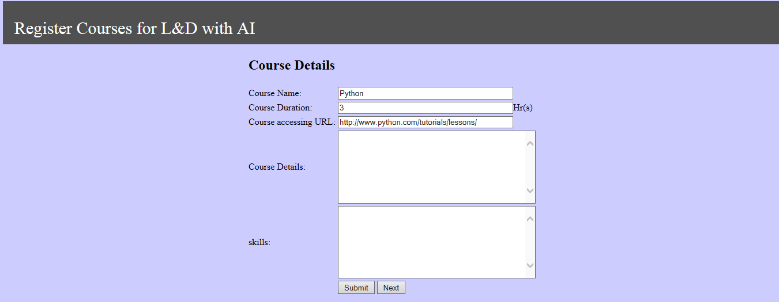
Demonstration- Course Information
On this screen new course information will be submitted after which AI based recommendation engine will be triggered to generate notification to interested & matched employees.

Slide 11
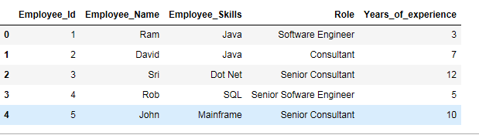
Demonstration- Sample employee & skills data.
Sample Employee Skills dataset used by our Recommendation engine.

Slide 12
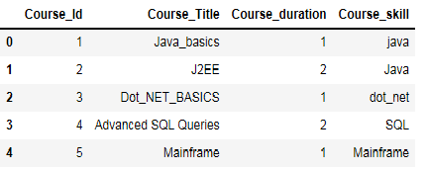
Demonstration- Sample course data.
Sample Courses dataset used by our Recommendation engine.

Slide 13
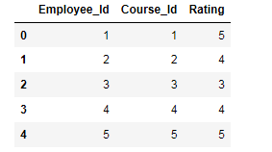
Demonstration- Sample feedback data.
Sample Feedback dataset used by our Recommendation engine.

Slide 14


Demonstration- Algorithm to train AI Recommendation engine.
Based on our analysis, collaborative Filtering fits well for our Learning and development system. There are two types of Collaborative Systems both of which are core of AI engine.
1. User-User collaborative filtering:
This system first finds the similarity score between Employee skills. Based on this similarity score, it then picks out the most similar Employees and recommends Courses which these similar Employees have liked or bought previously.
Prediction:
2. Item-Item collaborative filtering:
In this system, we compute the similarity between Courses taken by user and taking their feedback into consideration.
Prediction:

Slide 15
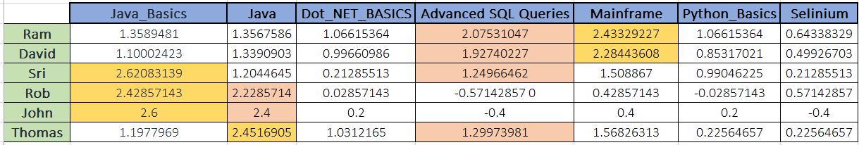
Demonstration- Collaborative filtering output
User-User collaborative filtering:
In the above prediction, the matching/liking criteria for the courses depends on the correlation.
If correlation > 1
->then recommend the course.
If correlation < 0
->Won’t recommend the course.

Slide 16
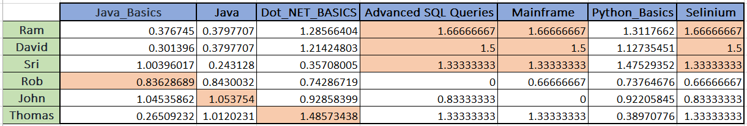
Demonstration- Collaborative filtering output
Item-Item collaborative filtering:
In the above prediction, the matching/liking criteria for the courses depends on the correlation.
If correlation > 1
->then recommend the course.
If correlation < 0
->Won’t recommend the course.

Slide 17
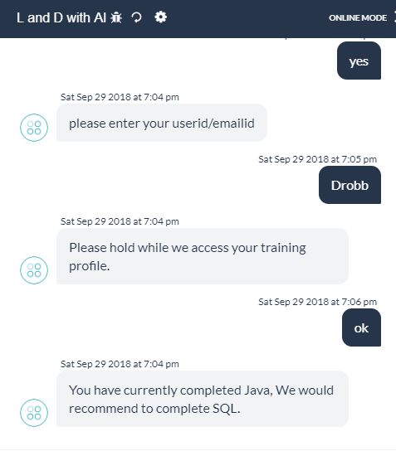
ROBUSTNESS: Showcase the robustness of the trained model (Demonstrate that your trained model generalizes, e.g. via a train/test/validate approach – 1 slide
Chat bot Demo:

Slide 18
Thank You.

