Slide 1

Multi-Touch Marketing
Attribution and ROI Dashboard
Internship Project Presentation
Submitted by:
Chaitanya Pawar
Lonali Rai
Anusha Jidage
Bhargavi
Submitted to: Infotact Solutions & Co.
Tools: Python • SQL • Tableau • Google Colab

Slide 2

Content:
Introduction.
Objectives.
Problem Statement.
Methodology.
Attribution Model.
Result.
Conclusion.

Slide 3
Introduction:
This project analyzes multi-touch marketing attribution to understand how different marketing channels contribute to customer conversions.
It compares First-Touch, Last-Touch, and Linear Attribution models to assign conversion credit fairly.
The dataset was cleaned and processed using Python, Pandas, and SQL logic.
Key KPIs such as Total Spend, Attributed Revenue, ROAS, CAC, and Conversions were calculated.
An interactive Streamlit dashboard was deployed to visualize channel performance, funnel analysis, ROI scatter plot, and campaign-level insights.

Slide 4
Objectives:
To clean and prepare marketing touchpoint data for analysis using Python and Pandas.
To identify customer journeys and understand how different marketing channels contribute to conversions.
To implement and compare First-Touch, Last-Touch, and Linear Attribution models.
To calculate important marketing KPIs such as Total Spend, Attributed Revenue, Conversions, ROAS, and CAC.
To build and deploy an interactive Streamlit dashboard for channel performance, funnel analysis, ROI analysis, and campaign-level insights.

Slide 5
Problem Statement:
Problem Statement
Marketing teams use multiple channels like Google Ads, Meta Ads, Email, Organic Search, Referral, and Direct to reach customers.
Customers usually interact with multiple touchpoints before making a final conversion.
Traditional Last-Click Attribution gives full credit only to the last channel.
This may ignore the contribution of earlier channels and lead to wrong marketing budget decisions.
This project solves the problem by building a Multi-Touch Attribution and ROI Dashboard to analyze channel performance, conversions, ROAS, and CAC.

Slide 6
Methodology:
Data Collection: Marketing touchpoint data was collected in CSV format, including customer journeys, channels, campaigns, ad spend, conversions, and revenue.
Data Cleaning and Preprocessing: The dataset was cleaned using Python and Pandas by converting date columns, handling numeric values, removing duplicates, and sorting customer journeys.
Attribution Modeling: Three attribution models were implemented: First-Touch Attribution, Last-Touch Attribution, and Linear Attribution.
KPI Calculation: Important KPIs such as Total Spend, Attributed Revenue, Attributed Conversions, ROAS, and CAC were calculated for each marketing channel.
Dashboard Development and Deployment: An interactive dashboard was created using Streamlit to visualize channel performance, ROI scatter plot, funnel analysis, and campaign-level insights.

Slide 7
Attribution Models:
First-Touch Attribution The first marketing channel that interacts with the customer gets full conversion credit. Example: Google Ads → Email → Direct → Conversion Credit goes to Google Ads.
Last-Touch Attribution The last marketing channel before conversion gets full credit. Example: Google Ads → Email → Direct → Conversion Credit goes to Direct.
Linear Attribution All touchpoints in the customer journey share conversion credit equally. Example: Google Ads → Email → Direct → Conversion Credit is shared equally between Google Ads, Email, and Direct.

Slide 8
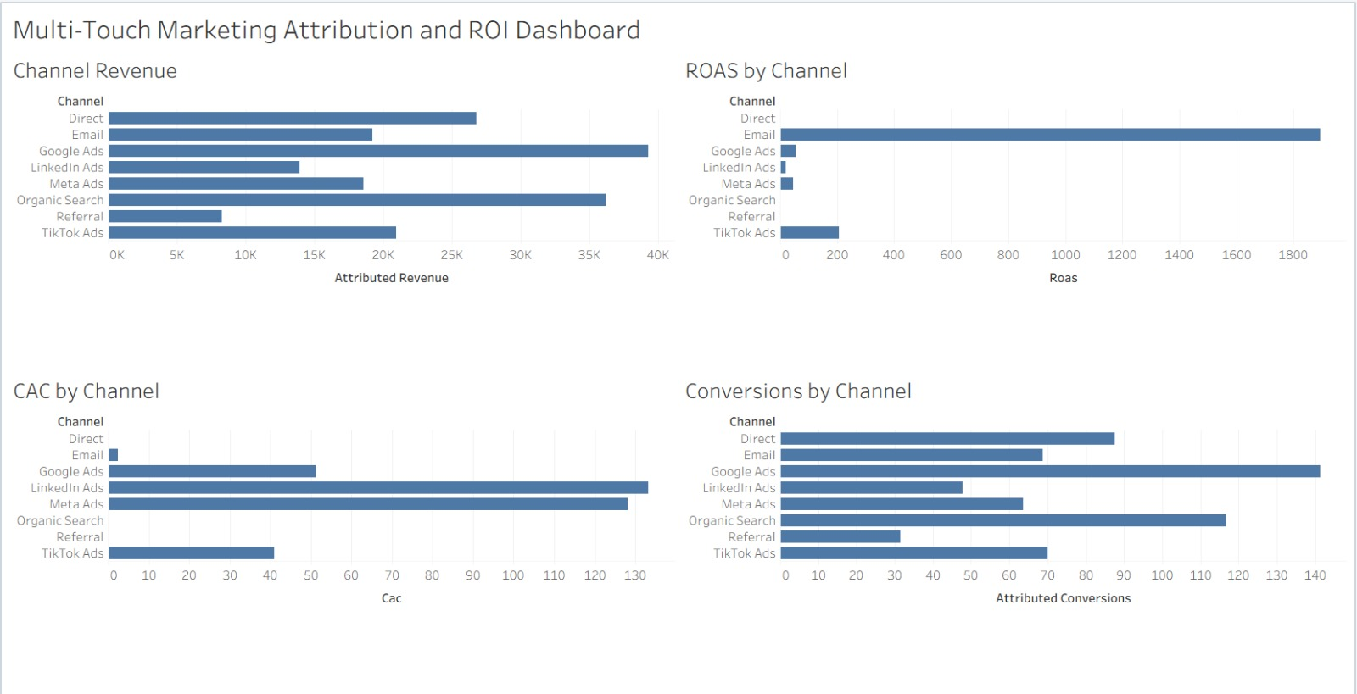
Result:
Tableau Dashboard Preview

Slide 9
Conclusion:
This project successfully developed a Multi-Touch Marketing Attribution and ROI Dashboard to analyze how different marketing channels contribute to conversions and revenue. By implementing First-Touch, Last-Touch, and Linear Attribution models, the project provides a better understanding of the complete customer journey. Important KPIs such as Total Spend, Attributed Revenue, Conversions, ROAS, and CAC were calculated to evaluate marketing performance. The deployed Streamlit dashboard helps visualize channel performance, funnel drop-off, ROI analysis, and campaign-level insights. Overall, this project supports data-driven marketing decisions and helps businesses allocate their marketing budget more effectively.

Slide 10
Thank You

