Slide 1
Grubhub
Case Study

Slide 2
Obstacles to growth
Drivers
Partnership with Restaurants
Customer Loyalty
Notes:
Customer Loyalty is questioned

Slide 3
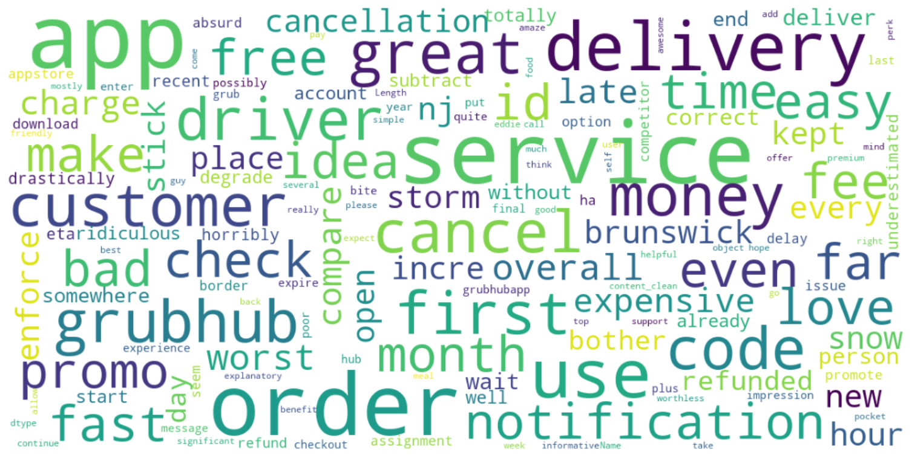
Notes:
Word Cloud is a data visualization technique used for representing text data in which the size of each word indicates its frequency or importance. The above wordcloud was generated from the Grubhub
Review in the Google Play Store.

Slide 4
What worked so far?
Flawless App Experience
Great discounts and refunds
Saves previous orders for faster ordering

Slide 5
What didn’t work so far?
High Delivery Fee when compared to competitors
Late Delivery
Less communication on the status/tracking of the order and visibility of Driver Progress
GPS part of the app are not always accurate
Promo code during checkout never works

Slide 6
Recommendations
Ensure Faster Delivery and reduced delivery charges
Feature Improvement : Offer itemized lists of restaurants sorted by the cost of delivery, making it easy to seek out a cost-effective option without clicking through a menu first
Cost Transparency : Categorized restaurants with upfront delivery charges
Targeted Campaigns : Provide more offers and promotions to loyal customers
Search Engine Optimizations :
Support more local restaurants

Slide 7
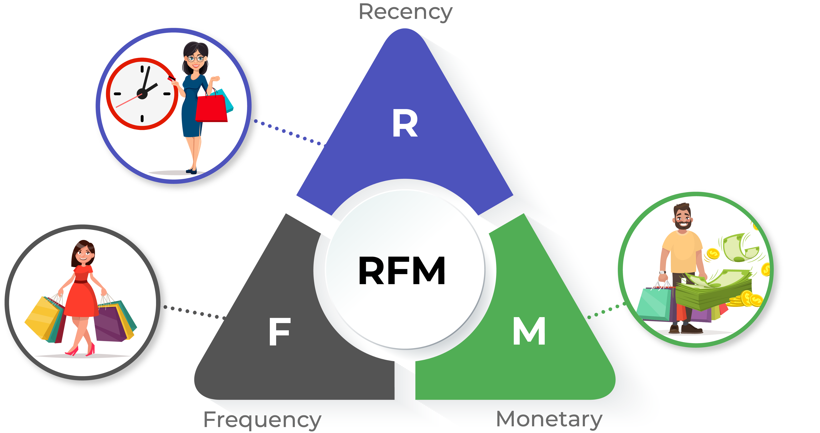
Loyal Customers – RFM Analysis

Slide 8
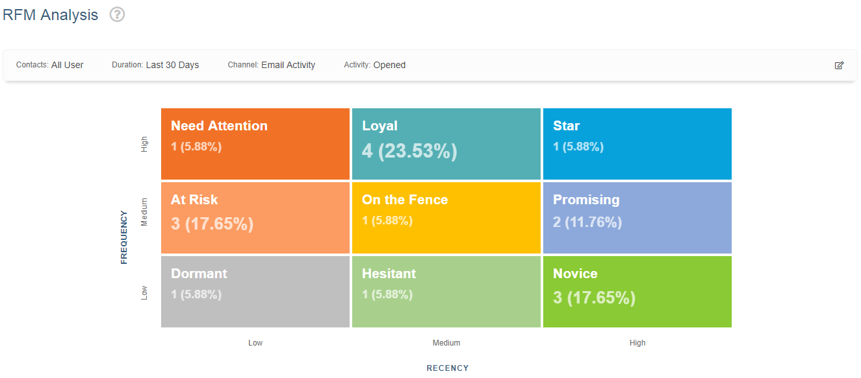
Email Activity

Slide 9
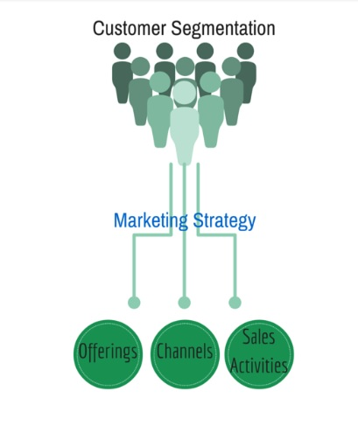
Customer Segmentation
Notes:
Helps identify least and most profitable customers, thus helping the business to concentrate marketing activities on those most likely to buy your products or services
Helps build loyal relationships with customers by developing and offering them the products and services they want
Helps improve customer service
Helps maximize use of your resources
Helps improve or tweak products to meet customer requirements
Helps increase profit by keeping costs down

Slide 10
Conclusion
For now, delivery companies must place an emphasis on customer service. They must be courteous and professional if they’re to earn customer loyalty. Until there are drones delivering our food, this is still a people business.
That human element is vital for any company looking to carve out a piece of the market.

