Slide 1

Data Science Case Study
- Anusha Manjunatha

Slide 2
Agenda
Introduction | EDA & Data Pre-Processing | Base Model evaluation | Recommendation
Business Background | Understand the data | Methodology | Challenges
Understanding Problem Statement | Explore the trends | Metrics Definition | Potential Solution
Goals | Data Pre-processing tasks | Metrics Evaluation | Future Work

Slide 3


Background
European bank wants to sell Term Deposits
Phone call-based marketing campaigns were conducted to sell the product.
Analyze the marketing campaign data to understand the best trend.
Evaluate the current model
To build a predictive model to identify if the customers will subscribe to the term deposits.

Slide 4
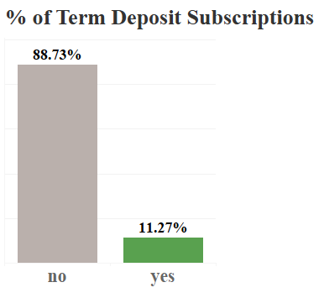
Exploratory Data Analysis
Data is related with direct marketing campaigns of a European banking institution.
Includes 41188 customers with 10 numerical features and 10 categorical features.
Target feature tells us if the client has term deposit Yes: 1 – Subscribed
No: 0 – Not Subscribed
Imbalanced dataset (11% Target rate)
88.73% not subscribed
11.27% subscribed
ModelPerformance feature provides the probability of subscribing to term deposit in the current model

Slide 5

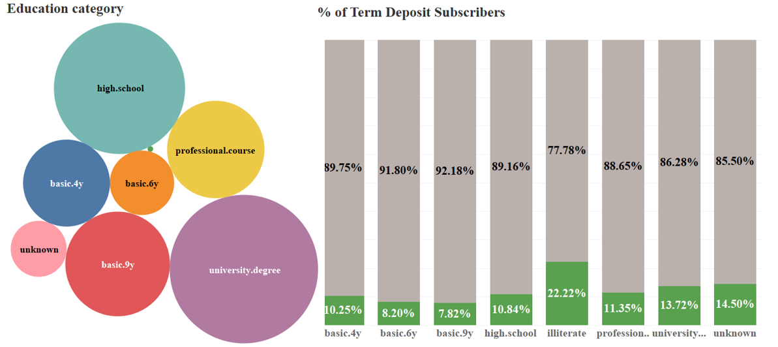
Exploratory Data Analysis
Illiterates
Customers with education background as “University Degree” are in high numbers. Illiterates have smaller sample size of 18

Slide 6
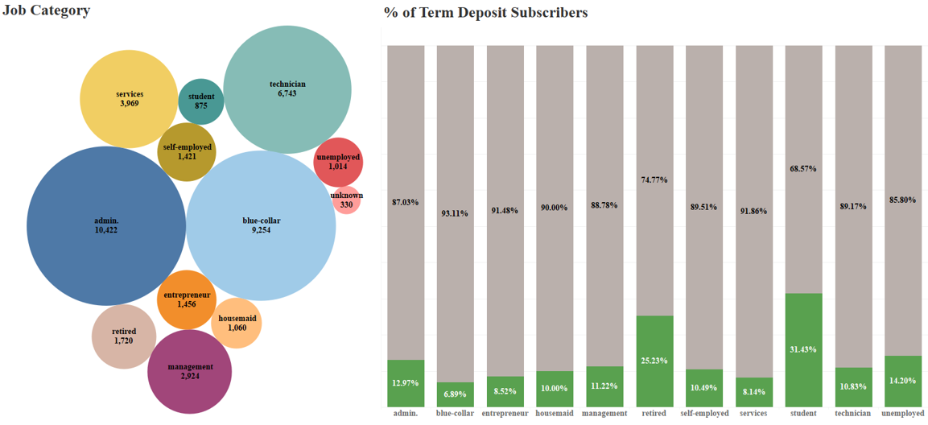
Exploratory Data Analysis
Customers with Blue-collar jobs have the least subscriptions in spite of being the second highest count in the data. Good to focus on customers who are students and retired, since they have high subscriptions.

Slide 7
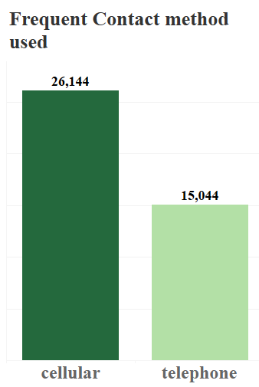
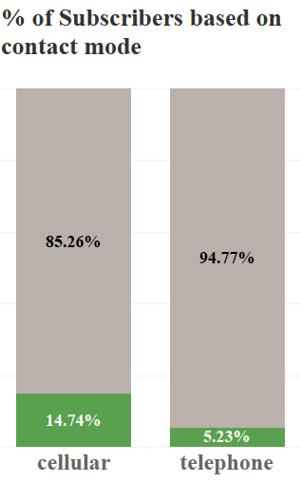
Exploratory Data Analysis
More customers are contacted through cellular method, which is efficient enough for successful subscriptions when compared to telephone contact method.

Slide 8
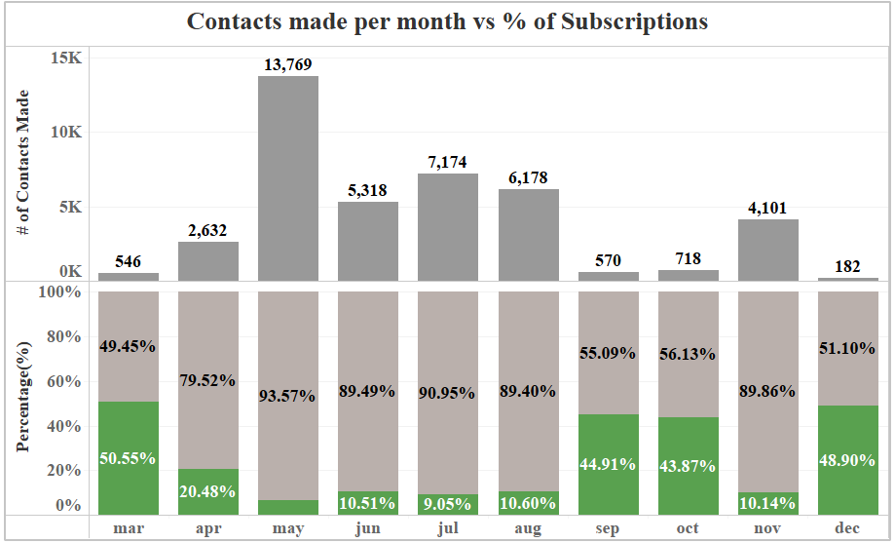
Exploratory Data Analysis
Important fact to consider here, high rate of subscriptions during September, October, December and March.

Slide 9
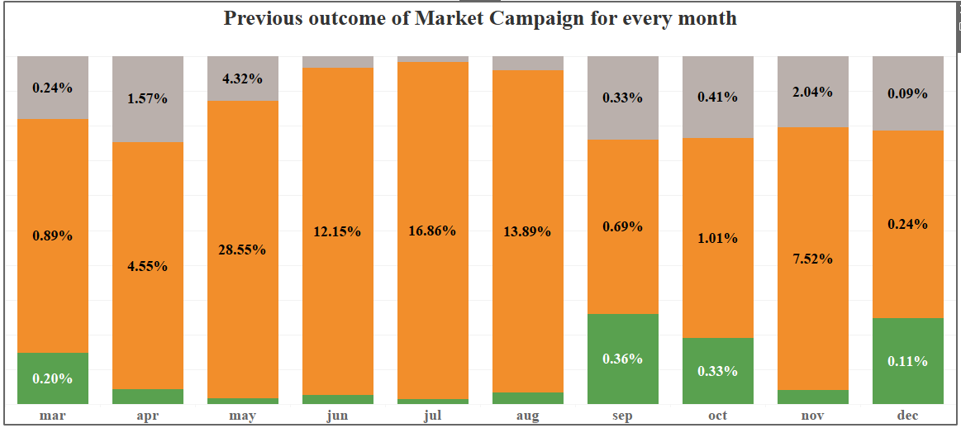

Exploratory Data Analysis
Peak successful subscriptions during September, October, December and March when compared to other months.

Slide 10
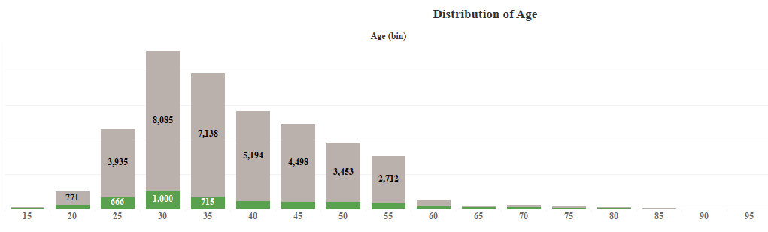
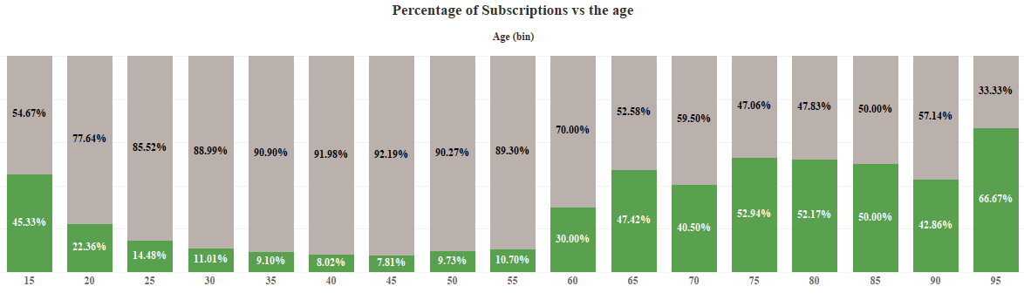
Exploratory Data Analysis
Younger group and older age group can be persuaded more to subscribe.

Slide 11
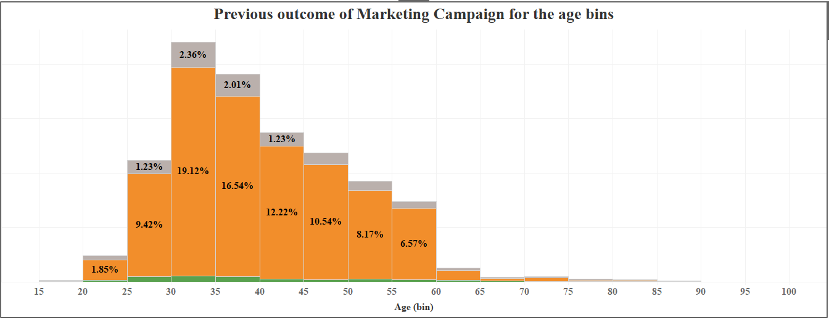
Exploratory Data Analysis
Previous campaign was more successful with customers between age 25 to 60, they are our potential targets

Slide 12
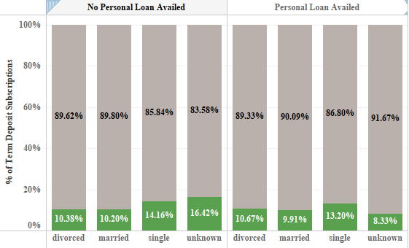
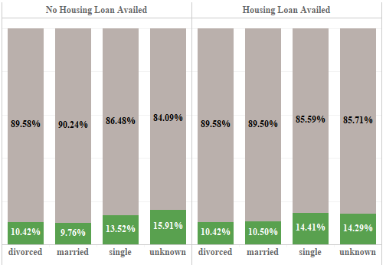
Exploratory Data Analysis
Plot to understand personal and housing loan status along with the marital status of customers. Good to focus on customers who are single.

Slide 13
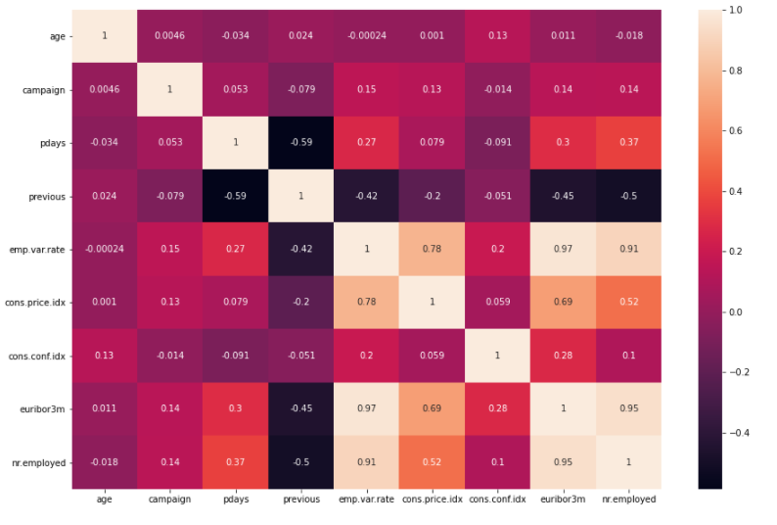
Exploratory Data Analysis
Employment variation rate, Number of employees and Euribor 3 months rate are correlated. Employment variation rate is a combination of Number of employees, this results in Multicollinearity issues.

Slide 14
Data Pre-processing
No Missing values, but there are records with “Unknown” values counting to 12.7K rows.
Approx. 8.5K unknown rows listed in “default” feature which accounts for has credit card in default?
Removed 12 duplicated rows.
No Inconsistent, invalid or any structural errors in the data.
Outliers are found in Age (421 rows only), pdays, previous. Pdays and previous has no much influence on the model, could be dropped.
Encoded target feature using Label Encoder and removed the target categorical feature.
Used One-hot encoder to encode all the categorical features.
Numerical Features are scaled using standard scalar.
Dropped current model predictions.

Slide 15
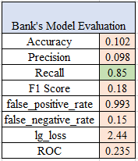
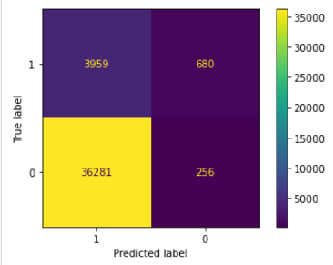
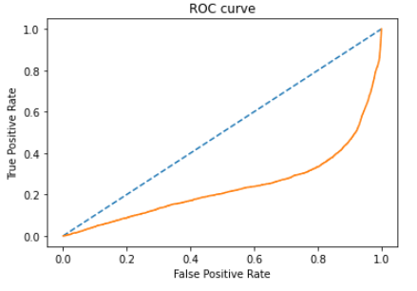
Base Model Evaluation
Accuracy: 10.2 %.
Recall: 85% of the customers were correctly identified that they had subscribed to the term deposit.
Precision: True positive value of 9.8% of the customers, did subscribe to the term deposit. Results in inefficient use of marketing resources and funds.
F1-Score: 0.18. Higher the score, better is the model. F1 score conveys the balance between the precision and the recall.
Model can do better

Slide 16

Recommendation
Handling Imbalanced Classification Data
Approach to handling Imbalanced Data
A. Data Level approach: Resampling Techniques:
1. Random Under-Sampling
2. Random Over-Sampling
3. SMOTE
B. Algorithmic Ensemble Techniques
1. Bagging
2. Boosting

Slide 17
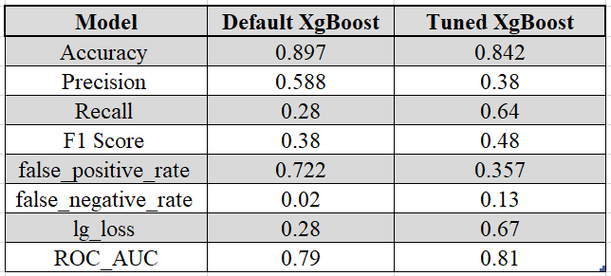
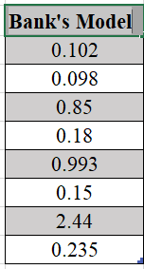
XgBoost Model Results
Metrics improved. Can explore Use sampling techniques as described, preferably SMOTE as part of future work.

Slide 18

Customers to be targeted: young and older age people.
To focus on customers who are students and retired.
Potential customers with university degree is possible.
To focus on customers who are single and with no personal and housing loan taken.
Cellular contact mode is good.
Plan campaigns from September through March instead of May to November.
Bank’s current model could do better.
Use XgBoost instead, which takes care of class imbalance.

Slide 19

Questions?

