Slide 1
Weather On Crime
Presented by Team-12 :-
Anusha Meka
Manasi Subhedar

Slide 2
Project Idea:
→ There is a new gun policy in chicago that has been passed in early 2013.
→ Can we attribute a fall in violent crime in Chicago to its new conceal and carry laws?
→ In our home town there is a notion that crimes are high during summers due to unemployment. I made analysis on does weather can impact the crime rate in chicago as well.
→ I found interesting results between crime rate and temperature.

Slide 3
Goals:
→ Correlation between various types of crimes and temperature.
→ Data distribution of personal and property crimes with temperature.
→ Relationship crime has with environmental factors like temperature as well as temporal factors like the hour of the day and day of the week.
→ Statistical modeling for personal and property crimes.
→ Find evidence of substantial differences in reporting crime data since 2013

Slide 4
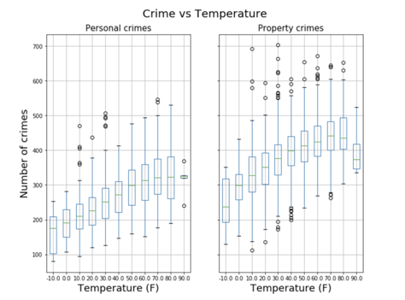
Distribution of personal and property crimes data with temperature:
→ There are 32 types of crimes. Divided into personal and property crimes.
→ Temperatures are binned.
For ex: if temperature is between 0-10 make it as 10.
→ From the figure, # of crimes are increasing with temperature.

Slide 5
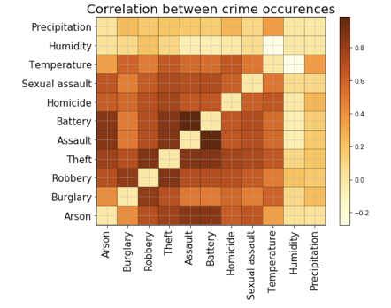
Correlation between various types of crimes and temperature:
→ High correlation between Battery and Assault.
→ Low correlation between Humidity and Temperature.
→ By default, we have hard coded diagonal to zero.
→ Both Battery and Assault comes under personal crimes.

Slide 6
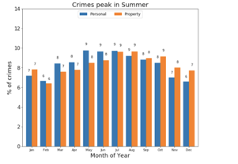
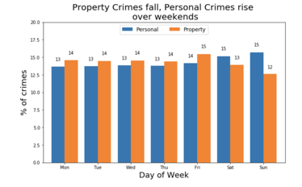
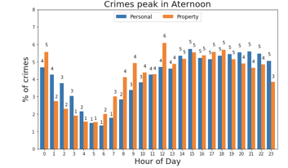
Relationship crime has with temperature as well as temporal factors:

Slide 7
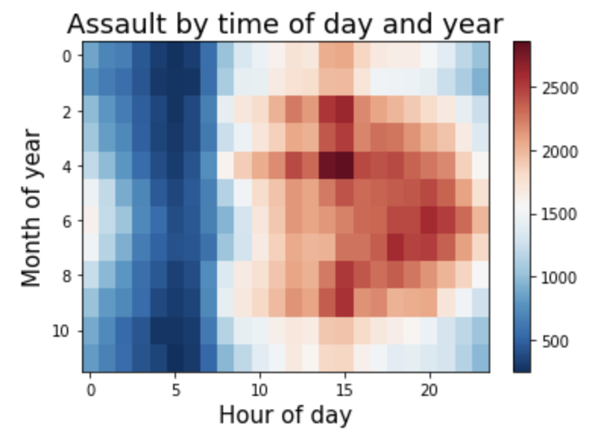
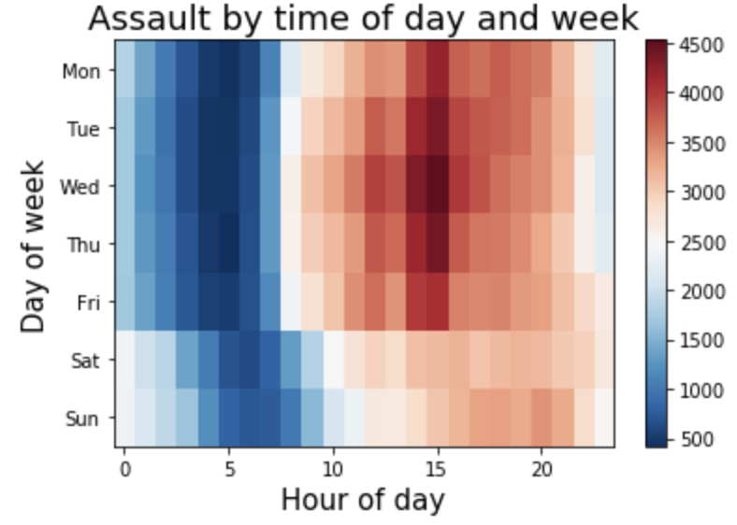
Contd..
→ As there is high correlation between Battery and Assaults, we shall dig deeper on both.
→ Assaults are high during noon hours.
→ High over the weekdays and less over the weekends

Slide 8
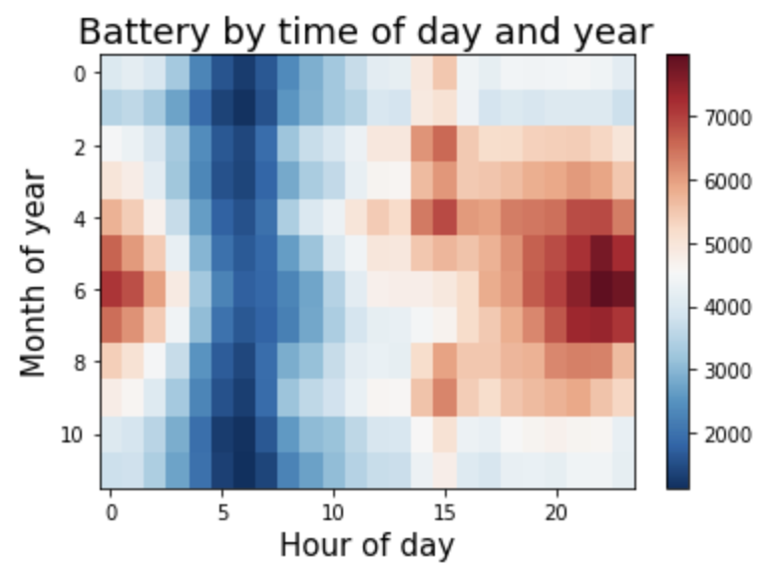
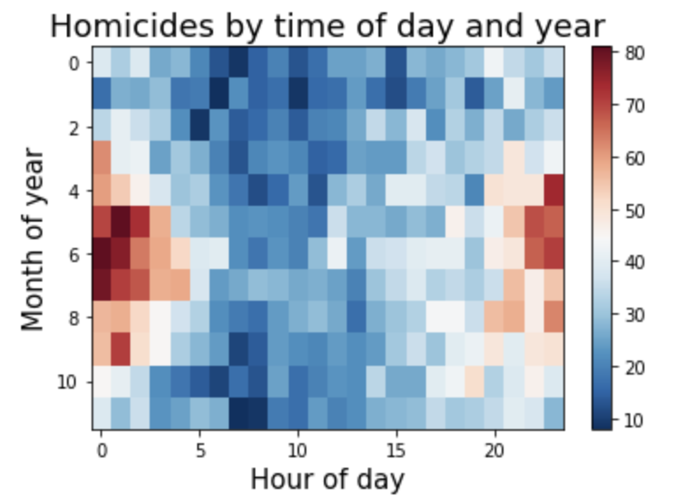
Contd..
→ Battery Crimes are high starting from noon and extreme at late evenings.
→ Homicides/Murders are high at midnights.

Slide 9
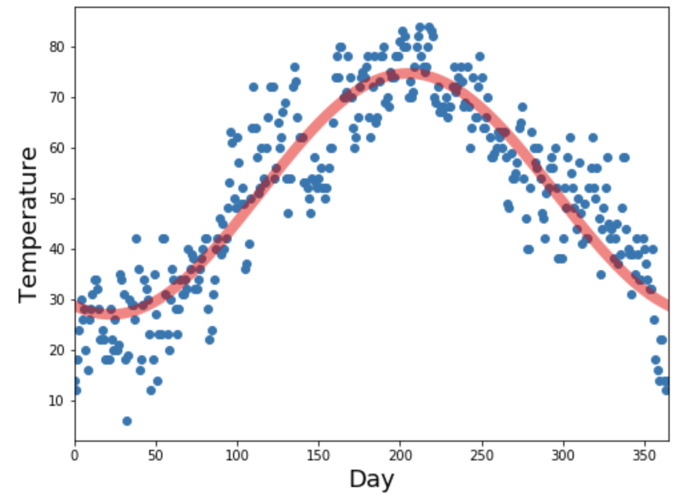
Curve fitting Temperature vs Day of year:
→ I considered an year 2001 and plot the temperature(blue dots) on each each day.
→ Perform OLS linear regression and draw a model that fits the data.
→ In the next slides, you are going to see whether the same model works for the crimes as well for every year.
→ Predict how cimes going to be for reat of the years.

Slide 10
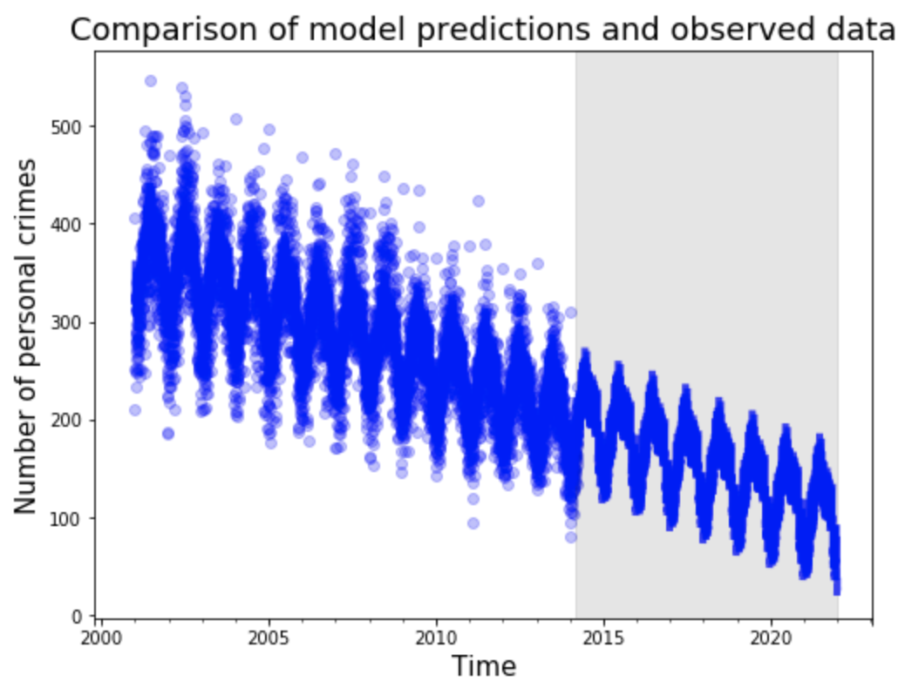
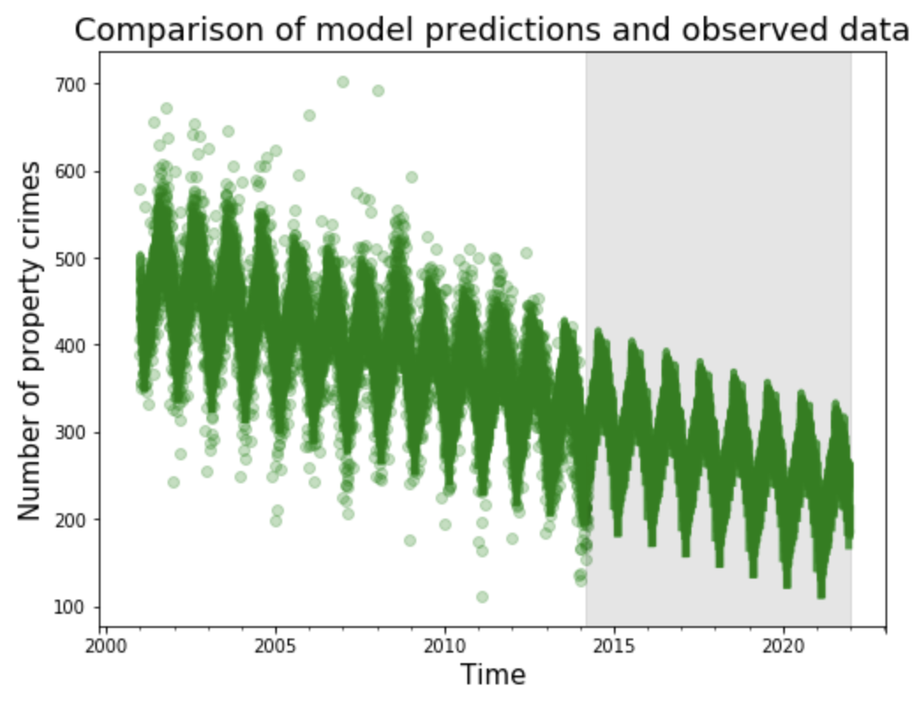
Statistical modeling for personal and property crimes:
→ Light colored dots are the observed values (# crimes/day) and solid zig-zagged line is predicted. Gray colored window is prediction for years 2014 to 2021.
→ Clearly, crimes in every year is following the same model as temperature which are high in summers.
Personal Crimes:
Property Crimes:

Slide 11
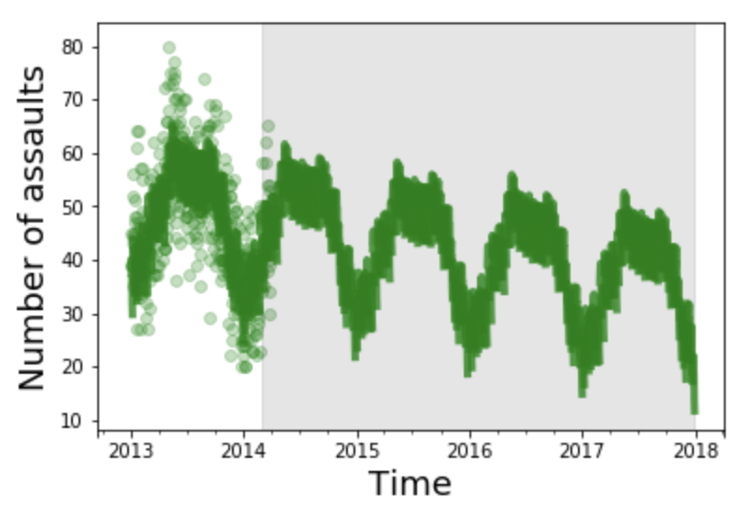
Does assaults follows statistical model?
→ This is just to see whether a randomly picked crime is following the same statistical model?
→ If so, Is there a significant change after the gun policy passed in 2013?
→ From the figure, we can say that assaults is also following the model.
→ There is a continuous decrease trend, but not a huge difference in case of assaults.

Slide 12
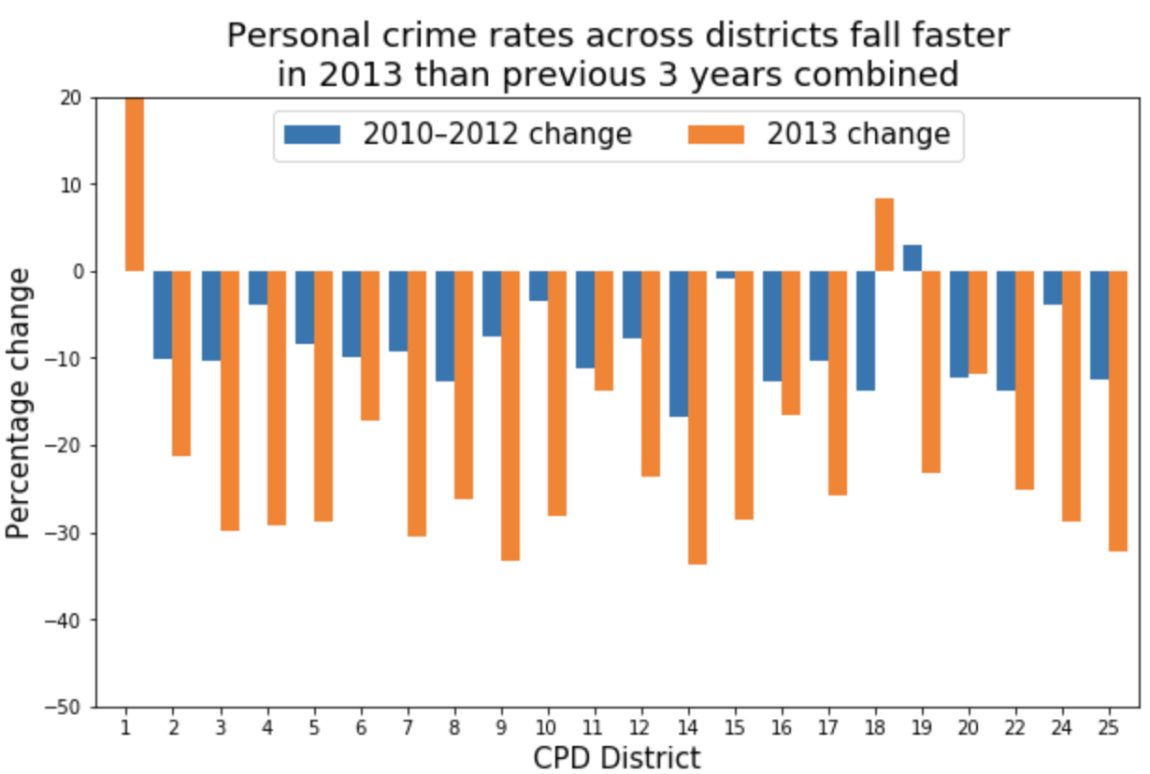
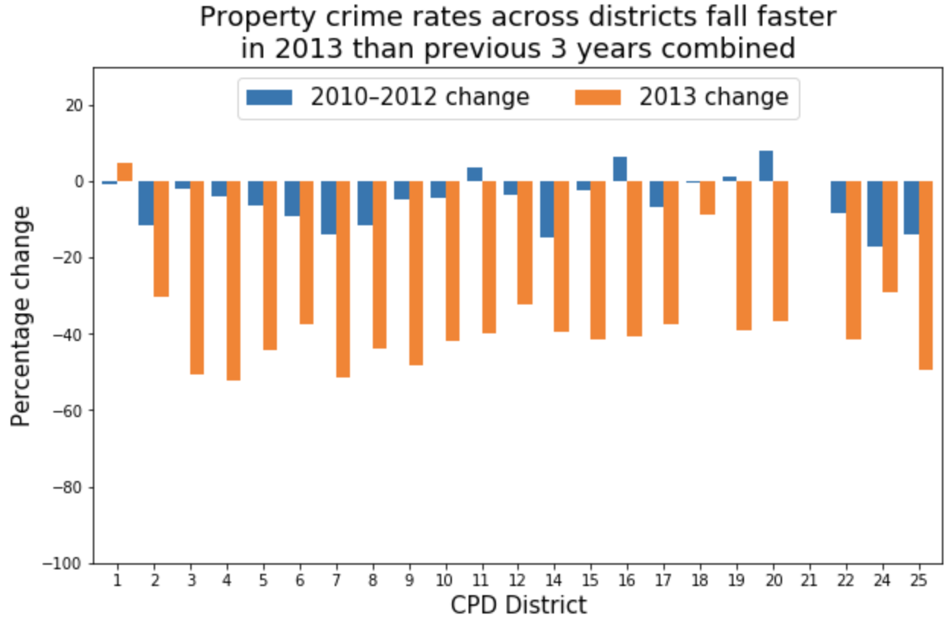
Find evidence of substantial differences in reporting crime data since 2013:
→ Both personal & property crimes rates across districts fall faster in 2013 when compared to 2010-12 percentage change. There is a huge difference for district 15.
Personal Crimes
Property Crimes

Slide 13
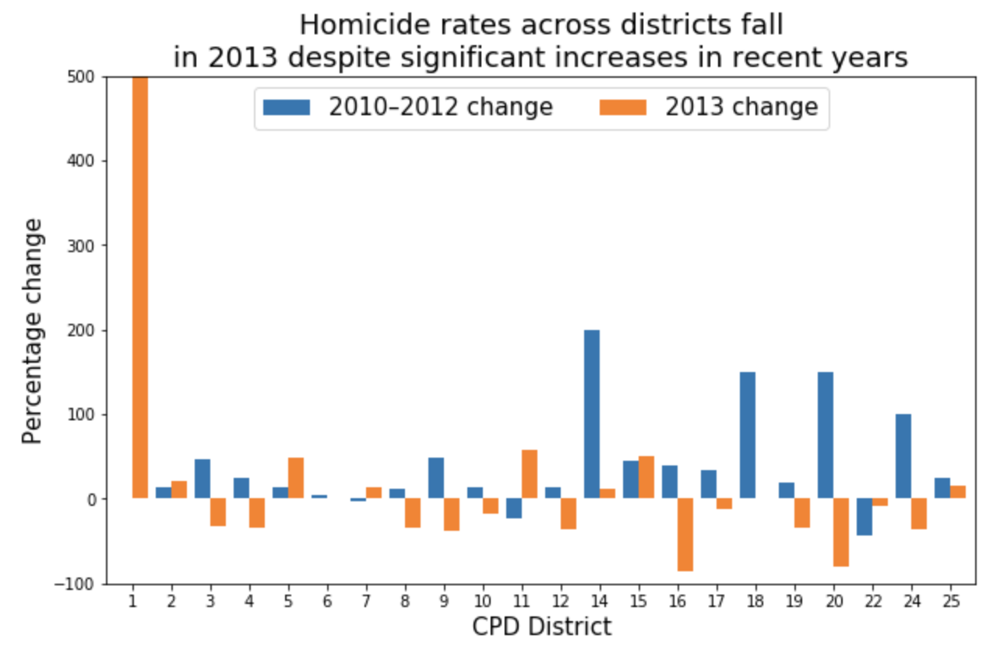
What about Homicide crime rate since 2013?
→ Consider a random crime and see how faster crimes in district 15 fall?
→ Unlike to previous slide graphs, there is increase in # of homicide crime rate in district 15.
→ From overall analysis, how can we say which district is safe to live with less # of crimes when compared to others.

Slide 14
Ttest_1samp Result:
1 [2.49591088 0.03717818] 2 [1.83446617 0.10392335] 3 [4.63480444e+00 1.67751911e-03] 4 [4.02234258e+00 3.82864659e-03] 5 [4.41494397e+00 2.24156286e-03] 6 [-0.23363273 0.82113759] 7 [4.11362157e+00 3.37373940e-03] 8 [2.84320227 0.02170478] 9 [4.40683339e+00 2.26596900e-03] 10 [5.69487012e+00 4.57076333e-04] 11 [8.83196796e+00 2.12806818e-05]
→ District 15 has the lowest p-value. Does that mean there is significant decrease in crime rate?
→ If so, Is 15th district safe to live?
12 [4.71291676e+00 1.51595611e-03]
14 [4.16585517e+00 3.13989412e-03] 15 [1.03501082e+01 6.56125307e-06] 16 [3.31174059 0.01067051] 17 [7.36932476e+00 7.84683815e-05] 18 [4.43391307e+00 2.18558593e-03] 19 [5.72493732e+00 4.41519622e-04] 20 [6.61927931e+00 1.66020060e-04] 22 [4.06783246e+00 3.59419989e-03] 24 [2.60793459 0.03123036] 25 [4.40466529e+00 2.27254184e-03]

Slide 15
Contd..
→ Perform a ttest_1samp on each district with one column having percentage change for years 2010 - 12 and other column with percentage change from year 2012 to 2013.
→ Statistically it is shown that district 15 records faster fall in number of crimes. Does the p-values support the same?
→ In this case, ttest results too conveyed the same i.e., district 15 has lower p-value and so we can say that district 15 in chicago is safe to live for most type of crimes when compared with others.

Slide 16
THANK YOU

