Slide 1
Weather On Crime

Slide 2
Goals:
→ Correlation between various types of crimes and temperature.
→ Distribution of personal and property crimes with temperature.
→ Relationship crime has with environmental factors like temperature as well as temporal factors like the hour of the day and day of the week.
→ Statistical modeling for personal and property crimes.
→ Find evidence of substantial differences in reporting crime data since 2013

Slide 3
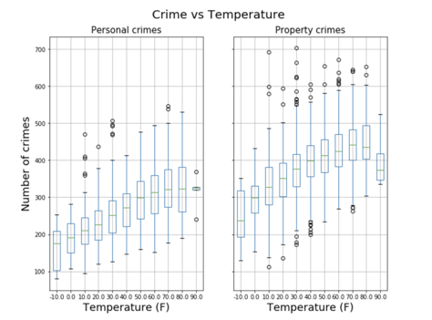
Distribution of personal and property crimes with temperature:

Slide 4
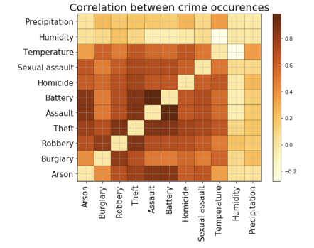
Correlation between various types of crimes and temperature:

Slide 5
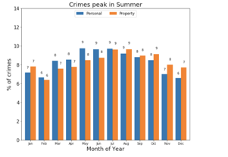
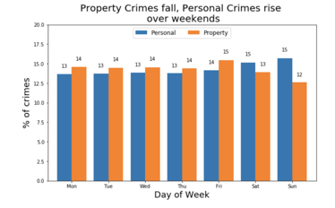
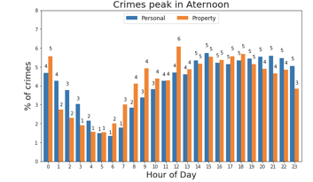
Relationship crime has with temperature as well as temporal factors:

Slide 6
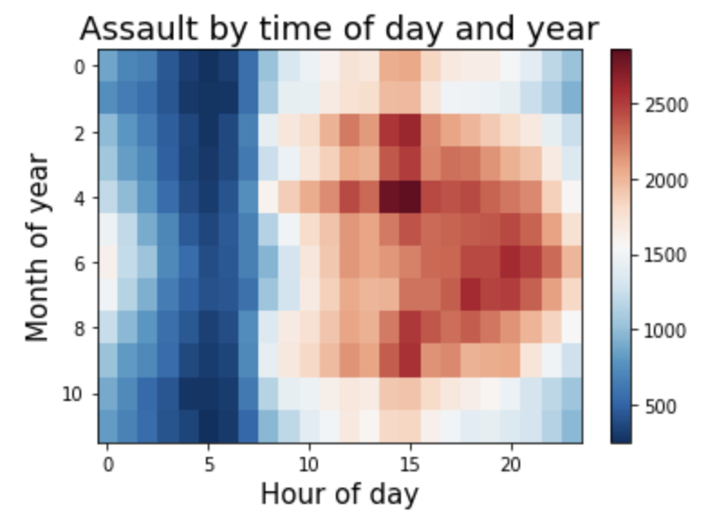
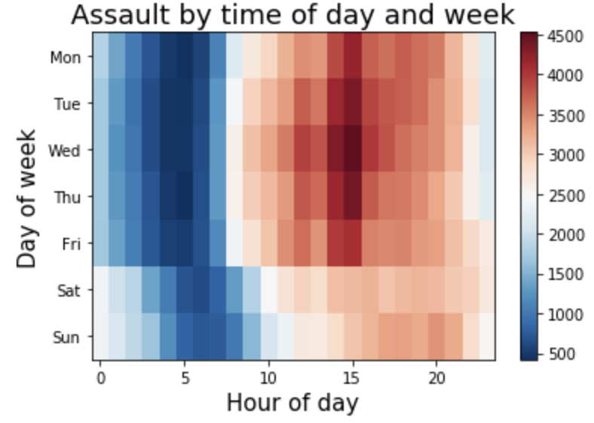
Contd..

Slide 7
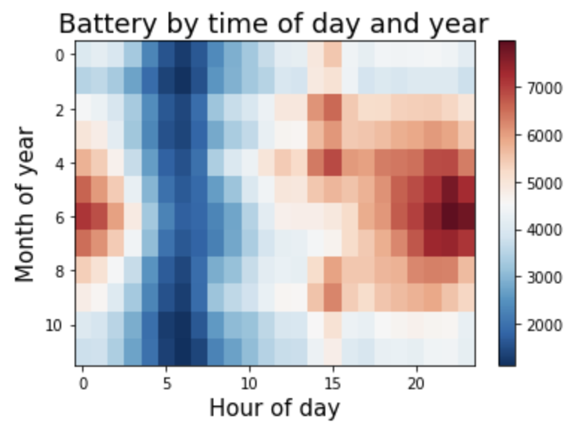
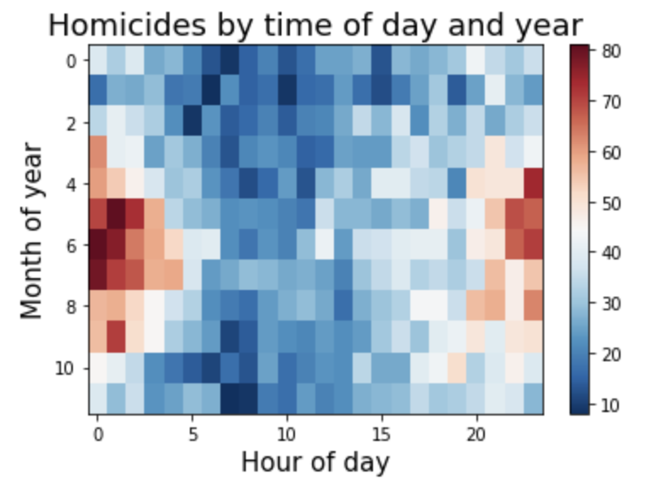
Contd..

Slide 8
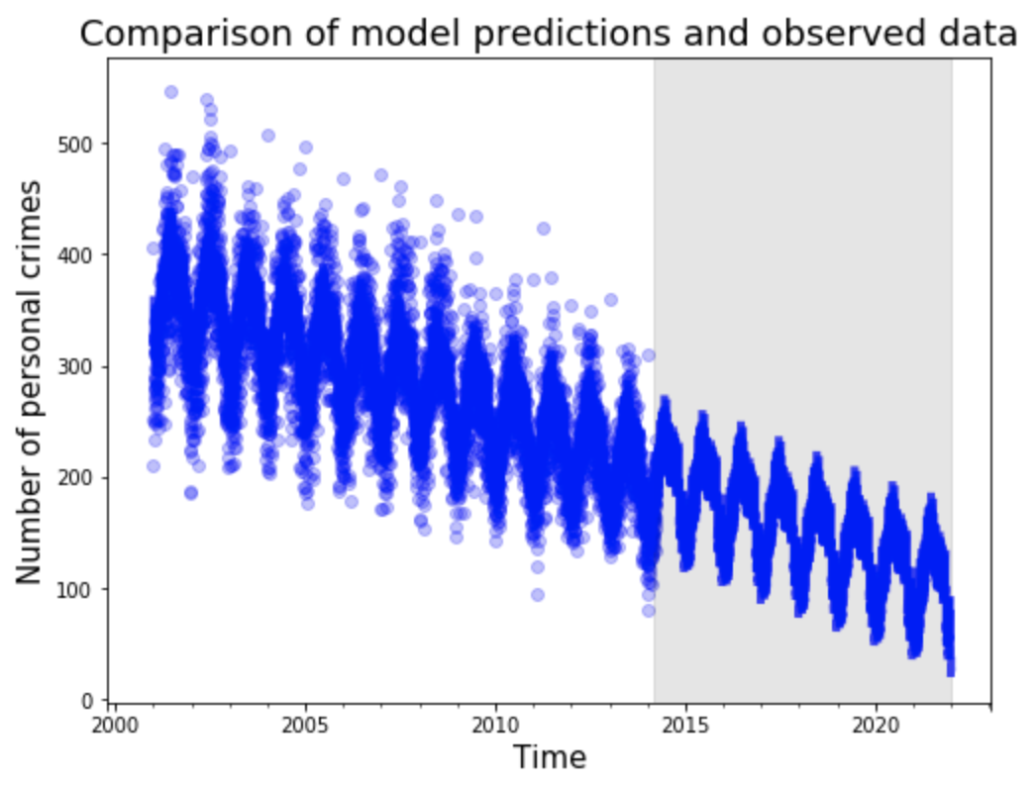
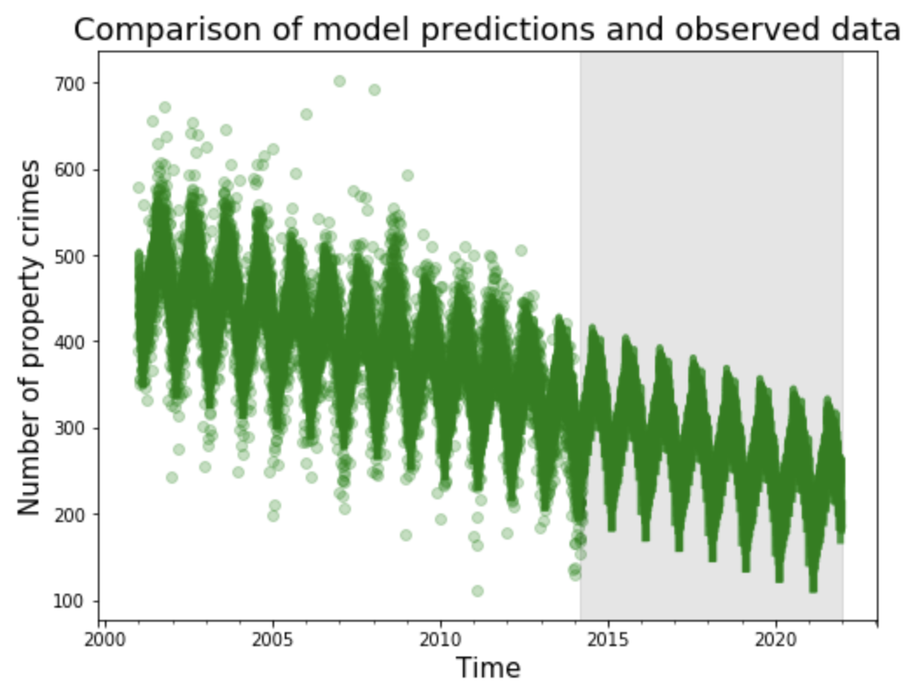
Statistical modeling for personal and property crimes:
Personal Crimes:
Property Crimes:

Slide 9
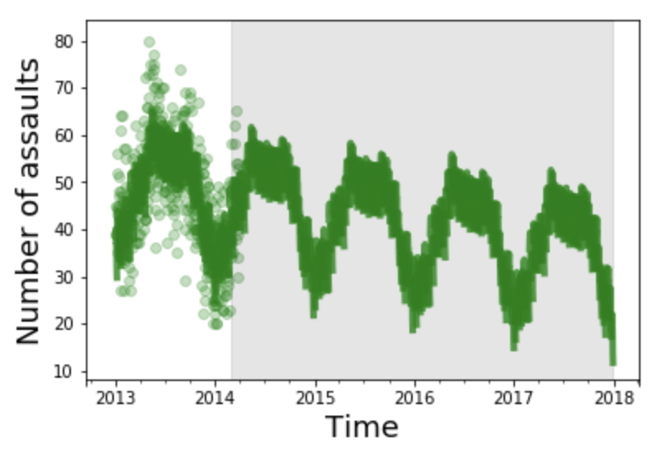
Does assaults follows statistical model?

Slide 10
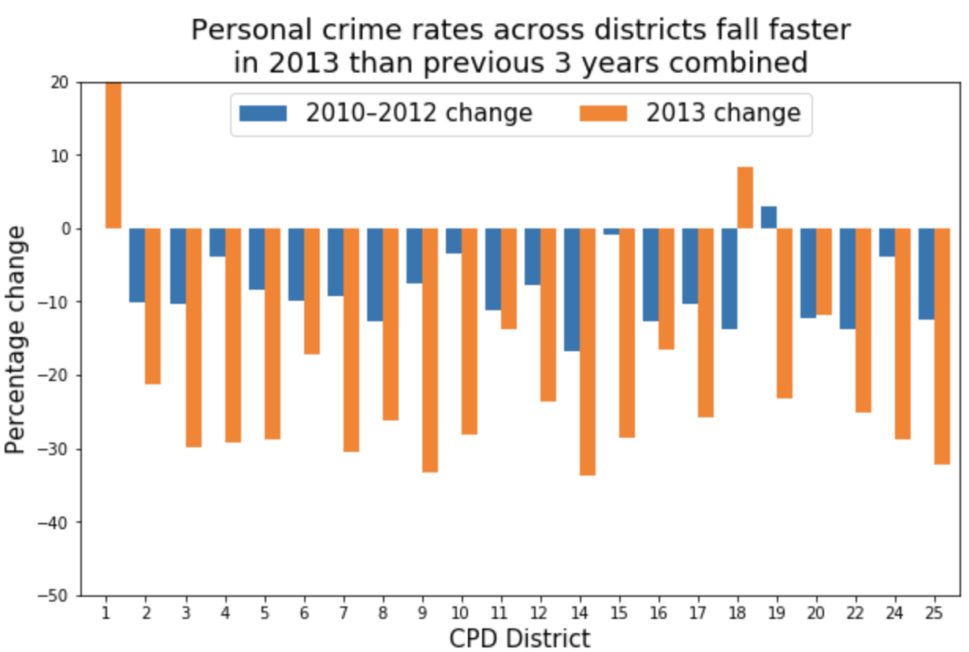
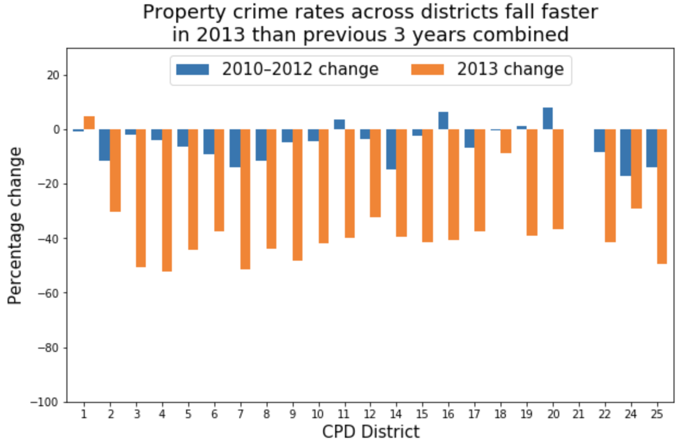
Find evidence of substantial differences in reporting crime data since 2013:
Personal Crimes
Property Crimes

Slide 11
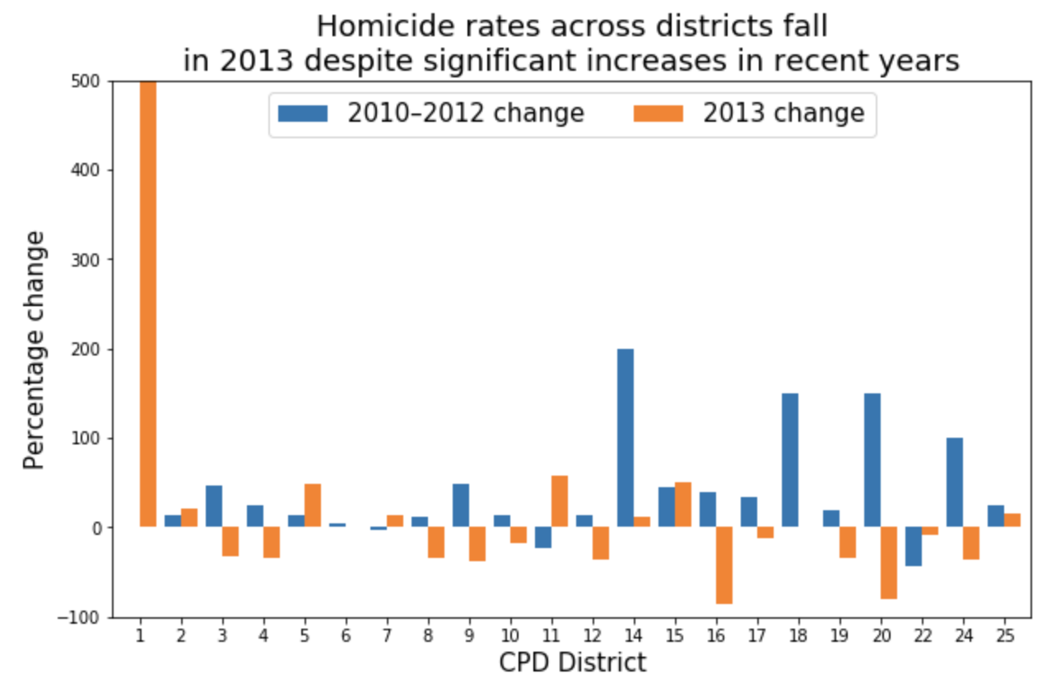
What about Homicide crime rate since 2013?

Slide 12
Ttest_1samp Result:
1 [2.49591088 0.03717818] 2 [1.83446617 0.10392335] 3 [4.63480444e+00 1.67751911e-03] 4 [4.02234258e+00 3.82864659e-03] 5 [4.41494397e+00 2.24156286e-03] 6 [-0.23363273 0.82113759] 7 [4.11362157e+00 3.37373940e-03] 8 [2.84320227 0.02170478] 9 [4.40683339e+00 2.26596900e-03] 10 [5.69487012e+00 4.57076333e-04] 11 [8.83196796e+00 2.12806818e-05]
→ District 15 has the lowest p-value. Does that mean there is significant decrease in crime rate?
→ If so, Is 15th district safe to live?
12 [4.71291676e+00 1.51595611e-03]
14 [4.16585517e+00 3.13989412e-03] 15 [1.03501082e+01 6.56125307e-06] 16 [3.31174059 0.01067051] 17 [7.36932476e+00 7.84683815e-05] 18 [4.43391307e+00 2.18558593e-03] 19 [5.72493732e+00 4.41519622e-04] 20 [6.61927931e+00 1.66020060e-04] 22 [4.06783246e+00 3.59419989e-03] 24 [2.60793459 0.03123036] 25 [4.40466529e+00 2.27254184e-03]

Slide 13
THANK YOU

