Slide 1
MINI PROJECT
Reg No | Name | Branch
251100690002 | Krupal Sonidi | Cyber Security
251100690004 | Anusha N M | Cyber Security
251100690037 | Daksha D | Cyber Security
Project Title | ML Powered Network Threat Detection and Prevention
Guide | Samarendranath Bhattacharya (Assistant Professor )

Slide 2
CONTENTS
Introduction
Objective
Literature Review
Operational Flow
Implementation
Results
Conclusion
References

Slide 3

INTRODUCTION
Cyber attacks like SYN, UDP, and ICMP floods are increasing, and traditional systems fail to detect them in real time, this project uses an ML-based IDPS to monitor live traffic and detect anomalies.
Splunk enables centralized monitoring and real-time analysis of threats, while n8n automates response actions like blocking malicious IPs.

Slide 4
OBJECTIVE
Detect network attacks in real time
Classify traffic using Machine Learning
Automatically block malicious IP addresses
Integrate Splunk for real-time log analysis and security monitoring.
Use n8n to automate incident response and alert workflows.

Slide 5
LITERATURE REVIEW
Paper & Year | Author | Focus / Approach | Key Features / Methods | Dataset / Evaluation | Main Findings | Gaps / Comments
A Simple and Robust Approach of Random Forest for Intrusion Detection System in Cyber Security | Manish Choubisa, Dr. Ruchi Doshi, Dr. Narendra Khatri, Dr. Kamal Kant Hiran | Proposed a machine learning-based IDS using Random Forest classifier with random feature selection to improve robustness | Incorporates random feature selection to reduce dimensionality. Focus on robust and efficient intrusion detection. Handles classification of normal vs attack traffic. | Evaluated on standard IDS datasets (e.g., KDD-based datasets) (not explicitly detailed in abstract) | RF performs better than many traditional classifiers for IDS. Improved accuracy and robustness in detecting attacks. Feature selection enhances performance and reduces complexity. | Limited discussion on real-time deployment Dataset details and diversity not clearly emphasized. Does not address zero-day attacks or adversarial attacks. Comparison with deep learning models is limited.
AI-Driven Real-Time Network Intrusion Detection using Machine Learning and Deep Learning | Divyanshu Joshi, Vivek Bagmar | Developed a real-time intrusion detection system using AI (ML + DL) to identify malicious network traffic. | Reviews methods across URL-, HTML-, visual-based detectors; proposes prototype classifier. | Based on KDD-based dataset (e.g., KDDCup’99) Evaluated using Accuracy, Precision, Recall, F1-score | Random Forest delivers top performance (~99.8%), proving AI-based IDS is accurate, stable, and superior to traditional methods. | Focuses on binary detection with limited coverage of real-world scenarios, zero-day attacks, and deep learning.

Slide 6
LITERATURE REVIEW
Network Intrusion Detection System using Random Forest and Gradient Boosting Machines (2024, CONIT) | Indira Bharathi, Rohan Makhija | Proposed an IDS using ensemble learning techniques (Random Forest + Gradient Boosting) for improved intrusion detection | Uses RF and GBM with preprocessing and feature selection to classify normal and attack traffic accurately. | Uses standard IDS datasets (e.g., KDD-based datasets) Evaluated using accuracy, precision, recall, F1-score | Ensemble models improve detection accuracy and performance. Gradient Boosting enhances prediction over single models. RF provides stability and robustness | Limited real-time implementation with outdated datasets and minimal comparison to deep learning.

Slide 7
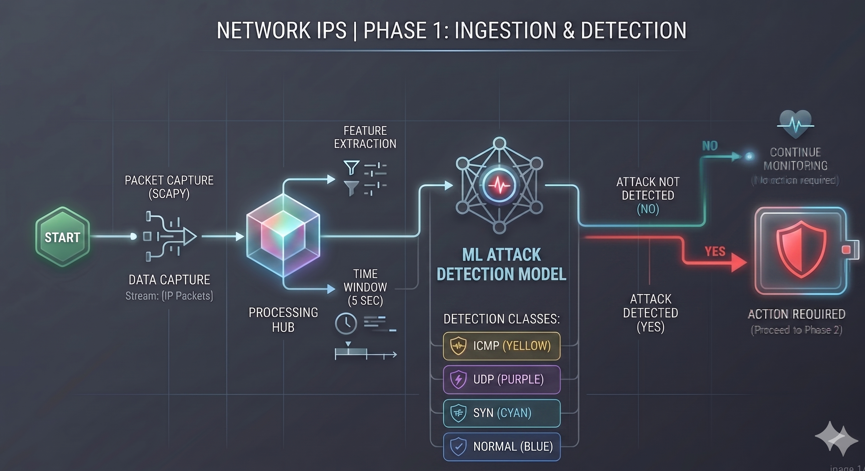
IMPLEMENTATION
Captures and processes live network traffic.
Extracts features and applies ML-based detection.
Classifies traffic (ICMP, UDP, SYN, Normal).
riggers action if an attack is detected.

Slide 8
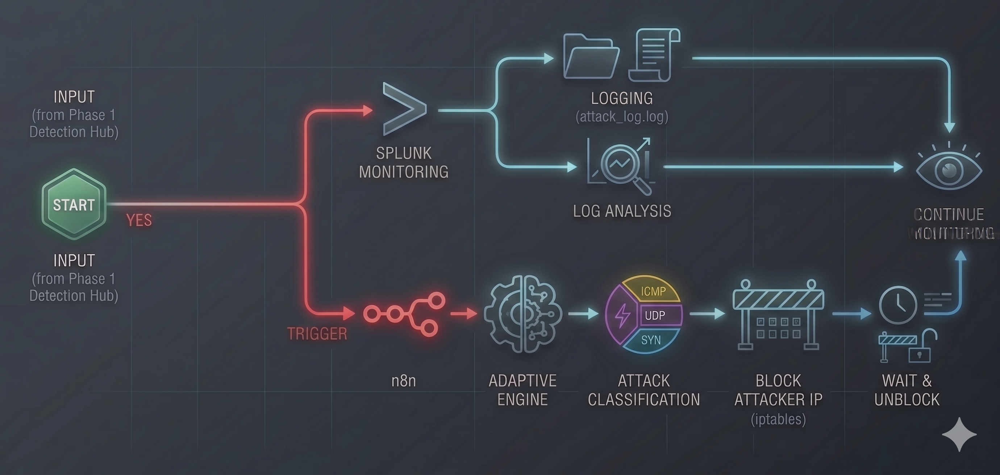
IMPLEMENTATION
Logs and monitors attacks using Splunk.
Automates response using n8n.
Blocks attacker IP and unblocks after a time.
Continues real-time monitoring.

Slide 9
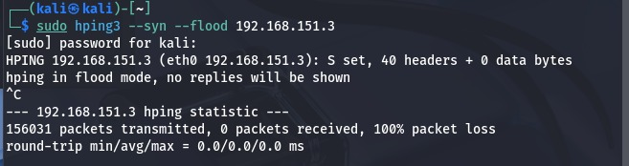
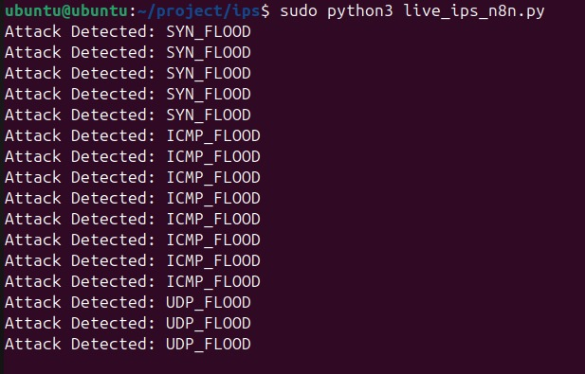
RESULTS
Successfully simulated attacks live traffic in the system. The model accurately detected attacks in real-time and classified them.
Implemented automatic response by blocking attacker IPs for 60 seconds and unblocking them dynamically.

Slide 10
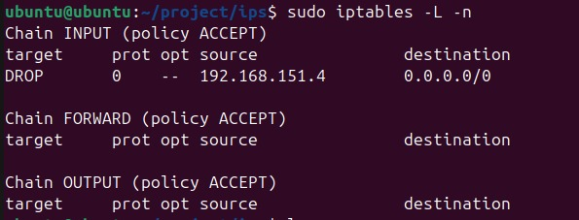
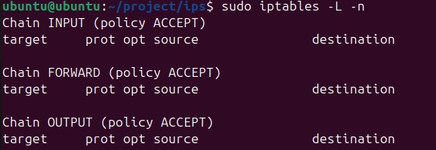
RESULTS

Slide 11
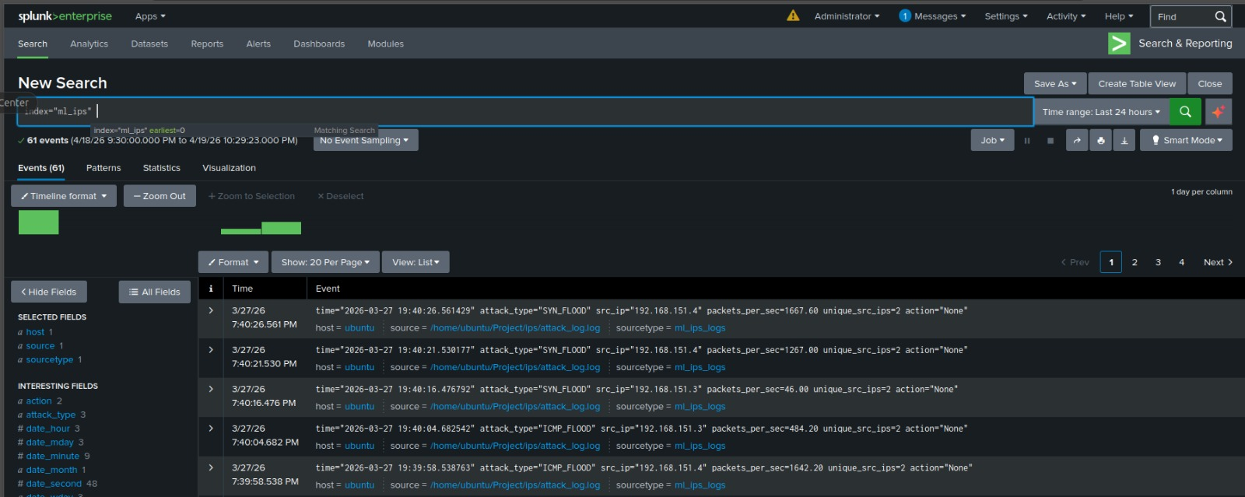
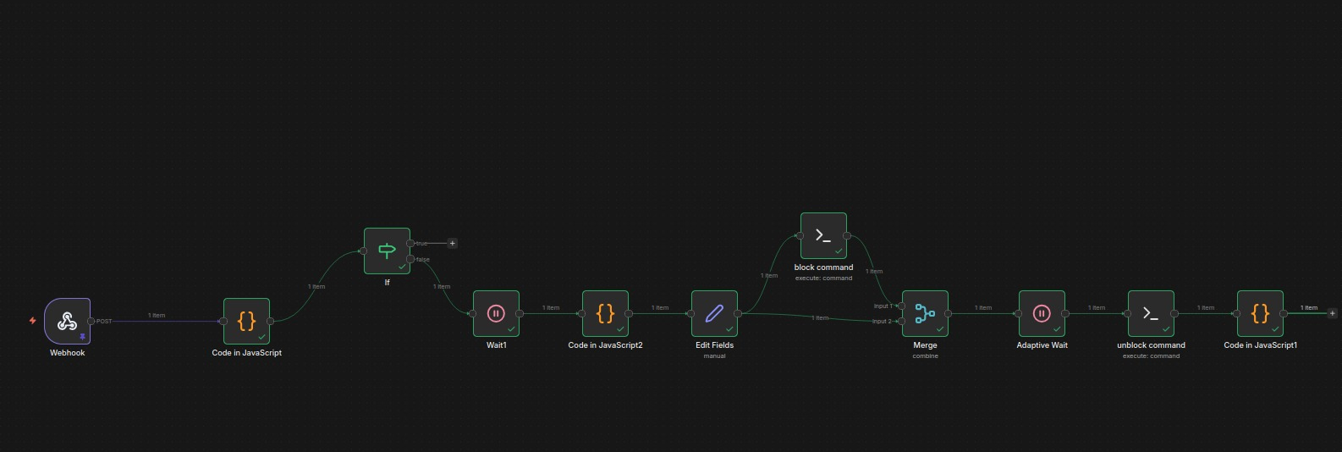
RESULTS
Integrated Splunk and n8n.

Slide 12
Live network traffic is captured and features are extracted in real-time (time windows).
CONCLUSION
Real-time network traffic monitoring and feature extraction.
Accurate detection of attacks using Machine Learning (Random Forest). Successfully identified SYN, UDP, ICMP or the normal traffic.
Automatic blocking and dynamic unblocking of malicious IPS based on the detection.
Improved security with real-time response, integrated with Splunk and n8n for monitoring and automation.

Slide 13
REFERENCES
1. Manhas, P., & Jaismeen. "Packet Sniffer," International Advanced Research Journal in Science, Engineering and Technology (IARJSET), Vol. 9, Issue 2, Feb. 2022. DOI: 10.17148/IARJSET.2022.9228.
2. Raj, M. S. A., Priyadarshini, S. J., & D., M. "Investigation of Data Interception and its Vulnerabilities in HTTP and HTTPS networks through Packet Sniffers," 2024 2nd International Conference on Networking and Communications (ICNWC), IEEE, 2024. DOI: 10.1109/ICNWC60771.2024.10537403.
3. Siswanto, A., Syukur, A., Kadir, E. A., & Suratin. "Network Traffic Monitoring and Analysis Using Packet Sniffer," 2019 IEEE Conference on Network and Information Security, Institute of Electrical and Electronics Engineers, 2019.
4. Pallavi Asrodia, H. Patel, "Network Traffic Analysis Using Packet Sniffer," International Journal of Engineering Research and Applications, Vol. 2, Issue 3, May-Jun 2012, pp. 854 856.
5. Nayak, P., Brahmananda, S. H., & Sahana, D. S., "An Approach to Sniff Sensitive Information by Packet Sniffing," International Journal of Computer Applications in Engineering Sciences, Vol. 3, Special Issue, 2013.

Slide 14
THANK YOU

