Slide 1
MINI PROJECT
Name | Rohit S Nair Anusha N M Pankaj Arage
Registration Numbers | 251100690001 | 251100690004 | 251100690007
Branch | Cyber Security
Project Title | Phishing website simulation and detection
Guide | Samarendranath Bhattacharya (Assistant Professor )

Slide 2
CONTENTS
Introduction
Literature Review
Objective
Operational Flow
Implementation
Results
Conclusion
Future Scope
References

Slide 3

INTRODUCTION
Phishing is a cyberattack where attackers impersonate legitimate websites to steal sensitive data such as usernames, passwords, and credit card details.

Slide 4
OBJECTIVE
To simulate phishing attacks for educational and awareness purposes.
To design and implement a comprehensive phishing detection extension that identifies potentially malicious websites.
To integrate web application and detection practically.

Slide 5
LITERATURE REVIEW
Paper & Year | Author | Focus / Approach | Key Features / Methods | Dataset / Evaluation | Main Findings | Gaps / Comments
Detection of phishing websites using machine learning (2019/20) (Detection of Phishing Websites Using Machine Learning) | Amani Alswalin | Applies classical ML (URL + host + page features) for phishing website classification. | Feature-engineering: URL lexical, host/WHOIS, HTML features. Classifiers: SVM / Decision Tree / Random Forest. | Public datasets (e.g., Kaggle/PhishTank) with 10k-20k examples. | Achieves high accuracy (90%+). | Relies on handcrafted features; may not generalize well to novel phishing tactics.
Detection of phishing attacks (2018/19) (Detection of Phishing Attacks) | Zahit Zaya | Earlier survey/approach summarizing phishing website detection techniques. | Reviews methods across URL-, HTML-, visual-based detectors; proposes prototype classifier. | Smaller datasets; possibly less rigorous evaluation. | Provides overview of techniques and shows ML prototypes can detect phishing. | Less focus on deep/visual methods; fewer experiments; dataset/time-drift issues.

Slide 6
LITERATURE REVIEW
Phishing Website Detection Using Deep Learning Models (2023) (Phishing Website Detection Using Deep Learning Models | Ume Zara | Uses deep-learning (CNN, RNN, maybe hybrid) to detect phishing, moving beyond manual features. | Uses URL embeddings, HTML/text/visual analysis; deep nets to learn features automatically. | Possibly larger/modern datasets; experiments show high accuracy (98%+). | Deep models outperform classical ML; better at catching subtle phishing tactics. | Requires more compute; fewer open datasets; generalization/adversarial robustness still limited. | Phishing Website Detection Using Deep Learning Models (2023) (Phishing Website Detection Using Deep Learning Models | Uses deep-learning (CNN, RNN, maybe hybrid) to detect phishing, moving beyond manual features.

Slide 7
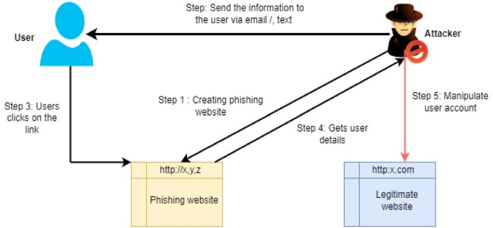
OPERATIONAL FLOW
1. Simulation Module:
    Design a phishing webpage mimicking a login portal – setoolkit, serveo.net(for masking), facading.
    Capture credentials safely for demonstration.
2.Detection Module:
Input: URL
Comprehensive Analysis using detection logic.
Generation of Risk Score (0–100)
Output: Shows banner or badge on risky sites.

Slide 8
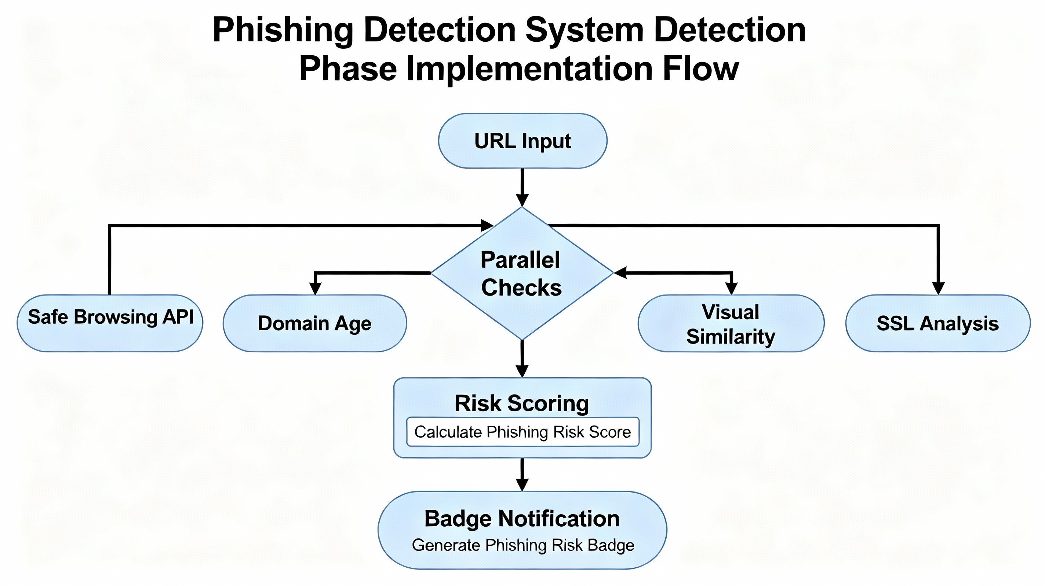







IMPLEMENTATION

Slide 9
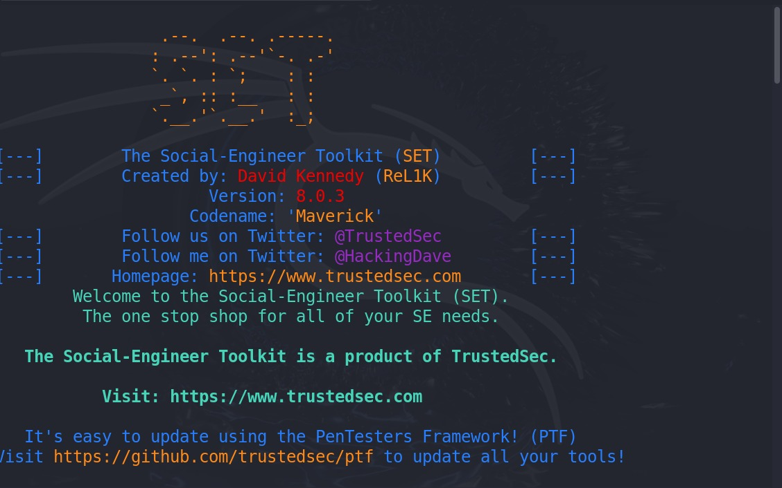
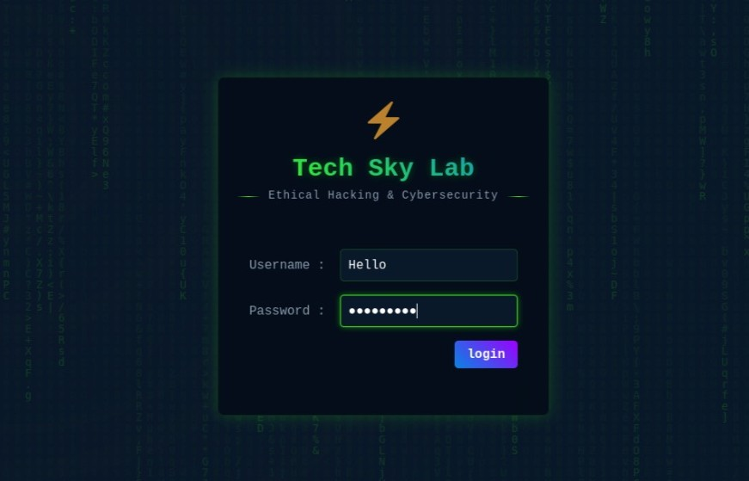
RESULTS
This is the setoolkit environment that used to create a phishing website and other attack vectors. This is developed by setoolkit developers for educational purpose.
Login website cloned to generate a phishing link

Slide 10
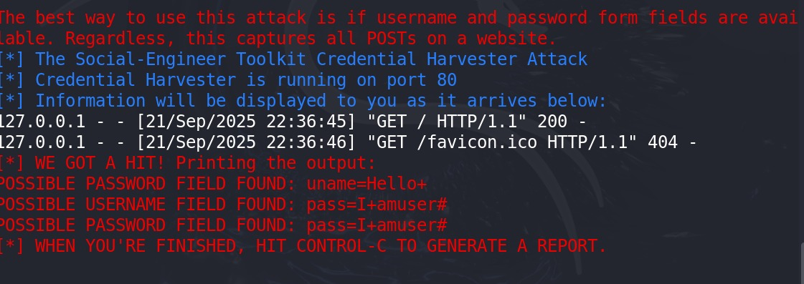
RESULTS
This is the captured login credentials of the website.

Slide 11
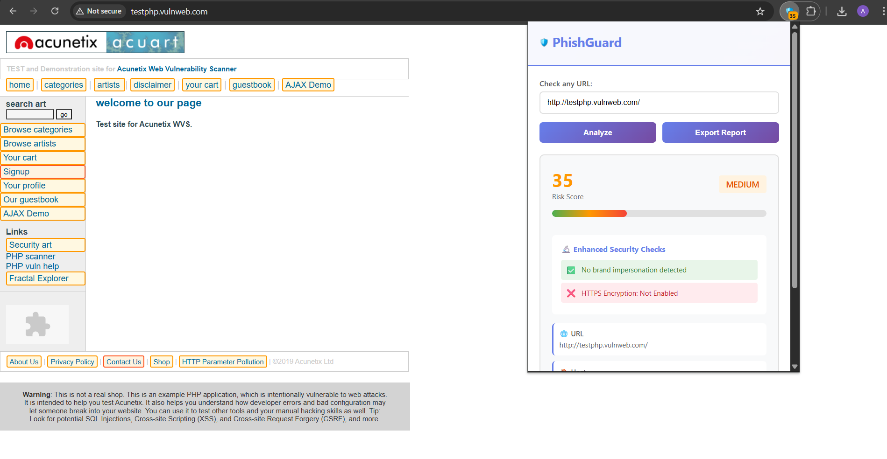
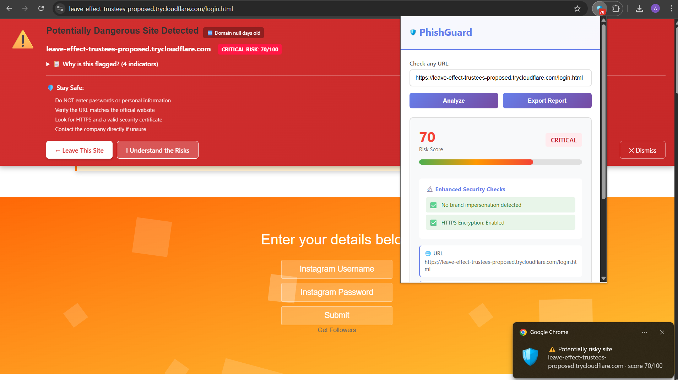
RESULTS

Slide 12

RESULTS

Slide 13
CONCLUSION
The developed PhishGuard system successfully detects and flags suspicious or malicious websites before users interact with them.
By combining heuristic analysis with trusted APIs and brand-similarity detection, it delivers a balanced phishing assessment.
The project demonstrates how real-time browser integration can enhance user safety and awareness, significantly reducing exposure to phishing attacks

Slide 14
FUTURE SCOPE
AI-Driven Classification: Integrate machine-learning models for dynamic URL and content classification.
Expanded Threat Intelligence: Incorporate additional threat-intelligence feeds and phishing blacklists.
User Reporting System: Enable users to report false positives and new phishing links to improve accuracy.
Behavioral Analysis: Add page-content and script behavior analysis to detect zero-day phishing attempts.
Cross-Platform Support: Extend protection to mobile browsers and other platforms.

Slide 15
REFERENCES
1. P. Liu and T. S. Moh, “Content Based Spam E-mail Filtering,” 2016 International Conference on Collaboration Technologies and Systems (CTS), Orlando, FL, pp. 218–224, 2016.
2. N. Agrawal and S. Singh, “Origin (dynamic blacklisting) based spammer detection and spam mail filtering approach,” 2016 Third International Conference on Digital Information Processing, Data Mining, and Wireless Communications (DIPDMWC), Moscow, pp. 99–104, 2016.
3. J. V. Chandra, N. Challa and S. K. Pasupuleti, “A practical approach to E-mail spam filters to protect data from advanced persistent threat,” 2016 International Conference on Circuit, Power and Computing Technologies (ICCPCT), Nagercoil, pp. 1–5, 2016.
4. C. Rupa, G. Srivastava, S. Bhattacharya, P. Reddy, and T. R. Gadekallu, “A machine learning driven threat intelligence system for malicious URL detection,” in Proc. 16th Int. Conf. Availability, Rel. Secur., New York, NY, USA, Aug. 2021, pp. 1–7, doi: 10.1145/3465481.3470029.
5. J. K. Lee, Y. Chang, H. Y. Kwon, and B. Kim, “Reconciliation of privacy with preventive cybersecurity: The bright internet approach,” Inf. Syst. Frontiers, vol. 22, no. 1, pp. 45–57, Feb. 2020, doi: 10.1007/s10796-020-09984-5.

Slide 16
THANK YOU

