Slide 1

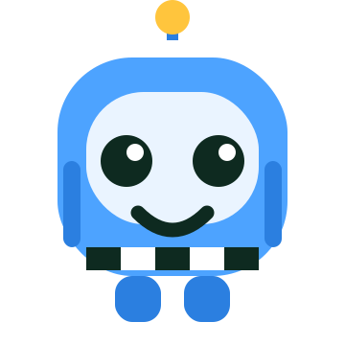
How Does AI Learn?
Train Ref-Bot, the AI referee — a lesson with no screens needed.
AI Literacy · Grades 3–5 · Unplugged
Notes:
Welcome. This lesson teaches how AI learns, with no devices. Kids will physically 'train' a classmate playing an AI referee. It mirrors the AI Ref computer game (the plugged half) — you can run this before or after the game, or on its own. Total time ~50 minutes.

Slide 2
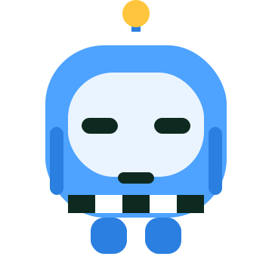
What is AI?
AI is a computer that can LEARN to make decisions by itself.
It is not magic, and it does not think like a person. It finds patterns in lots of examples, then uses them to decide.
You have seen AI before:
A voice helper that answers questions
Meet Ref-Bot, an AI that learns to be a badminton referee.
A game that plays against you
A phone that finds faces in photos
Notes:
Keep the definition concrete. AI = a computer that learns patterns from many examples and uses them to make decisions. Stress it is NOT magic and does NOT feel or think like us. Ask the class where they have seen AI (voice assistants, game bots, photo apps, recommendations).

Slide 3
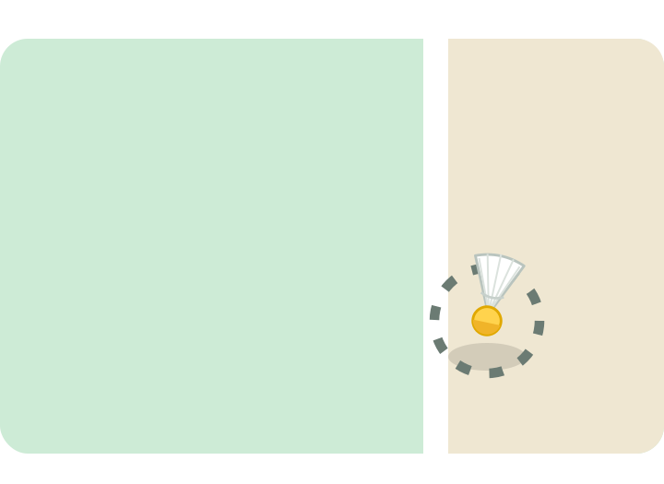
AI Helps Referees in Real Games
In big tournaments, cameras and AI watch the shuttle. The AI sees exactly where it lands and calls it IN or OUT.
IN or OUT?
Close calls are the hard ones — too fast and too close for human eyes. This is where AI helps most.
Today, your class will train an AI referee — just like Ref-Bot — with no computer at all.
Notes:
Real hook: badminton has used camera-and-AI line review (Hawk-Eye) since 2014, first at the India Open. Several cameras track the shuttle and rebuild its path to see where it landed. It is impressive but not perfect — which sets up Big Idea 4 later.

Slide 4
So… how does Ref-Bot KNOW?
It was not born knowing the rules. Nobody types in the answer.
It has to LEARN — from examples we show it.
Notes:
The core question of the whole lesson: how does the AI KNOW? Let kids guess. Steer them to: it must LEARN from examples. Everything after this is HOW that learning works, and what can go wrong.

Slide 5
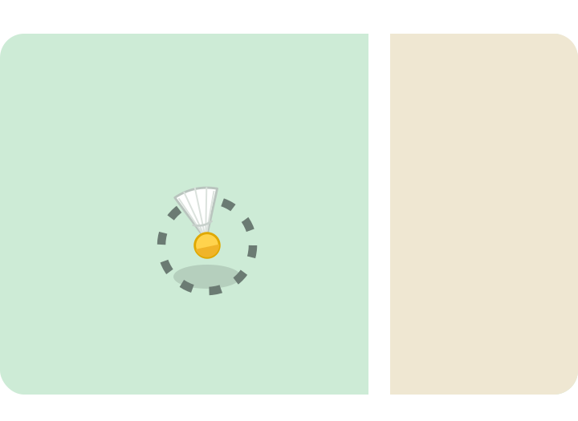
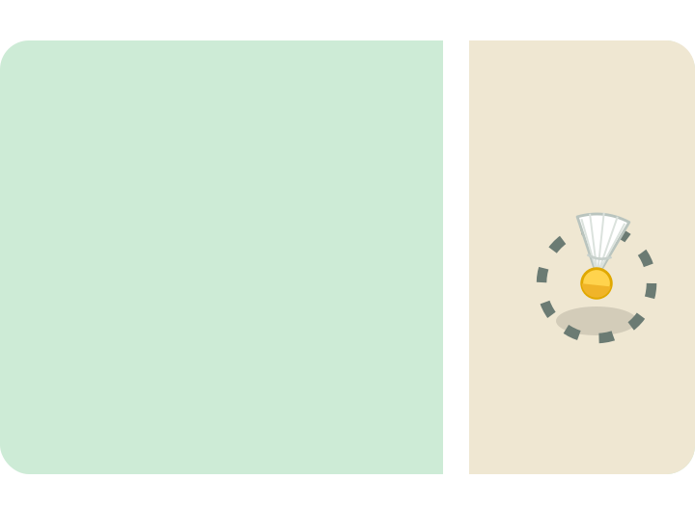
Big Idea 1 — AI Learns From Examples
We teach Ref-Bot by showing it examples. Each example is a shot with the answer written on it. All the examples together are called training data.
IN
OUT
The more good examples it sees, the better it learns the rule.
Notes:
Big Idea 1 — supervised learning. 'Training data' = examples, each with the correct answer ('label'). Introduce the word training data and write it on the board. This is the foundation for the activity's Round 1.

Slide 6
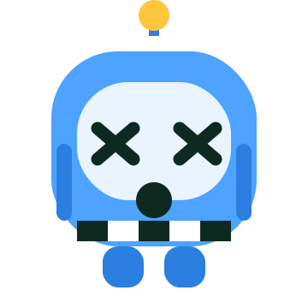
What If We Only Show One Answer?
A new OUT shot comes… and it still says “IN!” It gets it wrong.
If Ref-Bot only ever sees IN shots…
…then IN is the ONLY answer it learns.
Lesson: Ref-Bot needs to see BOTH answers — IN and OUT.
Notes:
This is the activity's first 'aha'. If the training data only contains one class (all IN), the model cannot recognise the other. Kids feel this in Round 1 when Ref-Bot fails an OUT. Lesson: you need examples of every answer.

Slide 7
Big Idea 2 — It Needs Many KINDS of Examples
Both answers is not enough. Ref-Bot also needs many DIFFERENT kinds of shots.
Easy shots
Close calls
Different spots
far from the line
right by the line
left, right, high, low
A close call is the real test. If Ref-Bot never practiced close calls, it will guess — and often be wrong.
Notes:
Big Idea 2 — representativeness. Even with both answers, if all examples are one narrow type (easy, far shots), the model fails on under-represented cases (close calls). This is the activity's Round 3. Write 'diverse' on the board.

Slide 8
This has a name: BIAS
When an AI only learns ONE kind of example, it becomes biased. It does well on what it practiced, and badly on everything else.
Fair AI needs FAIR examples. Many kinds of shots, from many places, so it treats every shot fairly. That is why real AI teams work hard to collect diverse, balanced data.
Notes:
Big Idea 2 named: BIAS. Keep it concrete for kids: 'learning only one kind of thing, so it is unfair on others.' For your own depth: this is exactly how real-world AI bias happens — a system trained on non-representative data performs worse for the groups or cases it rarely saw. Fair outcomes need fair, diverse, balanced data.

Slide 9
Big Idea 3 — The Labels Must Be Right
The answer on each example (IN or OUT) is called a label. Ref-Bot believes every label we give it.
A wrong label teaches the wrong rule. So we must check every label before Ref-Bot learns.
An OUT shot… labelled “IN” by mistake
Notes:
Big Idea 3 — label quality ('garbage in, garbage out'). The AI trusts its labels completely; a mislabelled example teaches the wrong rule. This is the activity's Round 4, where you deliberately mis-tag one card. Lesson: check your labels.

Slide 10
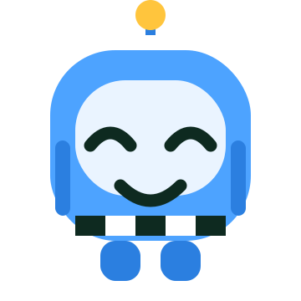
Big Idea 4 — People Must Check the AI
Even a well-trained Ref-Bot is not perfect.
It is fast, but it can still make mistakes — especially on close calls. So a person watches its calls and fixes the wrong ones.
AI works best when people and AI work together.
When it is wrong, YOU correct it — and it can learn from you.
Notes:
Big Idea 4 — human oversight. Models are fast but fallible, especially on edge cases. Responsible use keeps a human in the loop to review and correct. This is the activity's Round 5, where a student 'checker' verifies Ref-Bot. Tie back to real referees who can still overrule or review the system.

Slide 11
The Four Big Ideas
1 Learn from examples
2 Many kinds = no bias
AI learns from the examples (training data) we give it.
It needs diverse examples, or it becomes biased and unfair.
3 Right labels
4 People check AI
Wrong answers on examples teach the wrong rule.
AI is not perfect, so people must check and correct it.
Notes:
Recap the four ideas out loud; have kids say each one back. These four map exactly to the five levels of the computer game, so a class that plays the game will recognise them.

Slide 12
Now YOU Be the AI Referee!
Time for the unplugged game. One of you becomes Ref-Bot. The class trains it with example cards, then tests it — and discovers, together, everything on the last four slides.
See the Lesson Plan for full steps
Notes:
Transition to the unplugged activity 'Be the AI Referee'. Full setup, roles, and the five rounds are in the Lesson Plan document. If you have no printer, use a chalk court on the floor and a paper ball — the plan explains the no-materials version.

Slide 13
Who Can Train an AI?
Anyone.
Sport is for everyone — girls and boys. And so is AI. The people who build and train AI decide what it learns, so it matters that all kinds of people get to do it. Today, that includes you.
You showed the examples. You checked the calls. You are the trainer.
Notes:
Equity message, tied to the project's focus on girls in sport. The people who train AI shape what it does; representation among trainers matters. Emphasise that every child in the room just did real AI-trainer thinking.

Slide 14
You're an AI Trainer!
Next: play the AI Ref game to train your very own Ref-Bot on a screen — or run the unplugged game again with new shots.
Notes:
Close on identity: they are 'AI trainers'. Point them to the computer game to go deeper, or replay the unplugged game with fresh example cards.

