Slide 2
REST
Representational State Transfer
WebSite
HTTP GET
Web Browser
VIDEO

Slide 3
A RESTful API explicitly takes advantage of HTTP methodologies defined by the RFC 2616 protocol.
Rest mostly uses
GET to retrieve a resource;
PUT to change the state of or update a resource, which can be an object, file or block;
POST to create that resource;
and DELETE to remove it.
And Copy, Patch, Lock etc.;

Slide 4
REST is an Architectural style in which a web service can only be treated as a RESTful service if it follows the constraints of being
Client Server
Stateless
Cacheable
Layered System
Uniform Interface

Slide 5
When to use REST and when to use SOAP
REST | SOAP
Limited resources and bandwidth | Asynchronous processing and subsequent invocation
Statelessness | Stateful operations
Caching | A Formal means of communication
Ease of coding , Multiple data formats

Slide 6
Principles of REST
The first principle is to provide a unique interface that provides all the CURD operations.
HTTP provides a unique interface to perform the CURD (Create, Read, Update, Delete) operations by HTTP methods as:
POST - create
PUT - update
GET - read
DELETE - DELETE

Slide 7
Cont..
URI
used ti uniquely identify a particular resource that we want to create, update, read or delete.
Rest supports multiple data formats as HTTP supports MIME type like
XML, JSON, ..
Scalability
Rest is stateless api

Slide 8
POSTMAN
HTTP client for testing web services.

Slide 9
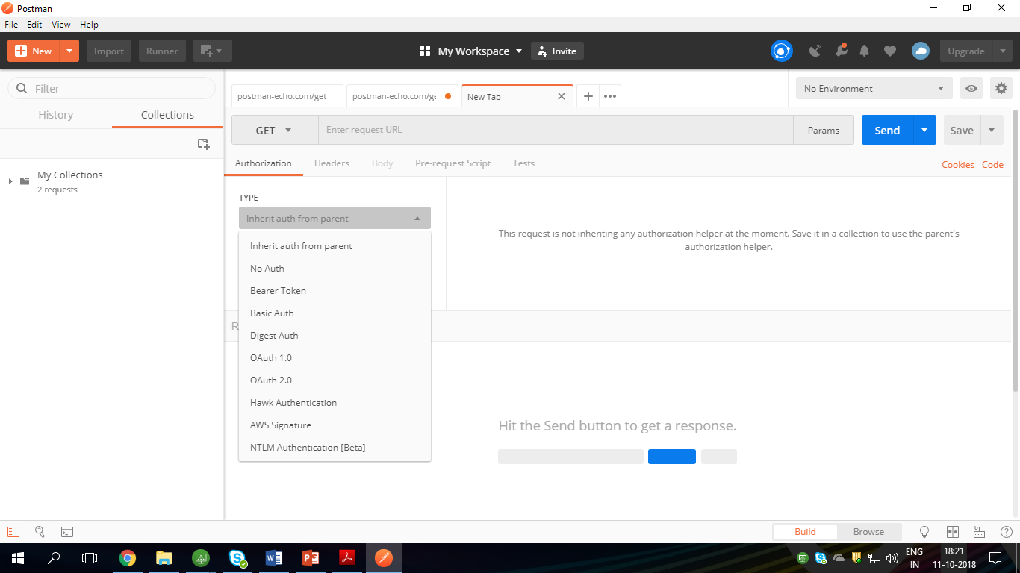

Slide 10
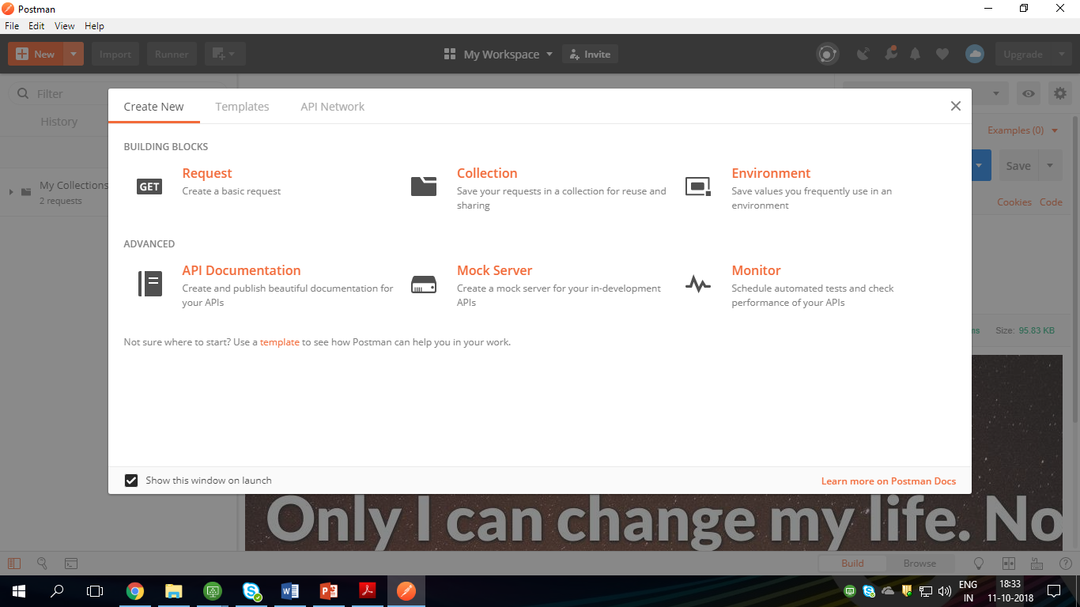

Slide 11
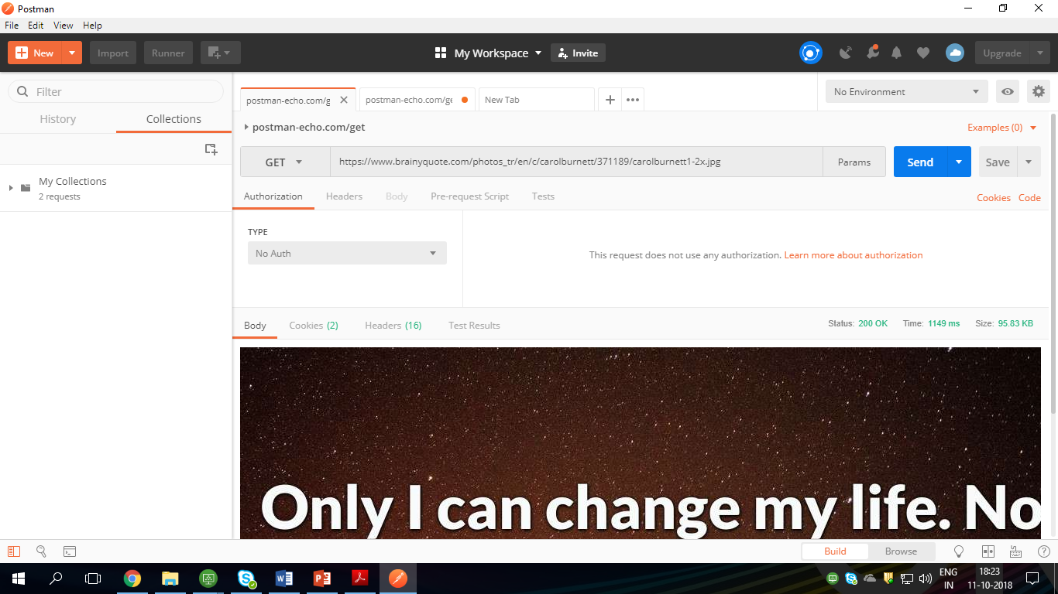

Slide 12
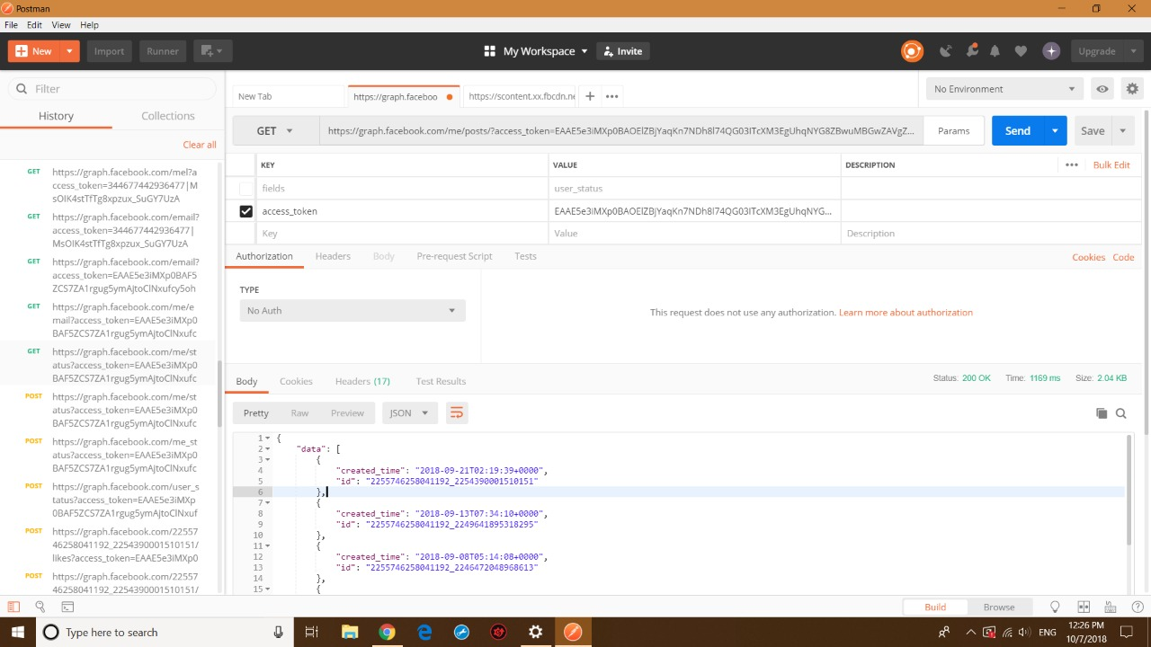

Slide 13
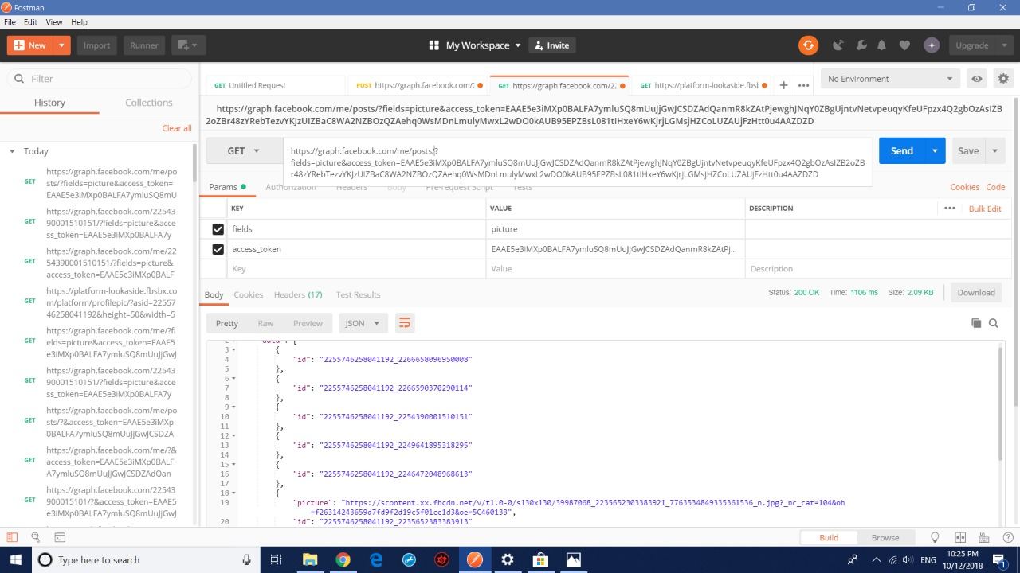

Slide 14
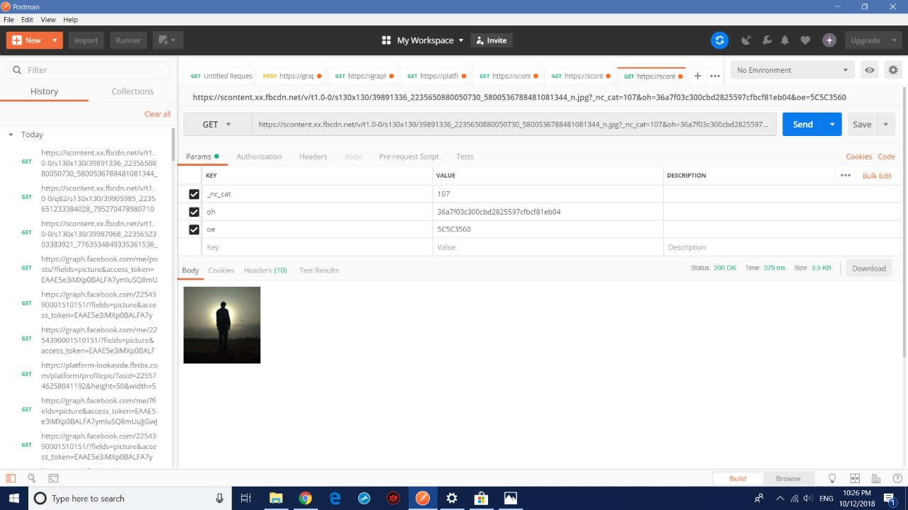

Slide 15
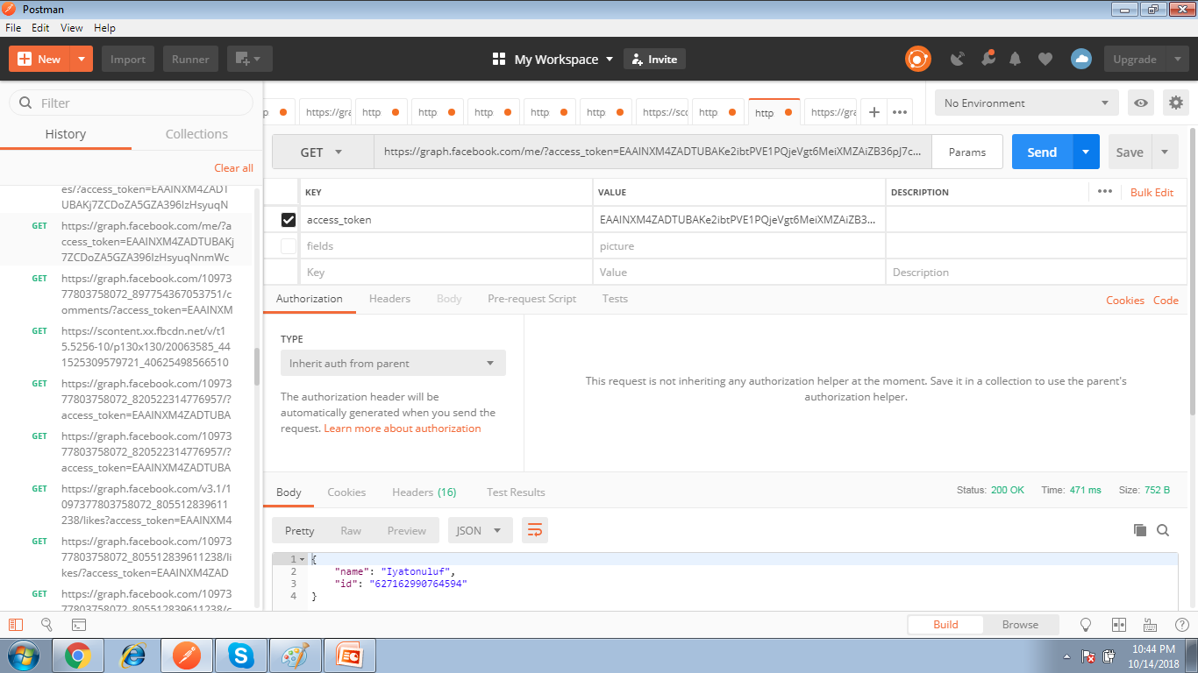
Page Access

Slide 16
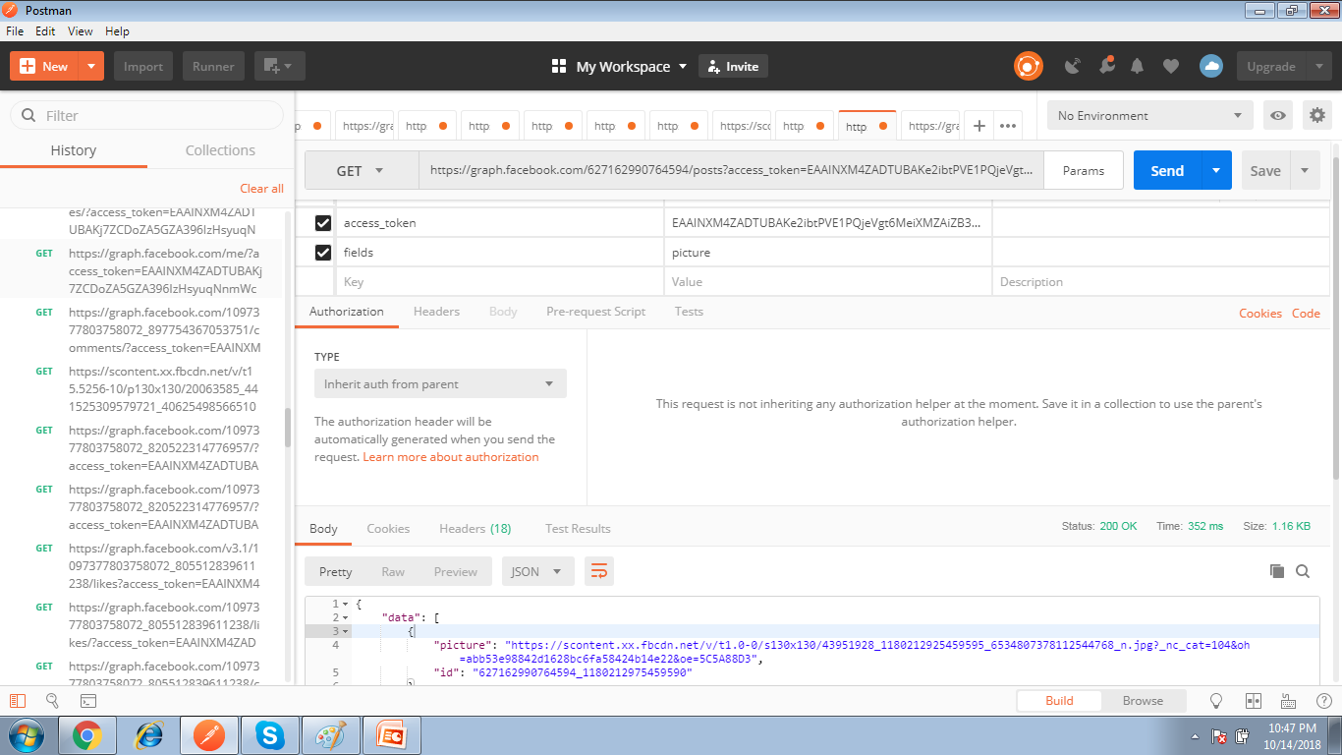
Accessing the posts in a page

Slide 17
