Slide 1
SECURE DATA HIDING IN IMAGES USING STEGANOGRAPHY
CAPSTONE PROJECT
Presented By
Student Name : T ANUSHA
College Name : RAGHU ENGINEERING COLLEGE
Department : CSC(CYBER SECURITY)

Slide 2
OUTLINE
Problem Statement
Technology used
Wow factor
End users
Result
Conclusion
Git-hub Link
Future scope

Slide 3
Problem Statement
There is a need to protect sensitive information from unauthorized access. Traditional encryption methods can make the presence of hidden data obvious and vulnerable.
To make the transmission secure we should use a technique to either change the message into some other format or hide it in something, so we could protect it from being disclosed.
The problem is how and what should be used for a secure transmission so that the data is not available to unauthorized person.

Slide 4
Technology used
OpenCV (cv2):
OpenCV is a powerful computer vision library in Python, and it is used here to read and write images. Functions like cv2.imread() and cv2.imwrite() handle image file operations.
OS (os):
The os module in Python provides a way to interact with the operating system. Here, os.system() is used to open the saved encrypted image using the default image viewer of the os.
String (string):
The string module in Python is included but not actually utilized in this code. However, it can be used for string manipulation and operations

Slide 5
Wow factors
Real-Time Encryption and Decryption:
Your project demonstrates real-time data hiding and retrieval within images, showcasing the
efficiency and practicality of steganography.
Versatility:
The method can be applied to various types of images and adapted for different use cases,
such as confidential communication, watermarking, or digital signatures.
Educational Value:
The project highlights fundamental concepts of image processing and security, making it an
excellent learning tool for students and enthusiasts.

Slide 6
End users
Government Agencies:
For securely transmitting sensitive information and maintaining confidentiality in communication.
Corporations:
Protecting intellectual property, confidential business information, and secure communication
between departments.
Healthcare Providers:
Ensuring the privacy of patient records and medical information.
Personal Use:
Individuals who wish to protect personal data, such as financial information or private
communications, from unauthorized access.

Slide 7
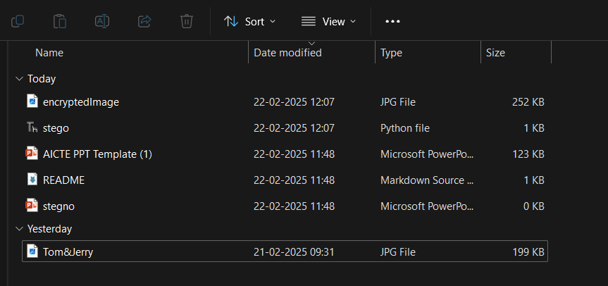
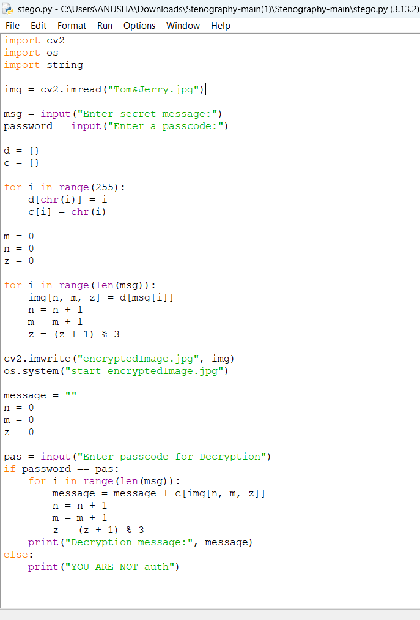
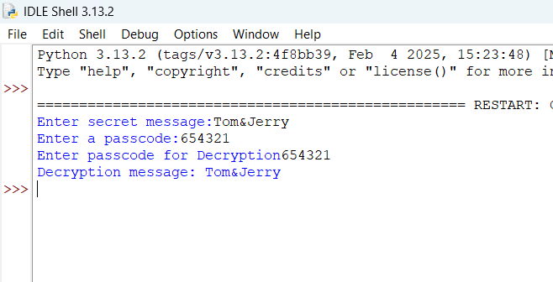
Results

Slide 8
Conclusion
The project successfully addresses the problem of protecting sensitive information from unauthorized access by utilizing steganography to embed hidden data within images. Unlike traditional encryption methods that may reveal the presence of confidential data, this approach ensures that the hidden information remains nearly undetectable, providing a more secure means of data transmission. By leveraging the power of steganography, the project not only enhances data privacy and security but also opens up new possibilities for secure communication in various fields, including government, corporate, journalism, healthcare, and personal use.

Slide 9
GitHub Link
https://github.com/AnushaTangudu/Steganography-project.git

Slide 10
Future scope(optional)
Advanced Algorithms:
Developing more sophisticated steganographic algorithms to increase the capacity and security of hidden data.
Cross-Format Steganography:
Expanding the technique to other media types such as audio, video, and documents, enhancing versatility and applicability.
Hybrid Techniques:
Integrating steganography with advanced cryptographic methods to provide multiple layers of security.
AI and Machine Learning:
Leveraging AI and machine learning to automate and optimize the data embedding and extraction processes, making them more efficient and robust.

Slide 11
THANK YOU

