Slide 1


SMART HOME LOAD FORECASTING
USING
LSTM

Slide 2

Introduction
Smart Home Load Forecasting using Long Short-Term Memory
(LSTM) neural networks involves utilizing LSTM's capabilities to model
and predict energy consumption patterns in a smart home.
LSTM stands for long short-term memory networks, used in the field
of Deep Learning. It is a variety of recurrent neural networks (RNNs) that
are capable of learning long-term data dependencies, especially in
sequence prediction problems.
This task can be accomplished by gathering historical data on energy consumption, Data processing, splitting the dataset into training, validation, testing sets, organizing the data into sequences, Designing the LSTM model architecture, Training the LSTM Model, Evaluating, Deployment, Real-time Forecasting and Continuous Monitoring.
The recurrent nature of LSTM is used for capturing the time-dependent nature of energy consumption patterns in smart homes.

Slide 3
Objectives
Energy management & renewable energy integration
Communication & networking
Embedded system & SBC optimization
IOT & sensor networks
Security & privacy

Slide 4
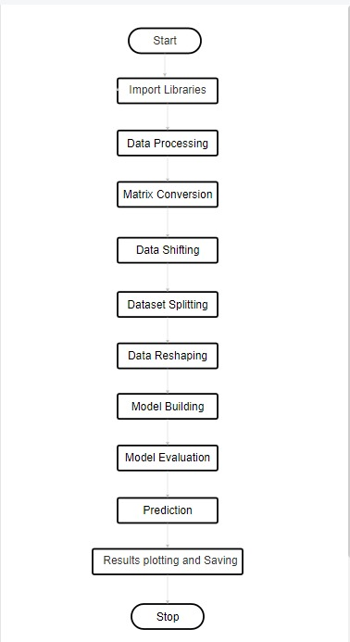
Flowchart:

Slide 5
Pseudo Code
1. IMPORT necessary libraries and modules:
- numpy for array operations
- pandas for data handling
- matplotlib for plotting
- MinMaxScaler for normalization
- LSTM and Dense layers from tensorflow.keras for modeling
- Sequential model from tensorflow.keras for building the neural network
- mean_squared_error from sklearn for model evaluation
2. SET the path for the CSV file to "csv_file_path".
3. READ data from "csv_file_path" into a dataframe called "df".
4. CONVERT the "Date" column in "df" to datetime format.
5. EXTRACT the "Load" column values from "df" and store them in "load_data".

Slide 6
6. INITIALIZE the MinMaxScaler and SCALE "load_data" to values between 0 and 1.
7. CALCULATE the size for the training dataset as 80% of the total data. SPLIT "load_data" into "train_data" and "test_data" using the calculated training size.
8. DEFINE a function "create_sequences":
INPUTS: data, seq_length
- Initialize empty lists: X and y.
- FOR each index in data up to (length of data - seq_length):
- Create a subsequence of length "seq_length".
- Append the last value of the subsequence to both X and y lists.
- RETURN X and y as numpy arrays.
9. CALL the "create_sequences" function for "train_data" and "test_data" with a sequence length of 2. Store results in "X_train", "y_train", "X_test", and "y_test".
10. RESHAPE "X_train" and "X_test" to be 3D arrays suitable for LSTM input.

Slide 7
11. BUILD the LSTM model:
- Initialize a sequential model.
- Add an LSTM layer with 50 units, ReLU activation, and appropriate input shape.
- Add a Dense layer with 1 unit.
- COMPILE the model using the Adam optimizer and mean squared error as the loss function.
12. TRAIN the LSTM model on "X_train" and "y_train" with 100 epochs, a batch size of 16, and display the progress.
13. MAKE PREDICTIONS using the trained LSTM model on "X_test" and store them in "y_pred".
14. REVERT the scaling of "y_pred" and "y_test" to the original scale using the MinMaxScaler.
15. CALCULATE the root mean squared error between "y_test" and "y_pred" and PRINT it.
16. PLOT "y_test" as "Actual Load" with suitable labels and show the plot.
17. PRINT the reshaped "X_train" for inspection.

Slide 8
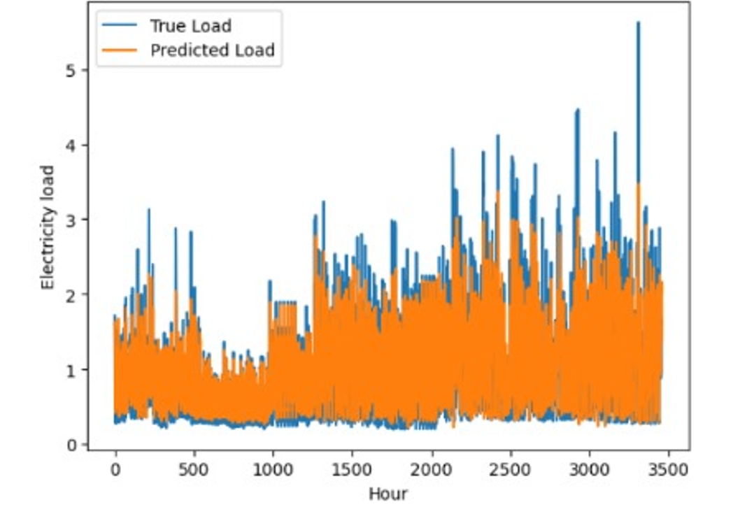
Graph 1:

Slide 9
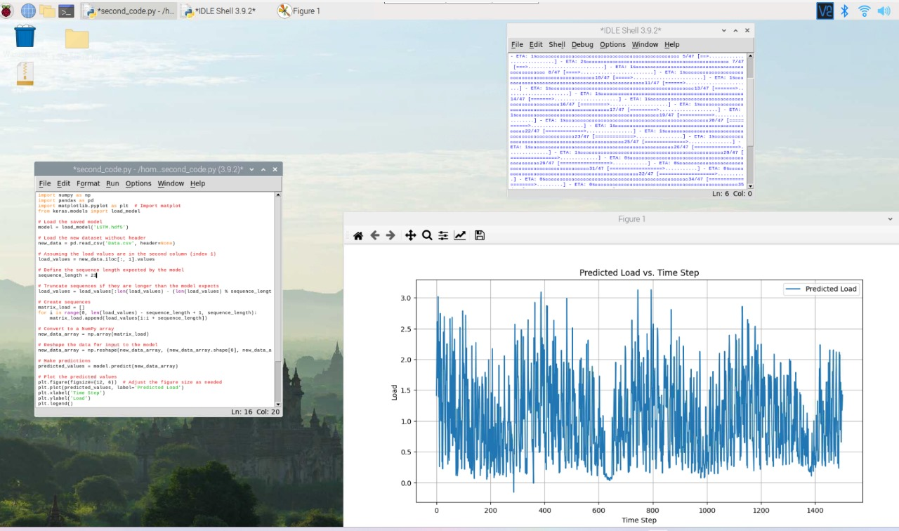
Output:

Slide 10
Future Scope
Increased Computational Power of SBCs
Integration with advanced sensors
Autonomous energy management
Edge AI and machine learning
Integration with smart grids
Enhanced user interfaces and feedback systems
Privacy preserving predictive models

Slide 11
Timeline:
The “SMART HOME LOAD FORECASTING ON SBC” project can be achieved in 2-3 weeks and requires an organized plan. The first week involves thorough planning, research, and buying components. In the second week, development starts at a swift pace, with parallel testing and coding. The third week concentrates on meticulous testing, finalizing the interface, integration, and deployment. This demanding timeline demands precise coordination and a skilled team.

Slide 12
Thank You

