Slide 1

Wireless Hacking & Security
Submitted By:
JS Dawood Ahmed (1DT17CS404)
Anusha Anil Shet (1DT16CS012)
Shivam kumar (1DT16CS093)
Meghana P (1DT16CS056)
Vinay MS (1DT16CS113)
  Under the Guidance
  Dr. Sandhya N

Slide 2
Contents
Wireless Standard 802.11 Overview
Types of Wireless Standards.
List of Tools Used For Wireless Hacking.
Types of Attacks
Security Measures.
Conclusion
References

Slide 3
Abstract
Wireless Local Area Networks frequently referred to as WLANs or Wi-Fi networks are all the vehemence in recent times.
Wireless networks offer handiness, mobility, and can even be less expensive to put into practice than wired networks in many cases.
On this segment, we'll seize a look at common threats, vulnerabilities related with wireless networks.

Slide 4
Introduction
In our present days, we see wireless networking technology is gaining more and more popularity due to its cost effectiveness and convenience .
These days we all are hooked to one or more wifi devices like phones, laptops, PDA's ,wireless keyboards etc.
The advantages of the wireless media has led to mass adoption of the WLAN technology. It has been integrated with all commonly used devices like laptops, mobile phones, tvs and other embedded devices. These devices provide you with a gateway to connect to the internet.

Slide 5
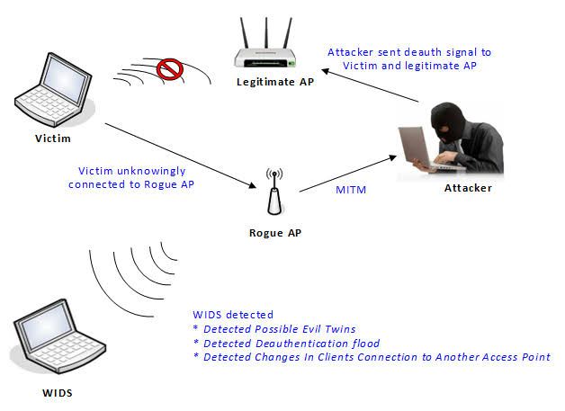
How it Works ?

Slide 6
802.11 Overview
IEEE 802.11 denotes a set of wireless
standards definied by IEEE
Most popular include 802.11a/b/g
802.11a is in the 5GHz band, b/g is in the
  2.4GHz band
802.11i is intended to improve security

Slide 7
Security Features
Service Set Identifier (SSID)
Used to differentiate between access points
Sent out in a beacon frame
These are plain text messages

Slide 8
Wired Equivalent Privacy (WEP)
WEP uses the stream cipher C4-RC4 generates a pseudorandom stream of bits (a “keystream”) which is combined with the plaintext using XOR
even Decryption is performed the same way
WEP uses two key sizes: 40 bit & 104 bit
64 bit and 128 bit WEP
To each is added a 24-bit initialization vector
(IV) which is transmitted in the clear.

Slide 9
WEP
WEP has several weaknesses
The weakness with RC4 is with the Initialization Vector (IV)
This lead to several different types of attacks
We will use a tool that combines two of these
attacks, and the appendix will describe another

Slide 10
WPA – Wi-Fi Protected Access
By increasing the size of the keys, the number of keys in use, and adding a secure message verification system, WPA makes breaking into a Wireless LAN far more difficult.
The Michael algorithm was the strongest that WPA designers could come up with that would still work with most older network cards; however it is subject to attack. To limit this risk, WPA networks shut down for 30 seconds whenever an attempted attack is detected.

Slide 11
Cracking WPA/WPA2 with Aircrack-ng
Step-1:-
First open terminal. We need to know the name of the wireless adapter connected to the computer because computer has many adapters connected.
command for this is iwconfig.
Step-2:-
For some wireless cards, it gives error messages to enable monitor mode on wireless cards. For that, you should use airmon-ng check kill.

Slide 12
Cracking WPA/WPA2 with Aircrack-ng
Step-3:-
In this step, you need to enable the monitor mode on the wireless card. The command is as follows:
airmon-ng start wlan0 (interface of wireless card).
Now this command will enable the monitor mode on the Wi-Fi card. So while using interface in any
terminal or command line use wlan0mon.
Step-4:-
We need to use the command airodump-ng wlan0mon, this will display all the access points in your surroundings and also the clients connected to that access points.

Slide 13
Cracking WPA/WPA2 with Aircrack-ng
Step-5:-
In this step we will add some parameters to airodump-ng. command is airodump-ng -c channel –bssid [bssid of wifi] -w [path to write the data of packets] wlan0mon[interface].
Step-6:-
In this step we deauthenticate the connected clients to the Wi-Fi.
The command is aireplay-ng –deauth 10 -a [router bssid] interface

Slide 14
Cracking WPA/WPA2 with Aircrack-ng
Step-7:-
Now we should start cracking the Wi-Fi with captured packets command for this is
aircrack-ng -b [bssid of router] -w [path to word list] [path to capture packets]

Slide 15
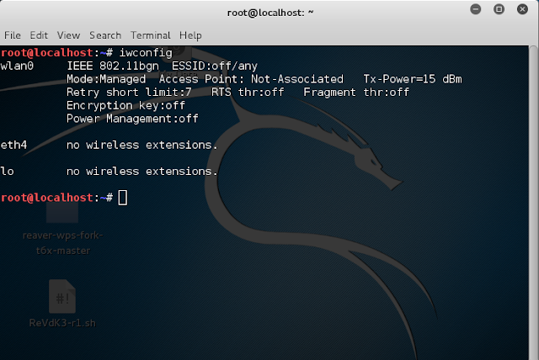
Snapshots

Slide 16
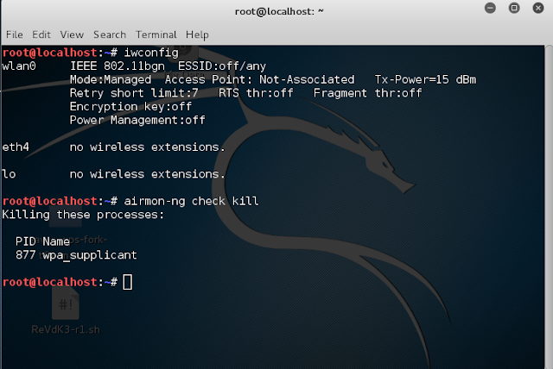

Slide 17
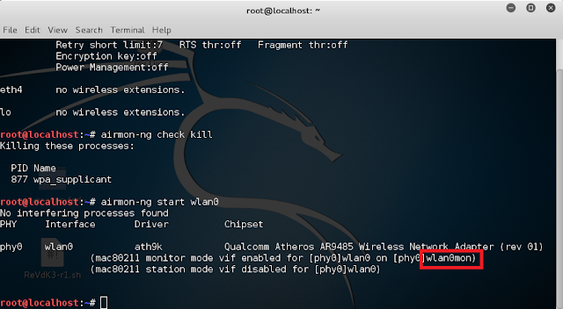

Slide 18
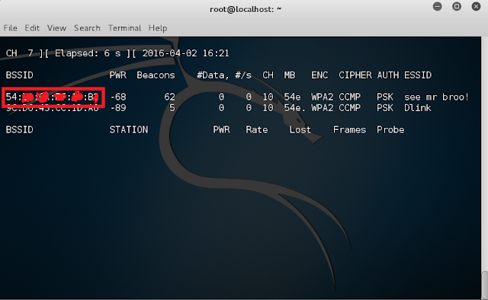

Slide 19
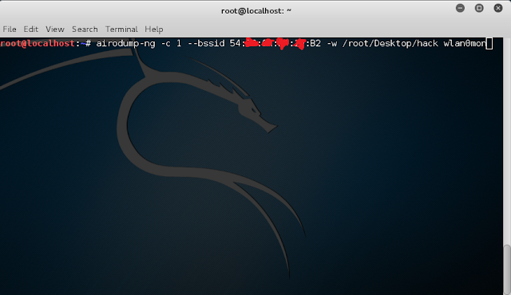

Slide 20


Slide 21
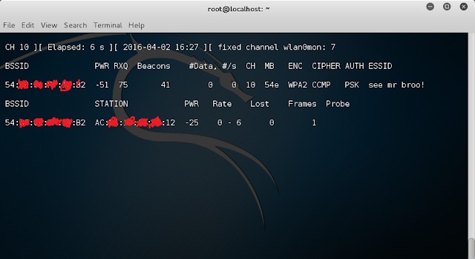

Slide 22
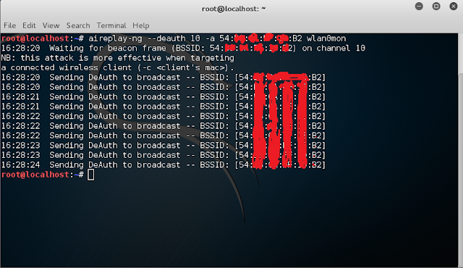

Slide 23
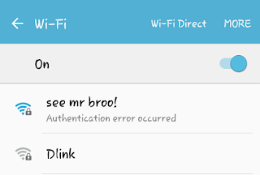

Slide 24
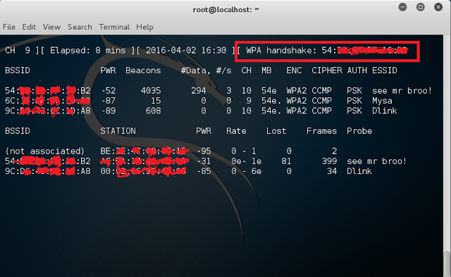

Slide 25
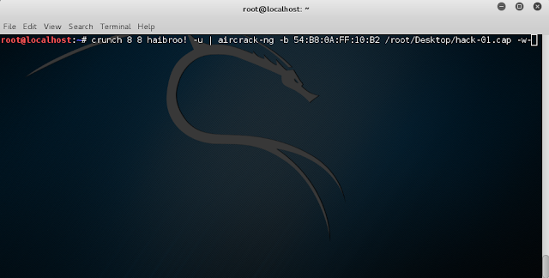

Slide 26
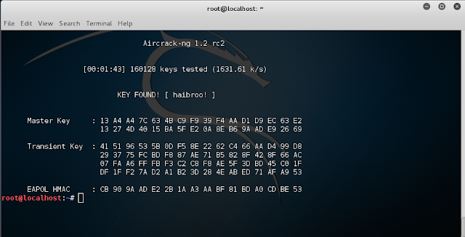

Slide 27
Cracking WIFI with wifite2
Steps:
1.Set Flags & Find a Target
If we know what channel we're attacking on, we can select it by adding the -c command followed by the channel number. Other than that, running Wifite2 is as simple as typing wifite and letting the script gather information.
2. Automate Attacks by Target Type
From our results list, let's select a target with both WPS enabled and clients attached. After selecting the number of the network we wish to attack, Wifite2 will proceed through the most expedient attacks against the network.

Slide 28
Cracking WIFI with wifite2
3.Skip & Examine Results
If Wifite2 is taking too long on any particular attack, we can always skip the current attack by pressing Ctrl-C to bring up a menu that asks if we'd like to continue. Here, you can skip to the next attack by pressing c, or type s to stop Wifite2.
By adding a good password file, we can improve our chances of cracking a Wi-Fi network password even if the faster WPS attacks fail.

Slide 29
Protecting Your Network
There are several methods to increase the
security of a wireless network
Turning off SSID broadcasting
SSID broadcasting helps attackers find your
WLAN
While not broadcasting will not stop anyone,
it will make your network less interesting

Slide 30
System Requirements
Hardware specification:
Processor : Intel(R) Core(TM) CPU
RAM : 2.0 GB
System type : 64-bit Operating system
Hard disk : 10 GB
Software specification:
Operating system : Kali Linux
Hacking Tool : Aircrack-ng, Hashcat, Wifite/Wifite2.

Slide 31
Conclusion
Therefore, from the process outcomes of wireless hacking and security project which was presented and successfully carried out by various wireless hacking tools and possible attacks on wireless networks. Although wireless networks will probably never be completely secure because research on protocol vulnerabilities will always continue, one can keep their network as secure as possible. Staying educated on the latest encryption schemes and other network security related items is probably the best way to keep your network secure. You will not be able to stop the sniffing of your traffic; however, you can prevent the attacker from being able to decipher the traffic. The protocols will continue to evolve to keep unauthorized devices from connecting to a wireless network. However, even the latest security methods have their weaknesses.

Slide 32
Links to tools
Ethereal :
  http://www.ethereal.com
Kismet :
  http://www.kismetwireless.net
Auditor security collection :
  http://new.remote-exploit.org/index.php/Auditor_main
Aircrack-ng :
  https://www.cybrary.it/0p3n/crack-wpawpa2-wi-fi-passwords-using-aircrack-ng/

Slide 33
References
1. www.searchsecurity.techtarget.com
2. http://sectools.org/wireless.html
3. https://www.cybrary.it/0p3n/crack-wpawpa2-wi-fi- passwords-using-aircrack-ng/
4. http://www.networkdictionary.com/security/Widely.php
5. https://medium.com/@brannondorsey/crack-wpa-wpa2- wi-fi-routers-with-aircrack-ng-and-hashcat-a5a5d3ffea46

