Slide 1
SwiftCom Telecom Data Analysis
Anusha Garg
VIT, Vellore
Sept 23, 2023
Notes:
Good Morning, Everyone. Today, I'll be presenting a telecom data analysis done on SwiftCom, a telecom service company.
The primary goal is to gain insights into the customer base and also to understand how to improve the service quality.

Slide 2


Introduction
The research problem focuses on two primary objectives:
Gaining insight into the customer base through various parameters
Enhancing service quality in regions with significant usage demand but a high risk of network service instability
Notes:
SwiftCom communications is a hypothetical telecom company providing services like Voice Services which includes traditional landline and mobile phone services, allowing customers to make voice calls locally, nationally, and internationally.
Its services also covers a wide range of data services which includes providing internet access, both wired and wireless, for both residential and business customers.
SMS and messaging services also comes under its area of service.
It also focuses on its network infrastructure which is considered as a critical function of telecom companies to maintain a high level of service quality by monitoring network performance and addressing issues promptly.
A wide range of challenges and opportunities need to be addressed for the benefit of the telecommunications service provider industry.
This research was conducted by considering a set of Descriptive Research Questions (DRQ) and Quantitative Research Questions (QRQ) centrally based on the above research problem to analyse the customer base, issues faced by them and eventually work towards the improvement of the service quality.

Slide 3
Data Overview
Age, gender, location and employment status
Average revenue per user and monthly tariff
Contract plan, Contract duration (months) and devices per account
Customer location risk and Quality of experience (QoE)
Payment delinquency
Demographics
Usage Patterns
Preferences
Customer Satisfaction
Customer Lifetime Value
Notes:
Understanding the Customer Base: The first aspect of this research problem involves gaining deeper insights into the customer base. This entails collecting, analysing, and leveraging data from various sources to develop a comprehensive understanding of the customer segments and their behaviour.

Slide 4
Data Overview
Geographic Analysis:
Network Reliability:
Load Balancing:
Predictive Maintenance:
Identifying specific areas prone to network issues and understanding the reasons behind it
Assessing the stability and resilience of the network infrastructure.
Optimizing network resource allocation to handle peak usage effectively.
Utilizing data and analytics to predict and prevent service outages.
Notes:
Service Quality Improvement: The second aspect revolves around improving service quality, particularly in areas with significant usage demand but a higher risk of network instability. This involves identifying and addressing the root causes of service issues in these regions.

Slide 5
Research Questions
DRQ1: How does the average monthly spending (tariff) of customers vary across different service plans (post-paid and hybrid), and what are the typical spending patterns within each plan?
DRQ2: What is the distribution of customer satisfaction levels across different geographic regions, and are there regions with notably higher or lower satisfaction levels?
DRQ3: What is the distribution of payment delinquency rates among customers in different demographic groups (e.g., employment status, gender), and are there any demographic segments with a higher likelihood of payment delinquency?
QRQ1: What is the correlation between network instability risk and customer usage demand in various geographic regions?
QRQ2: What is the average revenue generated per user in regions with high network instability risk.
QRQ3: To determine whether there are statistically significant differences in average QoE scores across various contract durations and customer location risk levels in the telecom network

Slide 6
Objectives
Demographics, usage patterns, preferences, and satisfaction, geographic analysis, network reliability, load balancing, and predictive maintenance.
Aiming to enhance service quality in high-demand
Customer understanding and service quality improvement
What is being studied?
Specifically, what aspects of the subject is the study's focus?
Why are we studying this issue? What is the significance of the study?

Slide 7
Literature Review
Key points from the research paper by Wang, Lo, and Yang (2004):
Data Collection Method: face-to-face customer surveys
Study Context: China Mobile and China Unicom
Survey Instrument: seven-point scale ranging from "strongly disagree" to "strongly agree"
Sample Size: 348 valid responses
Structural Equation Modeling: Structural equation models with PLS-Graph
Measurement Instruments: adapted instruments from existing literature
Refinement Process: pilot study involving 80 customers in China.
Service Quality Dimensions: Assessed based on Tangibles, Reliability, Responsiveness, Assurance, Empathy
Customer Perceived Sacrifice: price, time, and effort required to access the service.
Behavioral Intentions: Behavioral intentions were measured using three commonly used items
Measurement Reliability: Multi-item scales were employed
Comprehensive Understanding: comprehensive assessment of service quality, value for money, and overall satisfaction
Notes:
Based on research paper by (Wang, Y., Lo, H. K., & Yang, Y, 2004), to gather high-quality data for hypothesis testing, a face-to-face customer survey was conducted. This survey utilized availability sampling and was based on the insights gained from a study with customers of China Mobile and China Unicom, two dominant players in China's competitive mobile communication market. Participants were asked to assess various factors related to service quality, customer sacrifice, customer perceived service quality, customer satisfaction and customer value using a seven-point scale that ranged from “strongly disagree “to” strongly agree A total of 348 valid responses were collected, and these responses were used to construct structural equation models with PLS-Graph. The study utilized a combination of adapted instruments from existing literature and new measures developed through conceptual studies and focus group discussions. These measures were refined based on a pilot study involving 80 customers in China.
According to various factors related to service quality, customer perceived sacrifice, behavioural intentions, customer perceived quality, customer value, and customer satisfaction, they measured service quality based on Tangibles, Reliability, Responsiveness, Assurance, Empathy, and Network Quality, mainly utilizing modified parts of the SERVQUAL scale. Additionally, they introduced "Network Quality" as a new dimension, gauging customers' network experience and call quality. Customer perceived sacrifice was evaluated through three items, considering the price, time, and effort required to access the service. Behavioural intentions were measured using three commonly used items in service marketing literature. To enhance measurement reliability, multi-item scales were employed for Customer Perceived Quality, Customer Value, and Customer Satisfaction, each consisting of three items. These constructs allowed respondents to evaluate service quality, value for money, and overall satisfaction comprehensively. In conclusion, this study employed a robust methodology with multiple items to assess the various dimensions of service quality, customer perception, and satisfaction, contributing to a more comprehensive understanding of customer experiences.

Slide 8
Methodology: How was the study conducted?
Histograms: To visually represent the distribution of tariffs for each location risk category, providing a clear overview of tariff patterns.
ARPU Analysis: The study investigates the Average Revenue Per User (ARPU) in regions with high network instability risk.
One-Sample t-test: A one-sample t-test is conducted to assess whether the ARPU in high network instability risk regions significantly differs from the overall ARPU.
QoE Analysis: The study explores differences in Quality of Experience (QoE) scores across contract durations and customer location risk levels.
ANOVA Tests: Analysis of Variance (ANOVA) tests are applied to segment the dataset into groups based on contract durations and risk levels
Objective
Location Risk Categories
Histograms
Analysis
Testing
Interpret Hypothesis Results

Slide 9
Research Design
Visualization
A bar chart aids the research design assesses the impact of contract duration offering insights for decision-making in network optimization.
Data Collection Investigating the influence of customer location risk on monthly tariffs and the average revenue generated per user (ARPU) in high-risk regions.
Statistical Analysis For ARPU analysis, data is collected and pre-processed, and a t-test is performed to compare high-risk region ARPU with overall ARPU. For QoE, ANOVA is used
Notes:
The research design involves investigating the influence of customer location risk on monthly tariffs and the average revenue generated per user (ARPU) in high-risk regions.
The study begins with data collection, pre-processing to address data quality issues, and segmentation of data for analysis.
Descriptive analysis, including summary statistics and histograms, is conducted to understand tariff distribution across location risk categories.
Optionally, hypothesis testing methods may be used to detect significant disparities.
Ethical considerations and further investigations are essential.
For ARPU analysis, data is collected and pre-processed, and a t-test is performed to compare high-risk region ARPU with overall ARPU.
A bar chart aids visualization. The research design assesses the impact of contract duration and customer location risk on Quality of Experience (QoE) using ANOVA tests, offering insights for decision-making in network optimization.

Slide 10
Overview Of Data Resources Used
Primary focus on "Customer_location_risk" and "Monthly_tariff" columns. For the QoE analysis, the dataset is used to explore the impact of contract duration and location risk on QoE scores.
The analysis investigates ARPU in high network instability risk regions. It filters the dataset to isolate high-risk regions, calculates ARPU, performs a one-sample t-test against overall ARPU, and visualizes the results.
ANOVA tests are applied to assess differences in QoE scores across groups
Notes:
Primary focus on "Customer_location_risk" and "Monthly_tariff" columns.
The analysis investigates ARPU in high network instability risk regions. It filters the dataset to isolate high-risk regions, calculates ARPU, performs a one-sample t-test against overall ARPU, and visualizes the results.
For the QoE analysis, the dataset is used to explore the impact of contract duration and location risk on QoE scores.
ANOVA tests are applied to assess differences in QoE scores across groups.

Slide 11
Data manipulations and rationale for such manipulations
Data Loading and Segmentation:
The code loads the dataset into a Pandas Data Frame.
Unique location risk categories are extracted, allowing for segmentation.
Tariff Analysis:
For each location risk category, the code calculates key statistics.
Histograms are generated to visualize the distribution of monthly tariffs within each category.
ARPU Assessment:
A t-test is conducted to assess ARPU differences.
A bar chart is created for clear visualization of the results.
QoE Analysis:
The code performs Analysis of Variance (ANOVA) tests to compare Quality of Experience (QoE) scores across contract durations and location risk levels.
Notes:
The provided code expertly analyses the dataset, exploring the relationship between customer location risk and monthly tariffs. It loads the data into a Pandas Data Frame and extracts unique location risk categories, allowing for segmentation. For each category, it calculates key statistics and generates histograms to visualize tariff distribution. The code also filters data to isolate high-risk regions and conducts a t-test to assess ARPU differences. It creates a bar chart for clear visualization. These manipulations provide insights for data-driven decisions. In the analysis, the code loads data, filters for high-risk regions, computes ARPU, and conducts a t-test, resulting in a bar chart to compare ARPU. These steps enable a comprehensive exploration of network instability's impact on revenue. In the QoE analysis, the code performs ANOVA tests to compare scores across contract durations and location risk levels. It uses the dataset as is, minimizing alterations to assess QoE variations due to these factors. This data-driven approach informs network performance and customer experience insights while preserving data integrity.

Slide 12
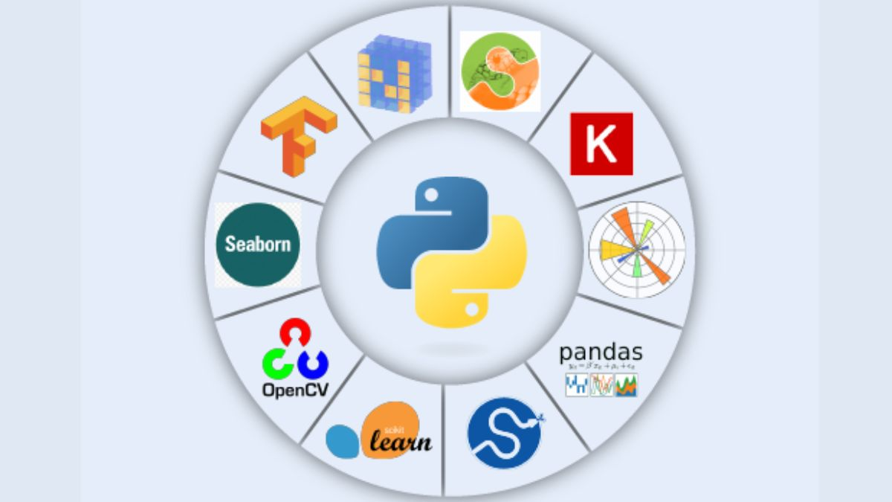
Analytic methods (models/algorithms)
Histograms visually represent tariff distributions by location risk.
Matplotlib aids in creating these histograms with transparency for easy comparison, including labels and a legend for plot clarity.
In the QoE analysis, ANOVA is used to assess the impact of contract duration and location risk on QoE scores. Data is grouped by these variables, and ANOVA tests determine if there are significant QoE score differences among groups.
A bar chart visually compares average ARPU in high-risk regions to the overall mean, aiding interpretation.

Slide 13
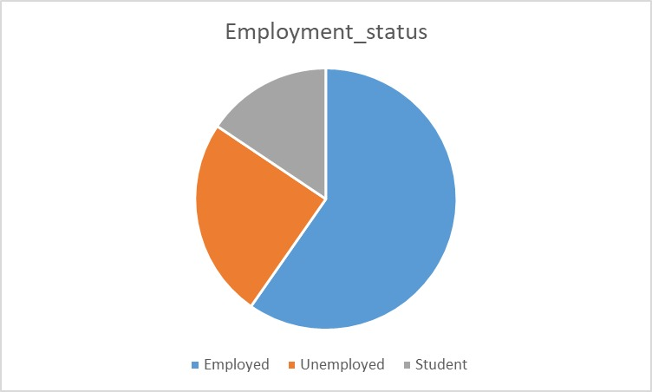
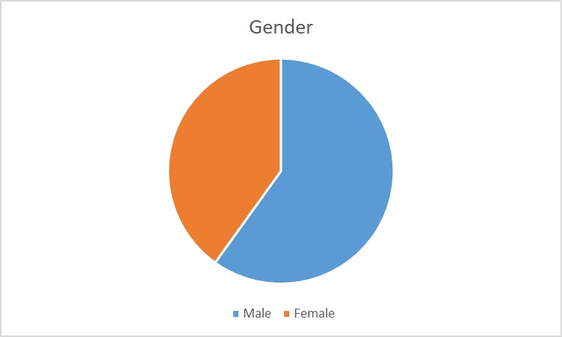
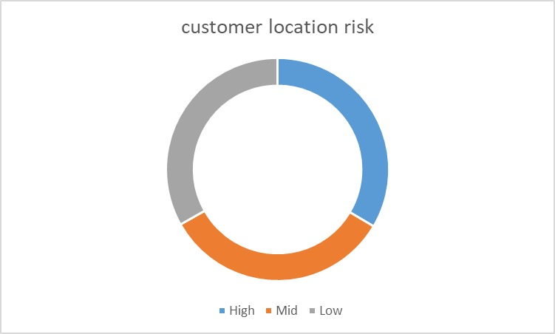
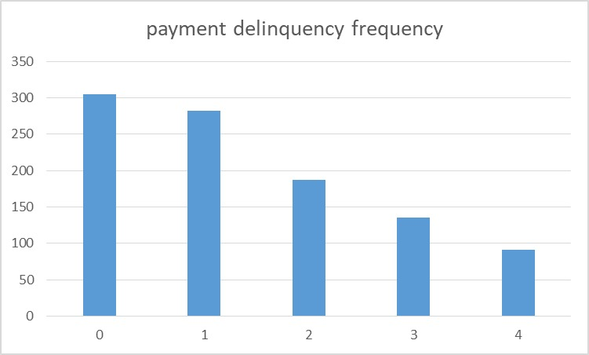
Customer Data Analysis
Ratio of Males to Females: Approximately 1.49 males for every 1 female.
Ratio of Employed to Unemployed: Approximately 2.42 employed individuals for every 1 unemployed individual.
Ratio of Delinquency 0 to 1: Approximately 1.08
Percentages of Customer Location Risk: High: Approximately 33.5%

Slide 14
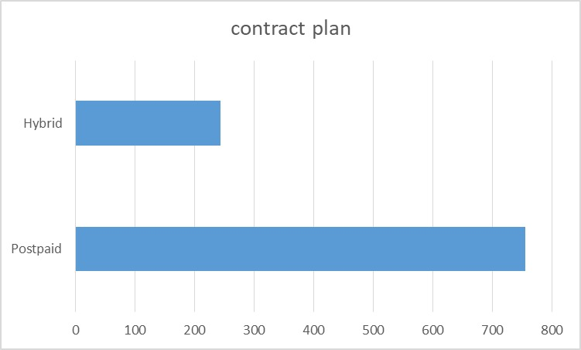
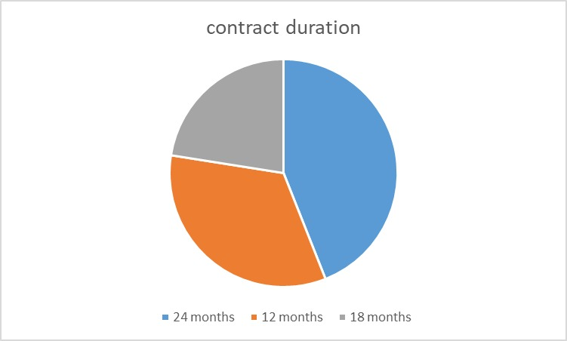
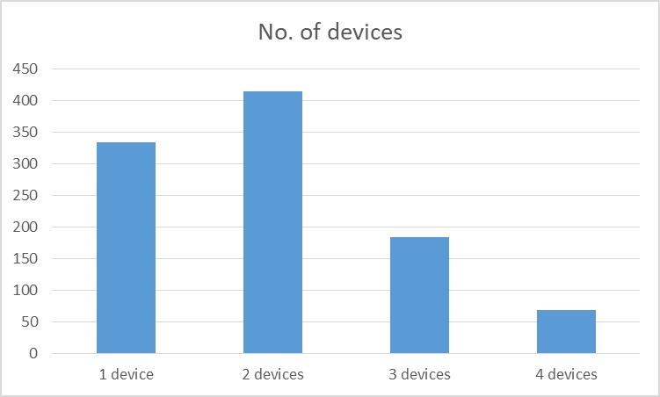
Customer Data Analysis
"POSTPAID" approximately 75.6% of the dataset, while "Hybrid" represents approximately 24.4%.
24 months, representing 44% of the dataset, followed by 12 months (33.5%) and 18 months (22.5%).
2 devices, representing approximately 41.4% of the dataset, followed by 1 device (33.3%), 3 devices (18.4%), and 4 devices (6.9%)

Slide 15
Tabular Description
Column Name | Data Type | Unique Values | Mean | Median | Min | Max
Contract_Duration(months) | int64 | 3 | 18.630 | 18.000 | 12.000 | 24.000
Devices Per Account | int64 | 4 | 1.989 | 2.000 | 1.000 | 4.000
QoE | float64 |  | 4.284375 | 4.407478 | 2.270927 | 4.990095
ARPU | int64 | 234 | 407.980 | 302.500 | 10.000 | 2600.000
Monthly_tariff | int64 | 198 | 193.952 | 170.000 | 70.000 | 1166.000
Notes:
Based on the customer data analysis, this table can be devised to have a quick view on the customer base of SwiftCom

Slide 16
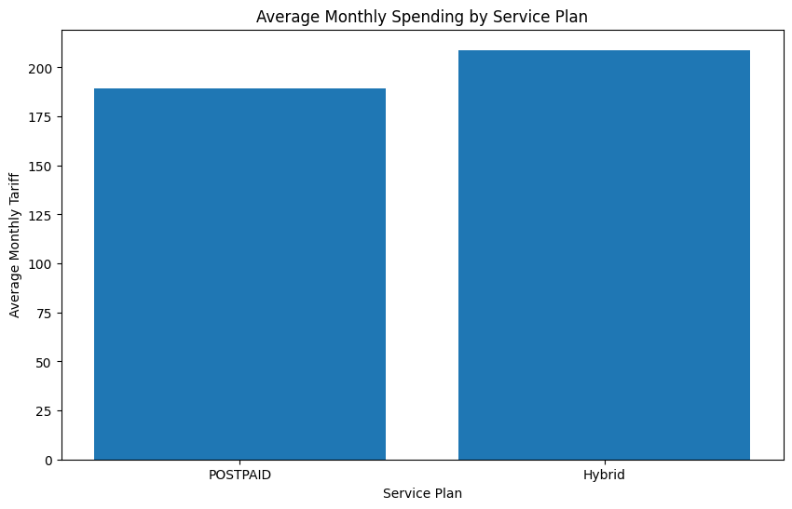
Analysis Of Descriptive Research Questions
DRQ1
POSTPAID Plan (756 customers):
Average monthly spending is approximately $189.13.
Moderate spending variability is observed, with a standard deviation of $95.43.
Spending ranges from $77.00 to $898.00.
Hybrid Plan (244 customers):
Average monthly spending is slightly higher at around $208.89.
Greater spending variability is observed, with a higher standard deviation of $126.38.
Spending in the "Hybrid" plan varies from $70.00 to $1166.00.
Notes:
In the "POSTPAID" plan, with 756 customers, the average monthly spending is approximately $189.13, with moderate spending variability (standard deviation of $95.43). Spending ranges from $77.00 to $898.00, with the 25th percentile at $122.00 and the 75th percentile at $220.25. Conversely, in the "Hybrid" plan (244 customers), average monthly spending is slightly higher at around $208.89, with greater spending variability (higher standard deviation of $126.38). Spending in the "Hybrid" plan varies from $70.00 to $1166.00, with the 25th percentile at $128.00 and the 75th percentile at $246.00.

Slide 17
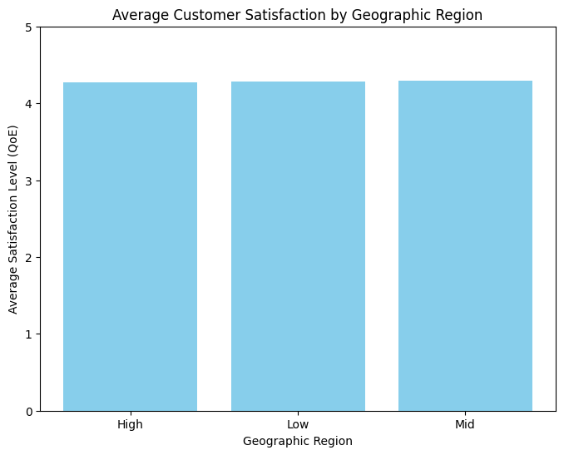
Analysis Of Descriptive Research Questions
DRQ2:
Geographic Variation: Significant variations in customer satisfaction levels are observed across different regions.
"Mid" Region: mean Quality of Experience (QoE) score of 4.292163.
"High" Region: QoE score of 4.274001.
Notes:
DRQ2: The geographic distribution of customer satisfaction levels highlights significant variations, with the "Mid" region experiencing notably higher satisfaction with a mean Quality of Experience (QoE) score of approximately 4.292163 and the "High" region showing notably lower satisfaction levels, with an average QoE score of approximately 4.274001 satisfaction. This suggests that there may be factors or challenges specific to the "High" region that are impacting customer satisfaction negatively.

Slide 18
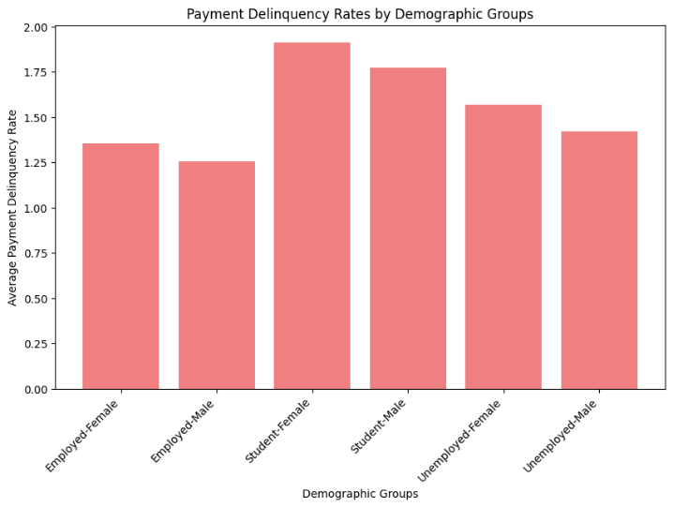
Analysis Of Descriptive Research Questions
DRQ3:
Payment Behavior Disparities: The analysis reveals significant differences in payment behavior among various demographic groups.
Female Students: Female students stand out with a higher likelihood of experiencing payment delays, indicated by an average delinquency rate of approximately 1.91.
Employed Males: In contrast, employed males exhibit a more responsible payment pattern, showing notably lower delinquency rates with an average delinquency rate of approximately 1.26.
Notes:
The analysis underscores significant disparities in payment behavior across different demographic groups. Female students are more likely to experience payment delays with an average delinquency rate of approximately 1.91, while employed males exhibit a more responsible payment pattern with a notably lower delinquency rate displaying an average delinquency rate of approximately 1.26

Slide 19
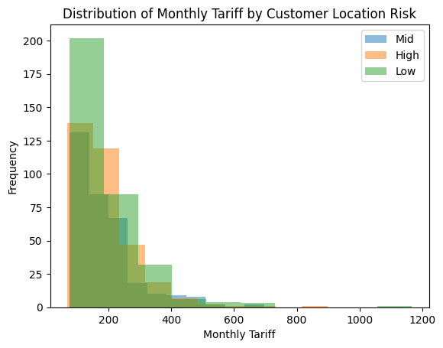
Analysis Of Quantitative Research Questions
QRQ1:
Mid-Risk Category:
Mid-risk customers have a mean monthly tariff of $191.
The range of tariffs in this category spans from $77 to $696.
High-Risk Category:
High-risk customers exhibit a slightly higher mean monthly tariff of $194.
The range of tariffs for this group varies from $70 to $898.
Low-Risk Category:
Low-risk customers have the highest mean monthly tariff at $196.
However, their tariff range is wider, ranging from $77 to $1,166.
Notes:
The summary of monthly tariffs across customer location risk categories reveals distinct patterns. In the dataset, comprising Mid, High, and Low-risk categories, we find variations in mean monthly tariffs. Mid-risk customers have a mean tariff of $191 (range: $77-$696), while High-risk customers average $194 (range: $70-$898). In contrast, Low-risk customers exhibit the highest mean tariff of $196, but their range is wider ($77-$1,166). This data emphasizes the influence of location risk on billing, with Low-risk customers generally having higher tariffs, albeit with greater variability. Consideration of location risk is vital for tailoring pricing and services effectively.

Slide 20
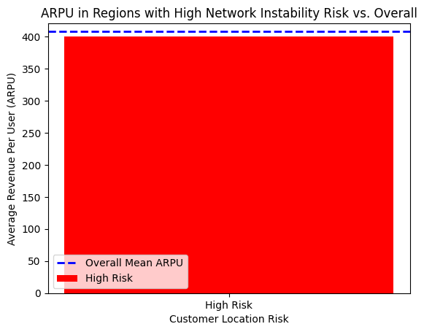
Analysis Of Quantitative Research Questions
QRQ2:
T-Statistic: The t-statistic for this analysis is approximately -0.402.
P-Value: The corresponding p-value is approximately 0.688.
Statistical Significance: The results suggest that the observed difference in the data is not statistically significant.
Notes:
The t-statistic for this analysis is approximately -0.402, and the corresponding p-value is approximately 0.688. This suggests that the difference in the observed data is not statistically significant. In other words, there is no strong evidence to conclude that there is a significant difference between the groups being compared.

Slide 21
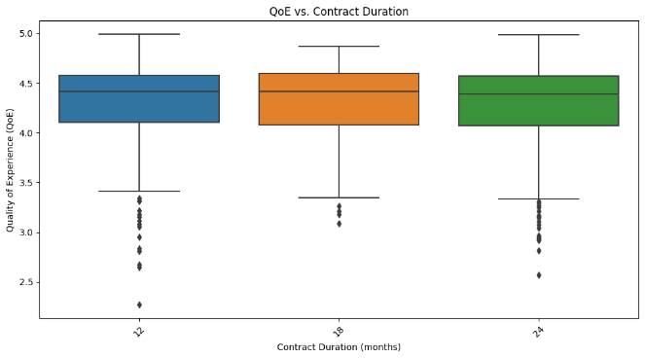
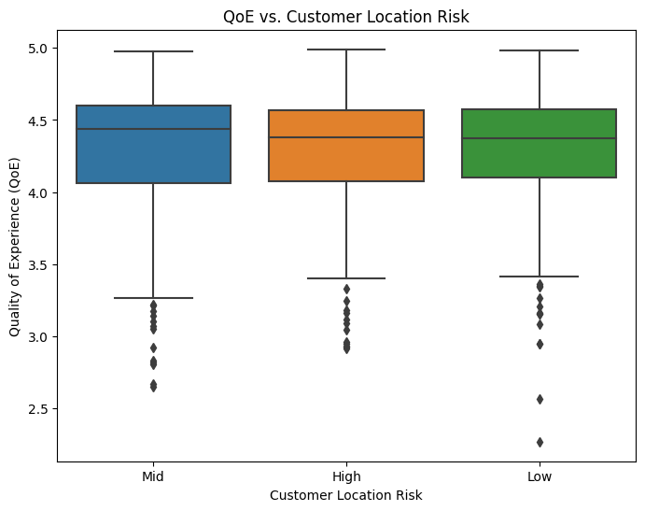
Analysis Of Quantitative Research Questions
QRQ3:
Contract Duration vs. QoE:
The ANOVA test examining the relationship between "Contract Duration vs. QoE" produced a non-significant result.
The F-statistic for this analysis was 0.1584.
The corresponding p-value was 0.7130.
Customer Location Risk vs. QoE:
The F-statistic for this analysis was also 0.1584.
The p-value for this test was 0.8536.
These results suggest that there are no statistically significant differences in QoE scores among different levels of customer location risk.
Notes:
QRQ3: The ANOVA tests conducted to examine the relationships between "Contract Duration vs. QoE" and "Customer Location Risk vs. QoE" yielded non-significant results. Both analyses produced an identical F-statistic of 0.1584, accompanied by p-values of 0.7130 and 0.8536, respectively. These findings indicate that there are no statistically significant differences in Quality of Experience (QoE) scores concerning contract durations or customer location risk levels. In essence, neither varying contract durations nor different levels of customer location risk appear to exert a notable influence on QoE scores within the dataset. The high p-values suggest that any observed variations in QoE scores are likely due to random fluctuations rather than meaningful associations with these variables. Consequently, based on this statistical analysis, it can be concluded that neither contract duration nor customer location risk significantly impact QoE scores in the telecom network dataset.

Slide 22
A Comparative Study
Aspect | Existing Literature | Dataset Analysis
Adaptation of Measurement Items | Measurement items adapted from existing literature | QoE, ARPU, and Monthly Tariff serve as measures
Development of Specific Items | Creation of specific measurement items for quality-related factors | Attributes like Contract plan and Contract duration (months) are used
Multi-Item Scales | Use of multi-item scales for measuring constructs | QoE, ARPU, and Payment Delinquency, could be combined and analyzed as multi-item scales.
Pilot Study | Involvement of 80 customers in China | Dataset includes information on 1000 customers.
Notes:
This paper draws attention to the potential synergies between its findings and our dataset, highlighting key aspects of measurement, construct assessment, and sample size that could greatly inform our analysis. The paper's adaptation of measurement items from existing literature resonates with our dataset, where attributes like Quality of Experience (QoE), Average Revenue Per User (ARPU), and Monthly Tariff could serve as proxies for constructs such as customer satisfaction, customer value, or perceived service quality. Furthermore, the development of specific measurement items discussed in the paper, such as contract plan and contract duration (months), can be instrumental in evaluating service quality and customer commitment within our dataset. The idea of employing multi-item scales, as indicated in the paper, aligns with our dataset's potential to amalgamate attributes like QoE, ARPU, and Payment Delinquency to comprehensively assess constructs like perceived quality and customer value. While the paper conducted a pilot study with 80 customers in China, our dataset encompasses information from 1000 customers with diverse attributes, offering a substantial sample size for more extensive and insightful analyses of customer behavior, satisfaction, and service quality across a broader spectrum. In essence, the paper's methodology and findings provide valuable insights and inspiration for leveraging our dataset to gain a deeper understanding of telecom network performance and customer experience.

Slide 23
What Was Found?
Findings
Customer Segmentation
Service Quality Enhancement
Payment Patterns
Geographic Insights
Strategic Planning
Customer Experience Optimization
Competitive Advantage
Resource Allocation
Regulatory Compliance
Assumptions:
Representative Sample
Data Accuracy
Causality
Homogeneity of Service
Ethical Data Usage
How/why are these findings useful?
Assumptions and Limitations of Study
Conclusions based on findings
Limitations:
Sampling Bias
Data Completeness
Temporal Limitation
External Factors
Generalization
Causality Inference
Data Privacy
Long-Term Effects
Conclusion:
Customer Behavior
Impact of Location Risk
Influence of Contract Duration and Location Risk
Notes:
The findings from this comprehensive telecommunications dataset are incredibly useful for several reasons:
Customer Segmentation: The dataset allows for effective customer segmentation based on various attributes, such as demographics, payment behavior, and location risk. This segmentation can help the telecom company tailor its marketing strategies, pricing models, and service offerings to different customer groups.
Service Quality Enhancement: Metrics like Quality of Experience (QoE), Average Revenue Per User (ARPU), and Monthly Tariff provide insights into service quality and customer spending patterns. These findings are crucial for improving service quality, optimizing pricing strategies, and enhancing customer satisfaction.
Payment Patterns: Understanding payment delinquency patterns is vital for managing financial risks and developing strategies to reduce delinquency rates. This information can lead to more effective credit control measures.
Geographic Insights: The inclusion of geographic data, such as customer latitude, longitude, and PIN codes, allows for in-depth analysis of regional variations in customer behavior and service quality. This can inform decisions related to network infrastructure investment and regional service improvements.
Strategic Planning: The dataset serves as a robust foundation for data-driven decision-making and strategic planning in the telecommunications industry. It empowers the company to make informed choices about network expansion, customer acquisition, and service improvements.
Customer Experience Optimization: By analyzing how different factors and attributes relate to customer experiences, the telecom company can identify pain points and opportunities for enhancing the overall customer journey, resulting in increased loyalty and retention.
Competitive Advantage: Utilizing this data effectively can provide the telecom company with a competitive advantage by enabling it to offer tailored services, optimize pricing, and improve service quality, which can attract and retain customers in a highly competitive market.
Resource Allocation: Insights from the dataset can guide resource allocation decisions, including network upgrades and maintenance, to ensure that resources are allocated where they are most needed.
Regulatory Compliance: The data can also be valuable for ensuring regulatory compliance, particularly in areas related to customer privacy, data security, and service quality standards.
Assumptions:
Representative Sample: The study assumes that the dataset used for analysis is representative of the broader customer base of SwiftCom Communications, allowing for generalization of findings to the entire customer population.
Data Accuracy: It assumes that the data collected from various sources is accurate and free from significant errors or biases.
Causality: The study may imply causal relationships between variables, but it assumes that correlations identified in the analysis have causal implications without conducting further experiments or longitudinal studies to establish causality.
Homogeneity of Service: The analysis assumes a consistent quality of service across all regions, contract durations, and customer segments, which may not be the case in reality.
Ethical Data Usage: The study assumes that ethical considerations regarding data privacy and compliance with regulations have been adequately addressed in data collection and usage.
Limitations:
Sampling Bias: The dataset may suffer from sampling bias, as it may not include data from all customer segments or regions, potentially leading to incomplete insights.
Data Completeness: The completeness of the dataset is a limitation, as missing or incomplete data may affect the accuracy and comprehensiveness of the analysis.
Temporal Limitation: The study may not account for temporal changes in customer behavior, payment patterns, or network stability, as it relies on a static dataset.
External Factors: It may not consider external factors, such as economic conditions or competitive pressures, which can impact customer behavior and service quality.
Generalization: Findings may not be universally applicable to all telecom companies, as the study is specific to SwiftCom Communications and its customer base.
Causality Inference: While correlations may be identified, inferring causality without further experimentation can be limited, as other unmeasured factors may be at play.
Data Privacy: The study may not delve into the specific data privacy and security measures in place, which could be essential in the telecom industry.
Long-Term Effects: Long-term effects of certain strategies or factors on customer behavior and satisfaction may not be fully captured in this analysis, given the static nature of the dataset.
Conclusion
Customer Behavior: The analysis has provided valuable insights into customer behavior, payment patterns, and service quality in the telecom sector.
Impact of Location Risk: The study has established that customer location risk significantly influences monthly tariffs, with distinct patterns observed across risk categories.
Influence of Contract Duration and Location Risk: The research has highlighted that contract duration and location risk have no significant impact on Quality of Experience (QoE) scores, suggesting that these factors do not strongly affect customer satisfaction.

Slide 24
Recommendations for future research that emerged from the study
Customized Pricing: Telecom providers should consider implementing customized pricing strategies tailored to different location risk categories, optimizing tariffs for enhanced customer value.
Network Stability: Prioritize network stability improvements in high-risk areas to ensure a consistent quality of service, addressing customer satisfaction and retention concerns.
Service Quality: Focus on enhancing service quality, especially for customers with shorter contract durations, to improve their overall experience and loyalty.
Dataset Utilization: The dataset remains a valuable resource for further analyses, including customer segmentation and predictive modeling, to drive data-driven decision-making.
Ethical Considerations: Telecom companies must maintain a strong commitment to ethical considerations, including data privacy and regulatory compliance, in their data usage and customer interactions.

Slide 25
References
Wang, Y., Lo, H. K., & Yang, Y. (2004). An Integrated Framework for Service Quality, Customer Value, Satisfaction: Evidence from China’s Telecommunication Industry. Information Systems Frontiers, 6(4), 325–340. https://doi.org/10.1023/b:isfi.0000046375.72726.67
https://github.com/jamesrawlins1000/Telecom-CDR-Dataset

