Slide 1
PHASE-1 SYNOPSIS REVIEW PRESENTATION
EMPLOYEE TRACKER
Submitted By :
Harsh Thadeshwar 4CB20CS035
Abhay Kamath 4CB20CS003
Anusha G Shanbhag 4CB20CS015
Karthik Prabhu 4CB20CS042
Under the guidance of :
Mr. Alok Ranjan

Slide 2
Contents
Introduction
Literature Survey
Objectives
Methodology
Future Implementation
References

Slide 3
Introduction
An employee tracker project is a software or system designed to monitor and manage the activities, performance, and whereabouts of employees within an organization. This type of project is typically implemented to enhance workforce management, productivity, and security. Employee tracker systems can employ various technologies, such as GPS, RFID, or software-based solutions, to keep track of employee movements, attendance, and work-related tasks. These projects can be valuable for businesses seeking to optimize operations, improve employee accountability, and ensure safety and security in the workplace.

Slide 4
Literature Survey
Sl. No. | Article Title | Authors | Journal | Methodology Used | Remarks
1. | Research on Face Recognition Technology Based on Deep Learning | Zhou Chun-rong | Research on Face Recognition Technology Based on Deep Learning" presented at the "2020 IEEE International Conference on Industrial Application of Artificial Intelligence (IAAI)." | Using HOG Features for Face Detection, Extracting Face Recognition Features from Images, Face Recognition Based on Neural Network. | Face recognition technology based on deep learning is effective in improving recognition efficiency and stability. Precision and recall rates are higher for the deep learning-based approach.

Slide 5
Literature Survey
Sl. No. | Article Title | Authors | Journal | Methodology Used | Remarks
2. | Location-based Monitoring | Christian jandl,Martina Hartner,Sebastian schlund | “Production & manufacturing research," Volume 11, Number 1, in 2023. | Data collection through location monitoring, controlled experimental conditions. | Location-based monitoring provides real-time insights and enhanced efficiency but must be implemented carefully, considering privacy, ethics, and legal aspects.
3. | Women Employee Security System using GPS And GSM Based Vehicle Tracking | Poonam Bhilare ,Akshay Mohite, Dhanashri Kamble, Swapnil Makode | INTERNATIONAL JOURNAL FOR RESEARCH IN EMERGING SCIENCE AND TECHNOLOGY, Volume-2, Issue-1, January-2015 | GPS device with an emergency button to track vehicle location, transmit alerts via GSM, and capture images for the security of women employees during transportation. | A Women Employee Security System that utilizes GPS and GSM for vehicle tracking enhances safety and security for female employees, providing real-time monitoring and assistance when needed.

Slide 6
Literature Survey
Sl. No. | Article Title | Authors | Journal | Methodology Used | Remarks
4. | An Android based Employee Tracking System | Enefiok Etuk, Uzochukwu Onwuachu | Article in International Journal of Computer Applications · November 2016 | Managing and monitoring large numbers of employees efficiently. It employs Java programming and follows an Object-Oriented Analysis and Design (OOAD) approach. | The developed system simplifies attendance tracking, enhances productivity, and reduces paperwork, offering a valuable tool for businesses and organizations.
5. | A Research on Mobile Applications for Location Tracking through Web Server and Short Messages Services (SMS) | Salman Khan, Waheed Ahmad, Riaz Ali, Salman Saleem | Article in VFAST Transactions on Software Engineering · November 2015 | The app sends live location (lat-long) to a server, updating it via SMS as a complete address for easy sharing. | The system has an Android app and web server for location tracking and emergency alerts, with features like updates, manual sharing, and emergency alerts.

Slide 7
Literature Survey
Sl. No. | Article Title | Authors | Journal | Methodology Used | Remarks
6. | Face Recognition System | Shivam Singh, Prof. S. Graceline Jasmine | http://www.ijert.org ISSN: 2278-0181 IJERTV8IS050150 Vol. 8 Issue 05, May-2019 | The proposed system utilizes face detection, feature extraction, and recognition algorithms, including the KLT Algorithm, Viola-Jones Algorithm and Principal Component Analysis (PCA). | It contributes significantly to the domain of face recognition technology, offering valuable insights, experimental results, and suggestions for future advancements.
7. | A low-cost, mobile real-time kinematic geolocation service for engineering and research applications | André Broekman, Petrus Johannes Gräbe | Department of Civil Engineering, Engineering 4.0, University of Pretoria, Pretoria, South Africa | The setup involves choosing an optimal location, precise ground plane fabrication, secure antenna installation, and efficient power/internet supply in a compact design. | The setup prioritizes accuracy and efficiency in a compact design for the base station's optimal location, ground plane, antenna, and power/internet supply.

Slide 8
Literature Survey
Sl. No. | Article Title | Authors | Journal | Methodology Used | Remarks
8. | A review of eye-tracking research in tourism | Noel Scott, Rui Zhang, Dung Le, Brent Moyle | Current Issues in Tourism, Volume 22, Issue 10 (2019) | Review eye-tracking for attention measurement in tourism and hospitality. Cover theory, pros/cons, data collection, analysis, applications, and suggest further research | "Eye-tracking in tourism methodology review" offers valuable insights into tourist behavior and experiences, benefiting researchers and marketers.
9. | DESIGN AND DEVELOPMENT OF GPS-GSM BASED TRACKING SYSTEM WITH GOOGLE MAP BASED MONITORING | Pankaj Verma, J.S Bhatia | International Journal of Computer Science, Engineering and Applications (IJCSEA) | Collaborative Filtering, Recommendation Systems, User-based Algorithms, Item-based Algorithms, GSM, GPS. | This system combines GPS and GSM technologies for vehicle tracking, enhancing location accuracy and remote monitoring.

Slide 9
Literature Survey
Sl. No. | Article Title | Authors | Journal | Methodology Used | Remarks
10. | Development of Employee Attendance Management Information System During the Covid-19 Pandemic Based on Website using QR Code | Ahmad Habib, Moch. Dzawil Haiat , Balok Hariadi | Journal of Information Systems (e-Journal) Vol.9 | No 2 |Th. 2022 | The research paper's methodology is structured around using agile project management (Scrum) to develop the online attendance system, with data collection from multiple sources, technology implementation, and rigorous testing to ensure system functionality and reliability. | QR code-based attendance tracking can streamline processes but requires careful consideration of privacy, security, and costs, along with ongoing improvements to maintain employee satisfaction and legal compliance.

Slide 10
Objectives
Enhance Workforce Management.
Increase Productivity.
Cost Control.
Feedback and Training.
Data-Driven Decision Making.

Slide 11
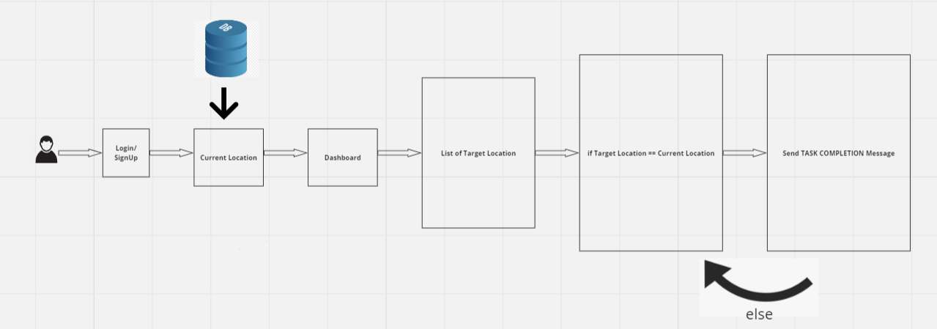
Methodology

Slide 12
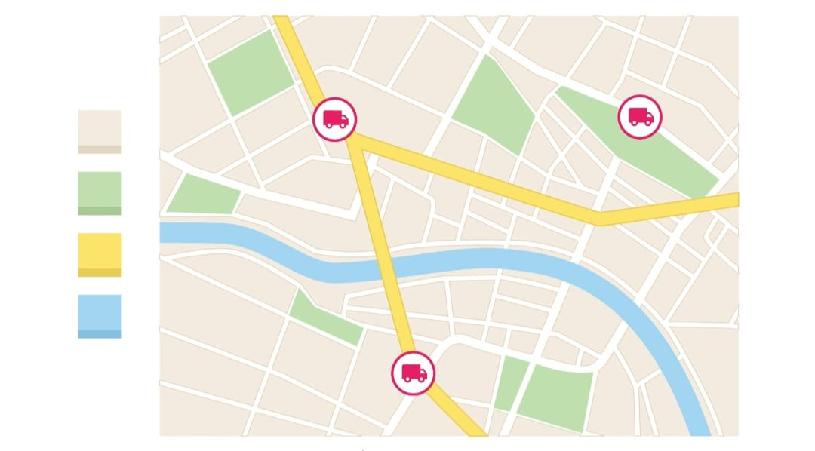
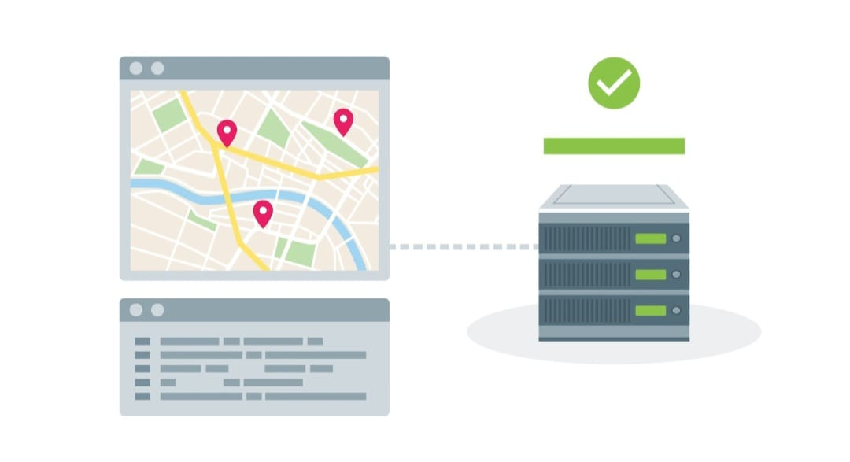
Step1:Where are Employees at any given time?

Slide 13
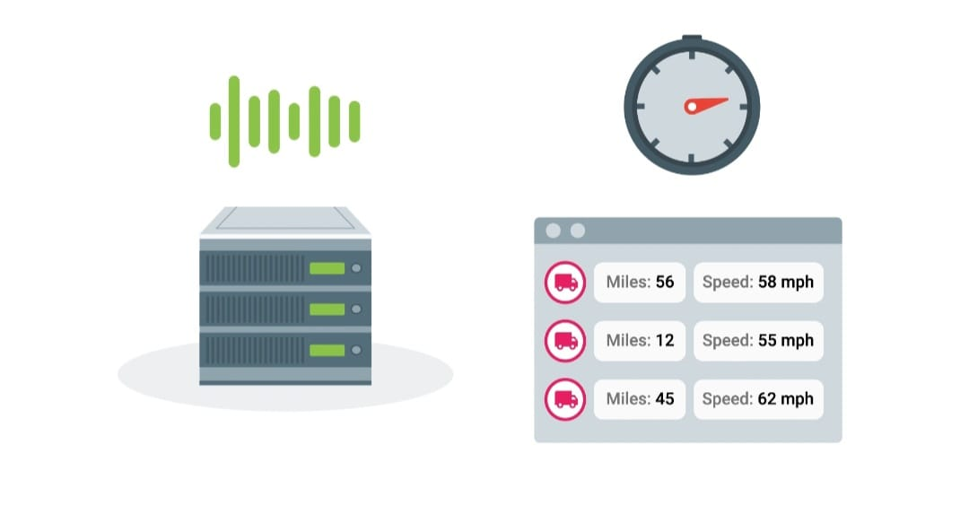
Step2:Getting real-time updates from database

Slide 14
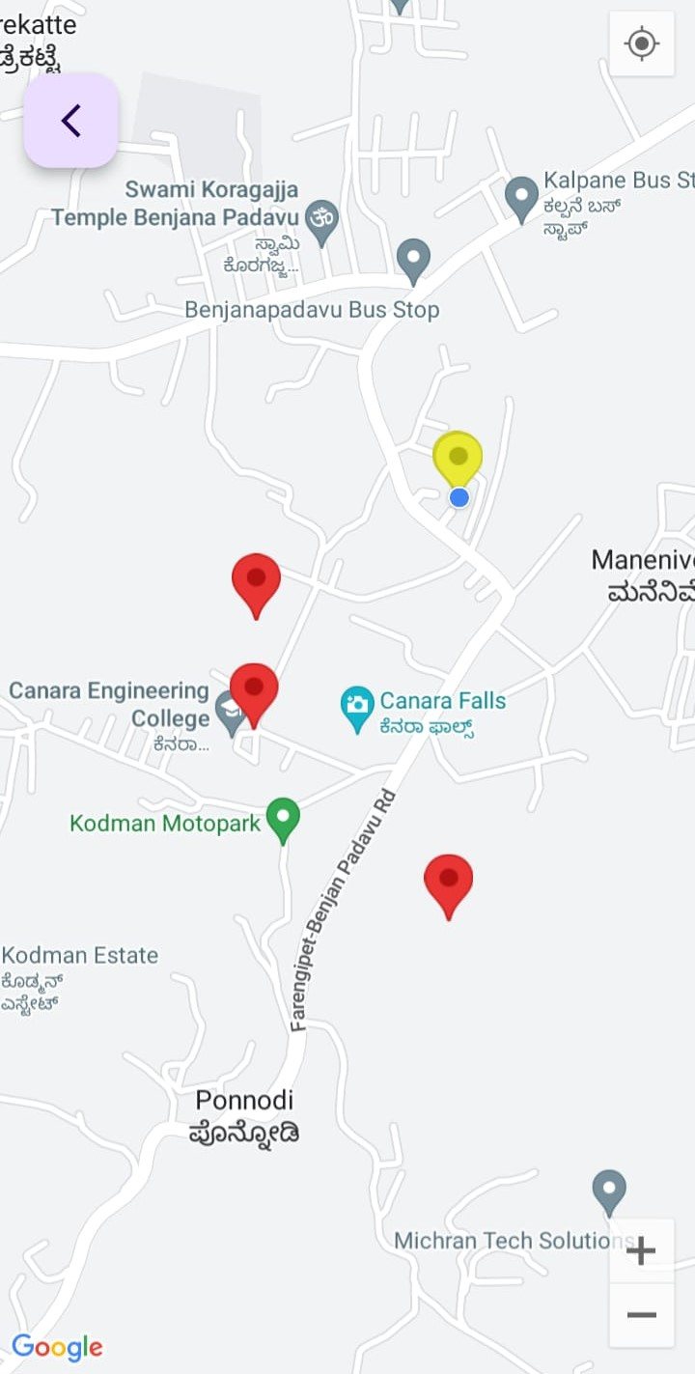
Step3:Displaying Employee Location. Target Location: RED Current Location:YELLOW
>

Slide 15
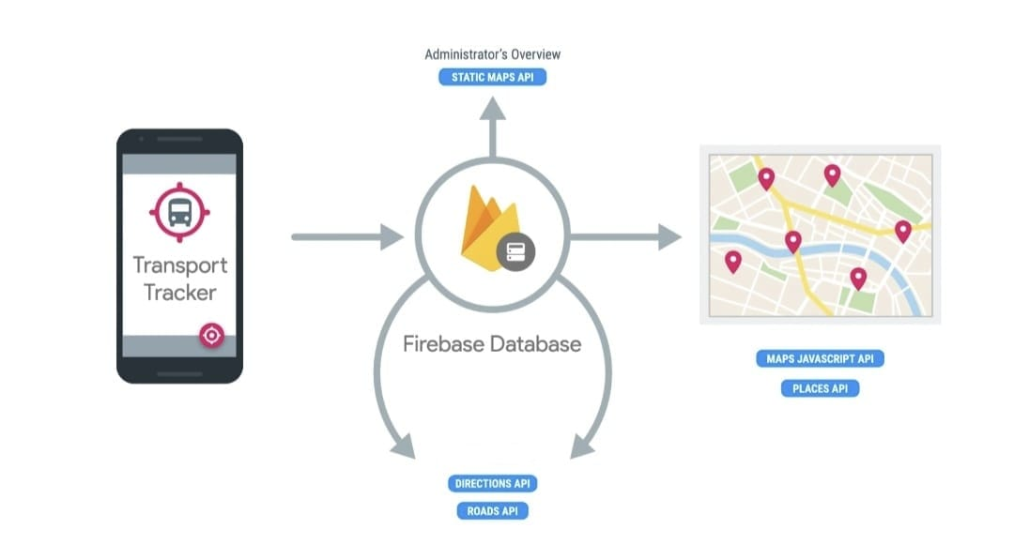
Step4:Admin Overview

Slide 16
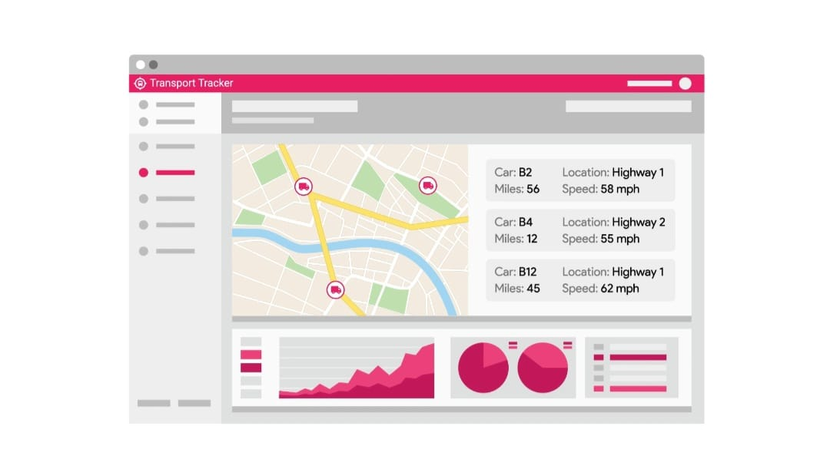
Future Implementation

Slide 17
References
[1] HU Yuping. Cross-Age Face Recognition Algorithm Based on HOG-CSLBP and Deep Learning [J]. Journal of Southwest China Normal University(Natural Science Edition),2020,45(03):115-120.
[2] ZHU Yongzhi, SU Xiaoyun. Face Recognition Technology based on Multi-Task Convolutional Neural Network [J]. Communications Technology,2020,53(03):718-723.
[3] Alder, G. S. (2001). Employee reactions to electronic performance monitoring: A consequence of organizational culture. The Journal of High Technology Management Research, 12(2), 323–342.
[4] INTERNATIONAL JOURNAL FOR RESEARCH IN EMERGING SCIENCE AND TECHNOLOGY, VOLUME-2, ISSUE-1, JANUARY-2015.
[5] Q. Aini, Y. I. Graha, and S. R. Zuliana, “Penerapan Absensi QRCode Mahasiswa Bimbingan Belajar pada Website berbasis YII Framework Application Student Attendance QRCode in Guidance Learn to Website Based on Yii Framework,” J. Ilm. SISFOTENIKA, vol. 7, no. 2, 2017.
[6] Salman, K., Ali, H., & Saleem, S. (2015). Research on Auto Mobile-Pc Upload Images Application through Bluetooth Using Java. VAWKUM Transaction on Computer Sciences. Retrieved from http://vfast.org/journals/index.php/VTCS/article/view/356
[7] Saleem, S., Khan, I., khan, S., & Rahman, A. (2015).Comparison of Cooperative Diversity Protocols in Various Relay Locations through Network Coding. VFAST Transactions on Software Engineering. Retrieved from http://vfast.org/journals/index.php/VTSE/article/view/357

Slide 18
References
[8] Sonal Kasliwal, Sushma Kotkar and H.D.Gadade (2016),Employee Tracking and Monitoring System Using Android International Journal of Innovative Research in Advanced Engineering (IJIRAE) SSN: 2349- 2763, Issue 03, Volume 3, page 1-4
[9] Deshpande, N. T., & Ravishankar, S. (2017). Face Detection and Recognition using Viola-Jones algorithm and Fusion of PCA and ANN. Advances in Computational Sciences and Technology, 10(5), 1173- 1189.
[10]Pankaj Verma, J.S Bhatia, DESIGN AND DEVELOPMENT OF GPS-GSM BASED TRACKING SYSTEM WITH GOOGLE MAP BASED MONITORING. Centre for Development of Advanced Computing, Mohali, Punjab, India.

