Slide 1
Uniform platform for Trusted application
Presented By
<number>

Slide 2
What is TrustZone
TrustZone is a feature of the processor architecture, and it allows us to “hardware-separate” a rich operating system, from a much smaller, tiny, secure operating system.

Slide 3
Goals and Objectives
To develop a VEE library for ARM trustzone using OPTEE which will support any platform like TrustZone Execution Environment(TEE), Qualcomm Execution Environment (QEE),X Execution Environment (X – Any) (XEE).

Slide 4
Requirements
OPTEE
Raspberry pi
Qemu

Slide 5
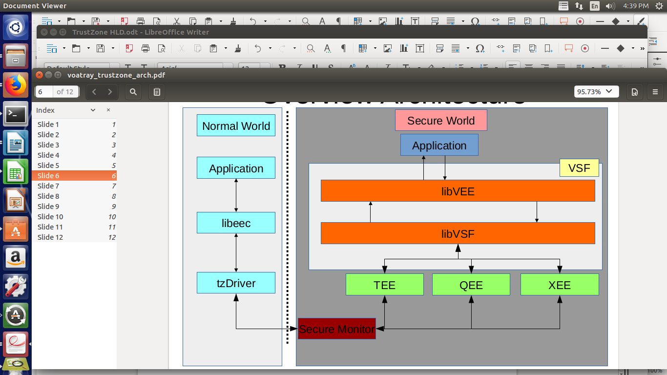
Block Diagram

Slide 6
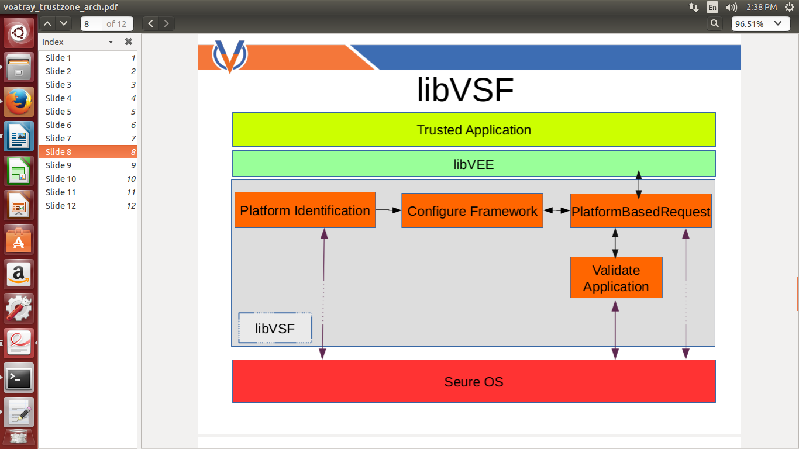

Slide 7
Platform Identification
Need of platform identification.
Get OS information from TA.
Get internal API’s used by global api.
Write code for platform identifying by using internal API’s.
Link platform information code to secure os library.
Call macros from application TA and observe OS information.
Call platform function in standard handler.

Slide 8
Framework Configuration

Slide 9
Triggaring Framework
Understood the code flow from Normal world to secure world.
Vector table:
optee_os/core/arch/arm/kernel/thread_a64.S
Handler:
optee_os/core/arch/arm/kernel/thread.c

Slide 10
Issues

Slide 11
Results

Slide 12
Conclusion

Slide 13
Thank you
<number>

