Slide 1
Uniform platform for Trusted application
Presented by
Pushpa Methekar
Anusha L
Akbar Saleem T

Slide 2
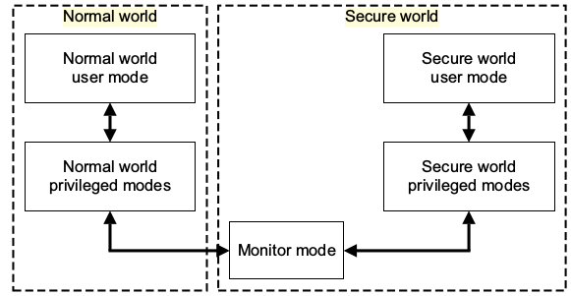
What is TrustZone?
TrustZone is a feature of the processor architecture, and it allows us to “hardware-separate” a rich operating system, from a much smaller, tiny, secure operating system.
Fig: Modes in an ARM core implementing the Security Extensions

Slide 3
Goal and Objective
To develop a VSF for ARM trustzone using OPTEE which will support any platform like Open Portable TrustZone ExecutionEnvironment(OPTEE),QualcommExecutionEnvironment(QEE) and XExecution Environment (X – Any) (XEE).

Slide 4
Requirements
OPTEE
Raspberry pi
Qemu

Slide 5
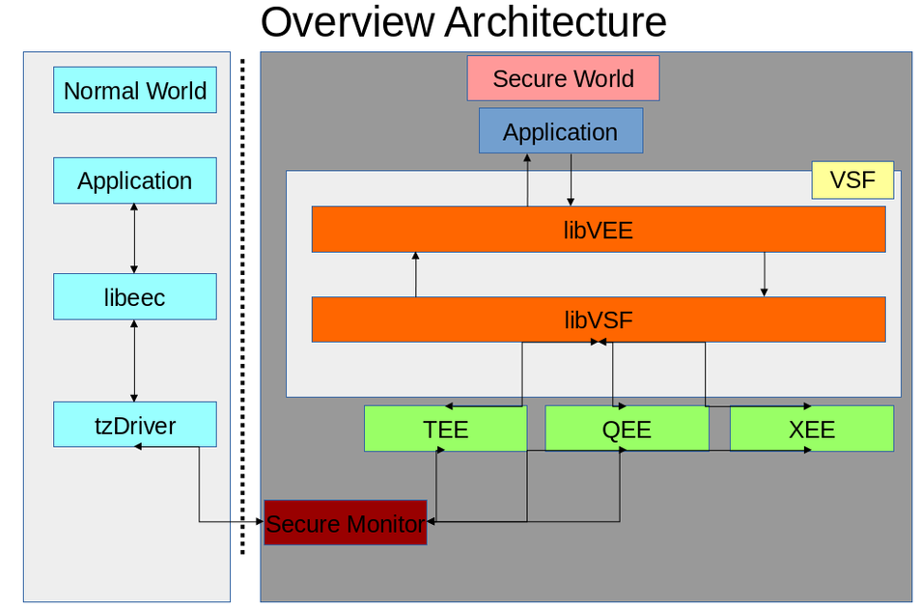
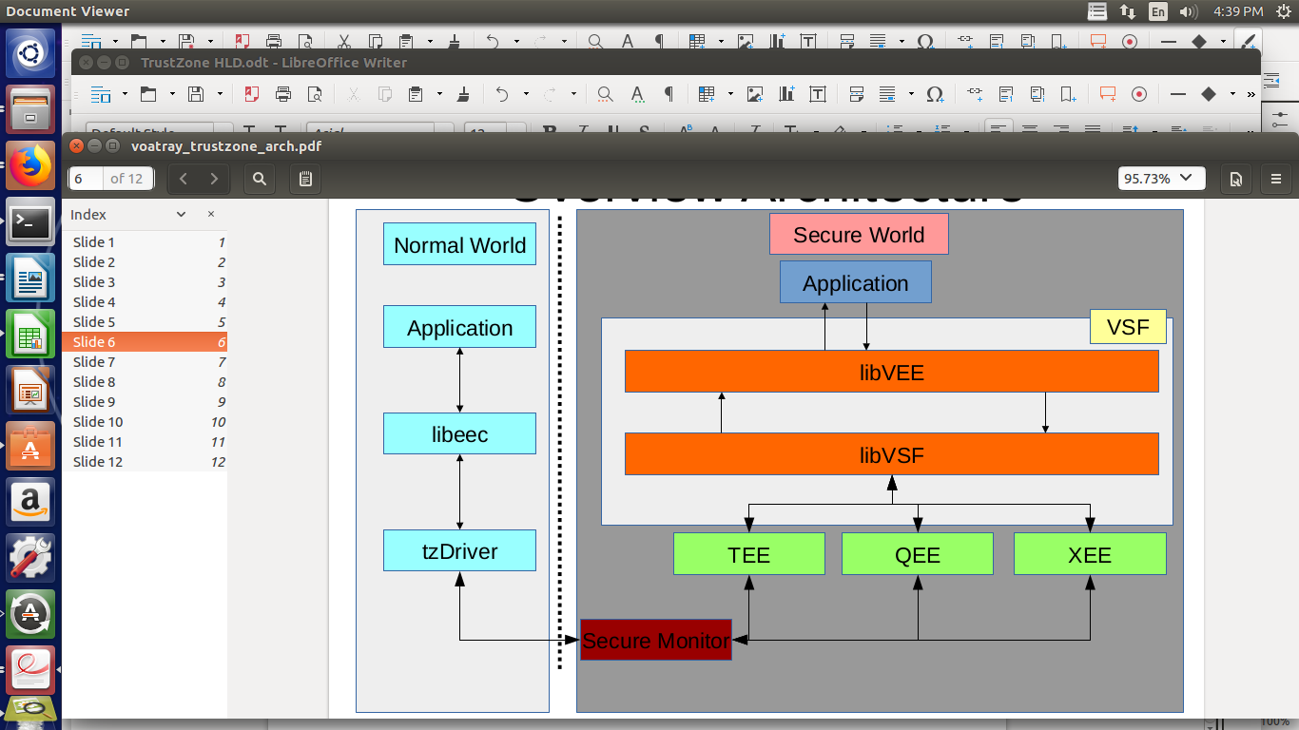

Slide 6
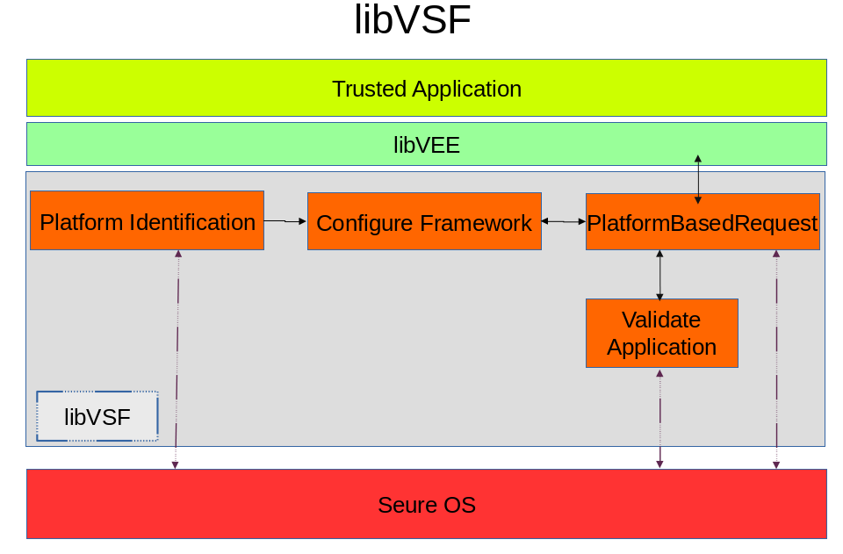

Slide 7
Platform Identification
Need of platform identification.
Get OS information from TA.
Get internal API’s used by global api.
Write code for platform identifying by using internal API’s.
Link platform information code to secure os library.
Call macros from application TA and observe OS information.
Call platform function in standard handler.

Slide 8
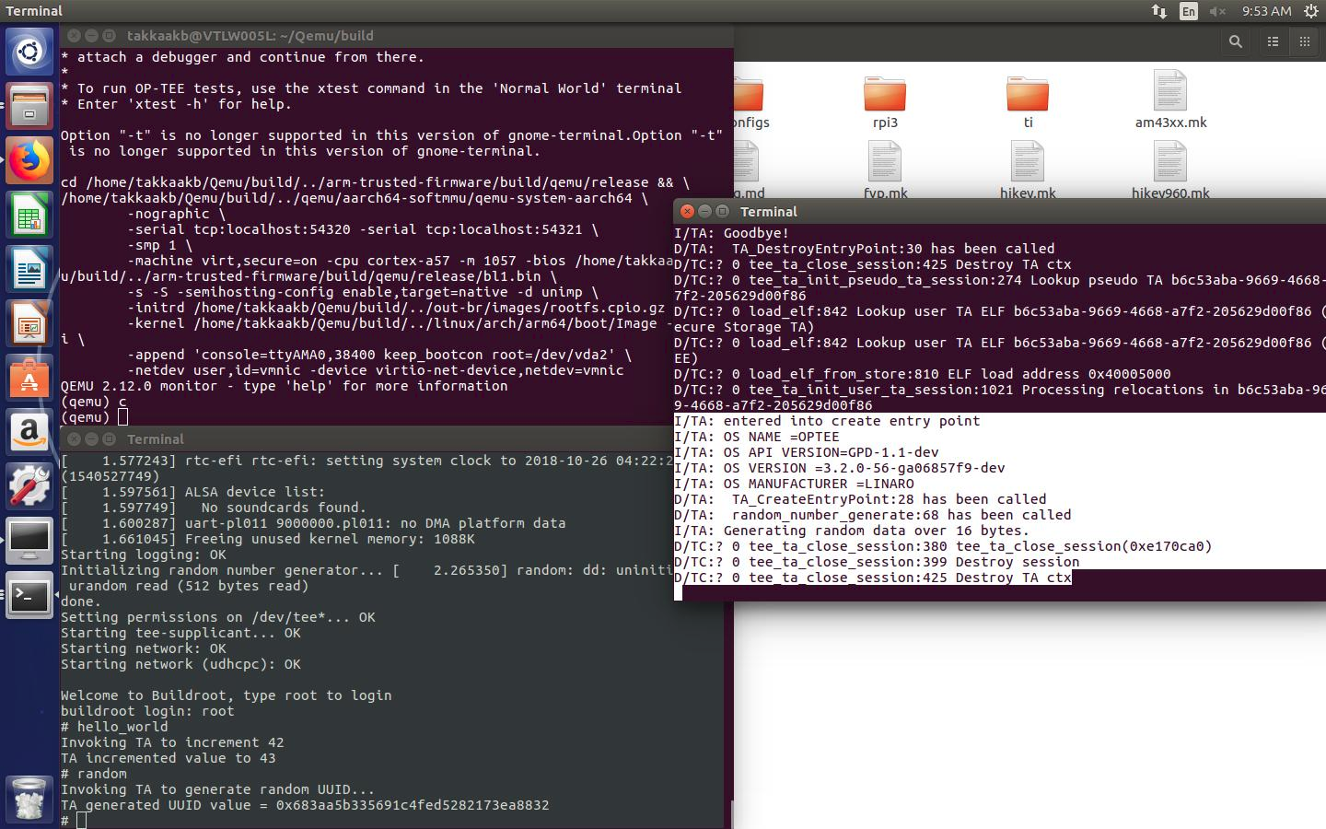

Fig:Platform Information Details

Slide 9
Framework Configuration
VSF
    LibVEE
    LibVSF
LibVEE contains all the VEE APIs for TA.
Breaking bond between OS and Application
Created structure to pass all the arguments to TA.
Mapping in framework configuration.

Slide 10
Triggaring Framework
Understood the code flow from Normal world to secure world.
Vector table:
optee_os/core/arch/arm/kernel/thread_a64.S
Handler:
optee_os/core/arch/arm/kernel/thread.c
Added interrupt handler.

Slide 11
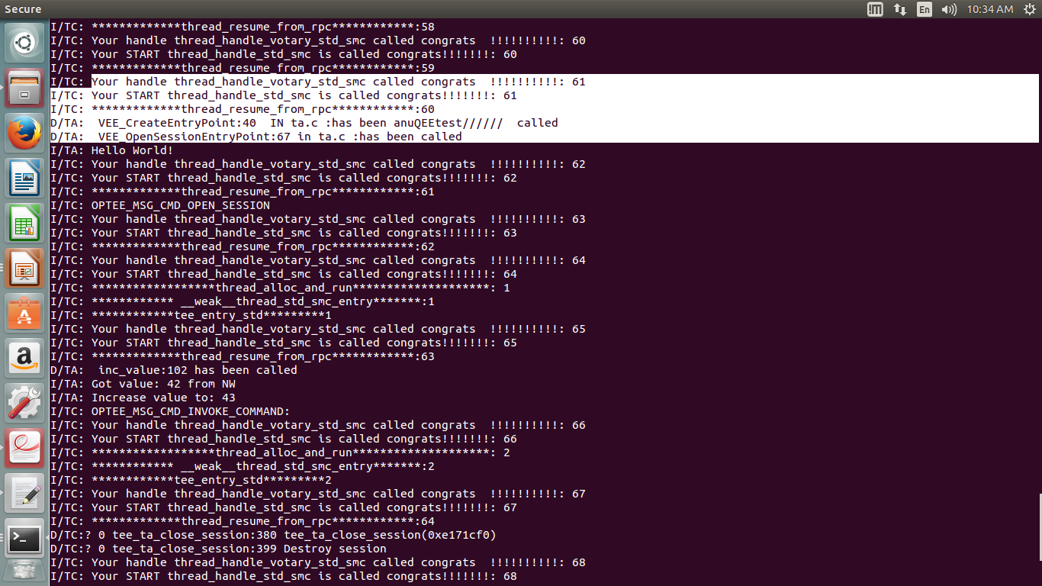

Slide 12
Conclusion
We have succeccfully created libVEE, It is working on OPTEE platform and tested properly. In libVSF platform identification has been done .

Slide 13
Thank you

