Slide 1
ARM Trustzone Votary Secure Framework
libVSF (Votary Secure Framework)

Slide 2
Review Histroy
S. No. | Updates | Version | Update | Created by
1. | 06/08/2018 | 0.1a | Initialial Draft | Alok Dubey
2. | 28/11/2018 | 0.1b | Adding flow diagram | Alok Dubey

Slide 3
Contents
S. No. | Content | Slide No.
1 | Acronym Used | 4
2 | Flow Diagram | 5
3 | Overview architecture | 6
4 | libVEE | 7
5 | libVFS | 8
6 | Platform Identification | 9
7 | Framework Configuration | 10
8 | Platform Based Request | 11
9 | Validate Application | 12
10 | Flow diagram app to secos | 13
11 | Flow diagram framework initialization | 14

Slide 4
Acronym Used
Acronym
NSW | Non Secure World
SW | Secure World
VSF | Votary Secure Framework
EE | Execution Environment
TEE | TrustZone Execution Environment
QEE | Qualcomm Execution Environment
XEE | X Execution Environment (X – Any)
VEE | Votary Execution Environment
EEC | Execution Environment Client

Slide 5
Call Flow Diagram
Application
NSW
SW
Application
VSF
Trustzone Lib
Trustzone EE
Trustzone Driver
Trustzone Kernel
Secure Monitor
Developed by Votary

Slide 6
Overview Architecture
Normal World
Secure World
Application
Application
VSF
libVEE
libeec
libVSF
tzDriver
TEE
QEE
XEE
Secure Monitor

Slide 7
libVEE
Trusted Application
VEE Core API
VEE Storage API
VEE Crypto API
VEE Time API
VEE Arthmetic API
VEE Customize API
libVEE
libVSF

Slide 8
libVSF
Trusted Application
libVEE
Platform Identification
Configure Framework
PlatformBasedRequest
Validate
Application
libVSF
Seure OS

Slide 9
Platform Identification

Slide 10
Framework Configuration

Slide 11
Platform Based Request

Slide 12
Validate Application

Slide 13
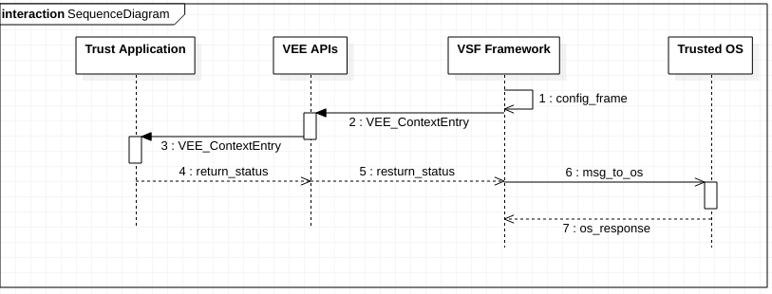
Flow diagram app to secos

Slide 14
Flow diagram framework initialization

