Slide 1
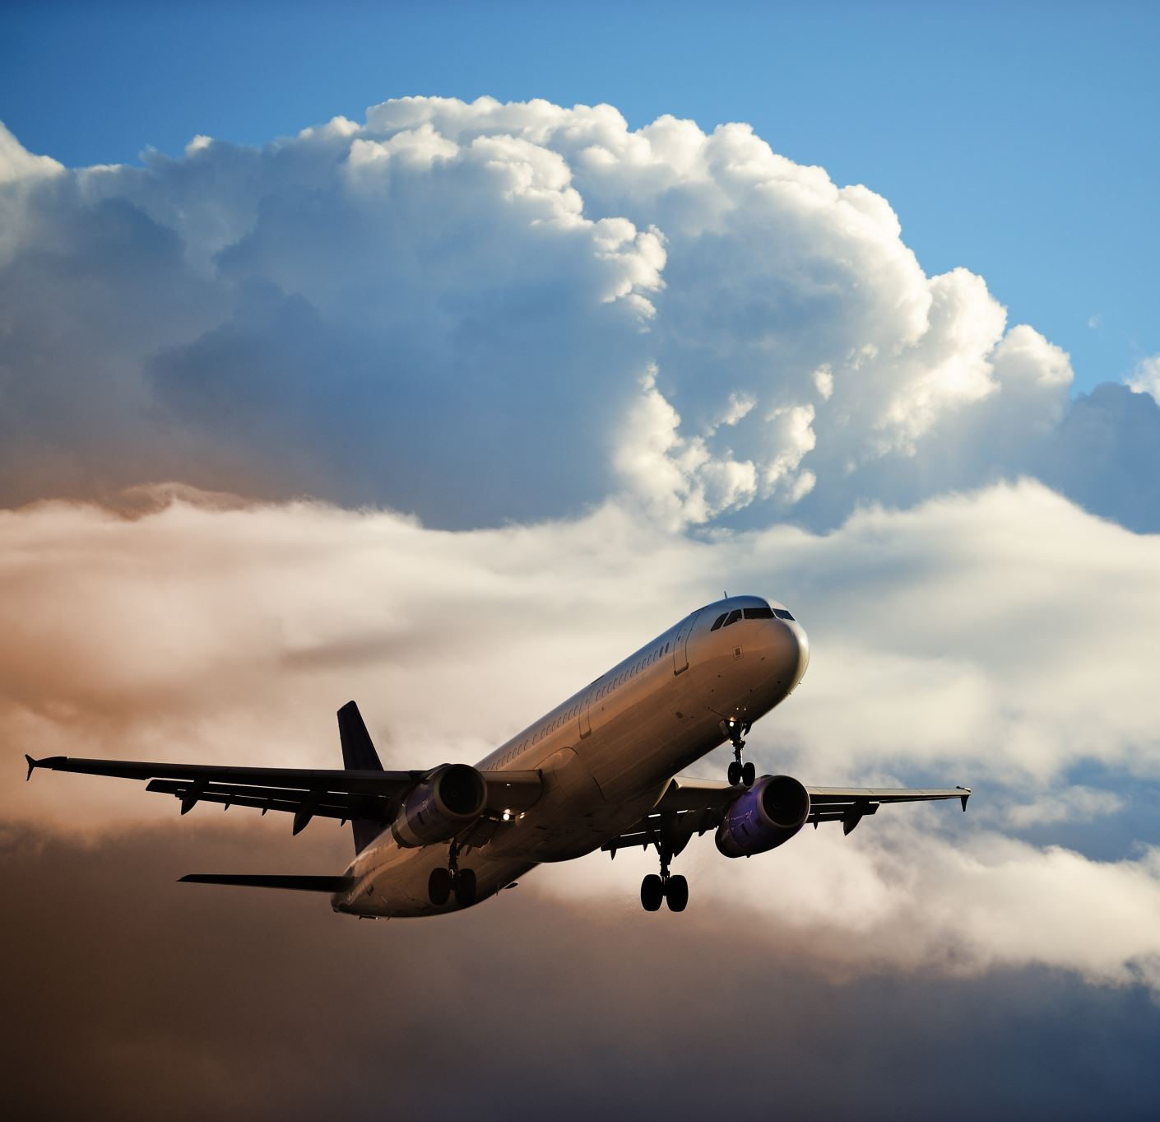
Flight fare Prediction
Anusha Maria Thomas 18BLC1117

Slide 2
Overview
This is a Flask web app which predicts fare of Flight ticket.

Slide 3
STEPS FOLLOWED
Model Training
Creation of application for deployment
Building a website using HTML and CSS

