Slide 1

EAST WEST INSTITUTE OF TECHNOLOGY BENGALURU-560091 (Affiliated to Visvesvaraya Technological University, Belgaum, Karnataka)
DEPARTMENT OF COMPUTER SCIENCE AND ENGINEERING
PROJECT PRESENTATION
ON
“ Multifunctional Vehicle Safety and Security Systems using IoT ”
BACHELOR OF ENGINEERING
IN
COMPUTER SCIENCE & ENGINEERING
Under the Guidance of
Prof Padmavathi B
Assistant Professor
Submitted By
ANUSHA JOSHI (1EW21CS017)
BINDUSHREE KM (1EW21CS029)
HARSHITHA R (1EW21CS054)
DEPARTMENT OF COMPUTER SCIENCE AND ENGINEERING

Slide 2
LIST OF CONTENTS
Introduction
Abstract
Literature survey
Problem statement
Objectives
Proposed System
Implementation
Snapshots
Conclusion
References

Slide 3
INTRODUCTION
Road safety is a critical global concern due to increasing accidents and traffic congestion. Traditional safety systems like locks and alarms have helped but lack integration and advanced functionality.
The project uses an ESP32 microcontroller to create a Multifunctional Vehicle Security System. It combines sensors for automatic light adjustment, accident detection, blind spot monitoring, and alcohol detection.
The system includes GPS for real-time tracking and Telegram-based emergency alerts. Bluetooth-enabled voice notifications keep drivers aware, enhancing overall safety.
The aim is to improve vehicle security, prevent theft, and promote responsible driving with an integrated smart safety system.
Dept of CSE,EWIT

Slide 4
ABSTRACT
The Multifunctional Vehicle Security System, powered by ESP32, integrates advanced sensors to enhance vehicle safety and driver alertness. It features high beam detection with automatic light dimming, accident detection with emergency alerts and GPS tracking, ultrasonic sensors for collision prevention, and alcohol monitoring to inhibit operation under the influence. An IR sensor detects one-handed operation and provides voice alerts, while relays enable adaptive control of vehicle functions like light intensity. This system promotes proactive and responsible driving through real-time monitoring, alerts, and advanced safety technologies.
2

Slide 5
LITERATURE SURVEY
TITLE | AUTHORS | YEAR | OBJECTIVES | ADVANTAGES | DISADVANTAGES
Intelligent Lighting Control System | Tan et al. | 2022 | Developed a lighting control system using LDRs and microcontrollers to detect oncoming headlights and automatically adjust light intensity. | Reduces glare from high beams and enhances road safety through automatic dimming. | Requires proper sensor calibration to avoid incorrect light adjustments
Vehicle Accident Detection System | Gupta et al | 2023 | Presented a vehicle accident detection system using an accelerometer to monitor sudden motion changes, triggering emergency alerts. | Improves emergency response times by automatically alerting services after an accident | May not detect accidents resulting from gradual vehicle tilting
Dept of CSE,EWIT

Slide 6
TITLE | AUTHORS | YEAR | OBJECTIVES | ADVANTAGES | DISADVANTAGES
Voice Alert Systems for Driver Communication | Liu et al. | 2023 | Explored voice alert systems to convey critical information to drivers, improving situational awareness without distraction | Delivers critical information to drivers without distracting them from their driving tasks. | Voice alerts may be missed in noisy environments, reducing their effectiveness.
Integrated Vehicle Safety Solutions | Patel et al. | 2024 | Discussed the benefits of integrating multiple sensor technologies into a cohesive vehicle safety framework to address various hazards. | Provides a comprehensive vehicle safety solution by addressing multiple hazards simultaneously. | Integration of multiple systems can be complex and expensive for vehicle manufacturers.
Dept of CSE,EWIT
4

Slide 7
PROBLEM STATEMENT
Modern vehicles face safety challenges such as distracted and impaired driving, inadequate blind spot monitoring, delayed accident response, and high beam glare. Activities like one-handed driving and alcohol consumption increase risks, while limited technologies fail to provide real-time detection, alerts, or proactive measures, compromising driver safety and situational awareness.
5

Slide 8
OBJECTIVES
High Beam Detection: To implement a Light Dependent Resistor (LDR) system that automatically adjust headlights and reduce glare from oncoming vehicles
Accident Detection: To utilize a tilt sensor to monitor the vehicle's orientation, enabling the system to detect accidents and trigger immediate alerts to emergency contacts, ensuring a quick response in critical situations.
Alcohol Detection: To integrate an alcohol detection sensor that evaluates the driver’s blood alcohol concentration, disabling vehicle operation if the alcohol level exceeds a predetermined threshold, thereby promoting responsible driving.
Voice Alerts: Enable Bluetooth communication for real-time driver notifications.
GPS Location Tracking: Send real-time location updates via Telegram to emergency contacts during critical situations.
Dept of CSE,EWIT

Slide 9
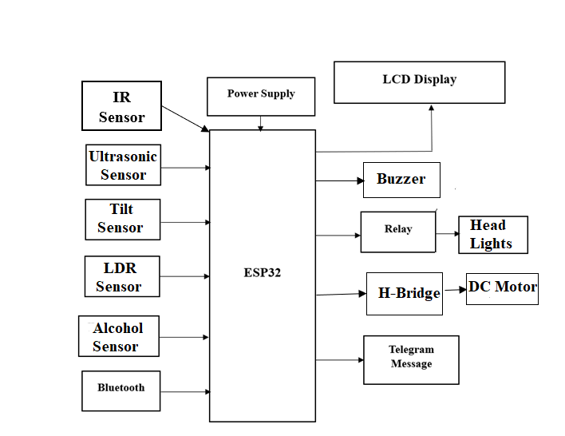
PROPOSED SYSTEM
7

Slide 10
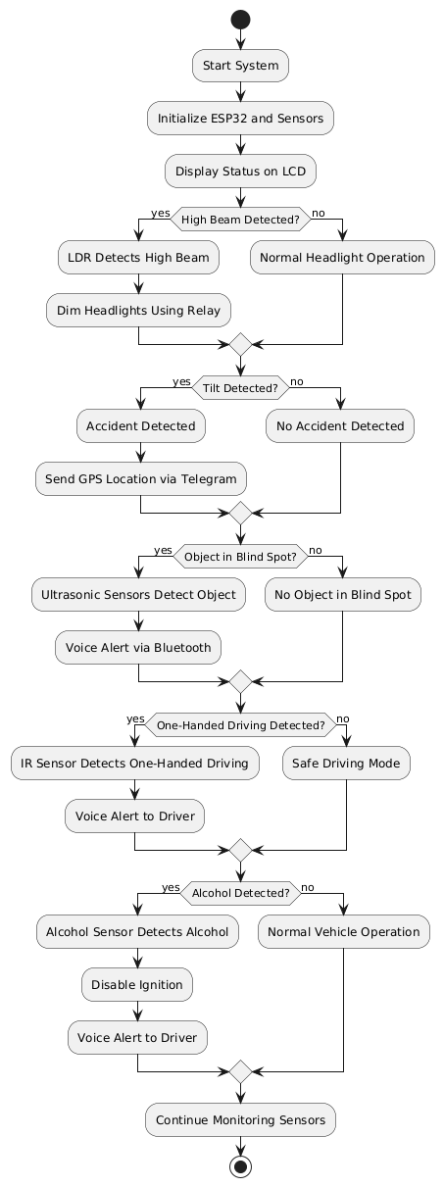
Flowchart:

Slide 11
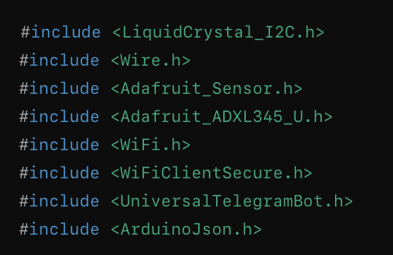
IMPLEMENTATION Include Libraries
CODE
Explanation
LiquidCrystal_I2C.h: Controls an I2C-based LCD display.
Wire.h: Manages I2C communication between components.
Adafruit_Sensor.h & Adafruit_ADXL345_U.h: Handle data from the ADXL345 accelerometer.
WiFi.h & WiFiClientSecure.h: Provide Wi-Fi connectivity and secure HTTPS communication.
UniversalTelegramBot.h & ArduinoJson.h: Enable communication with the Telegram bot and handle JSON data used in bot messages.
9

Slide 12
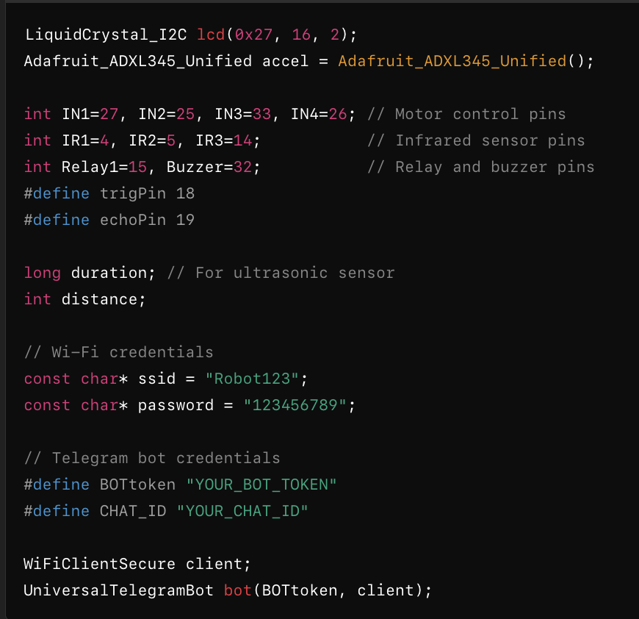
Initializing Components
CODE
Explanation
LCD and Accelerometer: Objects for controlling the LCD and accelerometer.
Pins: Assigns specific ESP32 pins for motors, sensors, relay, buzzer, and ultrasonic sensors.
Wi-Fi and Telegram Setup: Credentials for Wi-Fi and the Telegram bot are defined.
10

Slide 13
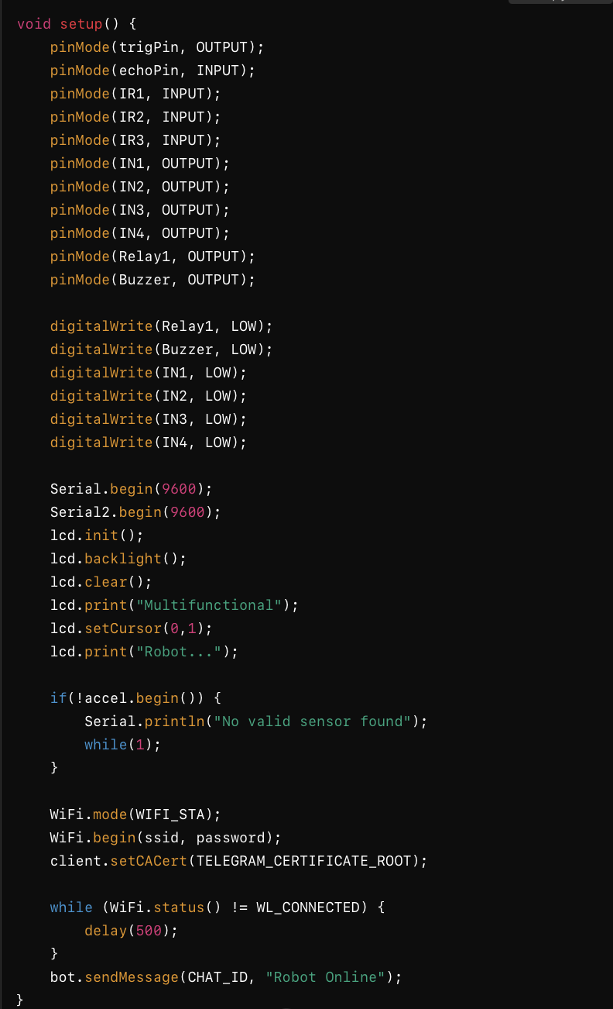
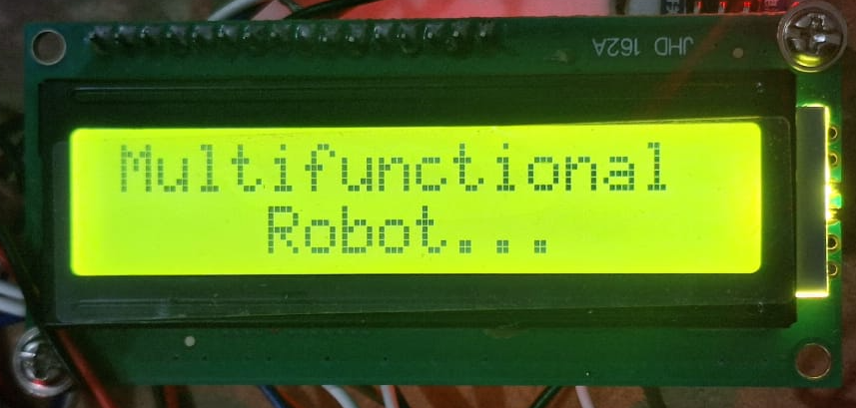
Setup Function
CODE
Explanation
Pin Configuration: Sets pins as input or output for sensors, motors, relay, and buzzer.
LCD Initialization: Displays a startup message.
Accelerometer Initialization: Checks if the ADXL345 is properly connected.
Wi-Fi Connection: Connects to Wi-Fi and sends a start message to the Telegram bot
OUTPUT:
( on LCD)
11

Slide 14
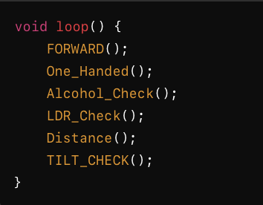
Main Loop
CODE
Explanation
Calls Subfunctions: The robot continuously performs tasks like checking for one-handed operation, alcohol levels, light, obstacles, and tilt.
12

Slide 15
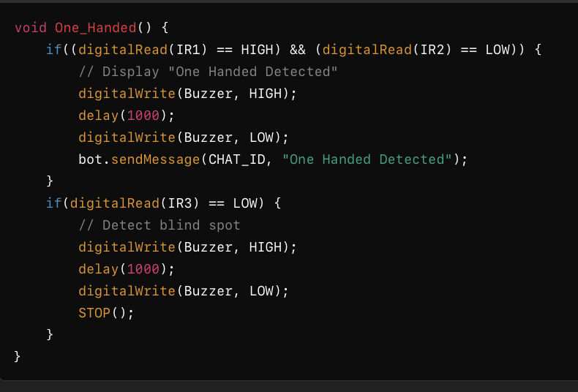
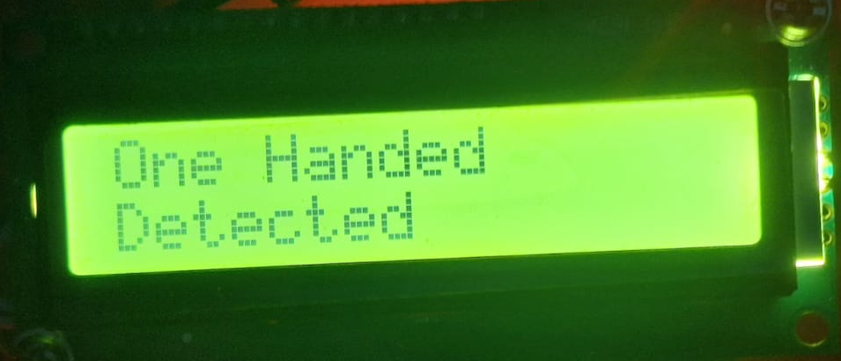
One-Handed Detection
CODE
Explanation
IR Sensors:Detect if one hand is detected or if a blind spot is present.
Actions: Triggers the buzzer, sends an alert, and stops if necessary.
OUTPUT:
( on LCD)
13

Slide 16
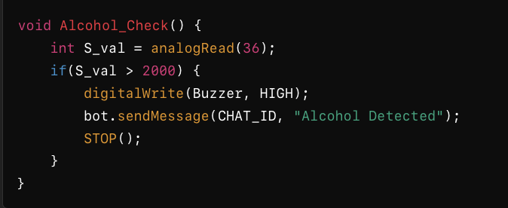
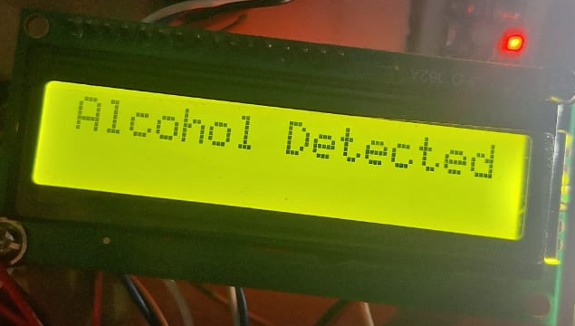
Alcohol Check
CODE
Explanation
Alcohol Sensor: Reads alcohol levels and stops the robot if they exceed the threshold.
OUTPUT:
( on LCD)
14

Slide 17
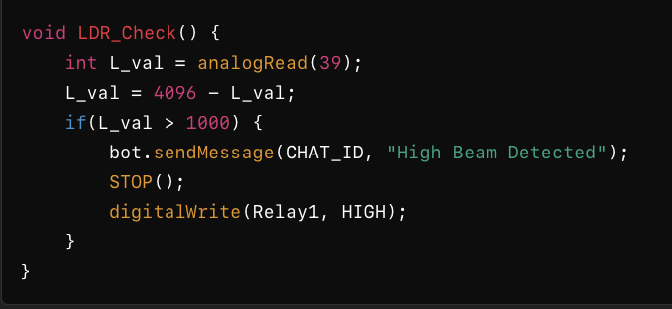
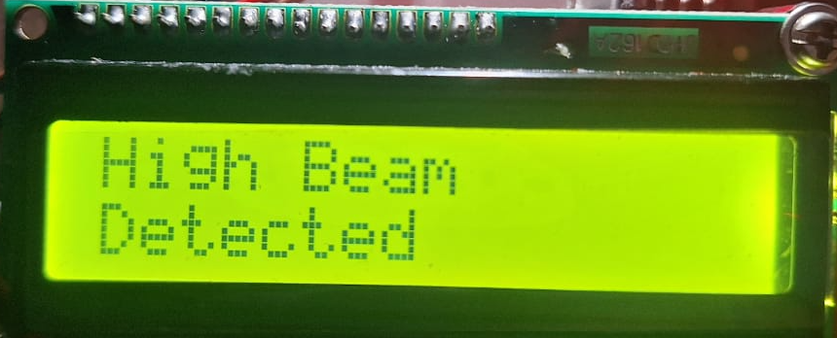
LDR Check
CODE
Explanation
Light Intensity: Detects high beams and sends a warning via Telegram.
OUTPUT:
( on LCD)
15

Slide 18
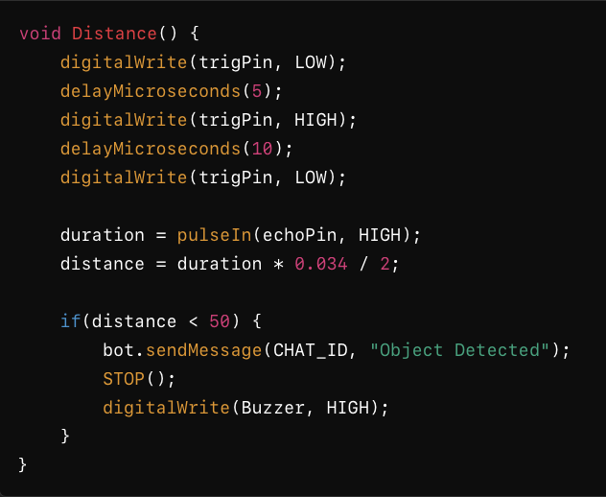
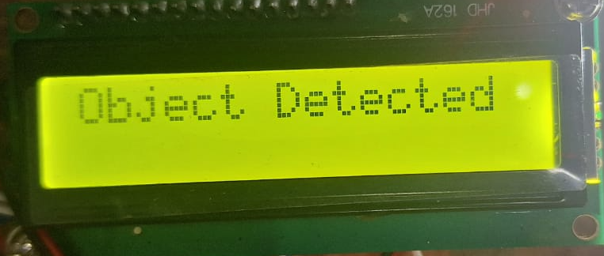
Distance Measurement
CODE
Explanation
Ultrasonic Sensor: Measures distance and stops if an obstacle is too close.
OUTPUT:
( on LCD)
16

Slide 19
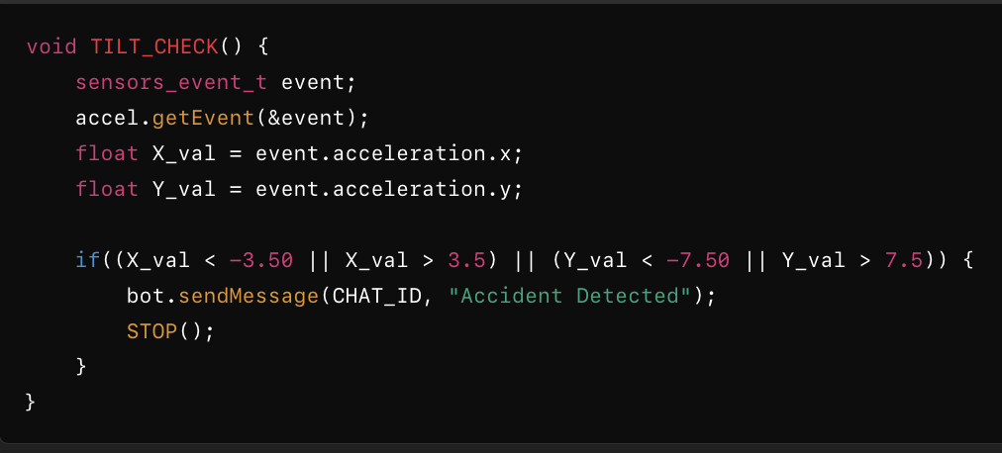
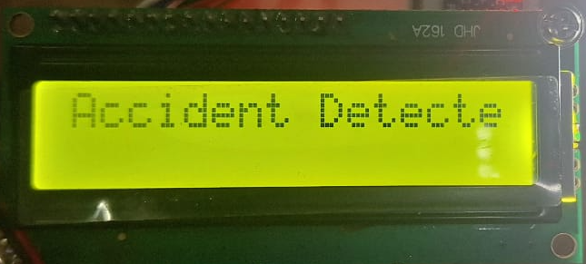
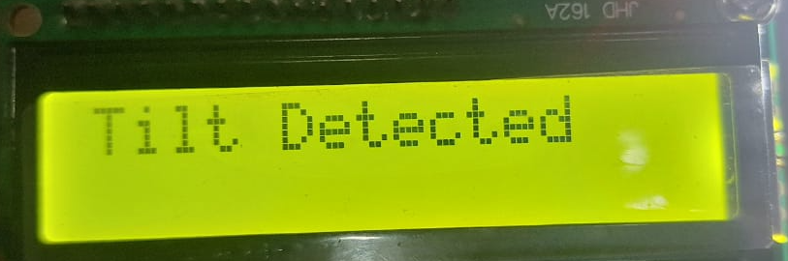
Tilt Detection
CODE
Explanation
Tilt and Accident Detection: Checks for unusual accelerometer values and sends accident alerts.
OUTPUT:
17

Slide 20
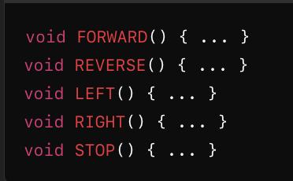
Motor Control Functions
CODE
Explanation
Movement Control: Defines motor states for forward, reverse, left, right, and stop.
18

Slide 21
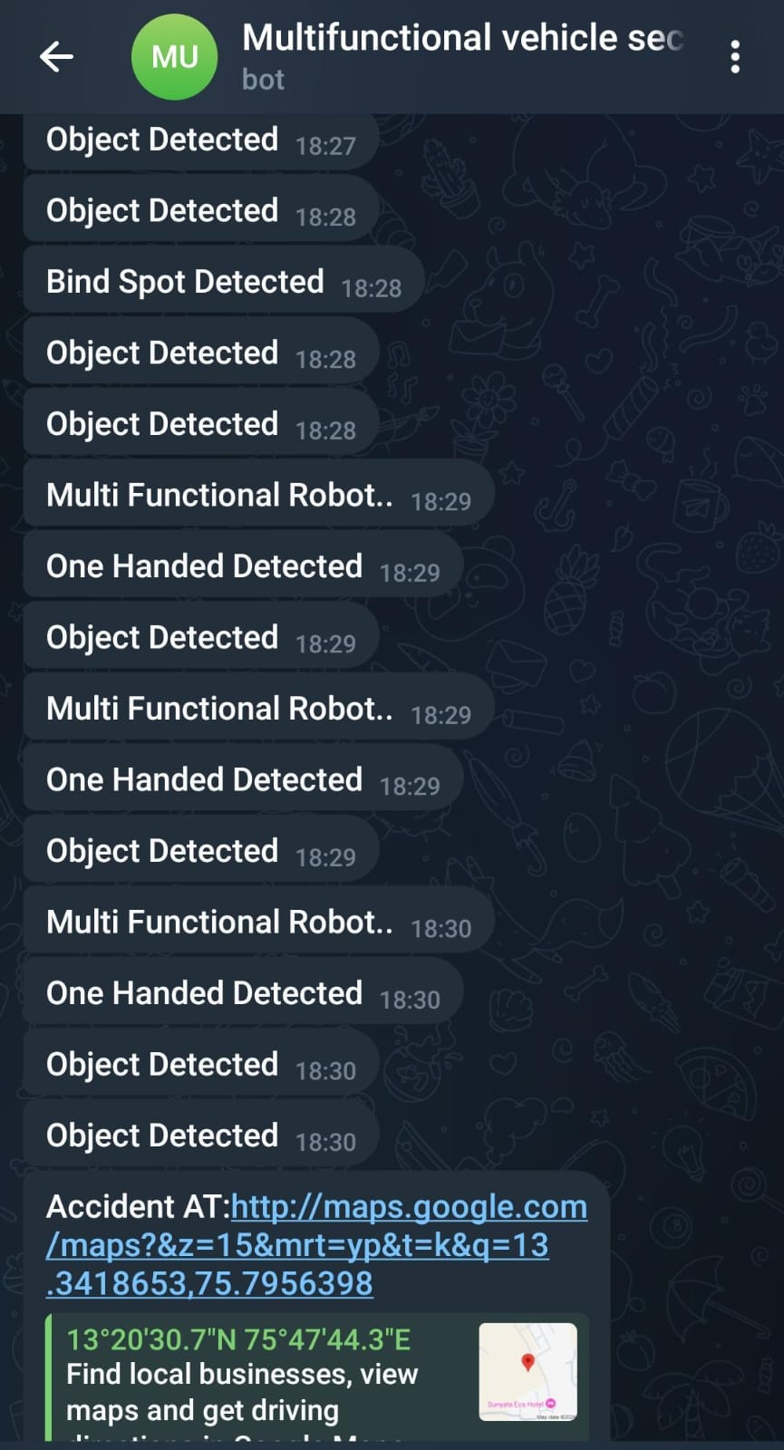
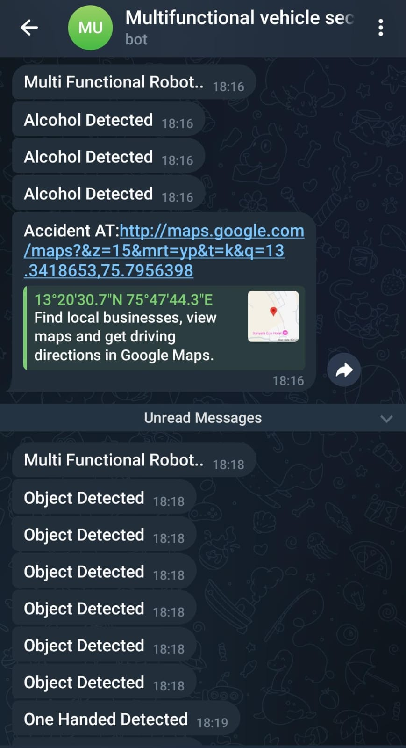
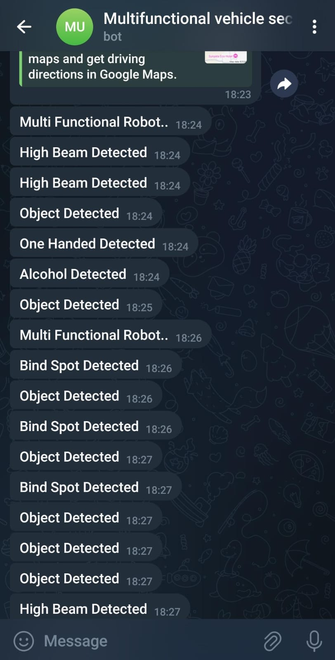
SNAPSHOTS
19

Slide 22
CONCLUSION
The Multifunctional Vehicle Security System combines advanced technologies like the ESP32 microcontroller, sensors, and real-time communication to enhance road safety and vehicle security. Features such as high beam detection improve visibility while reducing glare, and accident detection via tilt sensors alerts emergency contacts quickly, potentially saving lives. Ultrasonic sensors for object and blind spot detection improve driver awareness, reducing collision risks. The alcohol detection system promotes responsible driving, while Bluetooth voice alerts keep the driver informed without distraction. GPS tracking offers real-time location monitoring, enhancing security against theft. The system successfully integrates multiple safety and security features, demonstrating reliability and effectiveness in promoting safe driving and vehicle protection.
20

Slide 23
REFERENCES
[1] Tan et al., Sharma, P., & Singh, A. (2022). Development of an Intelligent Accident Detection system Using Accelerometer. International Journal of Vehicle Design, 84(1), 45-57. doi:10.1504/IJVD.2020.10020512
[2] Gupta et al., & Sethi, M. (2023). Object Detection and Blind Spot Monitoring in Vehicles Using ultrasonic Sensors. Journal of Automotive Engineering, 35(3), 175-186. doi:10.1177/09544070211004396
[3] Liu, Y., Chen, H., & Zhang, Q. (2023). Voice Alert Systems for Enhanced Driver Communication. transportation Research Part F: Traffic Psychology and Behaviour, 83, 169-180. doi:10.1016/j.trf.2022.04.00
[4] Patel, V., & Chavda, K. (2024). Integrated Vehicle Safety Solutions: A Review of Current technologies. International Journal of Automotive Technology, 24(2), 203-215. doi:10.1007/s12239-022-0023-x
Dept of CSE,EWIT

Slide 24
THANK YOU

