Slide 1
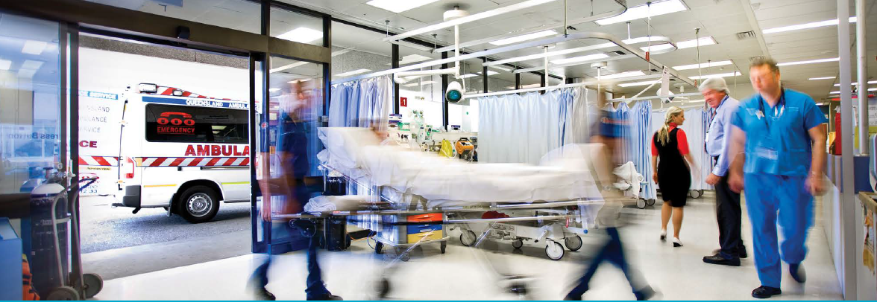

Predict whether a patient will be readmitted or not?
Presenter :
Anushi Shah

Slide 2
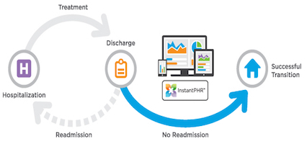
Hospital readmission : A hospitalization that occurs within 30 days after a discharge.
(Within 30 days)

Slide 3
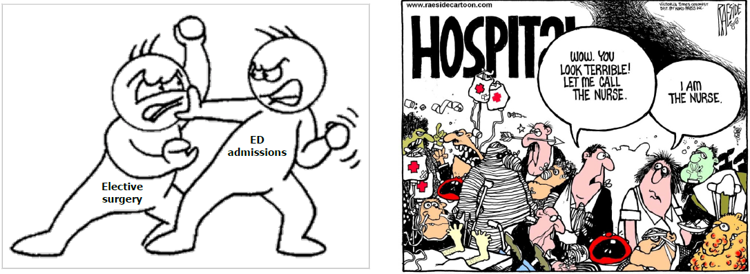
Why are readmissions a problem?
Huge cost burden
2011(US) – Readmissions cost $41 billion
High readmission rate – Poor quality of care
Increased wait times
Increased medical erros & negligence
Patient health at risk

Slide 4
Data set
Diabetes 130-US hospitals for years 1999-2008 Data Set
Center for Clinical and Translational Research, Virginia Commonwealth University
UCI Machine learning repository
101766 observations, 55 features

Slide 5
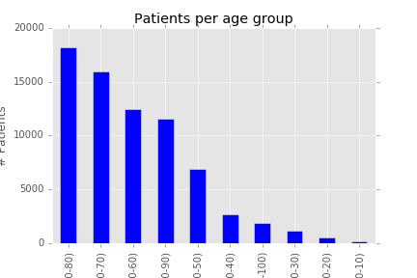
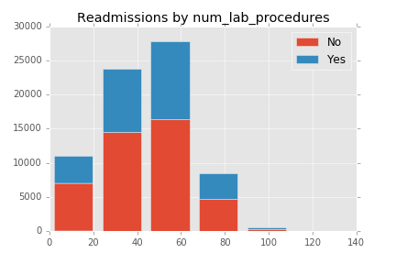
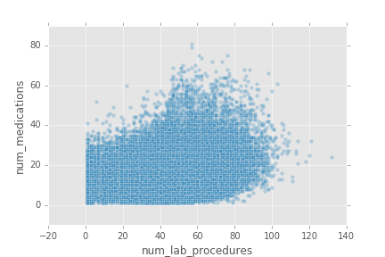
Data exploration

Slide 6
Data pre-processing
Drop :
irrelevant columns (Payer_code)
features with high % of missing values : weight (97%), medical_speciality (50%)
rows with missing values.
Transformation of categorical features
Use only first hospitalization per patient

Slide 7
Modelling Techniques
Total sample size : 71518
Split data set : Training(80%), Test(20%)
Target/Outcome : Readmitted (1/0)
Models :
- Logistic regression
- Decision trees
- Random Forest
- Xgboost

Slide 8
Results
Classifier | Accuracy
Logistic regression | 0.624
Decision Trees | 0.625
Random Forest | 0.62

Slide 9
Learning
Models
Statistical & theoretical concepts
Detailed level features may be helpful:
procedures (which ones, when performed)
medications (dose, duration)
BMI
medical speciality
Blood pressure
Electronic medical records with past history, family history

Slide 10
Future steps
Feature engineering & more investigation
Try other models
Try similar datasets
Dashboard

Slide 11
Thank You !!
☺
Life is not a piece of cake and so is machine learning.
Keep persisting!!

