Slide 1
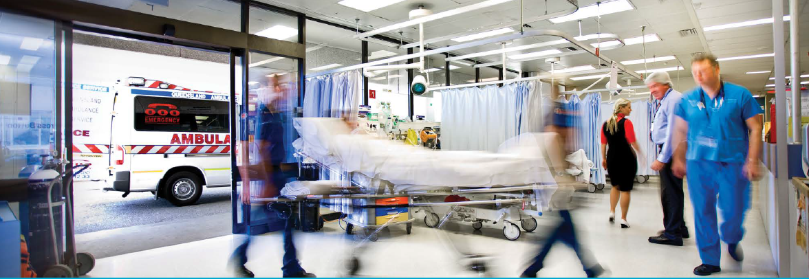
Predict whether a patient will be readmitted or not?
Presenter :
Anushi Shah

Slide 2
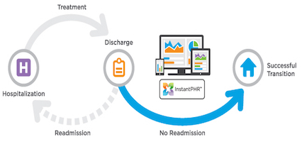
Hospital readmission : A hospitalization that occurs within 30 days after a discharge.
(Within 30 days)

Slide 3
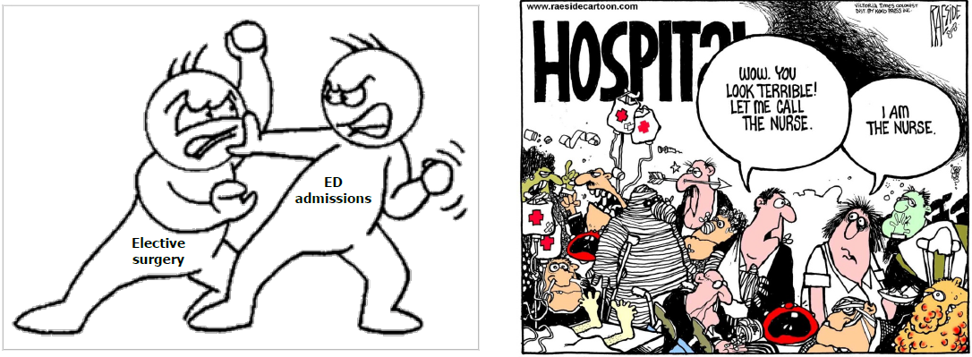
Why are readmissions a problem?
Huge cost burden
2011(US) – Readmissions cost $41 billion
High readmission rate – Poor quality of care
Increased wait times
Increased medical erros & negligence
Patient health at risk

Slide 4
Data set
Diabetes 130-US hospitals for years 1999-2008 Data Set
Center for Clinical and Translational Research, Virginia Commonwealth University
UCI Machine learning repository
101766 observations, 55 features

Slide 5
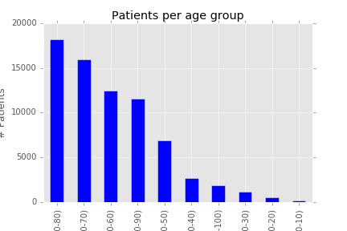
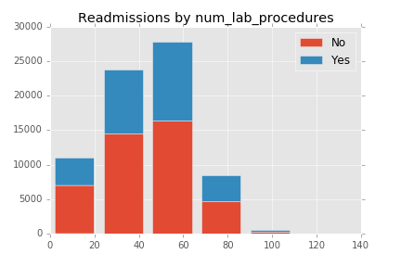
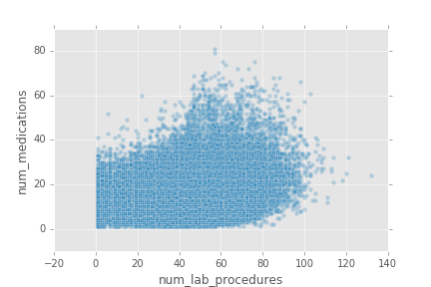
Data exploration

Slide 6
Data pre-processing
Drop :
irrelevant columns (Payer_code)
features with high % of missing values : weight (97%), medical_speciality (50%)
rows with missing values.
Transformation of categorical features
Use only first hospitalization per patient
Simplified goal (Balance distribution of classes)
Predict whether a patient would be ever readmitted?

Slide 7
Modelling Techniques
Total sample size : 71518
Features :
Split data set : Training(80%), Test(20%)
Target/Outcome : Readmitted (1/0)
Models :
- Logistic regression
- Regularized logistic regression
- Decision trees
- Random Forest
- Xgboost

Slide 8
Results
Classifier | Accuracy | AUC
Logistic regression
Regularized Logistic regression
Decision Trees
Random Forest
Xgboost
Add Graph here

Slide 9
Learning
Models
Statistical & theoretical concepts
Future steps
Feature engineering
Try other models
Dashboard

