Slide 1

ShelfLife
From a laptop to a monitored Kubernetes deployment: a DevSecOps capstone
Submitted By: Anushika Chauhan | Group-A | Roll Number: 10344
Notes:
Introduce yourself: Anushika Chauhan, Group-A. ShelfLife is a pantry and expiry tracker. The talk covers what was built, the architecture, then each DevOps layer with the real evidence: CI/CD, security scanning, Terraform on AWS, Kubernetes with Helm, GitOps with Argo CD, and Prometheus and Grafana.
1

Slide 2

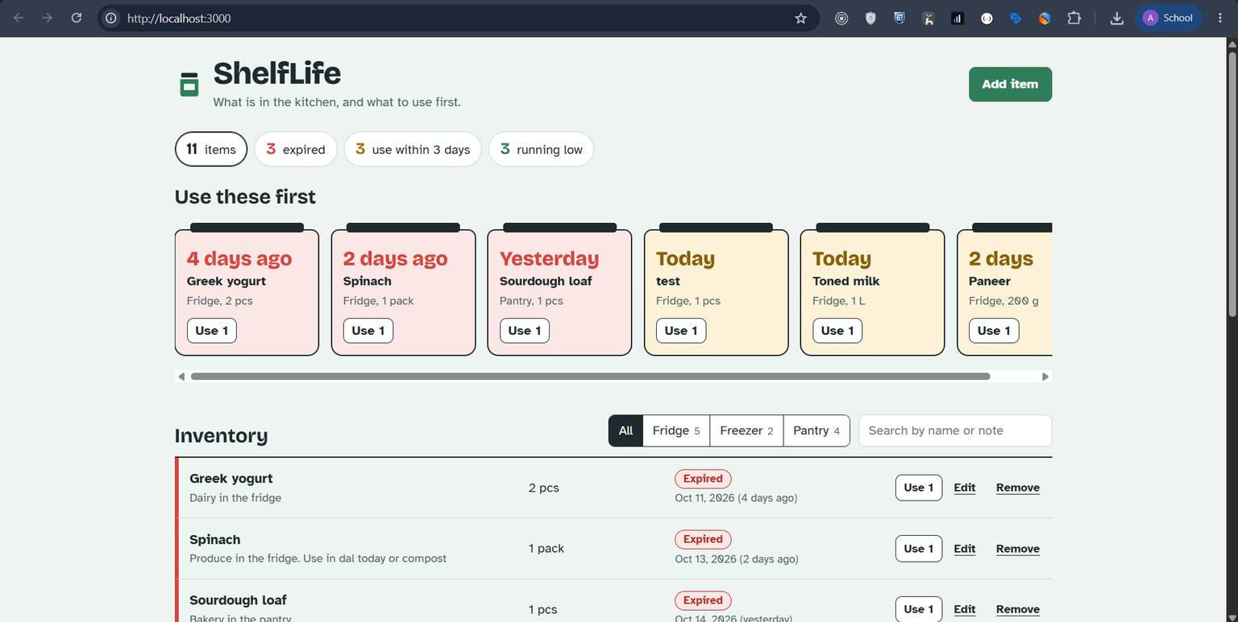
What ShelfLife does
Food goes off because nobody remembers what is at the back of the fridge.
ShelfLife running locally at http://localhost:3000 (Docker Compose)
  Record each item: where it is stored, how much is left, and its use-by date
  The "Use these first" shelf shows expired and soon-to-expire food first
  Counts and filters: expired, use within 3 days, running low
  "Use 1" updates the quantity; everything is saved in PostgreSQL
2
Notes:
Explain the product in plain words for a non-technical viewer. Data entered in the UI goes through the FastAPI backend into PostgreSQL and survives a refresh or restart.
2

Slide 3
Tech stack
Application
Quality
Containers
CI/CD
React 19 + Vite, FastAPI, PostgreSQL 17, SQLAlchemy, Alembic
pytest (17 tests), Ruff lint, migration check on Postgres
Multi-stage Dockerfiles, non-root users, Docker Compose
GitHub Actions, GitHub Container Registry, commit-SHA tags
Security
Cloud and IaC
Kubernetes
Operations
Trivy gate on both images (HIGH/CRITICAL fails the build)
Terraform, AWS VPC (2 public subnets), EKS 1.36, node group
Helm chart, Traefik Ingress, kind for local and CI
Argo CD (GitOps), Prometheus, Grafana
ShelfLife DevOps capstone
3
Notes:
One sentence per tile. Mention that every version is pinned in the repository and that Traefik replaced ingress-nginx because the ingress-nginx project was archived in 2026.
3

Slide 4
Architecture
The browser only calls relative /api paths. The Ingress sends / to the frontend and /api to the backend, so the same build works in Docker Compose, kind and EKS.
Frontend
Nginx + React, 2 pods
Argo CD
syncs Git to cluster
GitHub
chart + values
/
Browser
Ingress
Traefik
deploys
/api
Backend
FastAPI, 2 pods
PostgreSQL
StatefulSet + PVC
Prometheus
scrapes /metrics
Grafana
dashboard
ShelfLife DevOps capstone
4
Notes:
Walk the request path left to right, then the operations side: Prometheus scrapes the backend, Grafana reads Prometheus, Argo CD keeps the cluster equal to what is in Git.
4

Slide 5
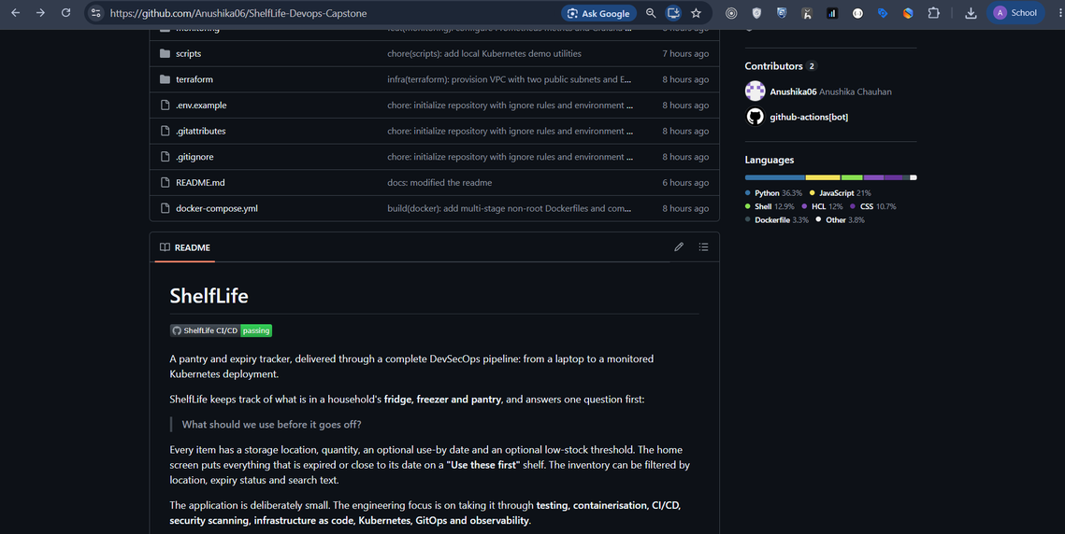
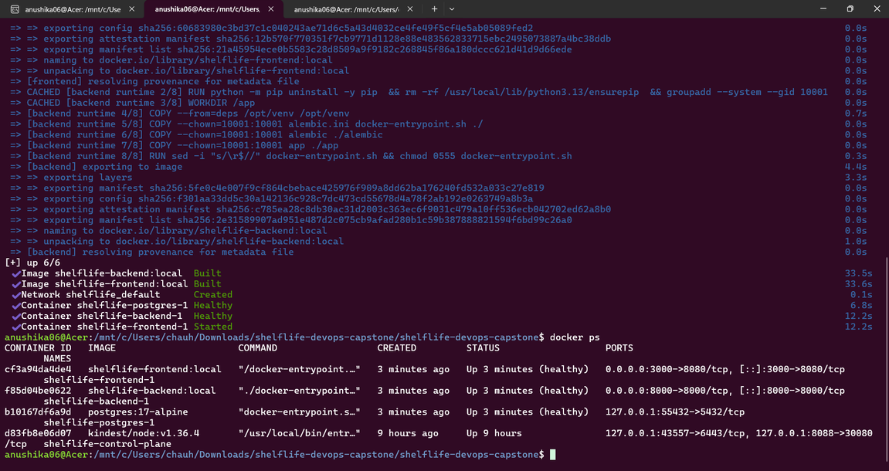
Codebase and local run
backend/ API, tests
frontend/ React UI
docker-compose.yml
.github/workflows/
terraform/ VPC + EKS
k8s/ namespaces
helm/ the chart
monitoring/ Prom + Grafana
argocd/ GitOps app
GitHub repository: folders, README and the passing CI badge
One command starts all three services:
docker compose up --build
ShelfLife DevOps capstone
5
docker compose up --build: postgres, backend and frontend healthy
Notes:
Show the folder structure and explain the design decisions: migrations owned by Alembic and run before the API starts, non-root containers, relative API paths.
5

Slide 6
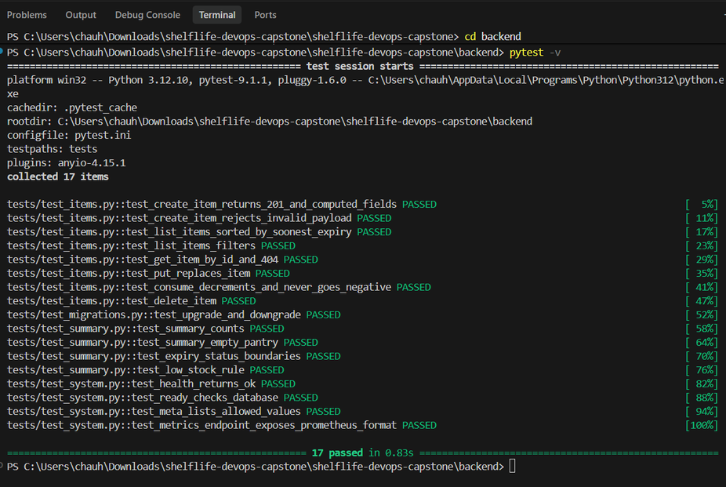
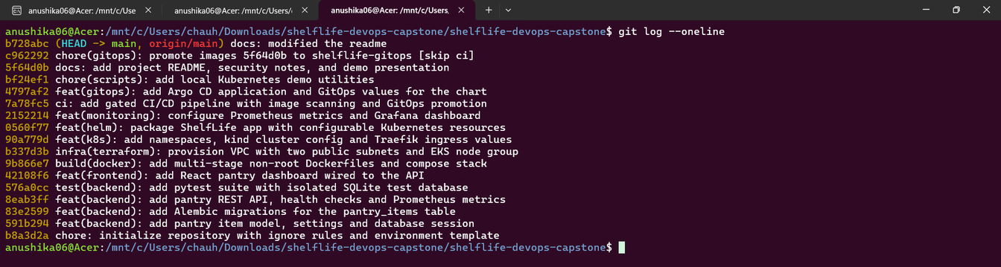
Testing and quality gates
17
5
0
pytest tests
API areas covered
tests touching the real DB
pytest -v: 17 passed
  conftest.py swaps DATABASE_URL to a temporary SQLite file before the app loads
  Covers health, readiness, items CRUD, consume, summary, metrics and migrations
  CI also runs alembic upgrade, downgrade and upgrade on a real PostgreSQL 17
  Ruff lint and format check fail the build like a failing test
git log --oneline: meaningful, phased commits
ShelfLife DevOps capstone
6
Notes:
Tests are the first gate: if one fails, no image is built or pushed. The screenshot shows pytest -v with all 17 tests passing against the isolated SQLite test database. The commit history shows the project built in phases with conventional commit messages.
6

Slide 7
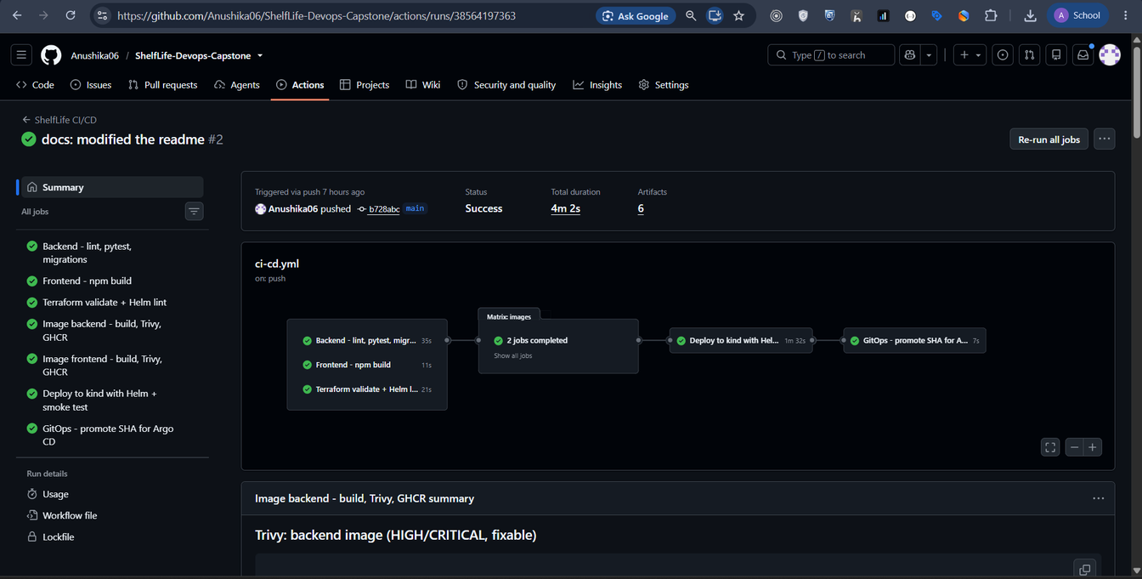
CI/CD pipeline
Test
pytest, Ruff, Alembic
Build
frontend + 2 images
Scan
Trivy gate
Publish
GHCR :git-sha
Deploy
kind + Helm + smoke
Promote
SHA into Git
Runs on every push to main. Each job needs the previous one, so a failed test or a HIGH/CRITICAL CVE stops the image from ever reaching the registry.
Images are tagged only with the commit SHA, never latest.
Run #2 on main (commit b728abc): all 7 jobs green, 4m 2s
ShelfLife DevOps capstone
7
Notes:
Trigger a push live, show the run starting, and narrate the jobs. Point out the needs chain and the SHA tag.
7

Slide 8
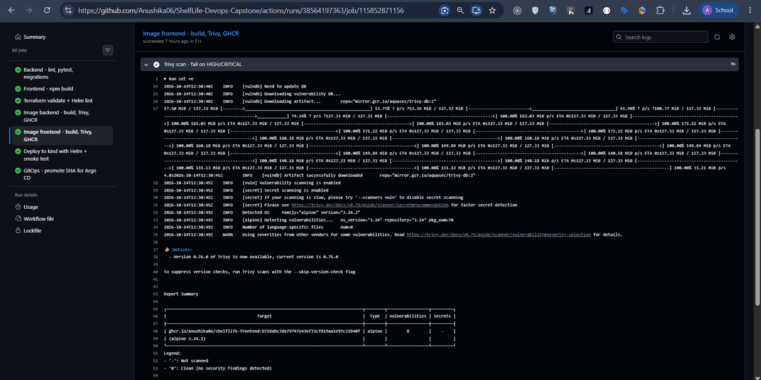
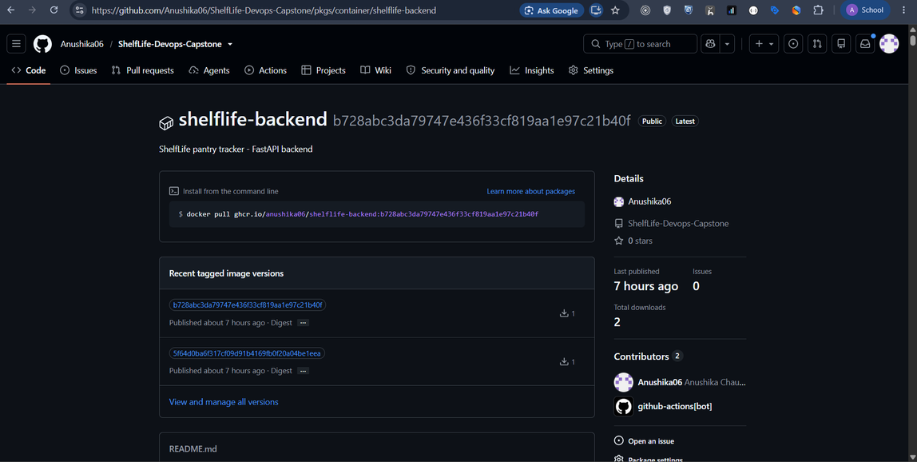
DevSecOps: Trivy and GHCR
  trivy image --severity HIGH,CRITICAL --ignore-unfixed --exit-code 1 runs on both images before the push
  Pipeline run #2 (commit b728abc): no fixable HIGH/CRITICAL findings in either image, so both were pushed
  During development a local scan found 4 HIGH in pip's vendored libraries; pip is now removed from the runtime image
  GHCR login uses the built-in GITHUB_TOKEN; images are tagged with the full commit SHA
Trivy on the frontend image: alpine 3.24.2, 0 vulnerabilities
GHCR shelflife-backend: tags are commit SHAs
ShelfLife DevOps capstone
8
Notes:
Trivy scanned the OS packages and the Python dependencies inside both images built for commit b728abc. It found no HIGH or CRITICAL vulnerabilities with a fix available, so the gate passed and the images were pushed to GHCR. Unfixed findings are excluded and re-checked on every build. Note: the 'Latest' badge on the GHCR page is GitHub marking the newest version, not a 'latest' tag. The next slide shows the backend scan and the frontend package.
8

Slide 9
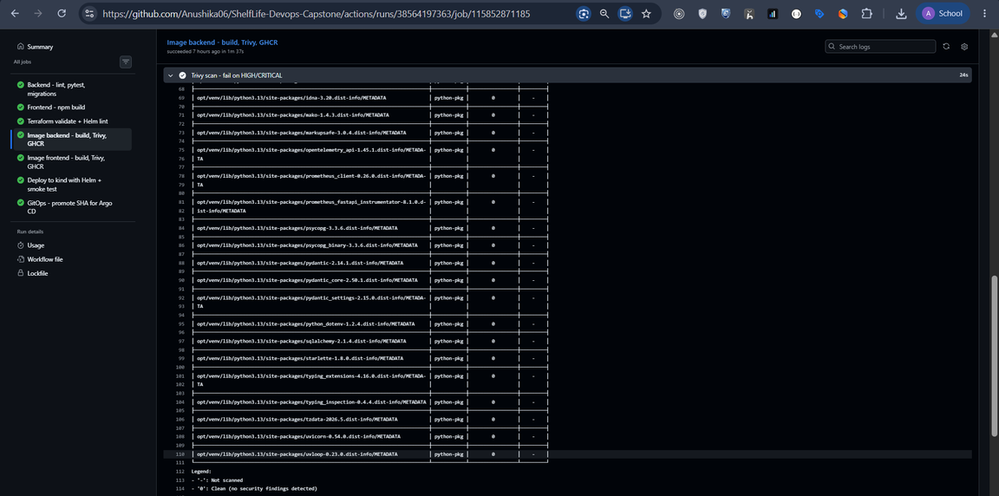
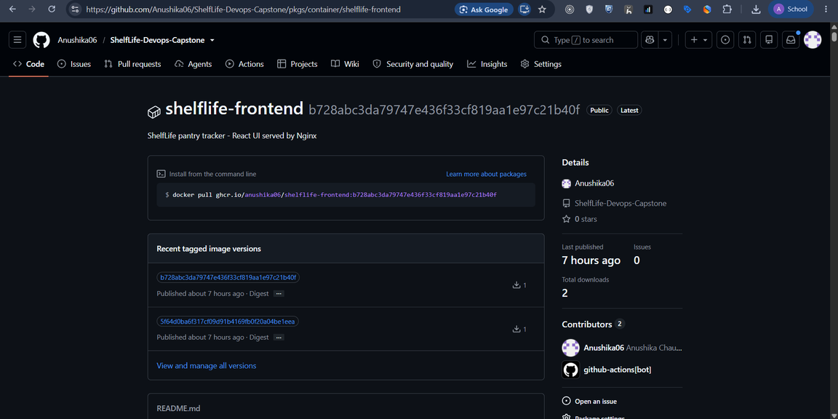
Security evidence for both images
Trivy on the backend image: every Python package 0 findings
GHCR shelflife-frontend: same SHA tag as the backend
Same pipeline run #2 (commit b728abc): neither image had a fixable HIGH or CRITICAL vulnerability, so the gate passed.
Both packages carry the identical 40-character commit SHA tag, so every running container traces back to one commit.
ShelfLife DevOps capstone
9
Notes:
Left: the backend Trivy step from the same pipeline run; every Python package in the virtualenv reports 0 findings. Right: the frontend package in GHCR with the same commit-SHA tags as the backend, so both images of a release are traceable to one commit.

Slide 10
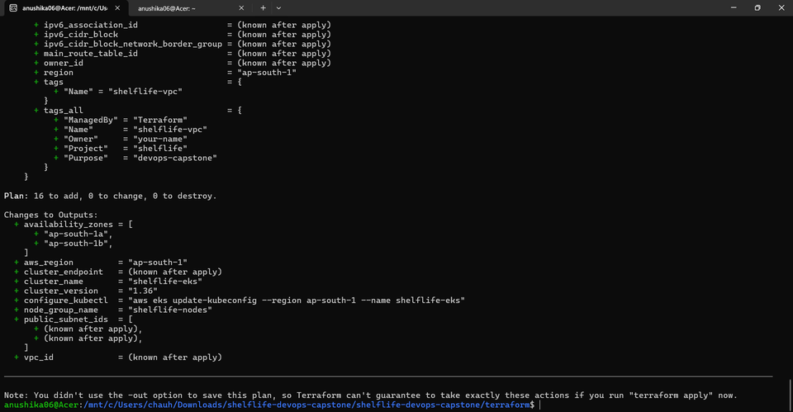
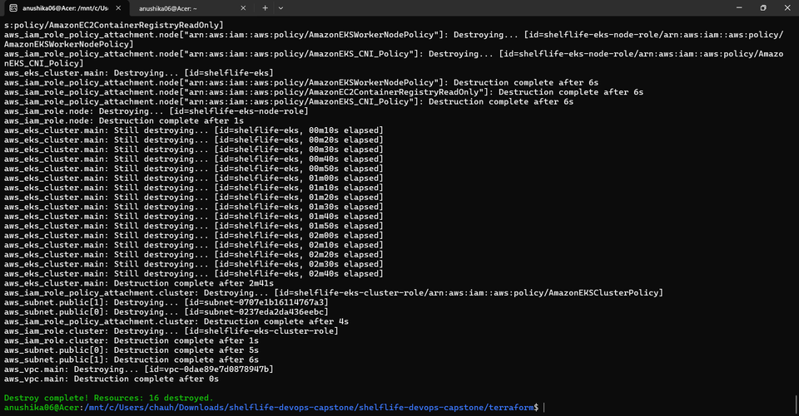
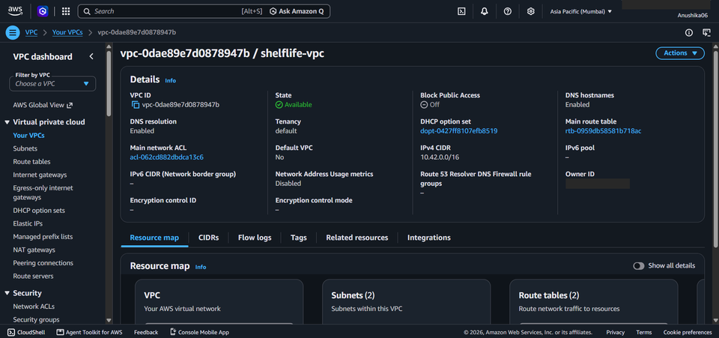
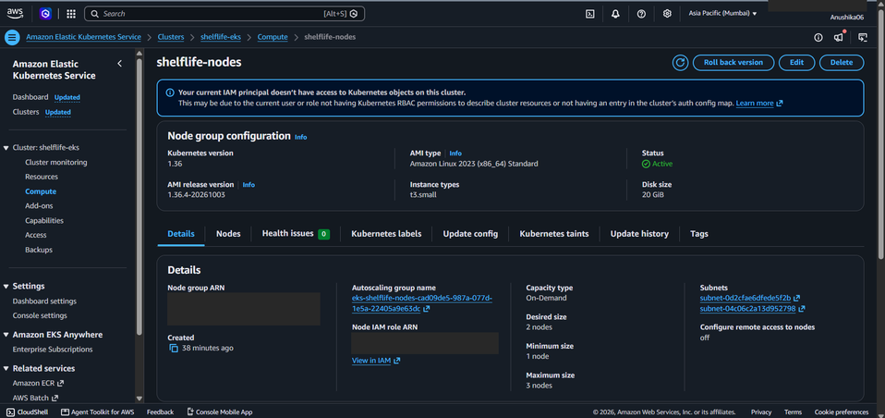
Infrastructure as code on AWS
VPC 10.42.0.0/16 (ap-south-1)
Public subnet A
AZ 1
Public subnet B
AZ 2
EKS 1.36 control plane
standard support only
terraform plan: 16 to add
terraform destroy: 16 destroyed
Managed node group
2 x t3.small (evidence run)
No NAT gateway, no control-plane logging, local state. Destroyed right after the evidence was captured.
shelflife-vpc, 10.42.0.0/16
EKS node group shelflife-nodes Active
ShelfLife DevOps capstone
10
Notes:
terraform plan created 16 resources in ap-south-1: the VPC, two public subnets, internet gateway, route table, IAM roles, the EKS 1.36 cluster and a managed node group. For the evidence run the node group used 2 x t3.small (the code default is t3.medium). Cost decisions: public subnets instead of a NAT gateway, standard support policy, and terraform destroy immediately after capturing the evidence. If you checked Billing, state the real cost; do not estimate. AWS account IDs are masked in these slides.
9

Slide 11
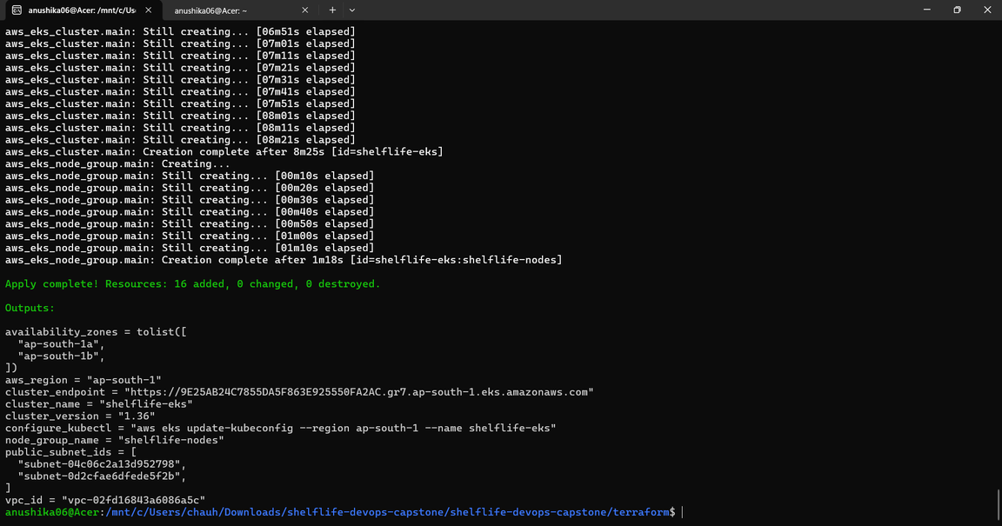
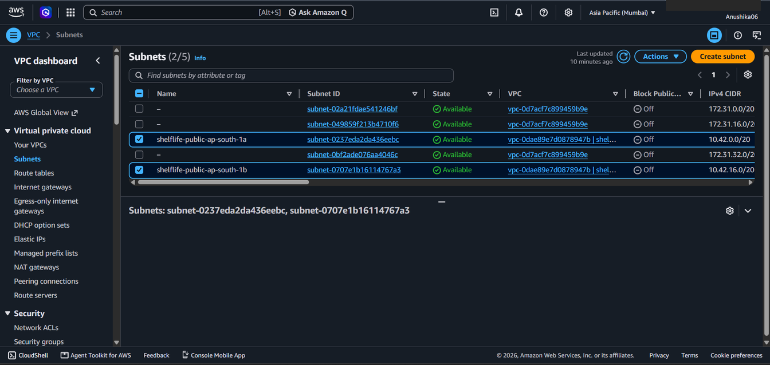
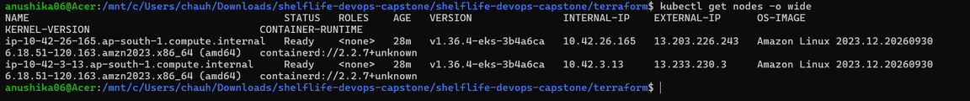
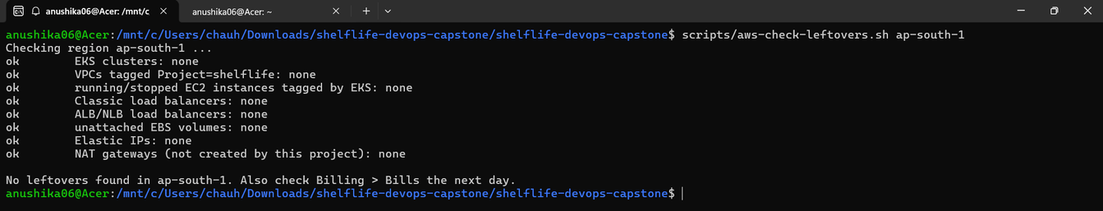
AWS evidence: apply, subnets, nodes, teardown
terraform apply: 16 added, outputs
Two public subnets in ap-south-1a and ap-south-1b
kubectl get nodes on EKS: 2 nodes Ready
scripts/aws-check-leftovers.sh: no leftovers after destroy
ShelfLife DevOps capstone
11
Notes:
Supporting AWS evidence: the apply output with the cluster and subnet outputs, the two public subnets in two availability zones, both EKS worker nodes Ready, and the read-only leftover check after terraform destroy showing no clusters, VPCs, instances, load balancers, volumes or IPs left.

Slide 12
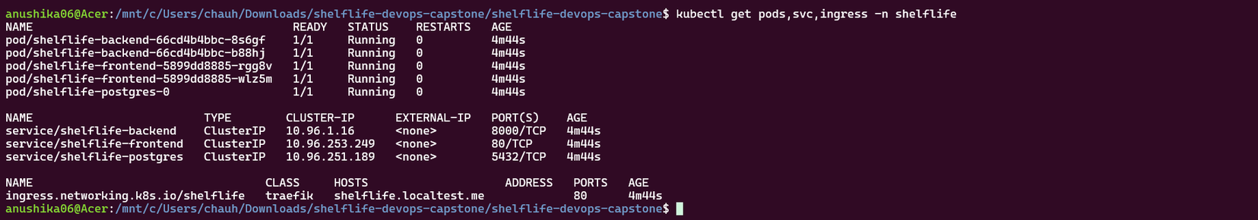
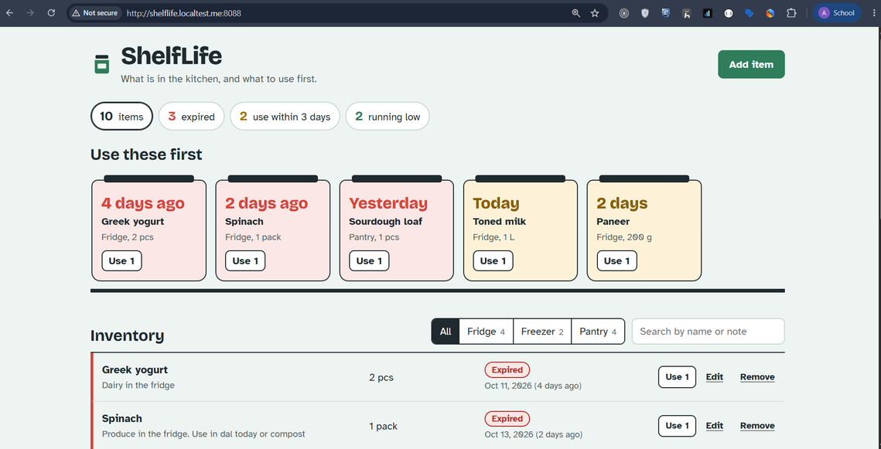
Kubernetes and Helm
kind cluster: pods Running, ClusterIP services, Ingress, helm list (deployed)
  k8s/namespace.yaml creates the shelflife and shelflife-gitops namespaces
  helm upgrade --install deploys 2 backend + 2 frontend pods and PostgreSQL
  ClusterIP Services; Ingress routes / to frontend and /api to backend
  Probes, non-root, read-only filesystem, PodDisruptionBudgets, helm test
  Image tags are required values: the chart refuses to render without a SHA
http://shelflife.localtest.me:8088 through the Traefik Ingress
ShelfLife DevOps capstone
12
Notes:
This is the local Kubernetes deployment on kind: 2 backend, 2 frontend and 1 PostgreSQL pod Running, ClusterIP services, the Ingress for shelflife.localtest.me and the Helm release deployed. The app opens through the Ingress on port 8088. The same chart has values-eks.yaml for EKS, but the application evidence here is from kind.
10

Slide 13
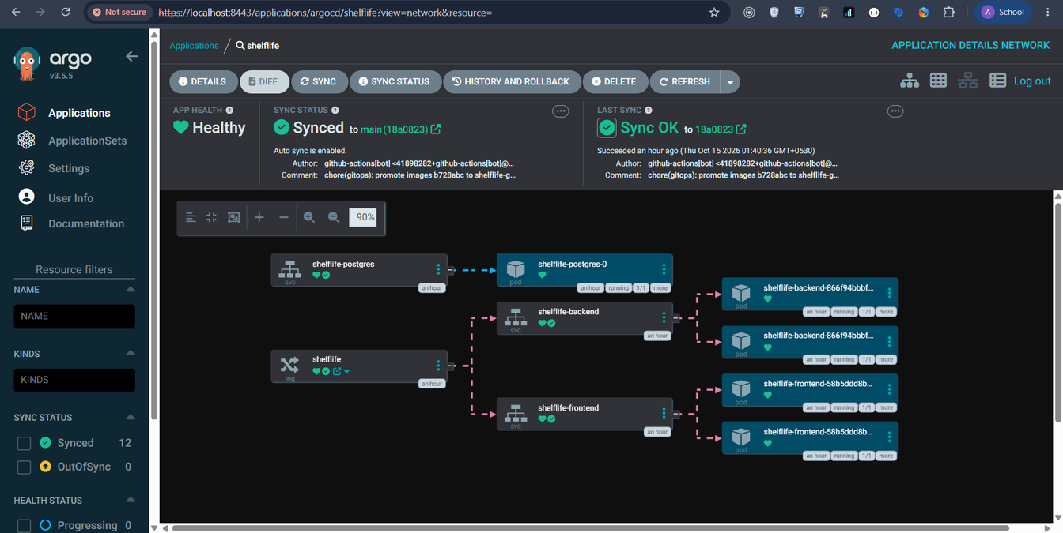
GitOps with Argo CD
git push
CI builds and scans
Argo CD syncs shelflife-gitops
Commit SHA to values-gitops.yaml
Git is the desired state. Automated sync with prune and self-heal: a manual kubectl change is reverted to what Git says.
Argo CD: shelflife Healthy and Synced to main (18a0823), auto sync on
ShelfLife DevOps capstone
13
Notes:
Show the synced application, then demonstrate the GitOps flow: push a change, the pipeline commits the new SHA, Argo CD rolls it out. Optionally scale a deployment by hand and watch self-heal revert it.
11

Slide 14
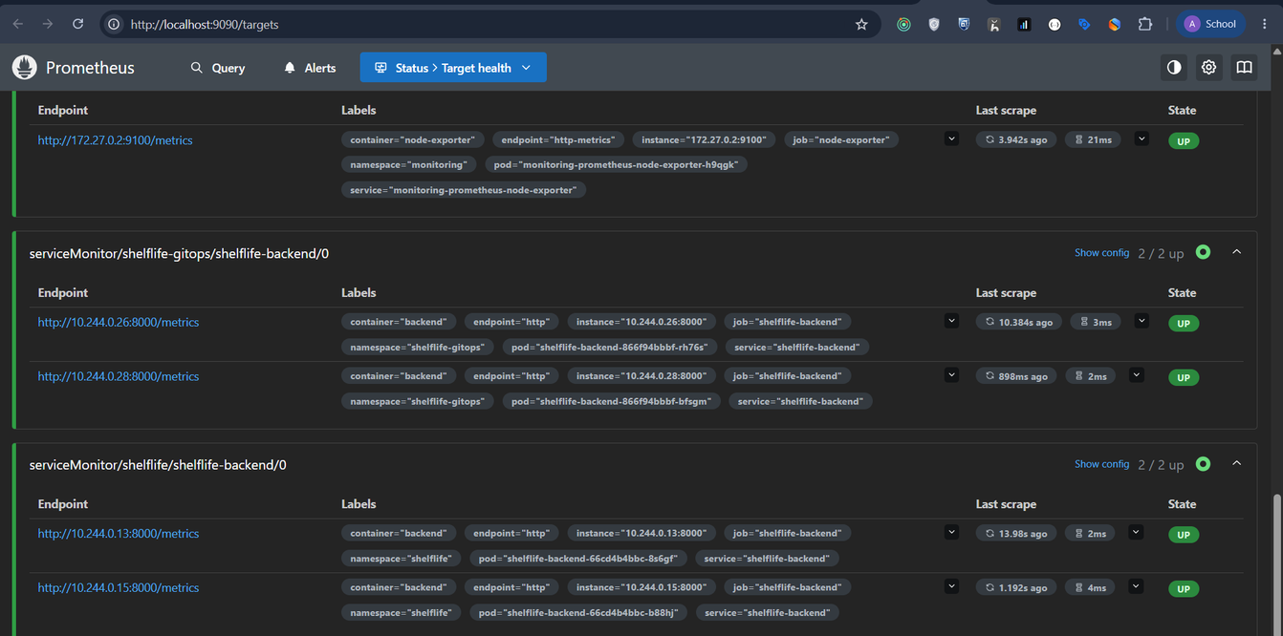
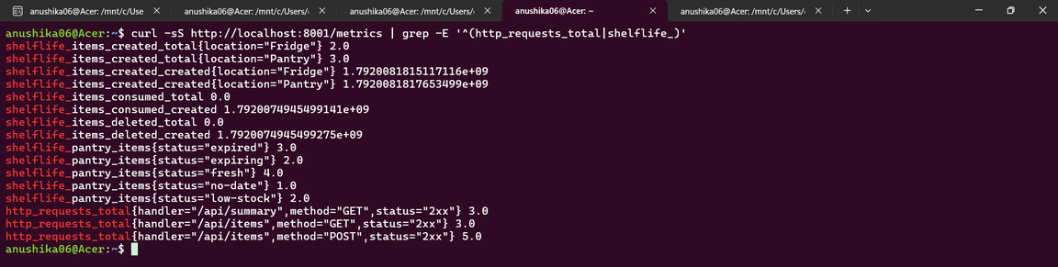
Observability
  Backend /metrics: request count, latency histogram, status class
  Business metrics: items added, used, removed, and items by status
  ServiceMonitor tells Prometheus to scrape both backend pods
  The ShelfLife API dashboard is provisioned automatically in Grafana
Prometheus targets: shelflife and shelflife-gitops backends 2/2 UP
curl /metrics
ShelfLife DevOps capstone
14
Notes:
The backend exposes /metrics: request counters and latency plus business metrics such as items by status. A ServiceMonitor tells Prometheus to scrape it; both the Helm release and the Argo CD release show 2/2 endpoints UP. The Grafana dashboard is on the next slide.
12

Slide 15
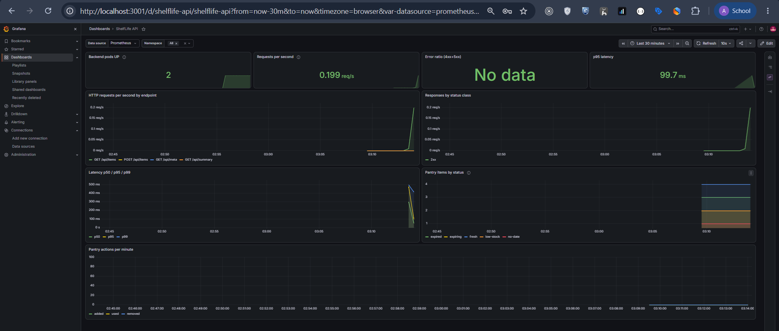
Grafana: ShelfLife API dashboard
2 backend pods UP, requests per second, p95 latency, requests by endpoint, pantry items by status
ShelfLife DevOps capstone
15
Notes:
The dashboard is provisioned automatically by the Helm chart. Panels show 2 backend pods up, about 0.2 requests per second, p95 latency near 100 ms, requests by endpoint and pantry items by status. The error-ratio panel shows 'No data' because no 4xx or 5xx responses were recorded in this window. Running scripts/generate-traffic.sh before recording makes every panel move.

Slide 16
Alternatives and trade-offs
Decision | Alternative | Why this choice
Public subnets, no NAT | Private nodes + NAT gateway | Lower cost for a 1 to 2 day demo; production would use private subnets
PostgreSQL in the cluster | Amazon RDS | Free on kind and simple to demo; RDS adds backups and HA at extra cost
Traefik Ingress | ingress-nginx | ingress-nginx was archived in 2026 and gets no more fixes
kind for K8s demos | EKS for everything | No cloud cost; EKS is used for the Terraform proof
GITHUB_TOKEN for GHCR | Personal access token | Short-lived, scoped to the run, nothing to leak
Local Terraform state | S3 backend with locking | One person, short-lived; a team needs remote state
ShelfLife DevOps capstone
16
Notes:
Pick two rows and explain them in your own words. These are the questions an examiner is most likely to ask.
13

Slide 17
Results
Module | Evidence | Status at hand-in
M1 App + M4 Docker | E01, E02 | Done: 3 containers healthy, UI at localhost:3000
M2 Testing | E04 | Done: 17 of 17 tests passed (pytest -v)
M3 Git | E03, E05 | Done: public repo, 20 meaningful commits
M5 CI/CD + M6 Trivy | E06, E07, E08 | Done: run #2 green; SHA tags in GHCR; Trivy clean
M7 Terraform | E09 to E12 | Done: plan 16 to add, applied in ap-south-1, destroyed
M8 Kubernetes + Helm | E13 to E16 | Done on kind: 2+2 replicas, postgres, Ingress, helm test
M9 Observability | E18 to E20 | Done: /metrics, targets 2/2 UP, Grafana populated
GitOps | E17 | Done: Argo CD Synced + Healthy (18a0823)
All screenshots are in demo/evidence/ and were captured from real runs on 14-15 October 2026.
ShelfLife DevOps capstone
17
Notes:
Every row is backed by a screenshot in demo/evidence. Kubernetes, Argo CD and monitoring evidence is from the local kind cluster; AWS evidence shows the VPC, subnets and EKS cluster that were applied and then destroyed.
14

Slide 18
Key learnings
Gates, not just tools
Smaller images, fewer CVEs
A scan only matters when its result can stop a release.
Removing what the app never uses fixed every HIGH finding.
Cost is a design input
Git as the source of truth
Support policy, NAT and load balancers change the AWS bill more than instance size.
With Argo CD, the deployed version is a commit you can read and revert.
ShelfLife DevOps capstone
18
Notes:
Speak to these in your own words; graders value honest reflection.
15

Slide 19
Thank you
Anushika Chauhan | Group-A
Repository: https://github.com/Anushika06/ShelfLife-Devops-Capstone
Notes:
Close with the repository link and invite questions.
16

