Slide 1
ONLINE QUIZ
APPLICATION
UNDER THE GUIDANCE OF:
POOJA MEHTA
SUBMITED BY:
ANUSHIYA S
KARTHIKA
KAVIYA
PREETHA V

Slide 2
Purpose of the Project:
Aim of this project is make easy to conduct exam. Through online examination System we have save the time expending between exam and result. The main idea behind developing this project is to prove fast way of conducting exam through internet. Through the help of this project a person can register free and give exam for checking his ability. Basically, it is an online test system that allows users to take online test and automatically generates results based on answer marked by user. It is built with help of Spring Boot, Angular and MySQL database.
Features of the Project:
Customization of test taking options.
Configuration of question types with different levels.
Efficiency to create a question bank.
Automation of planning and schedule.
Instant notification of exam schedule.
On screen evaluation for instant results.
High level online proctoring.
Interactive dashboard.

Slide 3
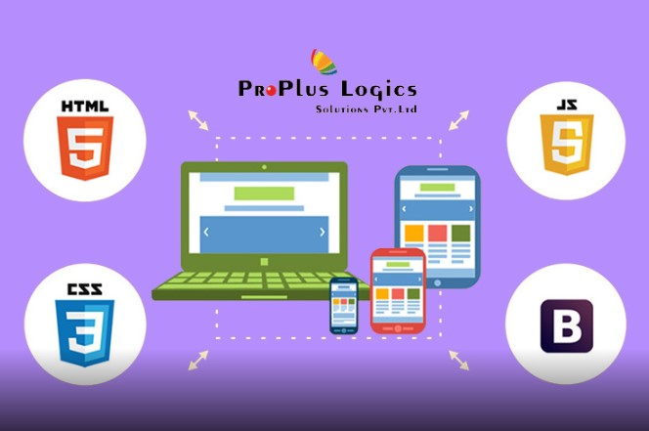


Technology Used :

Slide 4
Modules of the Project:
In this project there are two major modules:
Admin Module.
Student Module (User Module).
Features of Admin Module:
Admin can login.
Admin can add questions.
Admin can search/update/delete questions.
Admin can view questions lists.
Admin can view registered student list.
Admin can add notice.
Admin can view results.
Admin change password.
Admin can logout.

Slide 5
Features of Student Module:
Student can register.
Student can login.
Student can give an exam.
Student can view profile.
Student can update profile.
Student can change password.
Student can logout

Slide 6
Required Specifications:
Hardware configuration:
Operating System : Windows 10 and above.
Hard Disk : 500 GB.
RAM : 8 GB.
II. Software configuration:
Software IDE : Eclipse , Postman , MySQL , VS Code.
Language : HTML, CSS, Type Script.
Front End : Angular.
Back End : Spring Boot.

Slide 7
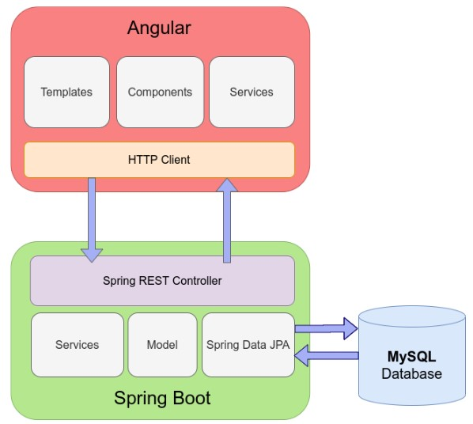
Connection To Database :

Slide 8
Spring Annotation :

Slide 9
Spring Annotation :

Slide 10
Conclusion :

Slide 11
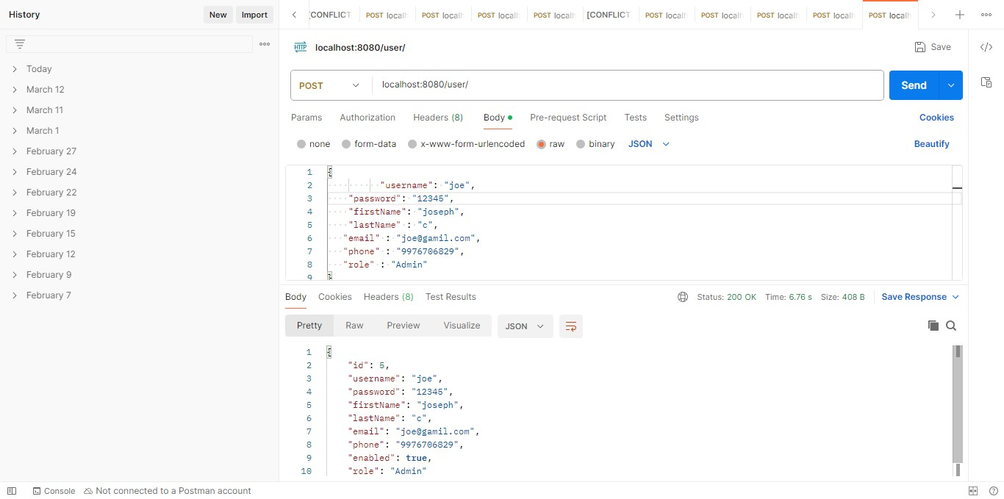
Admin Registration Form Postman :

Slide 12
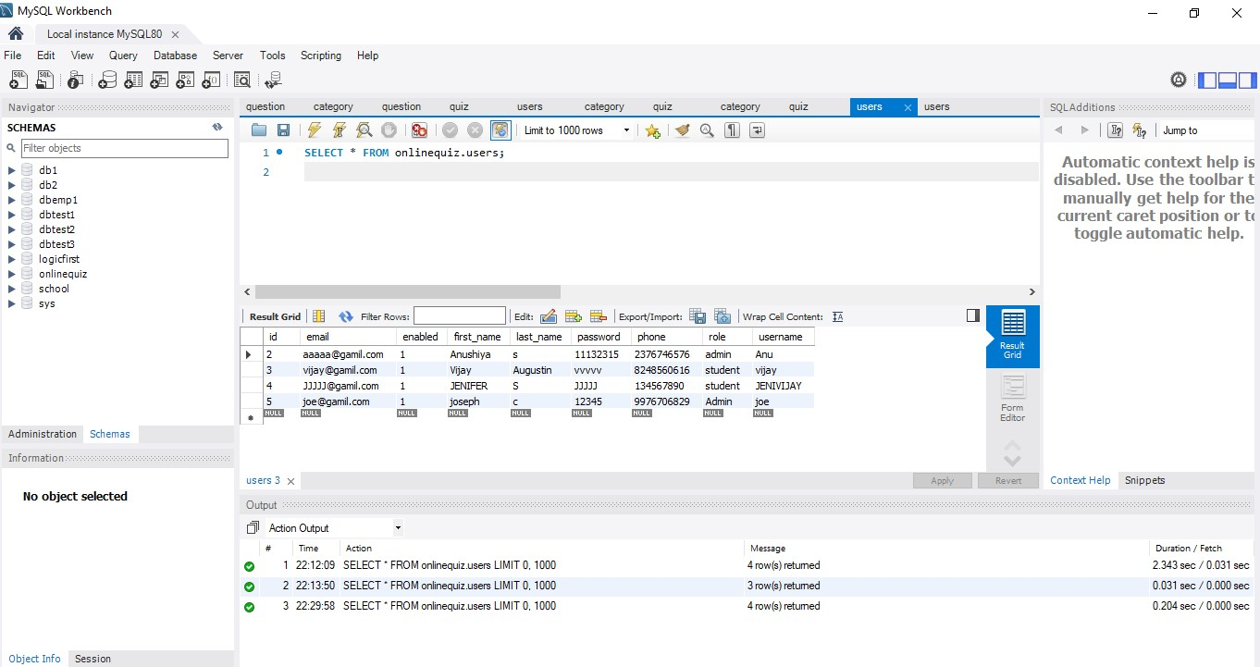
Admin Table :

Slide 13
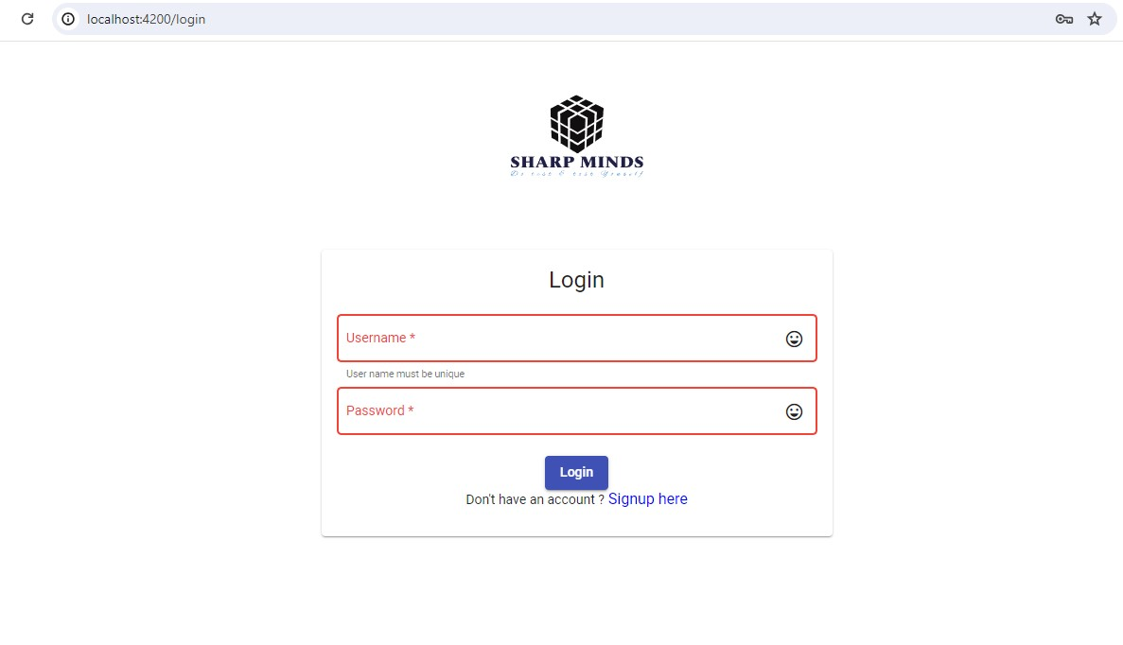
This is a login page here admin and user can login.
Those who has username and password can login here.
New user can click on the signup here for the Signup.
New user click here for signup

Slide 14
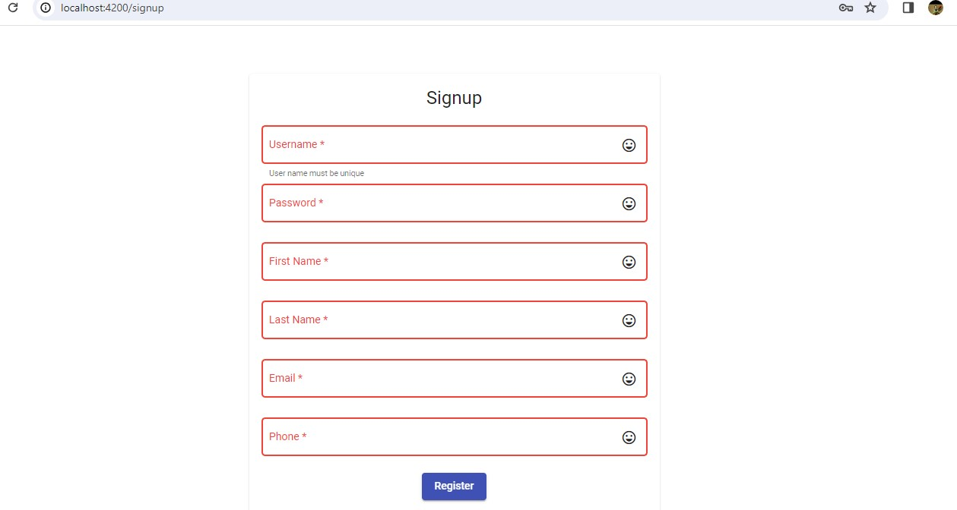
This is Signup page here new user must fill the all details.
Then click on the Register for registration.
After registration use the same username and password given below for login.
1
Must fill the all taps
2
Click here for registration

Slide 15
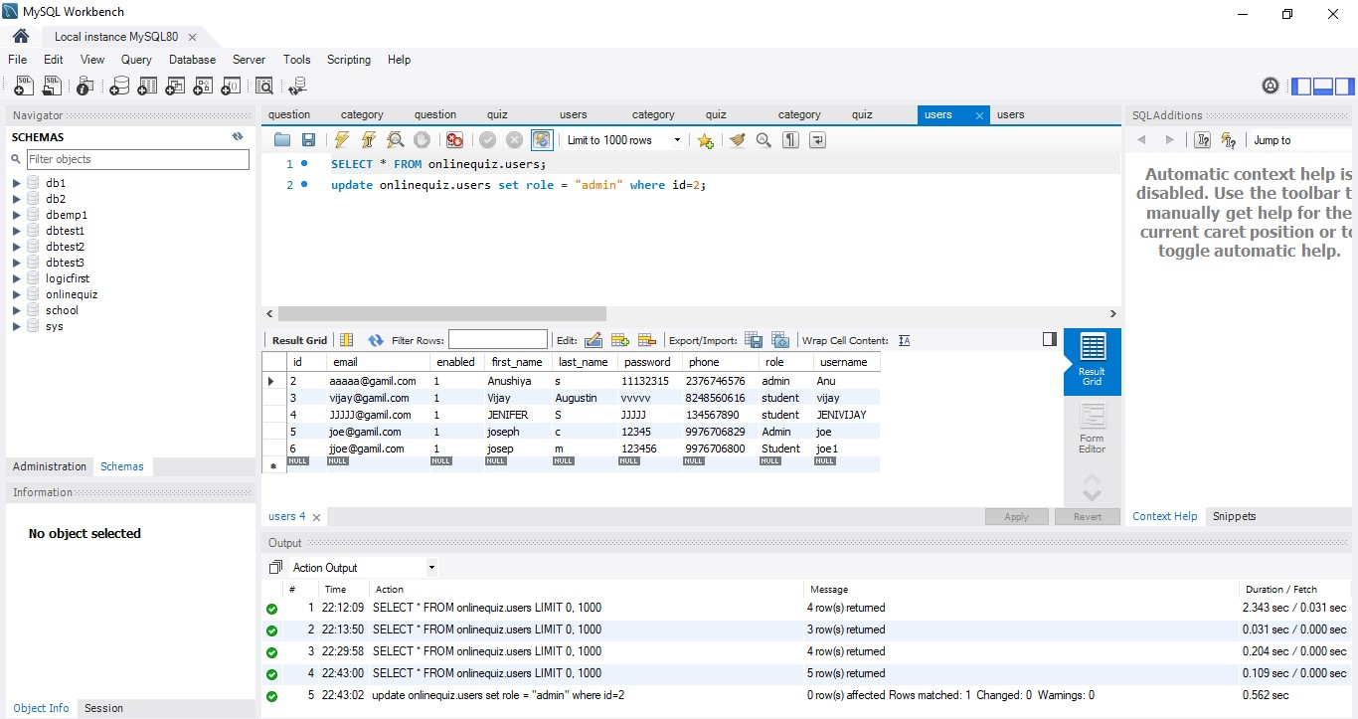
Student Table (User) :

Slide 16
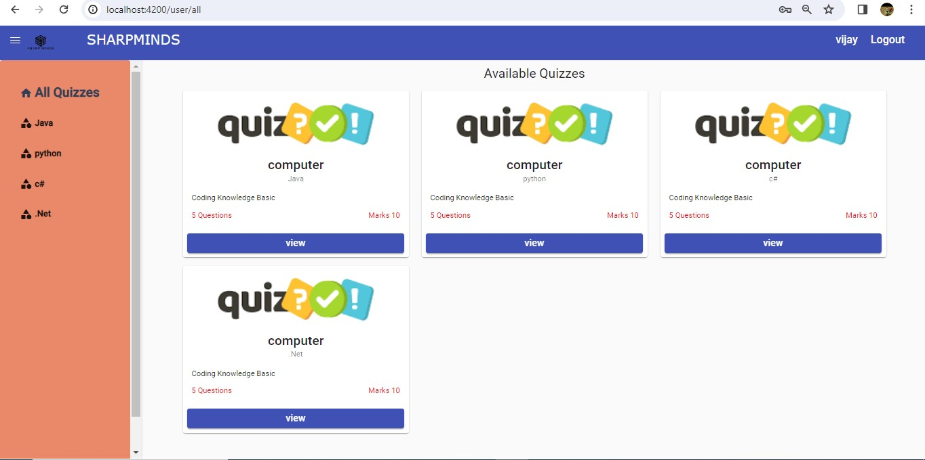
After login user will get this page.
Here user have All Quizzes.(like java, python, c#, .NET)
Here user can choose the Quizzes.
Click on the view to go next page.
Click on the view to choose Quizzes

Slide 17
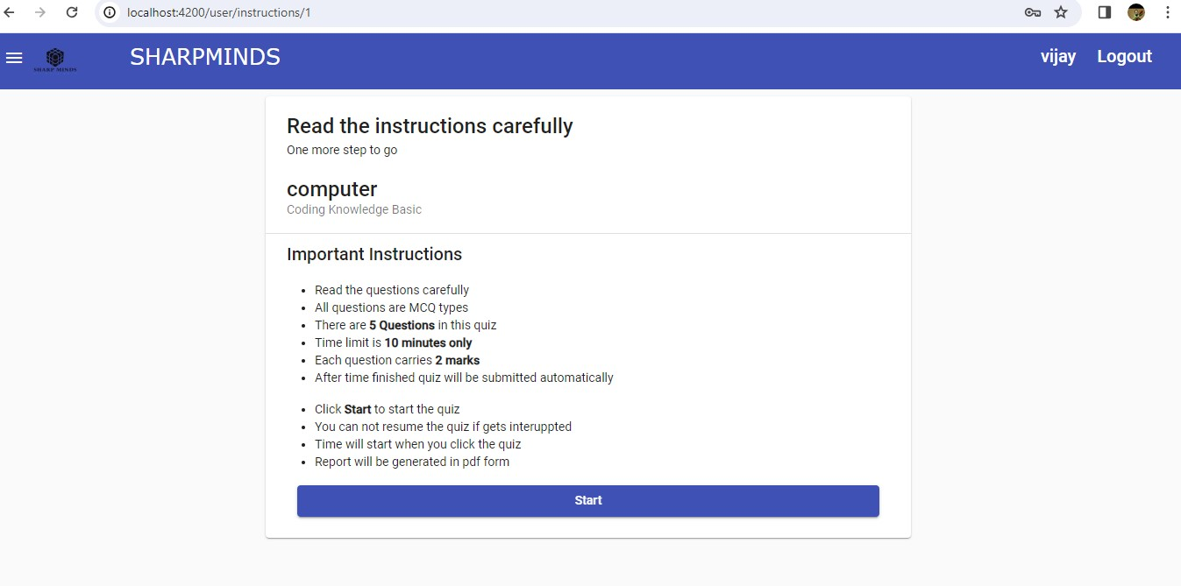
This is user Instructions page.
Here user read all the Important Instructions.
Then user click on the Start.
User click here for Start

Slide 18
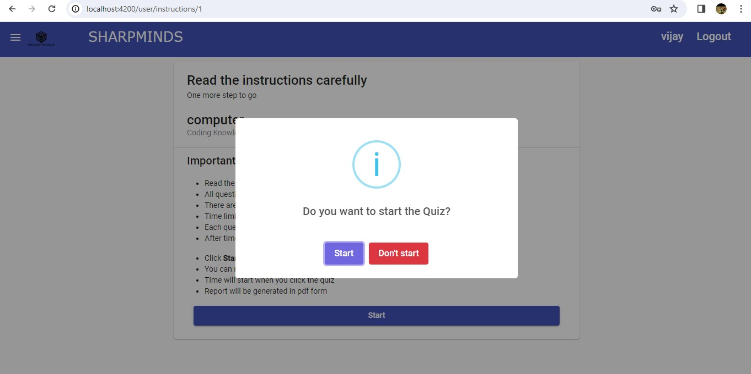
A confirmation pop-up will be displayed to start the quiz.
Click on the “Start” button to start. Else, click on the “Don’t start” button
User click here for Don’t start
User click here for Start

Slide 19
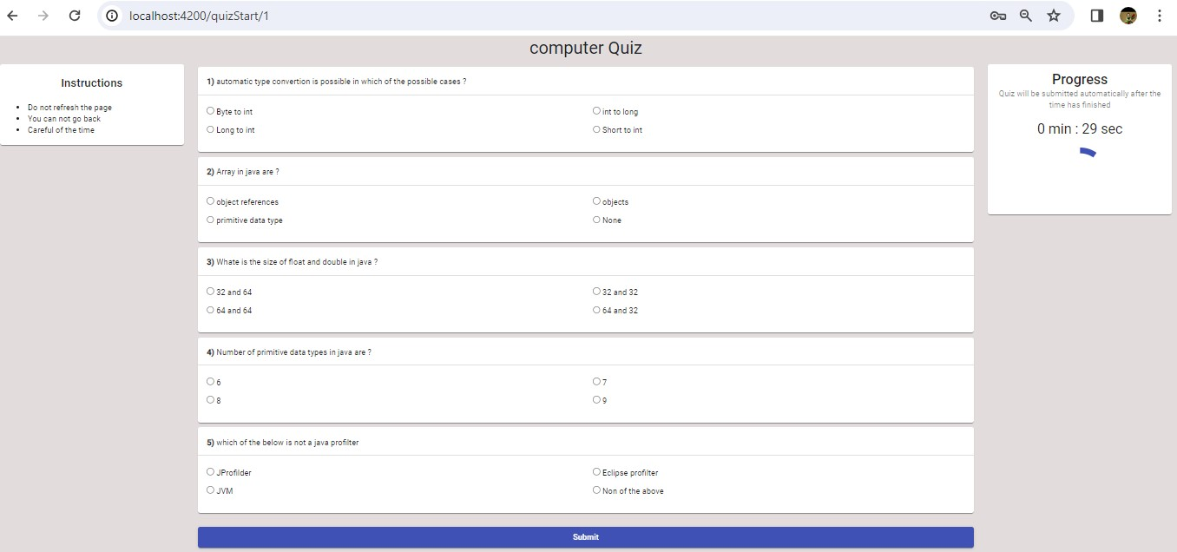
Here user have instructions.
Here user have questions and answers with 4 options.
Here user have remaining timing to finish the Quiz.
1
3
2

Slide 20
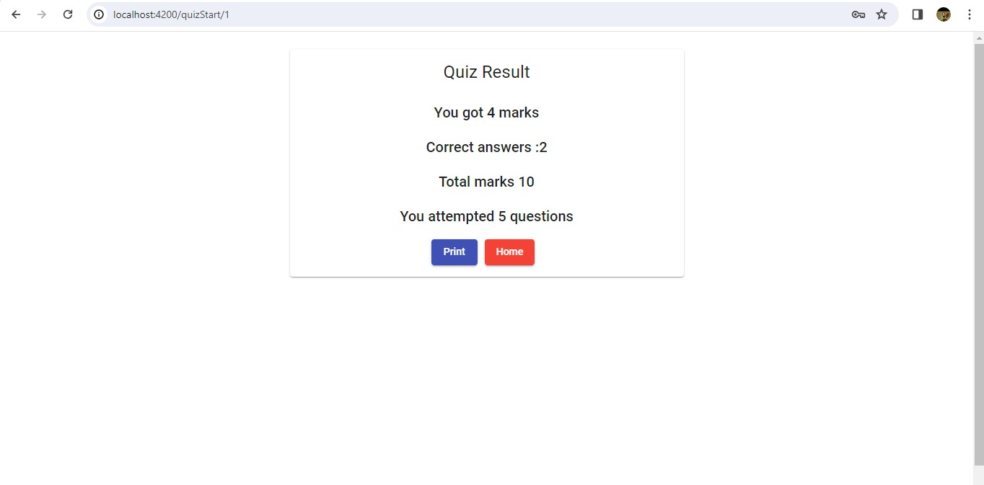
In this page user will get Quiz Result.
Here user can see the attempted questions, user marks and correct answers.

Slide 21
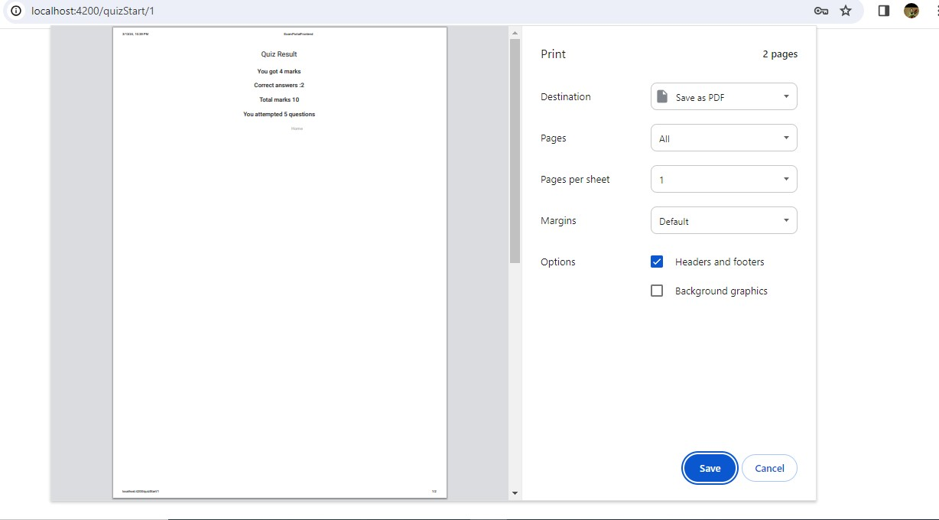
Here User will save Quiz Result in PDF format.

