Slide 1

See_k
Ai Driven Health Risk Assessment
Team Name - WHIZZBANG
ROHAN SINGH (E23CSEU0208) ANUSHKA AVANTI (E23CSEU0190)

Slide 2




TABLE OF CONTENT
1. Introduction 2. Motivation 3. Literature Review 4. Methodology Formulation 5. Results And Analysis
5.1 Experiment Setup 5.2 Dataset Description 5.3 Performance Measures 5.4 Results
6. Conclusion

Slide 3

INTRODUCTION
This project introduces an intelligent health assistant that combines symptom analysis, lifestyle evaluation, and medical imaging to assess the risk of chronic conditions like diabetes, heart disease, and stroke. By leveraging NLP, machine learning, and deep learning, the system processes user input to estimate risk levels and guide users toward appropriate next steps — whether it’s uploading medical scans for further analysis or adopting lifestyle changes.

Slide 4

MOTIVATION
1.Rising Chronic Disease Rates
– Chronic conditions like heart disease, diabetes, and stroke are growing rapidly worldwide. Early risk detection is critical to managing and preventing these illnesses.
2. Delayed Medical Attention
– Many people don’t recognize or act on early symptoms, which leads to late diagnoses and worse outcomes. This system bridges that gap.
3. Need for Accessible Health Insights
– In many regions, especially remote or underserved areas, quick access to professional healthcare isn't always possible. An AI assistant offers a fast, reliable first step.

Slide 5

LITERATURE REVIEW
1. Symptom Analysis -
Core to your system’s ability to understand user input and identify possible conditions.
2. Lifestyle-Based disease Prediction -
Directly supports your risk scoring for chronic diseases like diabetes and heart issues.
3.Multimodal Health AI -
This ties everything together and justifies your approach of combining different data types for more accurate predictions.

Slide 6

METHODOLOGY FORMULATION
The system begins by collecting user inputs, including symptoms and lifestyle factors. An NLP model (BioBERT) processes the symptom text to identify potential conditions. Simultaneously, a machine learning model (Logistic Regression or XGBoost) analyzes lifestyle and health data to predict risks of diseases like diabetes, heart disease, and stroke. If a high-risk condition is detected, the system prompts the user to upload relevant medical scans. These scans are then analyzed using deep learning models (ResNet or Vision Transformer) for confirmation. Finally, all outputs are combined to make a decision—either flagging a medical emergency or suggesting lifestyle improvements.

Slide 7

RESULTS
1.EXPERIMENT SETUP -
The system was trained using Kaggle datasets, with symptom, lifestyle, and imaging data. Models were evaluated on health risk prediction for conditions like heart disease, diabetes, and stroke.
2. DATASET DESCRIPTION -
The system uses symptom data, lifestyle data from Kaggle-sourced projects, and medical images from datasets like ChestX-ray14 and Stroke CT/MRI datasets, all obtained through publicly available Kaggle resources.
3. PERFORMANCE MEASURES
Evaluation was based on accuracy, precision, recall, and AUC-ROC to assess risk prediction and identify high-risk conditions.

Slide 8
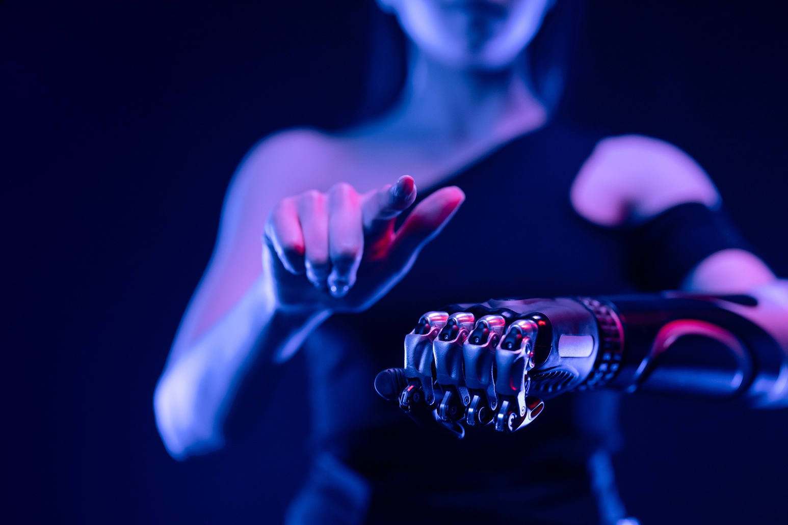
CONCLUSION
This AI-driven system combines symptom analysis, lifestyle data, and medical imaging to assess the risk of health conditions like heart disease, diabetes, and stroke. Using NLP and deep learning, it supports preventive healthcare by analyzing multiple inputs and guiding users toward better health management.

Slide 9

THANK YOU!
FOR YOUR ATTENTION

