Slide 1
Marketing Campaign Performance Analysis
Campaign Performance Analysis
By Anushka Gupta

Slide 2
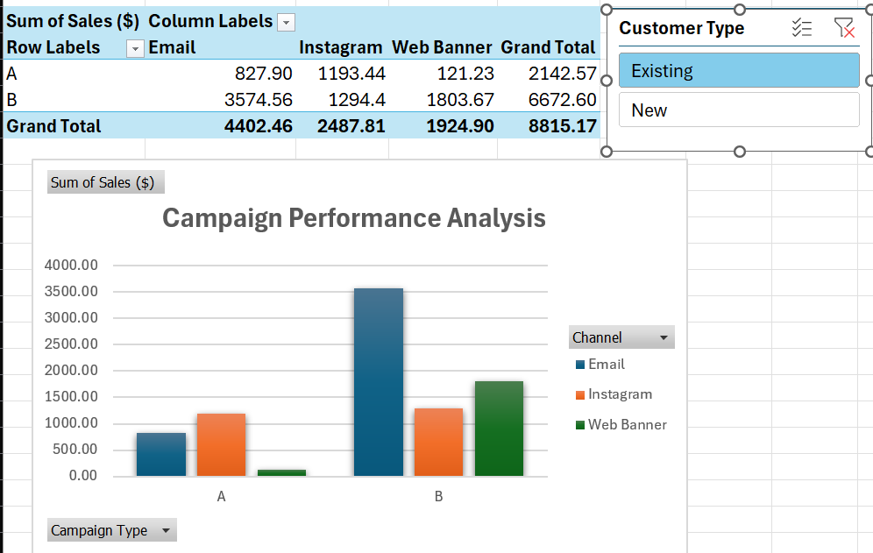
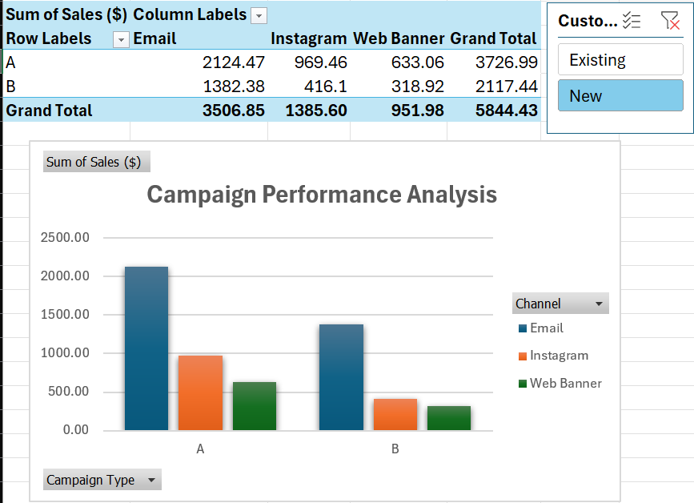
Marketing Campaign Performance Analysis
CPA (Existing)
CPA (New)

Slide 3
Recommendations
Increase investment in Email marketing.
Scale successful elements of Campaign B.
Optimize or reconsider Web Banner strategy.
Continue monitoring conversion rate alongside sales.
Final Conclusion: Campaign B delivered the strongest overall performance, with Email emerging as the most effective marketing channel.

