Slide 1

Talk It Geeks
Aim :
To build a discussion forum for college .
Guide Name:
Prof. Saurav Chandra

Slide 2
Team Members
Anushka Jain CSE 8-B 1900290130034
Sanyam Bansal CSE 8-B 1900290100132
Satyam Khare CSE 8-B 1900290100134

Slide 3
Introduction
Problem :
Lack of communication and networking between students of different year and branches during covid 19 lockdown.In the majority of the colleges and universities across India, thousands of students have many doubts and queries from "Which technology to choose?" to "How to crack interviews?". This is a one-stop solution for all these problems. It serves as a platform where students can drop in their questions for public view and any person from this vibrant community can help by providing answers to these questions.
Aim :
To build a Discussion/QnA forum for college .
Description :
The product is a brand-new self-contained website meant to be used as a student interaction platform for the students of KIET Ghaziabad, where the students can ask questions and have discussions pertaining to Institute-specific as well as global issues and topics. The user needs to create an account to post, answer a question or request a poll.

Slide 4
The main purpose of the website is to provide an easy way for the students to talk and interact with each other and hold discussions about different topics. They can talk about academic and non-academic themes. They can even chat about other issues that are common to most of them and orate their minds about other atypical topics.
This website could also come in handy for asking for help, finding blood donations among young people and keeping records of collected data with a little tweaks to the original code. So, the software has a lot of possibilities to turn into other useful platforms and be a comfortable communication podium for students, in it’s current form
Initial description of the various functionalities and services provided by the software. The document will also serve the basis for acceptance testing by the user The website enables the students of the institute to sign-up using the institute’s email ID using which they can login and use the website further.
Authorized users are provided with some facilities such as:
Ask a question on the any of the pre-defined topic.
Answer any question.
Request a poll and many more
Comment , upvote and Downvote

Slide 5
Why and how would a student use an online discussion forum?
I used a discussion forum to offer students a structured opportunity to interact with each other online around exam time.
For the purpose of reviewing for the exam students posted questions they had about course material, and other students answered them in the online forum. I also agreed to weigh in on student comments after each question had received at least one response from another student.
I had a few reasons for my decision to use the forum in this way. First, I knew that I would not have enough time to answer all of my students’ questions around exam time as I was preparing for my own qualifying exams during the same semester. I was also fairly certain that my students could be effective in teaching each other and answering one another’s questions; I wanted them to depend more on each other and less on me in the time leading up to the exam.
By using an online discussion, I hoped to encourage collaboration and to give students a structured opportunity to work together to find the answers to questions that they were having difficulty with.
This activity would also have another desired benefit — it would help students to practice writing and explaining concepts prior to doing so on the exam.

Slide 6
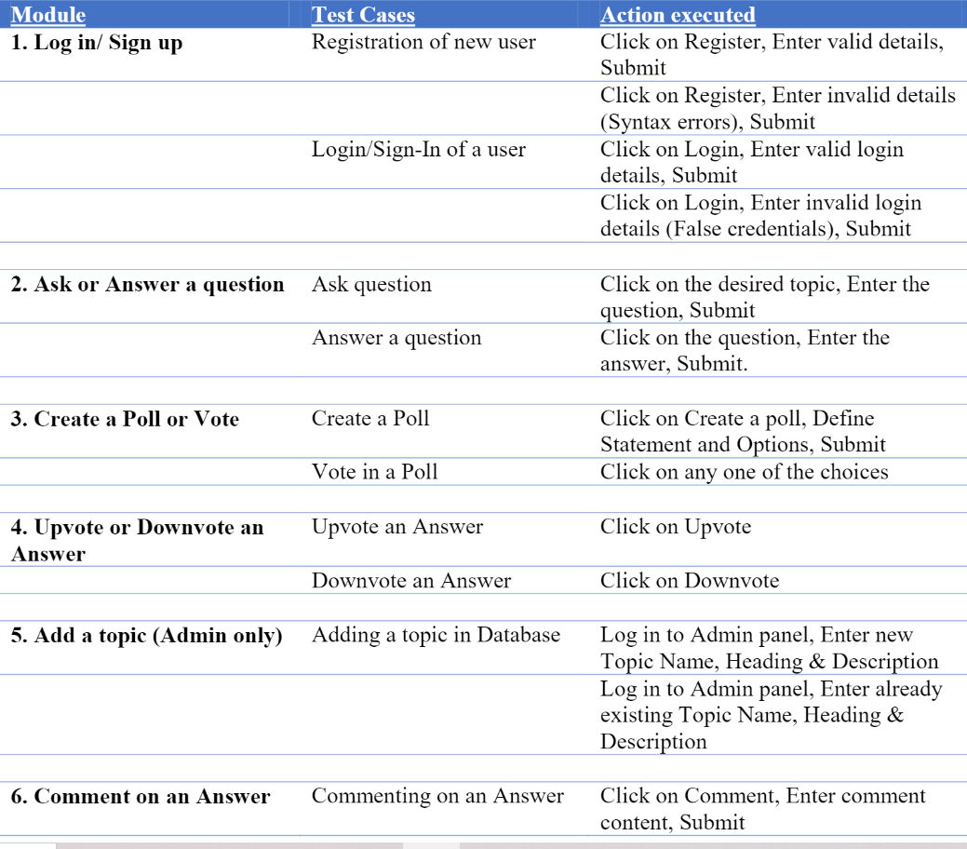
Basic functionality

Slide 7
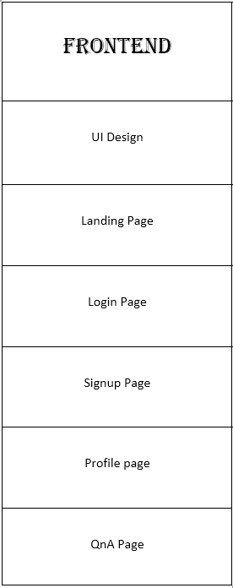
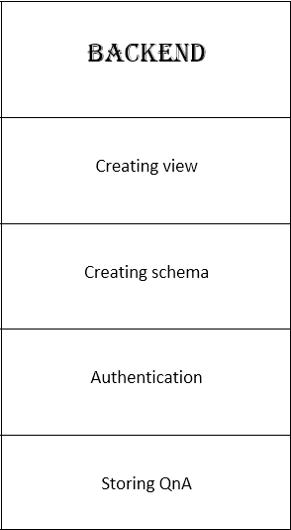
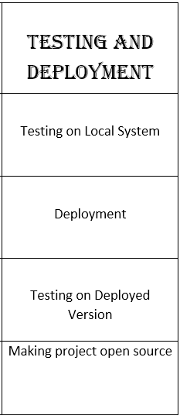
Methodology

Slide 8
Facilities Required
Hardware Requirements :
There are no special hardware interface requirements .
Software Requirements :
Coding Languages :
Tools and Technology :
Version Control Software :

Slide 9
Literature Survey
The project is an online discussion forum for students of an organisation that could be used by other organisations as well, to hold public discussions.
The Online Discussion Forum is an electronic network facilitating active communication and interaction among all students enrolled in the same course. When you post a message to the Online Discussion Forum, the post is immediately available to all other students in the organisation, allowing students to discuss different topics in their free time. A weekly Student Host directs students to perform certain tasks as outlined in the online course guide.
Online forums can be used for many purposes, such as helping students to review material before an assignment or exam, engaging students in a discussion of the course material before coming to class, and reflecting on material that they have read or worked with outside of class.
It allows users to create social networks and follow topics that interest them.
It focuses on high-quality questions and answers.
It enables users to vote on answers to highlight the most accurate information possible.

Slide 10
Pathways to conspiracy: The social and linguistic precursors of involvement in Reddit’s conspiracy theory forum
Another research paper from the authors like Colin Klein, Peter Clutton and Adam G. Dunn discussed the social and linguistic precursors of the infamous Reddit’s conspiracy theory forum.
The authors talked at length about dealing with the challenges faced by them while trying to maintain the linguistic integrity of a diverse platform like the Reddit discussion forum.
Many individuals who engage with conspiracy theories come to do so through a combination of individual and social factors. The interaction between these factors is challenging to study using traditional experimental designs. The availability of large datasets of user comments from Reddit gives a unique opportunity to observe human behaviour in social spaces and at scale.
Using a retrospective case-control study design, we analyzed how Reddit users who would go on to engage with a conspiracy-related forum differed from other users in the language they use, differences in the social environments where they posted, and potential interactions between the two factors. Together, the analyses provide evidence for self-selection into communities with a shared set of interests that can feed into a conspiratorial world-view, and that these differences are detectable relative to controls even before users begin to post in r/conspiracy.
They also suggested that survey-based and experimental studies may benefit from differentiating between passive private endorsement by individuals and active engagement with conspiracy theories in social spaces.
Research Paper Link : https://doi.org/10.1371/journal.pone.0225098

Slide 11
Analysis of student discussion posts
Online forums provide a much larger source of data for analysis, providing enough power to examine a larger number of factors at once. The sheer size of some corpora allows for effective unsupervised analyses, avoiding the coding issues present in traditional survey designs. While they are restricted to studying associations rather than experimentally manipulated effects, large observational datasets can be used to generate new hypotheses and guide future research designs.
They took another more specific piece of a literary asset while planning our project which was authored by the professors of Victoria University of Wellington in collaboration with the professors of the University of Auckland and Otago Polytechnic. Researchers investigate a novel learning environment in order to identify and understand the factors that could increase the effectiveness of these discussion forums.
The initial Quan text analysis is conducted in three simple steps by uploading a spreadsheet containing prompts and responses, selecting a prompt to analyse, and running the analysis. Issues are being addressed by using learning analytics to identify and understand patterns in students' course behaviour, aiming to reinforce those that are associated with successful learning outcomes and counter those that lead to disengagement and dropping out. They displays basic descriptive statistics and charts for each question-based dataset, including a number of responses, mean response length in words and sentences, most frequent words and multi-word units (bigrams or trigrams), and readability indices.
Research Paper Link : https://www.researchgate.net/publication/324417971_Analysis_of_student_discussion_posts_in_a_MOOC_Proof_of_concept

Slide 12
Untangling chaos in discussion forums: A temporal analysis of topic-relevant forum posts
According to the research paper from the Department of Computer Science & Engineering, College of Engineering and Computing, University of South Carolina, Columbia, talked about an effective experience in discussion forums is important for online learners to maintain their persistence in their course and maintain social interaction with not just your friends.
It touches on the different questions that surround a platform like this.
This also identifies learners’ meaningful participation patterns of topic-related forum posts through the temporal dimension and investigate how the longitudinal trajectory of online meaningful participation is associated with learner performance. This was achieved through Machine Learning techniques and latent semantic analysis (LSA) to classify forum posts.
Research Paper Link : https://doi.org/10.1016/j.compedu.2021.104402

Slide 13
The above research papers played a crucial role during the initial stages of our project planning and the current on-going process there . All of these touch the very essence of the idea we had in mind while selecting this project idea.
Department of Computer Science and Engineering (CSE)

Slide 14

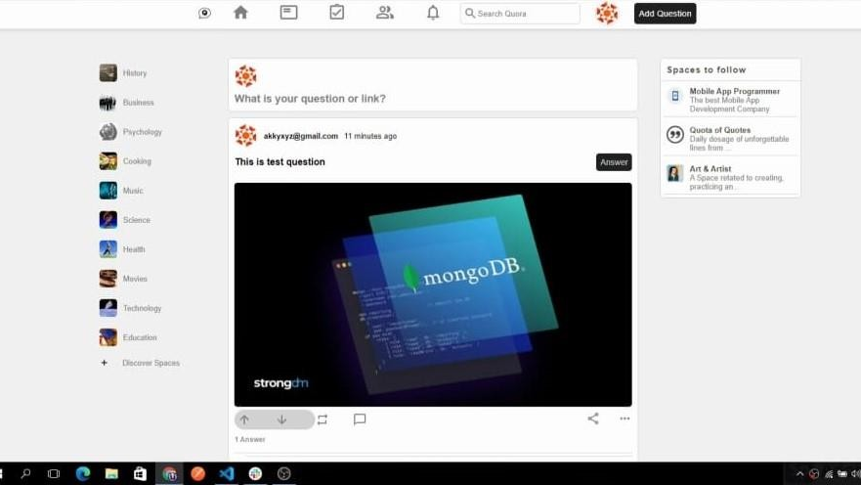
Results
Home Page :
It serves as a gateway to the community and provides a welcoming and informative introduction of the forums' purpose and features. Navigation bar consists of recent posts, user profile, settings, the search box. There are different sections for the forum such as history, music, business, science, health, technology, etc. The central part shows the feeds i.e., all the questions posted and the answers to them. There is an option to up-vote and down-vote the answers
Department of Computer Science and Engineering (CSE)

Slide 15
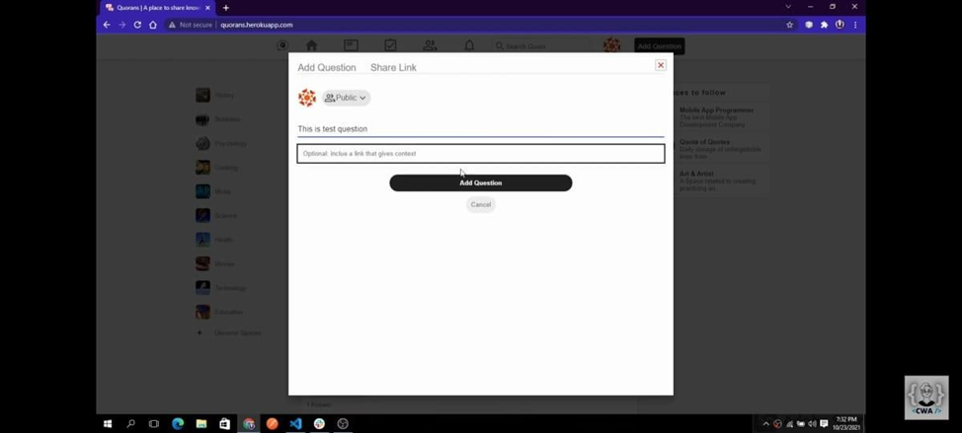
Post Question :
The user would be able to post any of his queries based on the forum. The post question feature of Talk IT Geeks is an integral part of our discussion forum site, designed to facilitate seamless communication and knowledge sharing among students. This feature allows users to submit their queries, problems, or topics of interest to the community, seeking assistance, insights, or solutions from fellow students. By posting questions, users can tap into the collective expertise and experiences of the Talk IT Geeks community, promoting collaborative learning and fostering a sense of camaraderie. This feature encourages active participation, engagement, and meaningful discussions, empowering students to find the answers they seek and expand their understanding of various IT-related subjects.
Department of Computer Science and Engineering (CSE)

Slide 16
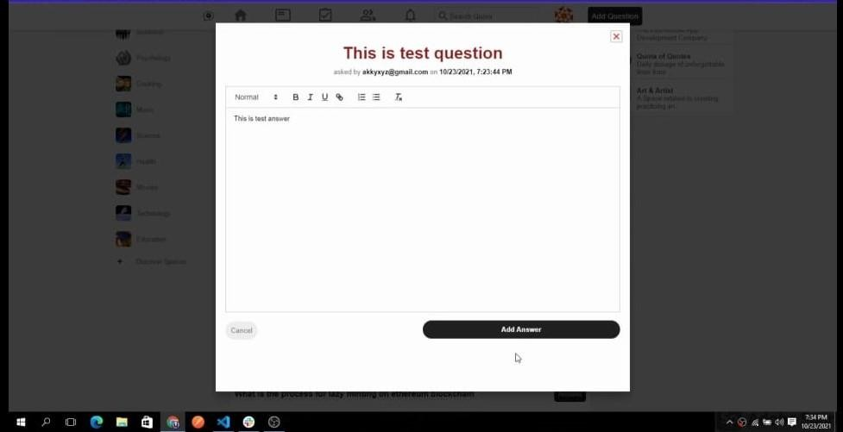
Answer Question :
The answer feature of Talk IT Geeks fosters a collaborative and dynamic environment where community members can contribute their expertise to help fellow students find solutions to their queries. This feature enables any member of the community to share their insights, knowledge, and suggestions by providing answers to the questions posted on the forum. By allowing diverse perspectives and experiences to come together, the answer feature promotes a rich exchange of ideas and facilitates comprehensive discussions.
To ensure the most helpful and relevant answers rise to the top, our platform incorporates a voting system where users can "like" the answers they find most valuable. This mechanism empowers the community to collectively curate the content, as answers receiving more likes are prominently displayed at the top. This not only aids in quickly identifying the most useful responses but also incentivizes users to provide high-quality answers that address the concerns of their peers effectively.
By leveraging the answer feature of Talk IT Geeks, students can tap into the collective wisdom of the community, benefit from diverse perspectives, and gain a deeper understanding of IT-related topics. It encourages active participation, knowledge sharing, and meaningful interactions, making the forum a valuable resource for both seekers and providers of information..
Department of Computer Science and Engineering (CSE)

Slide 17
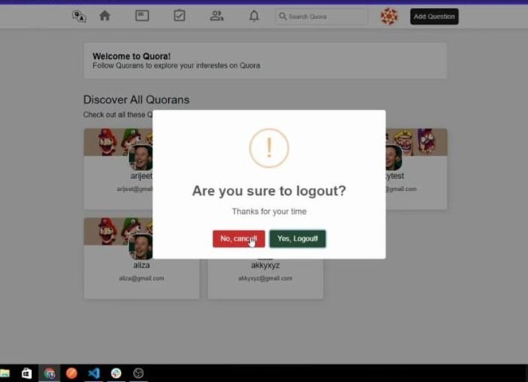
Logout :
The logout feature in the Talk it Geeks online discussion forum plays a vital role in maintaining user privacy, security, and trust. Its implementation as a prominent and easily accessible button enhances user experience and provides users with control over their account sessions. The findings of this project report contribute to the understanding of logout feature implementation in online discussion forums and can serve as a reference for future development of similar platforms.
Department of Computer Science and Engineering (CSE)

Slide 18


Slide 19
Conclusion
The complete project would solve the following issues through the already mentioned ways and technology:
Make a comfortable space for students of an institute to participate in healthy discussions.
Provide a platform for students to conduct surveys, polls and ask public queries that could be answered by any authorized user.
Restrict use of certain offensive and illicit words and media.
Discouraging cyber misbehave by allowing admin to verify users, and block questions and users if deemed necessary.
Department of Computer Science and Engineering (CSE)

Slide 20
References
Science Direct [7 Link :
https://doi.org/10.1371/journal.pone.0225098
Research Gate [8] Link : https://www.researchgate.net/publication/324417971_Analysis_of_student_discussion_posts_in_a_MOOC_Proof_of_concept
Research Paper Link[9] :
https://doi.org/10.1016/j.compedu.2021.104402
Department of Computer Science and Engineering (CSE)

Slide 21
THANK YOU

