Slide 1
Car Price Assignment
Presentation By
Anushka Singh
Maharishi University Institute of Technology

Slide 2
OBJECTIVE
Model question: Frame a predictive-modelling using R, where you have to predict the Price of the car.
Business Question: Imagine yourself as a Consultant. And your job is to advice customers about their optimum purchase of a car. Interpret the business problem in your way and give as many recommendations as you can from your prospective of understanding of the problem.

Slide 3
Count of Variables
Carbody(wagon)
Wheelbase
Cylinder_number(four)
Horsepower
Car_ID
Symboling
Car_Name
Fuel_Type
Aspiration
Door_number
Compression_ratio
Drive_wheel
Citympg
Peakrpm
Engine_location
Fuel_system
Car_length
Car_width
Car_height
Engine_type
Curb_weight
Engine_size
Boreratio
Stroke
Highwaympg
price

Slide 4
DEPENDENT VARIABLE
The dependent variable is “Price” of a car because after plotting a boxplot graph of a price variable there are so many outliers present in it. And the price of a car depends on a car features.

Slide 5
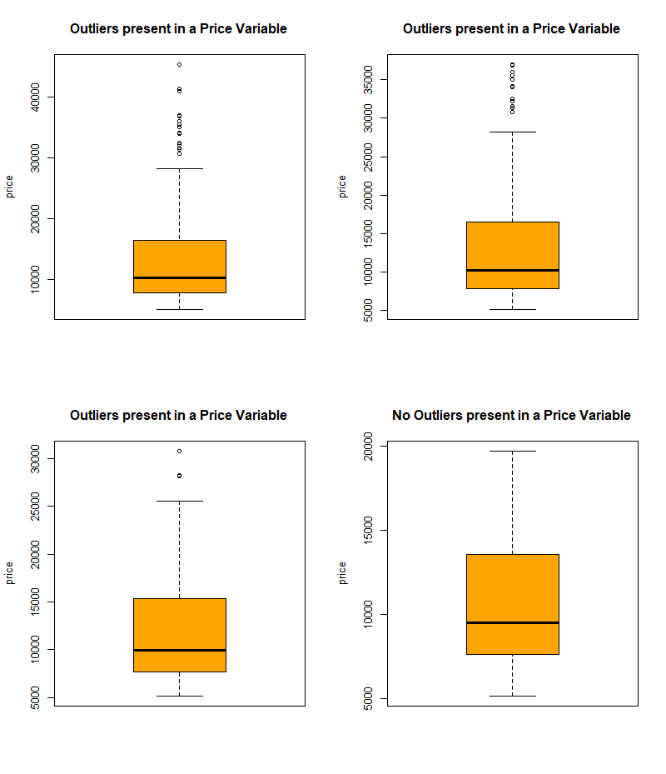

Slide 6
SIGNIFICANT VARIABLES
Carbody(wagon)
Wheelbase
Cylinder_number(four)
Horsepower

Slide 7
INSIGNIFICANT VARIABLES
Car_ID
Symboling
Car_Name
Fuel_Type
Aspiration
Door_number
Compression_ratio
Drive_wheel
Citympg
Peakrpm

Slide 8
Engine_location
Fuel_system
Car_length
Car_width
Car_height
Engine_type
Curb_weight
Engine_size
Boreratio
Stroke
Highwaympg

Slide 9
Reason behind eliminating the variables
fuelsystem_4bbl has a p-value > 0.05. Meaning this variable is not having enough impact. Let's drop it.
cylindernumber_five, six, three has a p-value > 0.05. Meaning this variable is not having enough impact. Let's drop it.
CarName is having a high VIF and is highly correlated to wheelbase and slightly with horsepower. Let's remove this.
peakrpm is having high p-value. Let's remove this
enginetype_ohc is having p-value > 0.05, making it insignificant in the model. Let's remove this.

Slide 10
stroke is having p-value > 0.05 . Let's remove this.
enginelocation is having the highest VIF. Let's remove this.
We see there is some obvious multicollinearity going on between predictor variables,
carlength with wheelbase, carwidth, curbweight
curbweight with enginesize, carlength, carwidth, wheelbase
enginesize with horsepower, crubweight of car
highway and city mpg's are highly correlated. We might choose to drop anyone of these.
We also plot some negative correlation among varaibles,
crubweight, horsepower with the higway /city mpg's

Slide 11
Explanation of significant variables
The cylinder number four is the most commonly available feature in 85% of the car data and since having 4 cylinders is attributed with relatively low-price cars the coefficient for this variable is negative.
For example, we can say, the price of the car changes by 0.00431 for every unit change in the wheelbase dimension if all other variables are held constant. And so is true for all other variables.
The predictor carbody_wagon suggest that the price of car increases by a factor of 0.83889 when the car body is wagon.
Horsepower is more business significant variable.

Slide 12
RESULTS OBTAINED
Significant variables (carbody_wagon, wheelbase, cylinder_number_four, horsepower) are useful to describe the Car’s price. All the independent variable have considerably low VIF and the Adj. R-Squared is 0.77 which is quite a significant fit. We will conclude with these variables as the final model predictor variables.
The final model accuracy is 85% .
In next slide, Test model plot has shown.

Slide 13
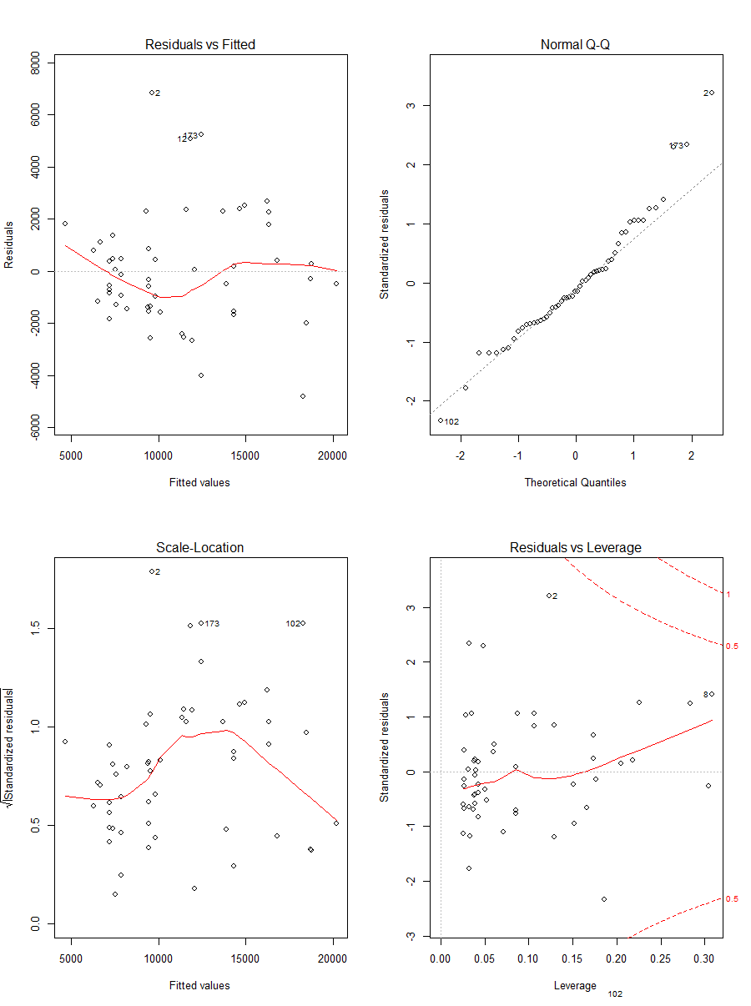

Slide 14
Variable relationships:
Positive: carbody_wagon, wheelbase, horsepower
Negative: cylindernumber_four

Slide 15
RECOMMENDATION
For profitability and effective pricing of cars in the market, the model's price predictors variables have to be regulated and balanced effectively to meet certain price levels and gain an edge over the other competitors.
Also, keeping into account the predominating or the popular factors of a car in market will give a better understanding of the needs and requirement of the clients.
symboling: moderate (0,1) Carbody: wagon
fueltype: gas aspiration: standard
doornumbers: four drivewheel: forward
engine location: front engine type: ohc
cylinderNumber: four fuelSystem: mpfi
This can be used to make the appropriate changes in design, features and the price offered to the customer.

Slide 16
THANK YOU.

